Slide 1
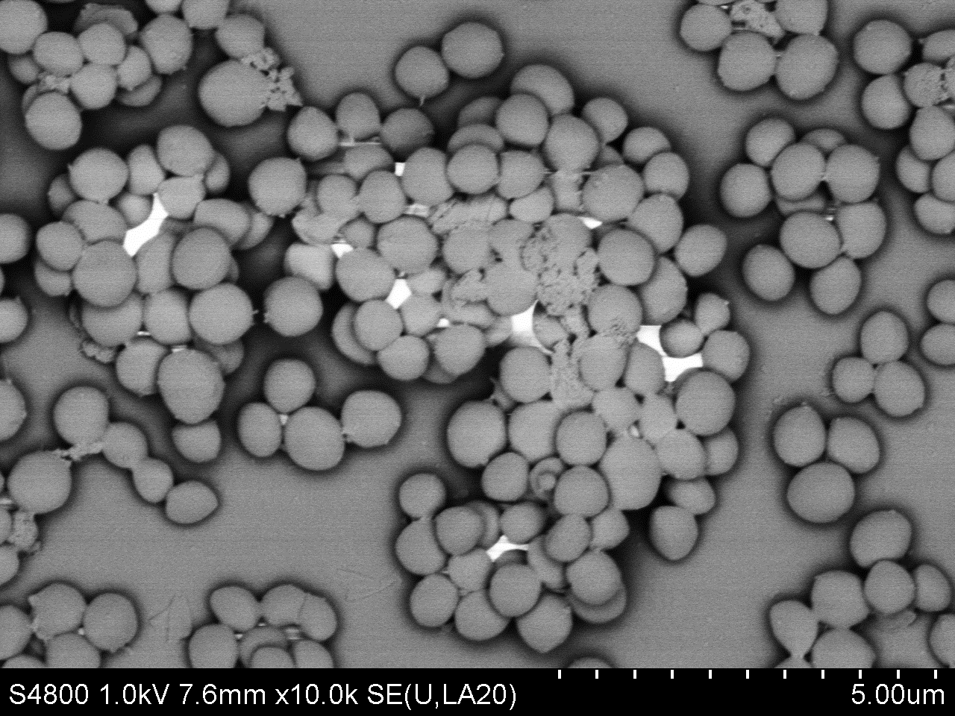
Carbon Black (nano)particles
+
-
β-Defensin-2
+
1% FBS/DMEM
Cell stimulation
Differential cytokine response
TSB
Staphylococcus
aureus
+
-
IL-8
Staphylococcus
aureus growth
Epithelial cells
GRAPHICAL ABSTRACT: Advanced nanoparticle testing in stressed / immunocompromised cell systems to complement current strategies in ‘healthy’ cells

