Slide 1
A Systems-Level Multi-Omics Dissection of Syndromic and Idiopathic Autism Reveals Distinct Regulatory Architectures, Molecular Biomarkers, and Therapeutic Vulnerabilities
Ondippili Rudhra¹, Sanjeev Kumar Singh¹
¹Computer Aided Drug Designing and Molecular Modelling Lab, Department of Bioinformatics, Alagappa University, Karaikudi-630 003, Tamil Nadu, India
Correspondence should be addressed to Dr. Sanjeev Kumar Singh, skysanjeev@gmail.com

Slide 2
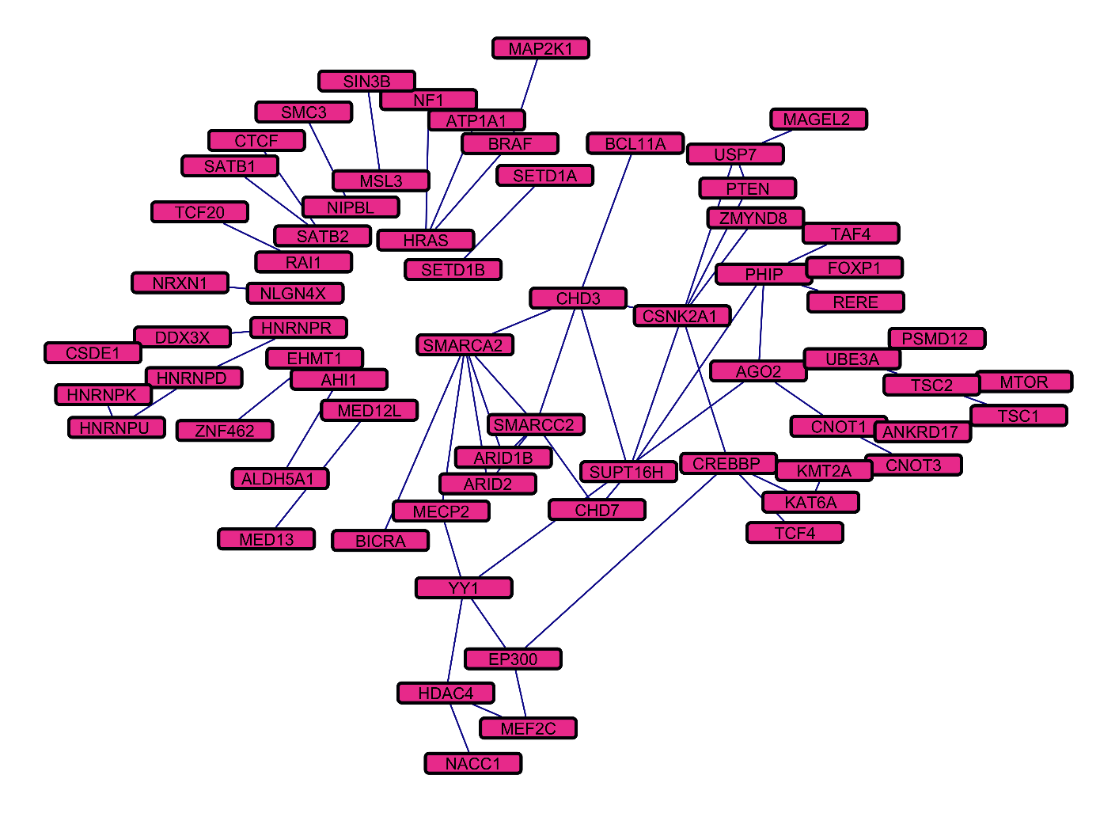
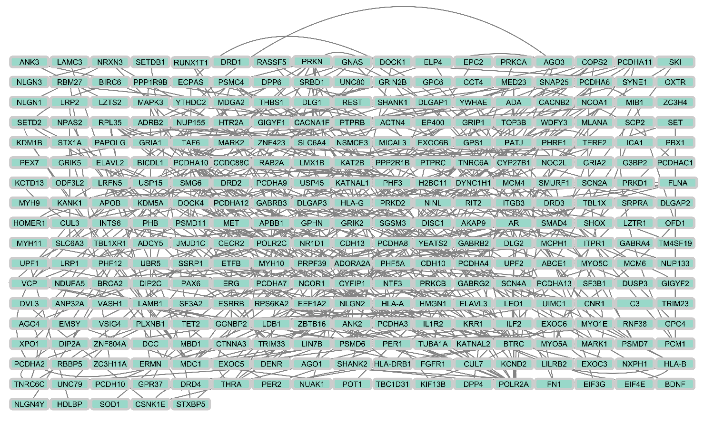
(a)
(b)
Supplementary Fig S1: The complete PPI network of (a) Syndromic autism (b) Idiopathic autism risk genes visualized using cytoscape.

Slide 3
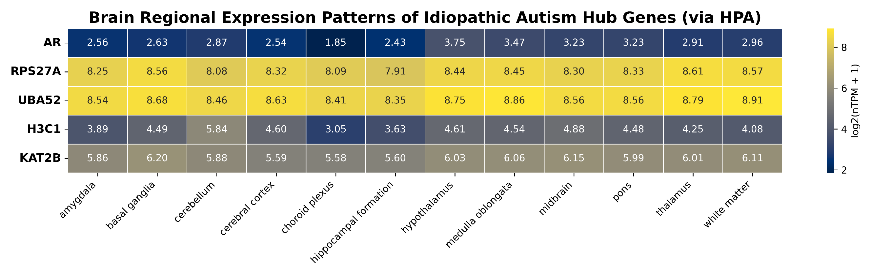
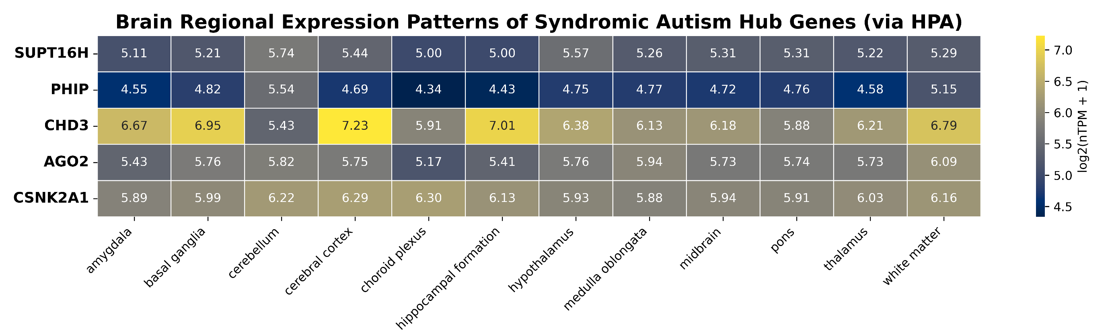
(a)
(b)

Slide 4
Supplementary Fig S2: Heatmaps illustrate the spatial expression profiles of selected hub genes across major human brain regions using data from the Human Protein Atlas (HPA). The top panel (a) represents hub genes identified in idiopathic autism (AR, RPS27A, UBA52, H3C1, KAT2B), while the bottom panel (b) represents hub genes associated with syndromic autism (SUPT16H, PHIP, CHD3, AGO2, CSNK2A1). Columns correspond to distinct brain regions, including amygdala, basal ganglia, cerebellum, cerebral cortex, choroid plexus, hippocampal formation, hypothalamus, medulla oblongata, midbrain, pons, thalamus, and white matter. Color intensity reflects log₂-transformed transcript per million values [log₂(TPM + 1)], with numerical values shown within each cell. Overall, idiopathic autism hub genes exhibit consistently higher and more uniform expression across brain regions compared with syndromic autism hub genes, which display greater regional variability, suggesting distinct neurobiological expression signatures between the two autism subtypes.

