Slide 1
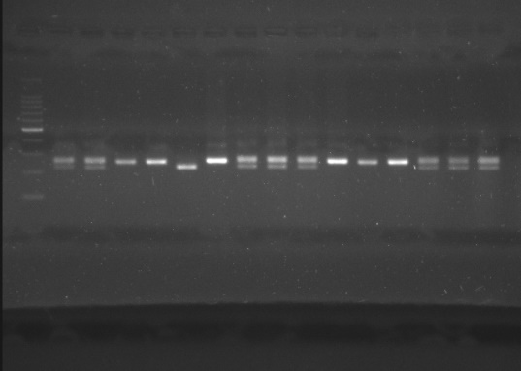
Fig.1(a-1)
Fig.1(a-2)
Fig.1(a-3)
Fig.1b
Supplementary Fig. 1(a-1,2,3) and (b): Raw figures of SSR markers which showed polymorphism in parental lines (PBW 343 and BSM 583) resolved on 3% agarose. These figures are used as Fig 3a and 3b in the manuscript

Slide 2
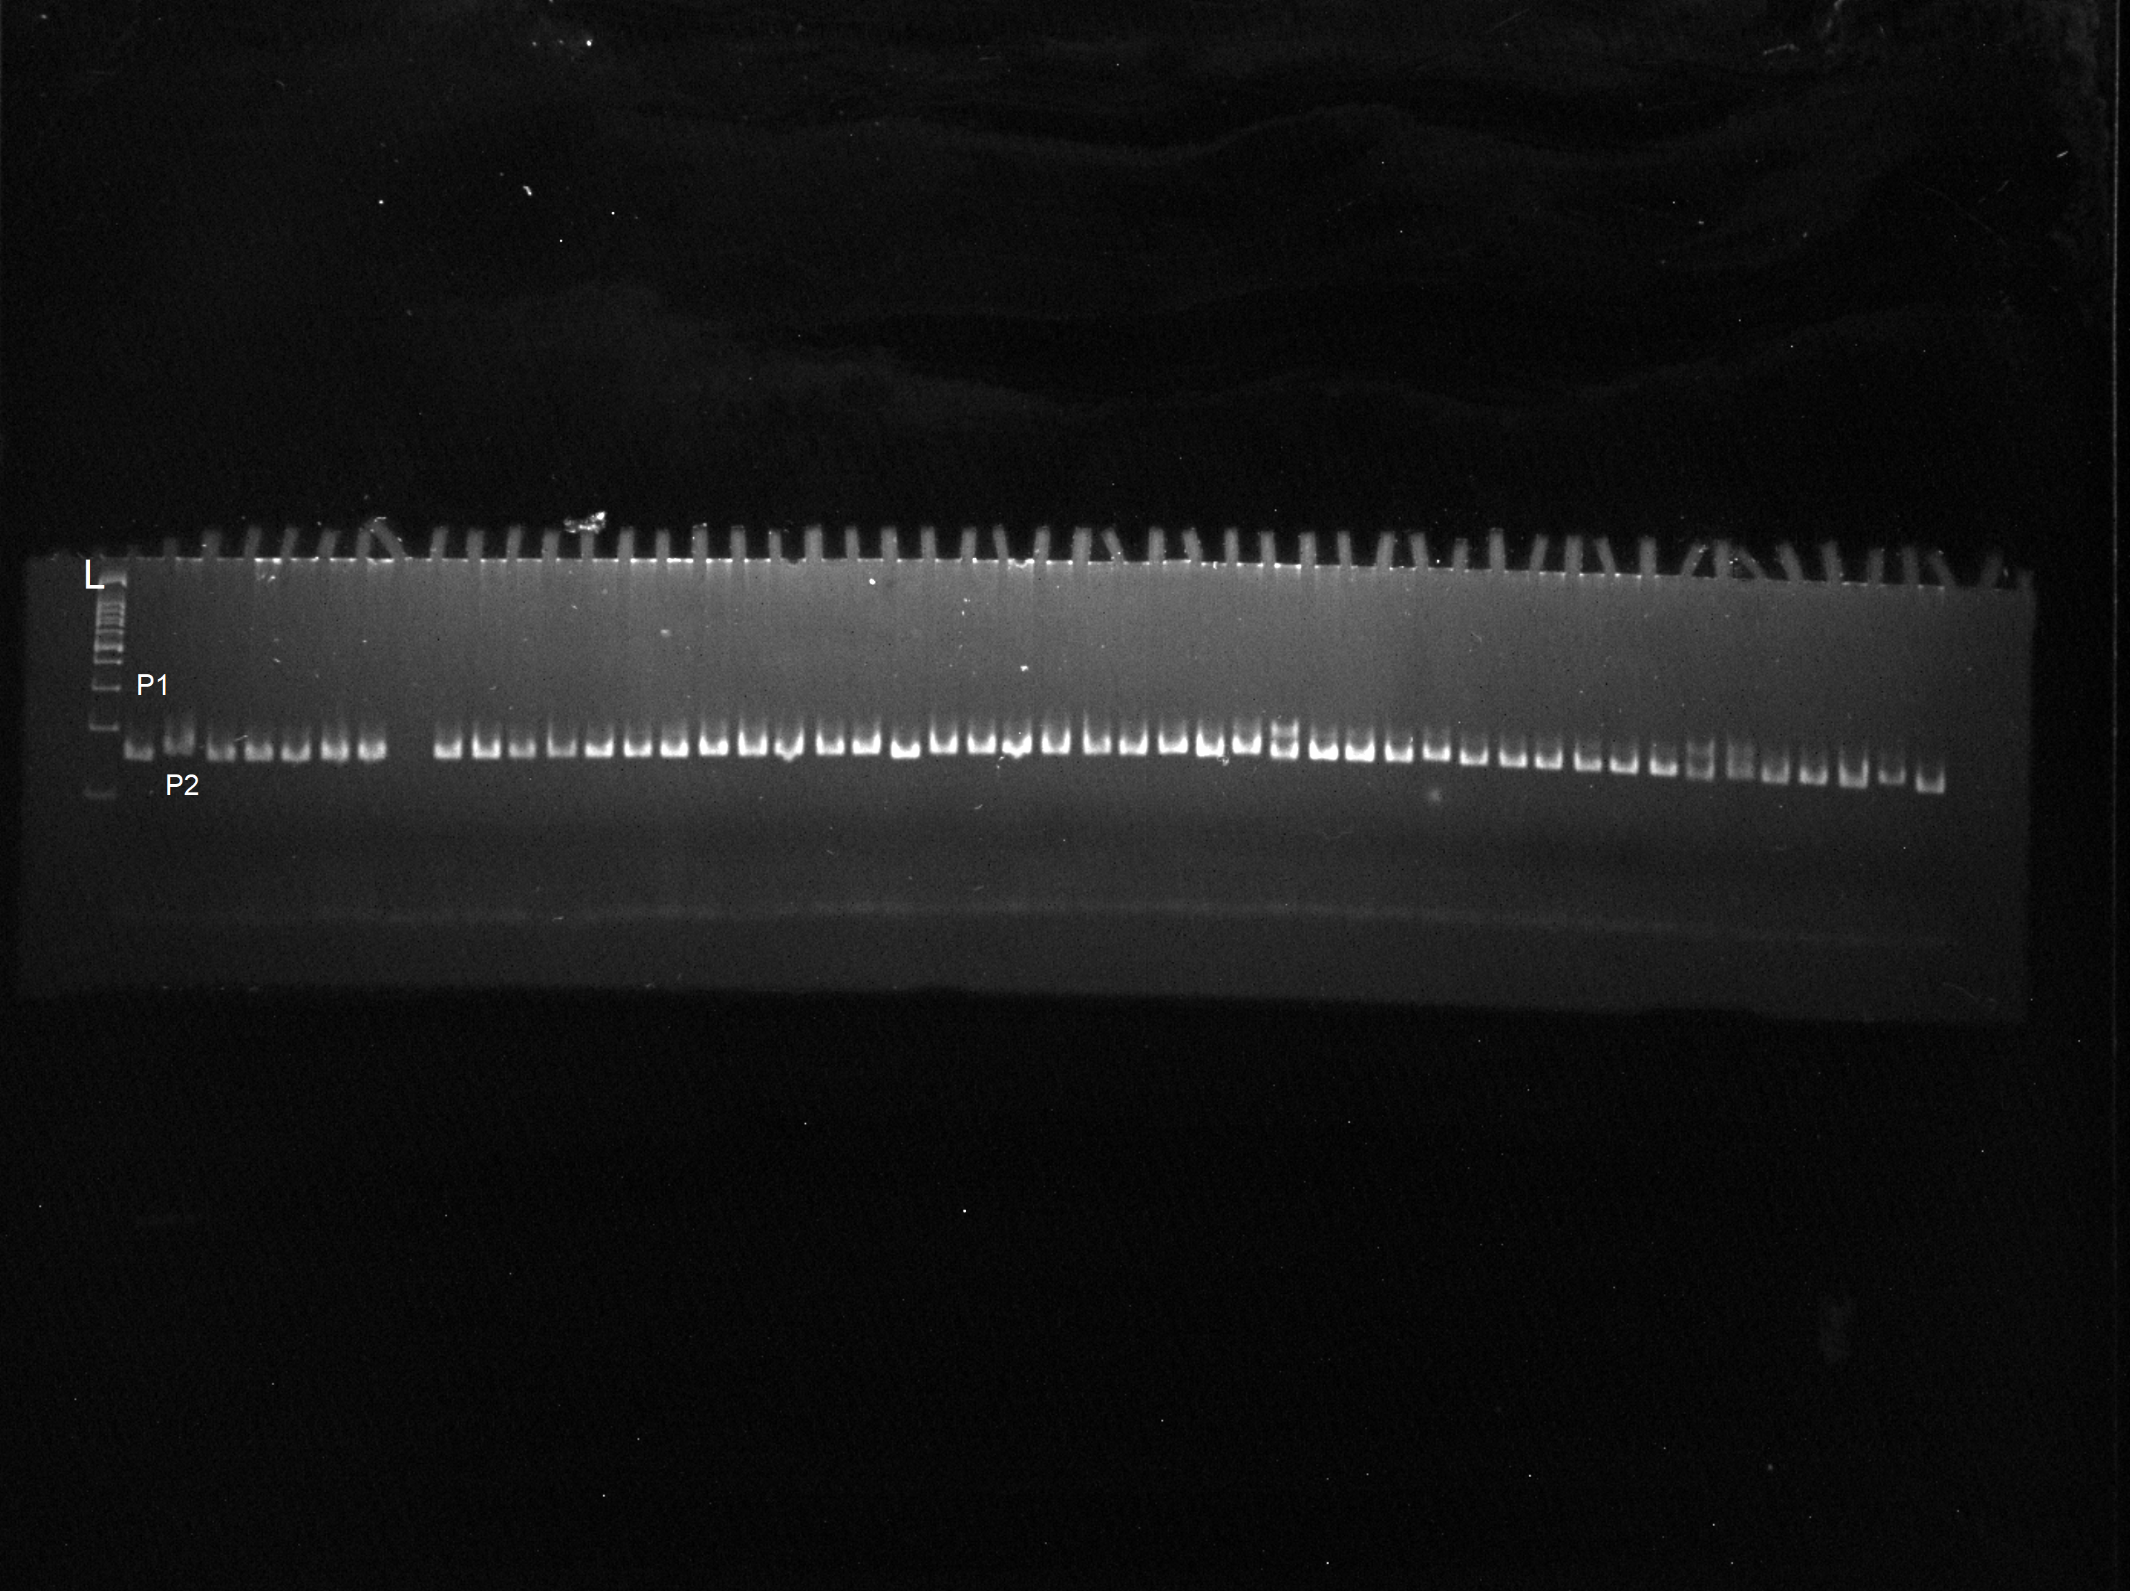
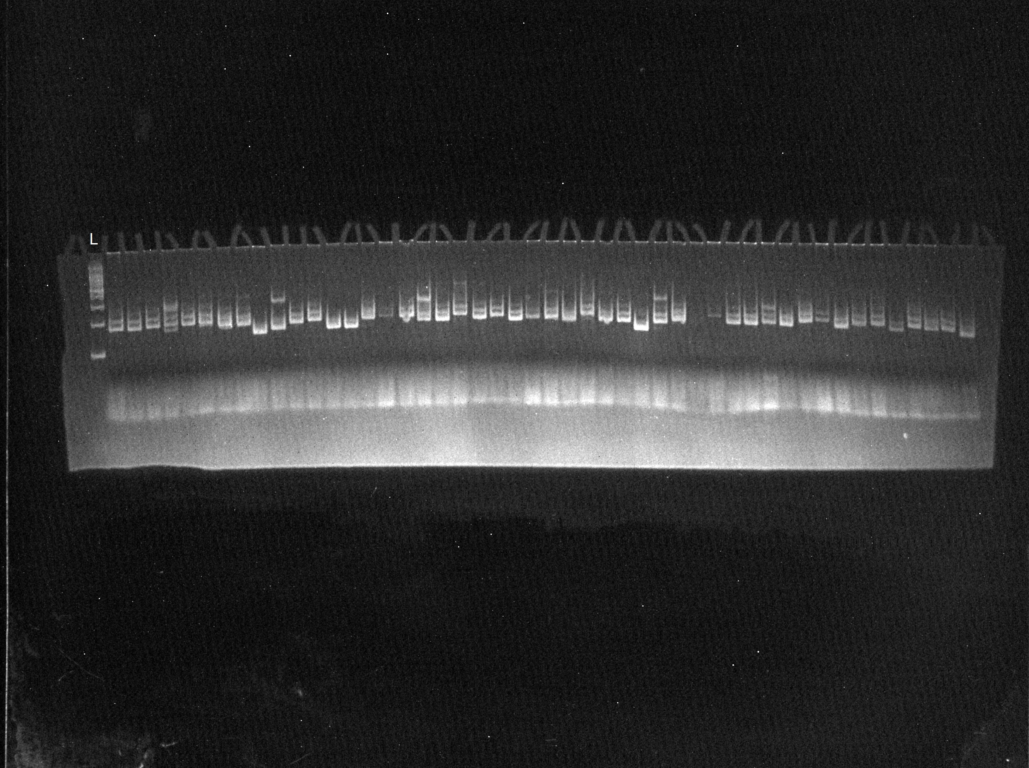
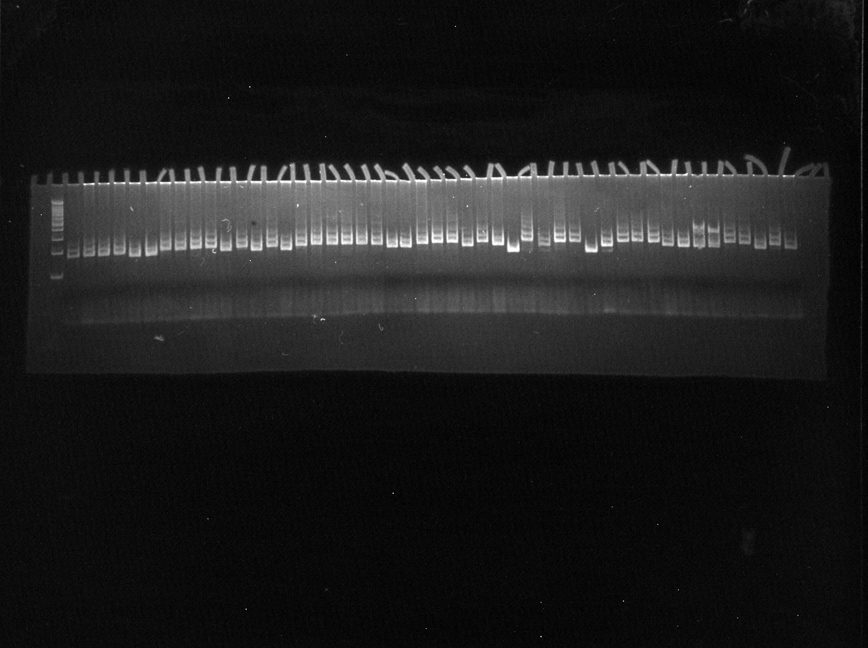
Fig.2.1
Fig.2.2
Fig.2.3
Fig.2.4
Supplementary Figure 2 (1 to 4)Polyacrylamide gel profile of SSR marker wmc182 showing amplification in F₂ Plants of PBW 343 × BSM 583 L: 100 bp ladder; P1: PBW 343; P2: BSM 583 . This picture used as Fig 4 in the manuscript.

