Slide 1
Dihydroartemisinin alleviates allergic airway inflammation by suppressing the PI3K-AKT signaling axis: integrated network pharmacology and experimental validation
Original image for Western blot

Slide 2
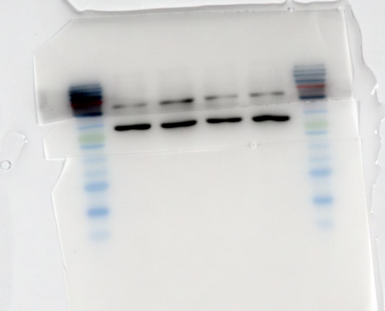


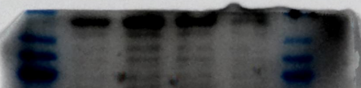
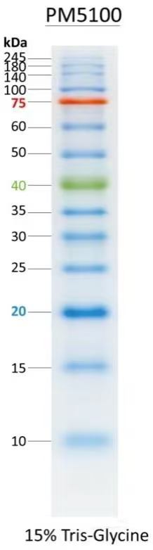



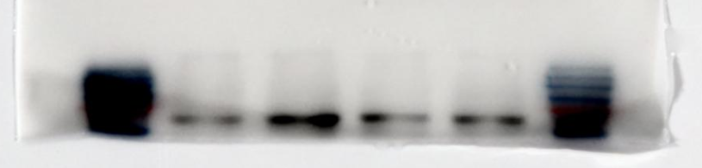



fig.4C-original
Con
HDM
DHA
HDM+DHA
β-actin:42kDa
original
——40kDa
β-actin:42kDa
——20kDa
TNFa：17kDa
original
TNFa：17kDa
IL1b:31kDa
original
——20kDa
IL1b:31kDa
P65:65kDa
original
——75kDa
P65:65kDa
PTGS2:68kDa
original
——75kDa
PTGS2:68kDa

Slide 3
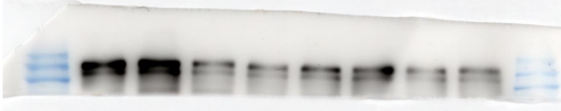




fig.4D-original
Con
HDM
DHA
HDM+DHA
EGFR:170kDa
original
——135kDa
EGFR:170kDa
MMP9:92kDa
original
——75kDa
MMP9:92kDa
β-actin：42kDa
original
——40kDa
β-actin：42kDa

Slide 4
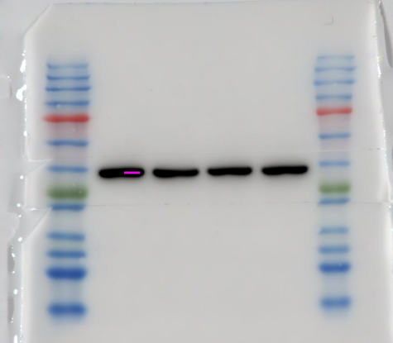
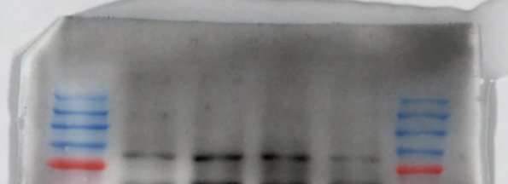
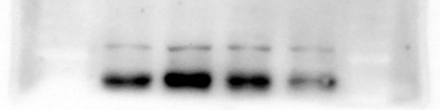
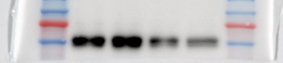

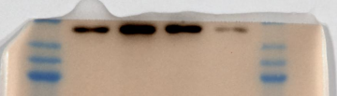



fig.4E-original
PI3K:85kDa
original
——75kDa
PI3K:85kDa
AKT:60kDa
original
——60kDa
AKT:60kDa
P-S6:32kDa
original
——35kDa
P-S6:32kDa
β-actin：42kDa
original
——40kDa
β-actin：42kDa

Slide 5
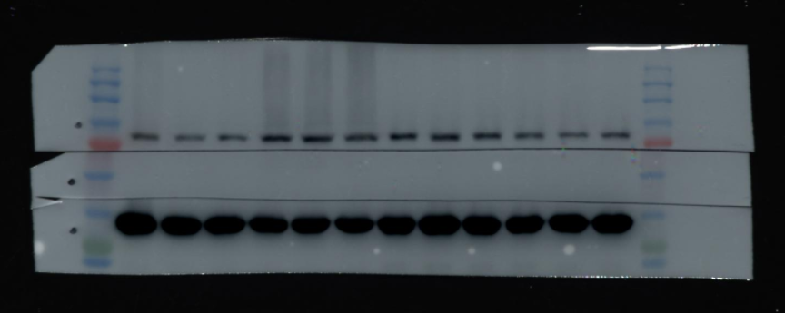
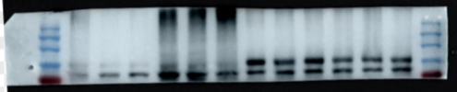


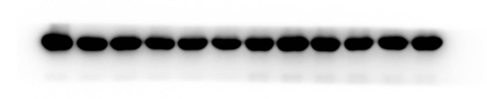
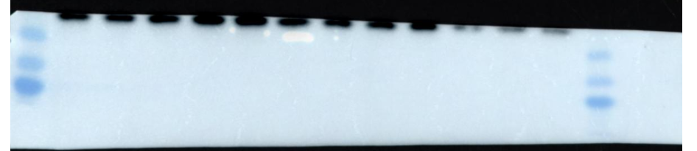

fig.7A-original
Con
HDM
DHA-L
DHA-H
MMP9:92 kDa original
——75kDa
MMP9:92 kDa
β-actin:42kDa original
——40kDa
β-actin:42kDa
P-S6:32kDa
——35kDa
P-S6:32kDa original
P-S6:32kDa

Slide 6
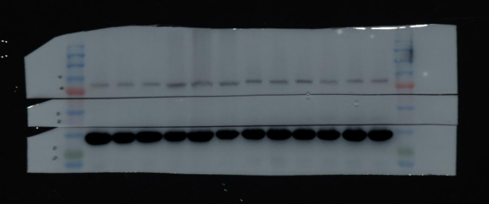
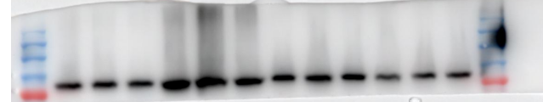
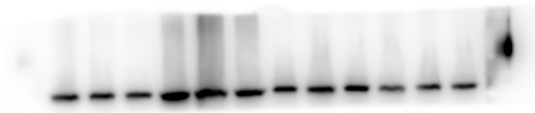


fig.7A-original
Con
HDM
DHA-L
DHA-H
PI3K：85kDa original
——75kDa
PI3K：85kDa
β-actin:42kDa original
——40kDa
β-actin:42kDa

Slide 7

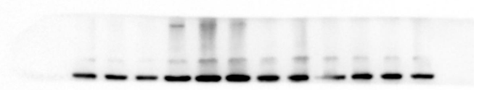



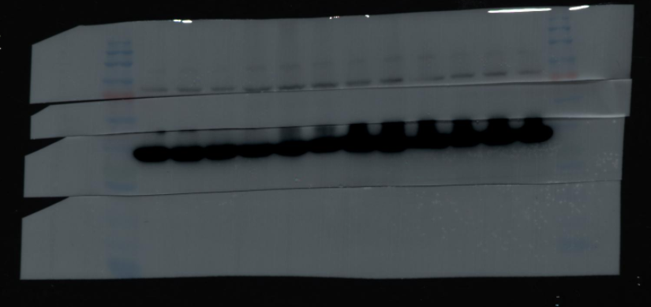
fig.7A-original
Con
HDM
DHA-L
DHA-H
NRF2：95kDa original
——75kDa
NRF2：95kDa
AKT:60kDa original
——60kDa
AKT:60kDa
β-actin:42kDa original
——40kDa
β-actin:42kDa
β-actin:42kDa original
——40kDa
β-actin:42kDa

