Slide 1
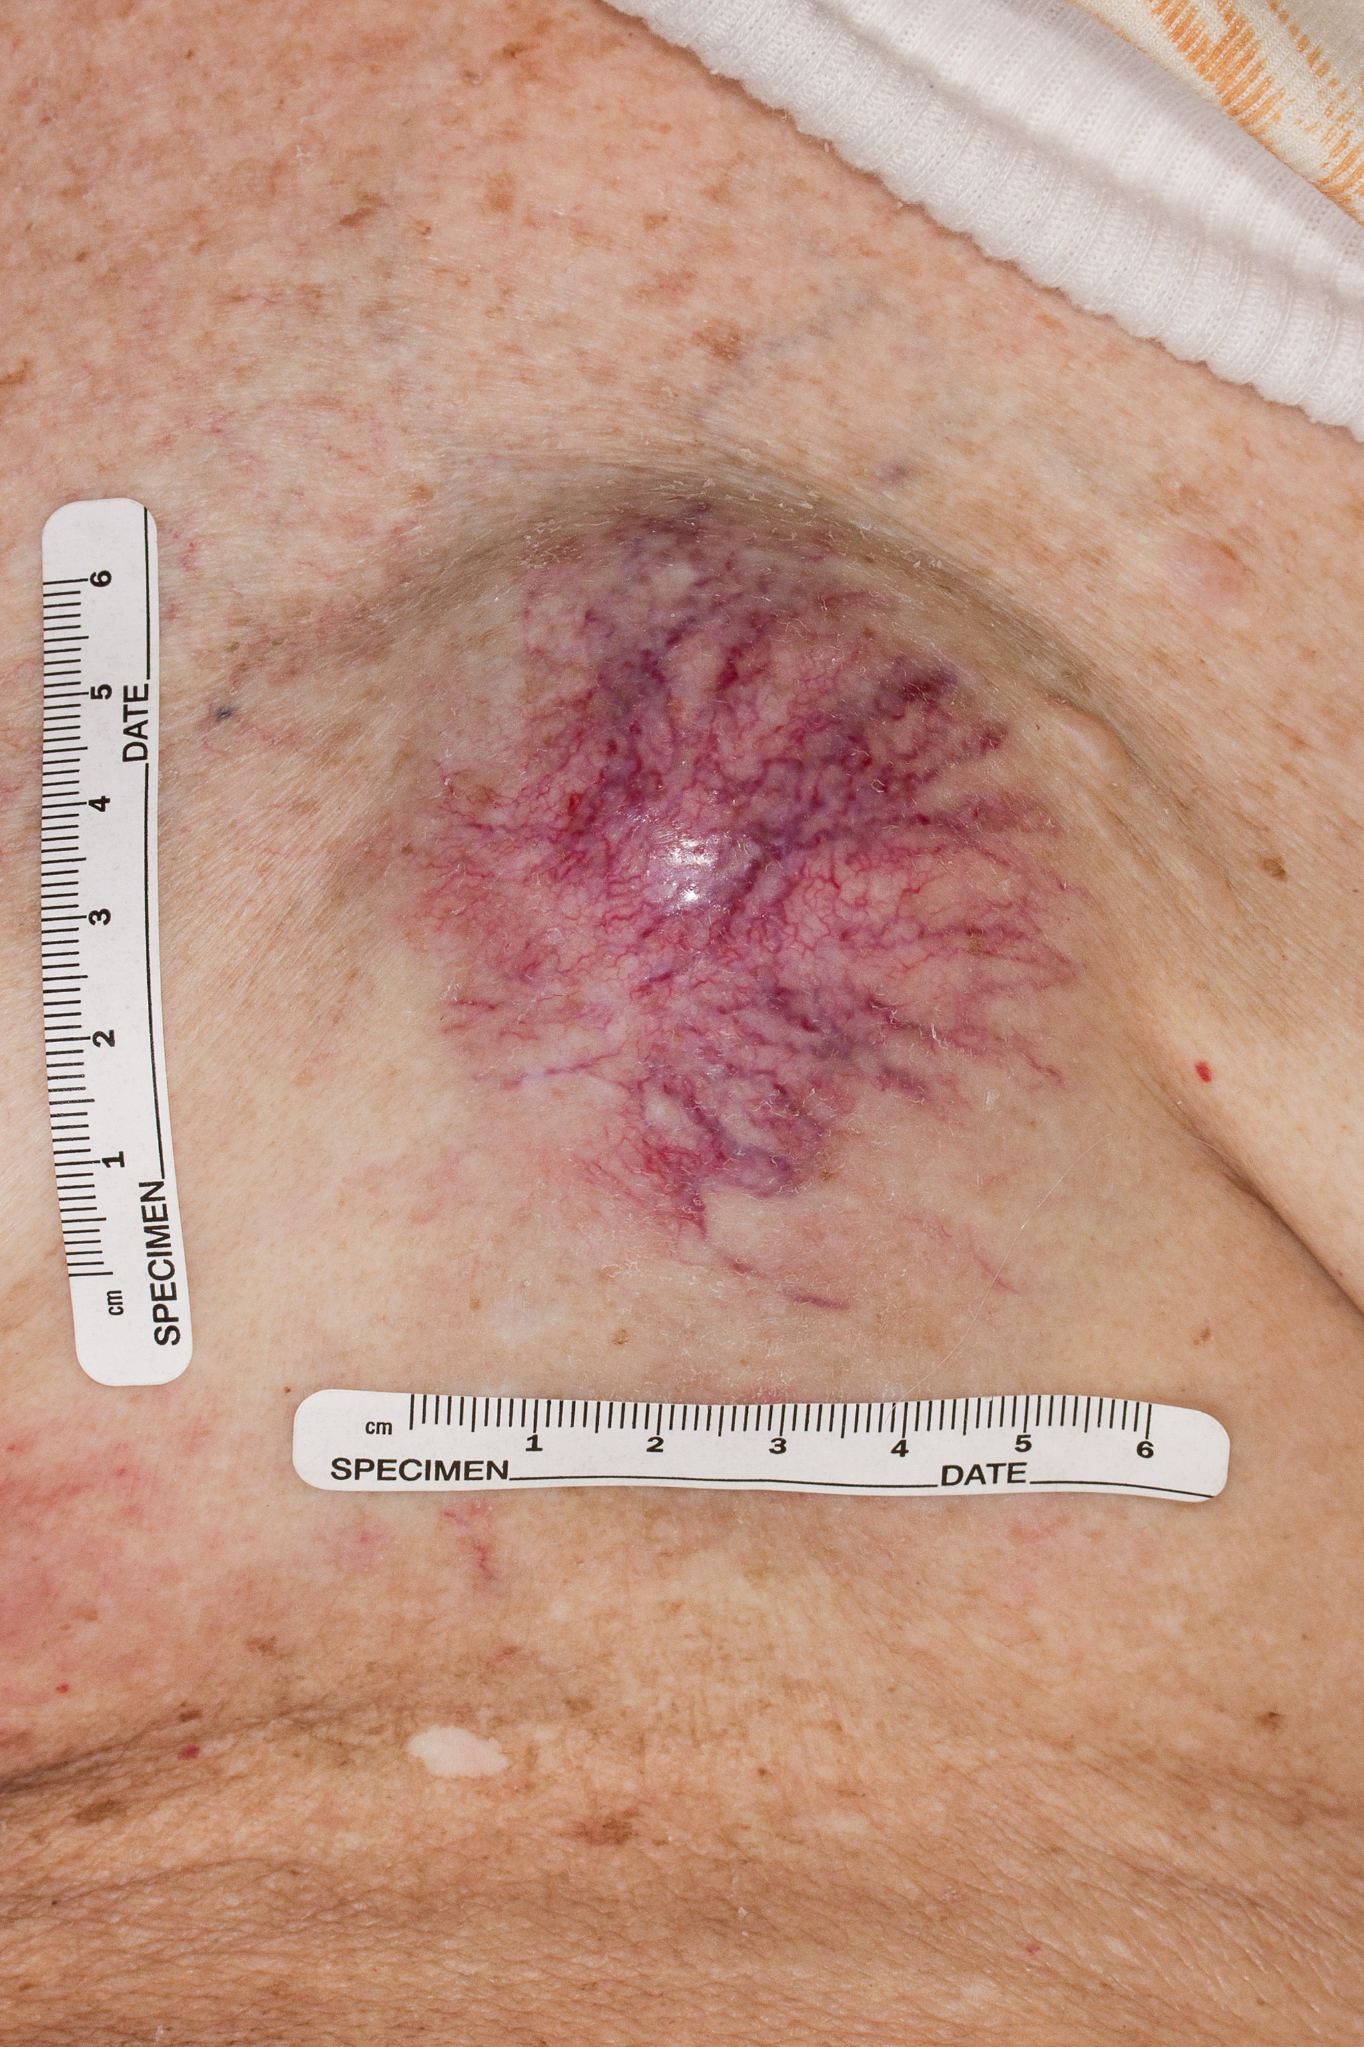
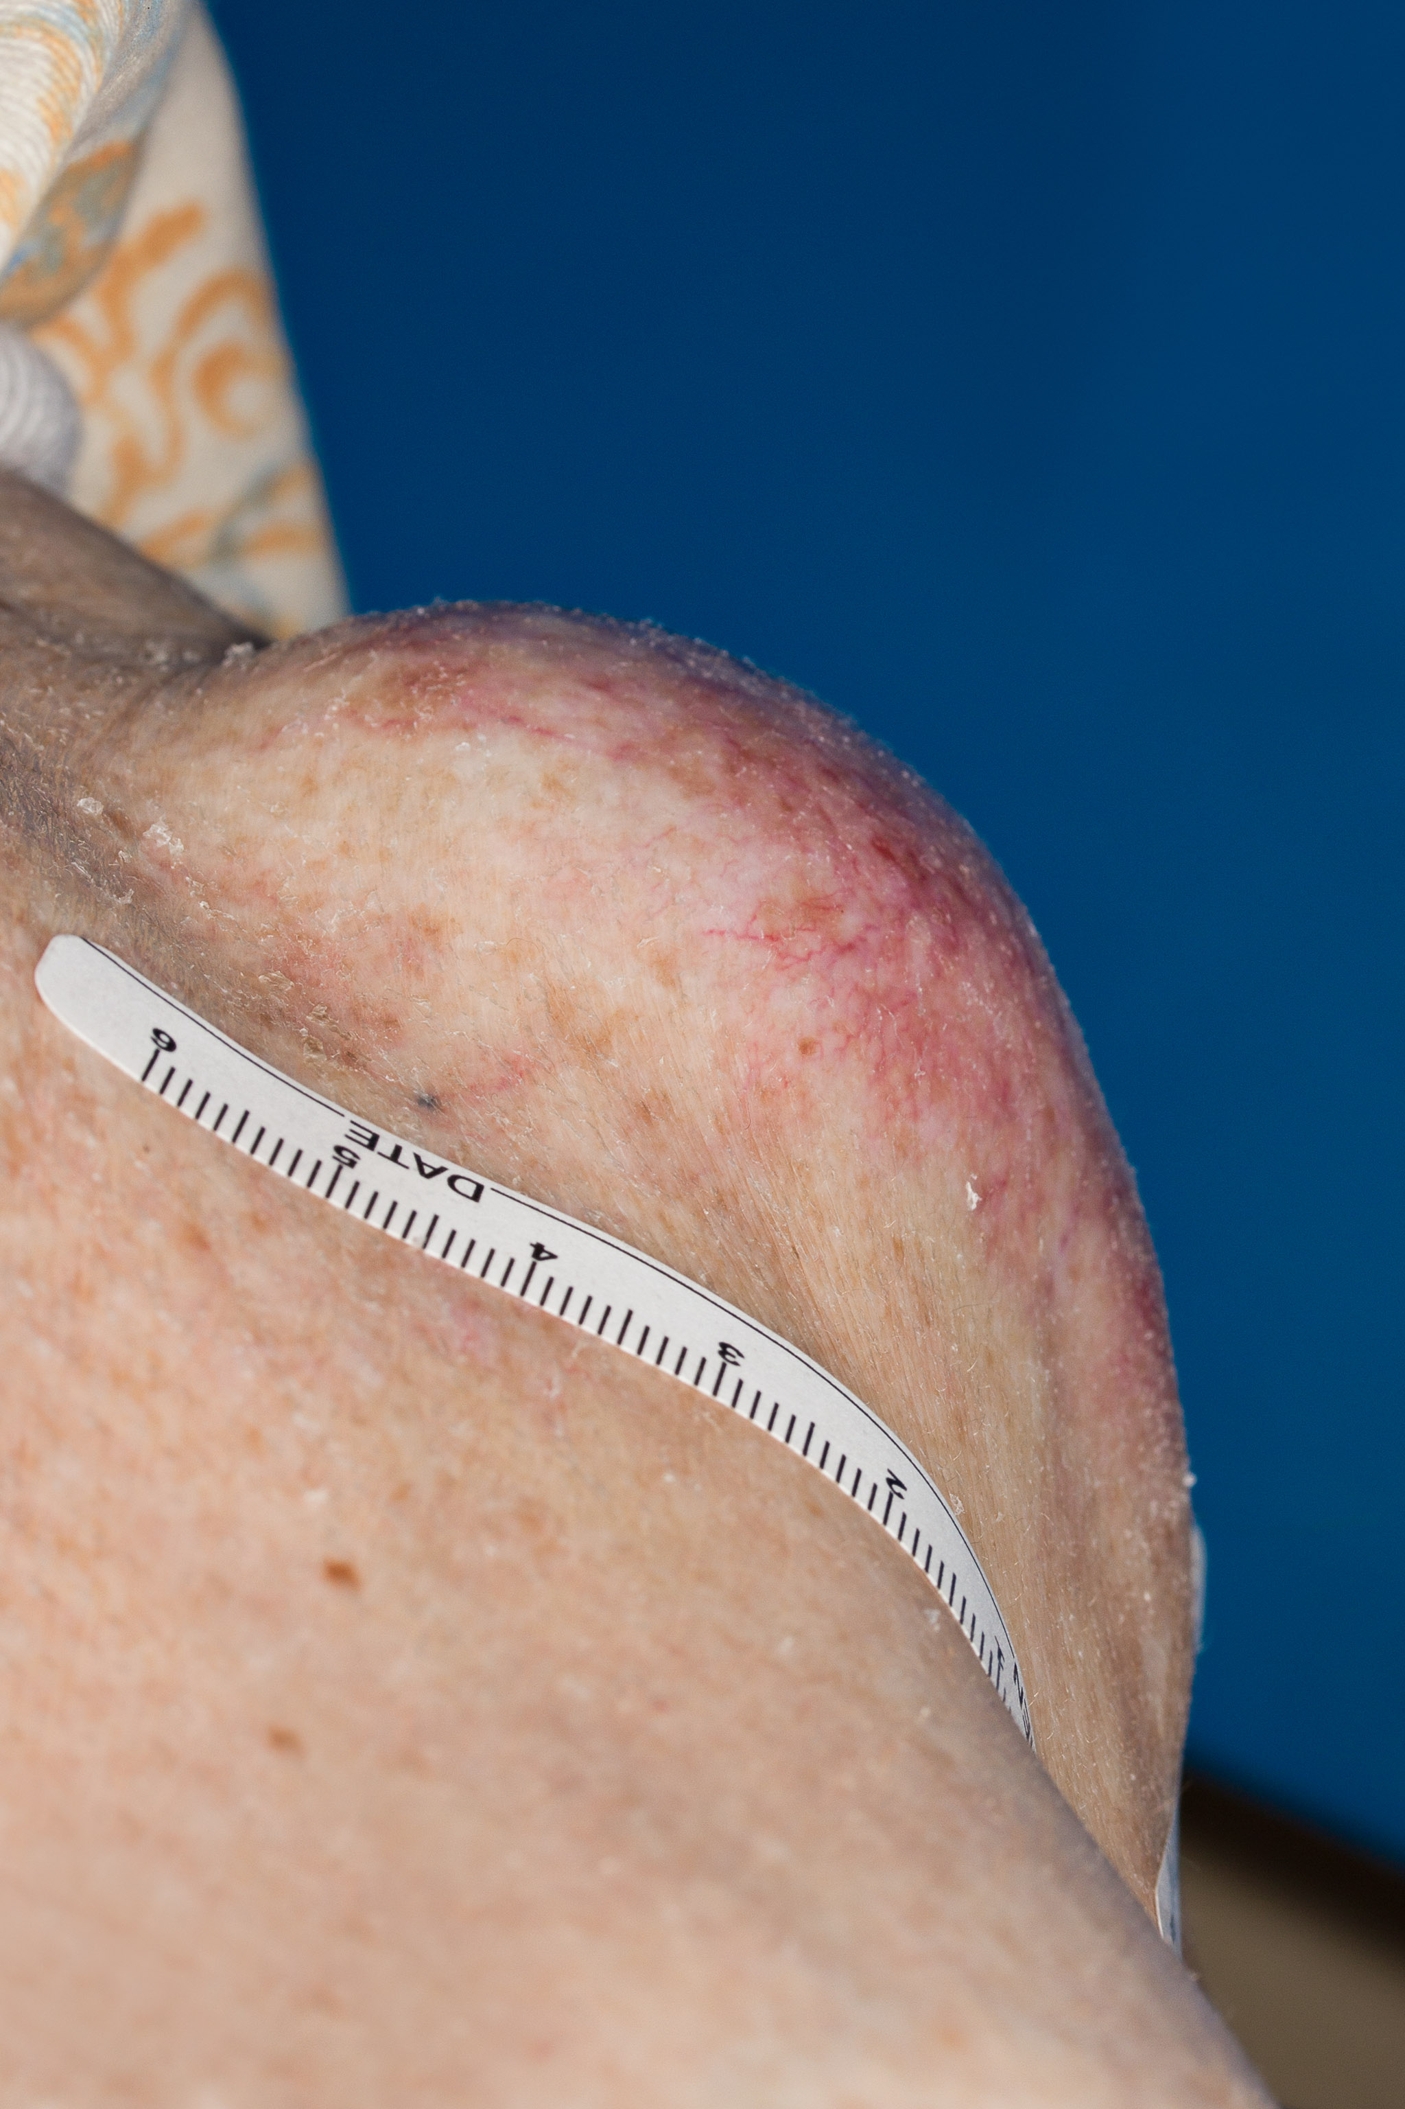
Supplemental Figure 1: Photograph of the patient’s recurrent plasmacytomas, here at the end of the disease course, on patient’s anterior chest.
Notes:
Supplemental Figure 1: Photograph of the patient’s recurrent plasmacytomas, here at the end of the disease course, on patient’s anterior chest.

Slide 2
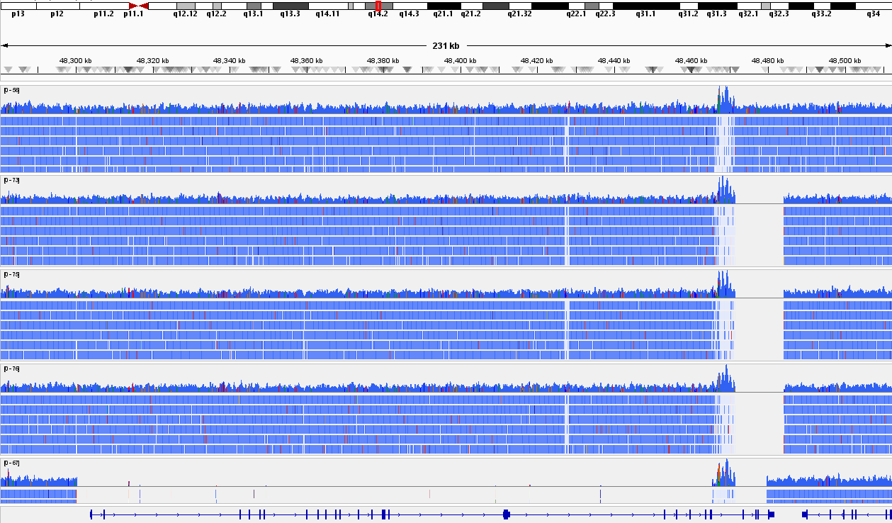
Chromosome 13
Chromosome Location
MC1286PE1
-4.0
-0.87
-4.1
-3.78
MC1286PE2
MC1286PE3
MC1286PE5
-0.47
-1.27
-3.97
-4.10
MC1286PE7
-0.57
-3.78
Reference Genome
RB1
Supplemental Figure 2A: WGS analysis reveals telomeric biallelic deletion of RB1 in MC1286PE2, MC1286PE3, MC1286PE5, and a large biallelic deletion in MC1286PE7.
Notes:
Supplemental Figure 2A: WGS analysis reveals telomeric biallelic deletion of RB1 in MC1286PE2, MC1286PE3, MC1286PE5, and a large biallelic deletion in MC1286PE7.

Slide 3
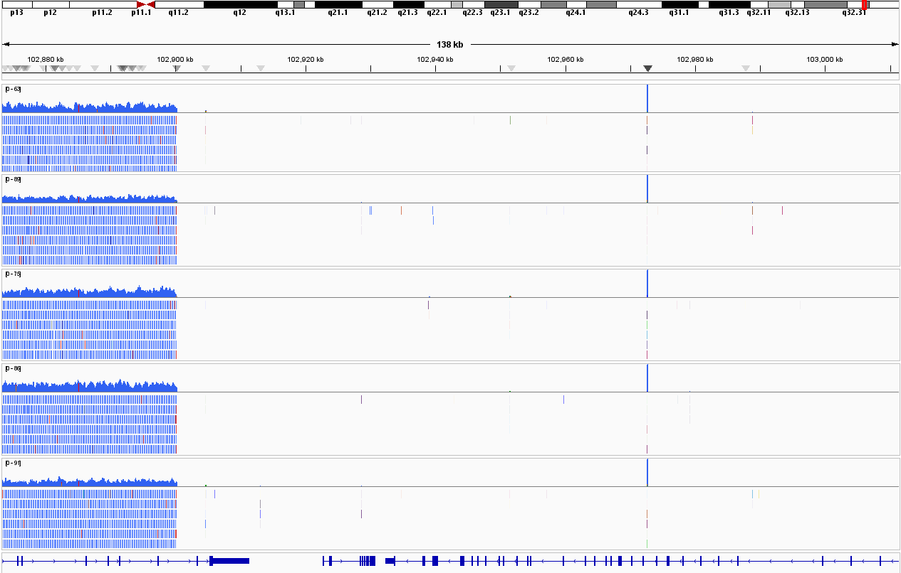
Chromosome 14
Chromosome Location
MC1286PE1
-4.0
-0.87
-4.1
-3.78
MC1286PE2
MC1286PE3
MC1286PE5
-0.47
-1.27
-3.97
-4.10
-0.57
MC1286PE7
-3.78
Reference Genome
TRAF3
Supplemental Figure 2B: WGS analysis reveals biallelic deletion of TRAF3 in all MC1286 cell lines.
Notes:
Supplemental Figure 2B: WGS analysis reveals biallelic deletion of TRAF3 in all MC1286 cell lines.

Slide 4
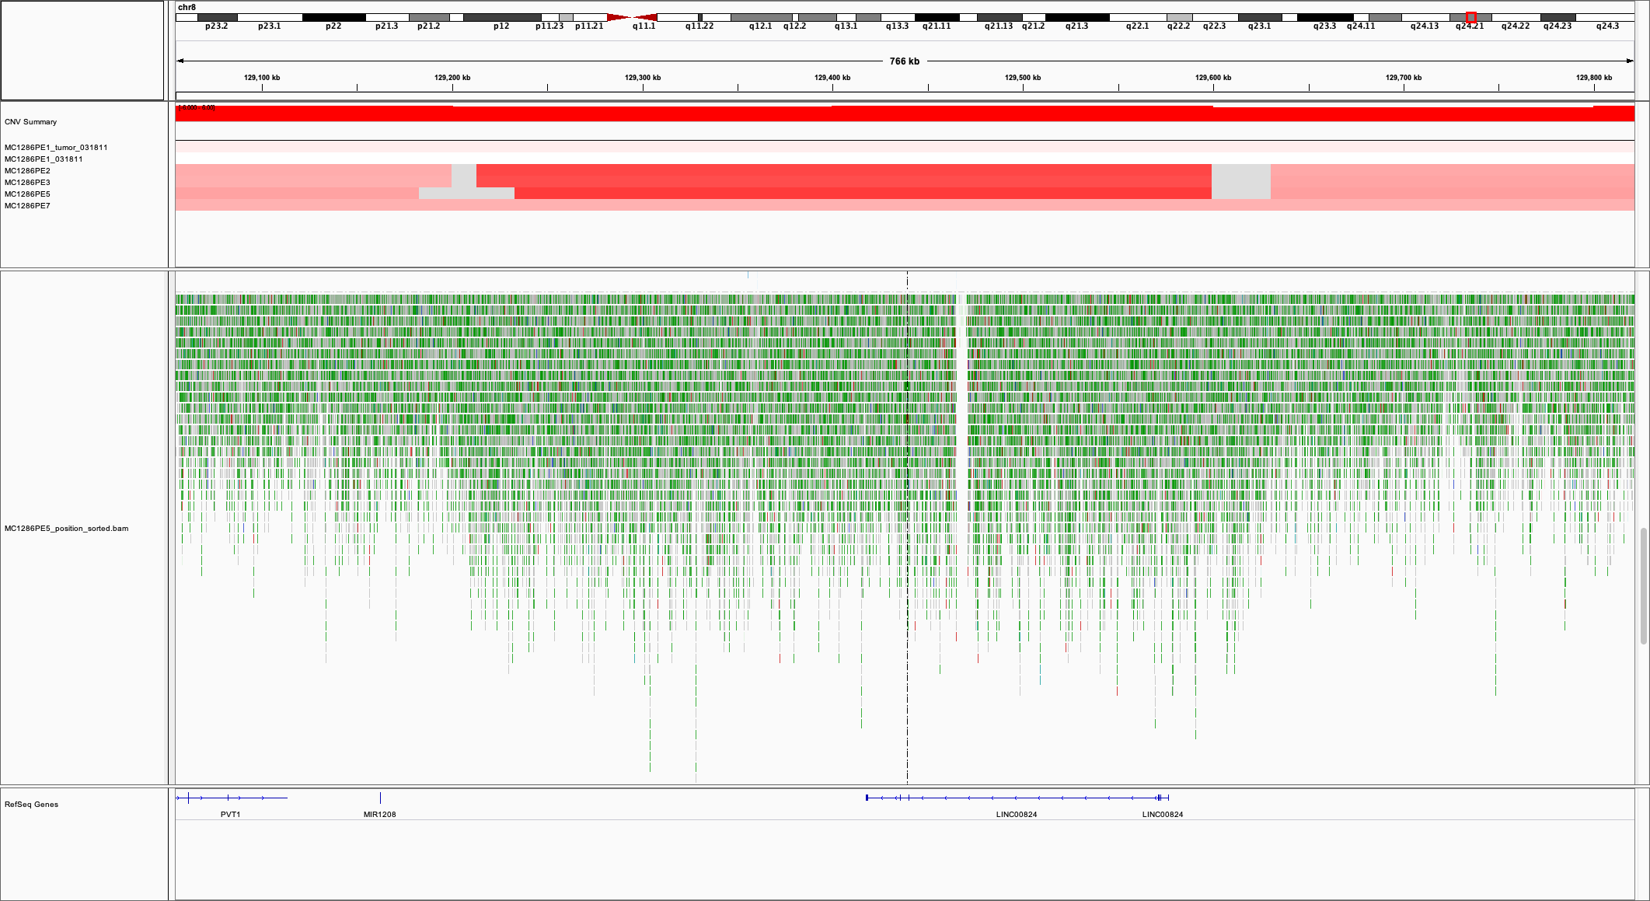
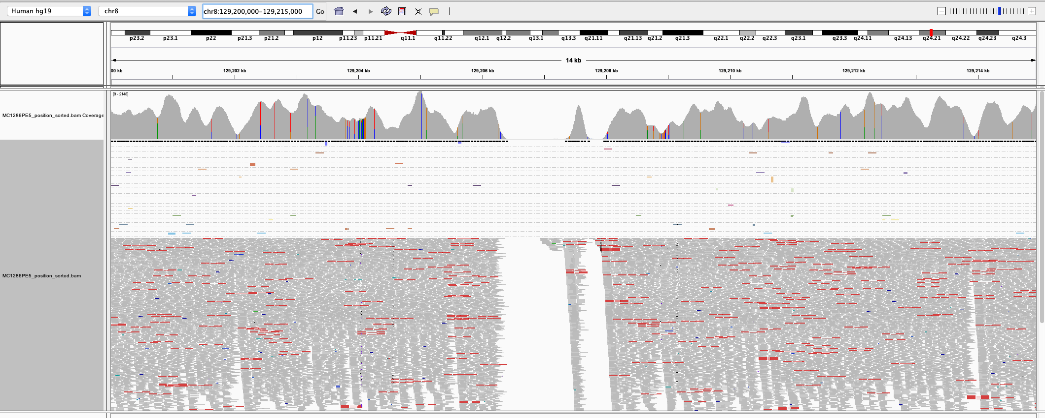
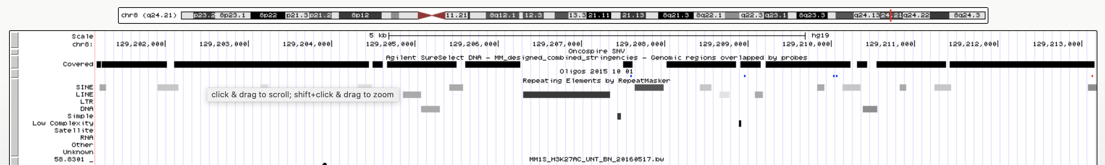
Chromosome Location
Supplemental Figure 3. Duplication of telomeric MYC by aCGH, mate pair, and custom capture NGS. (A) Top: aCGH analysis of MYC reveals telomeric duplication in MC1286PE2 (PE2), MC1286PE3 (PE3), and MC1286PE5 (PE5); cell lines are listed along the y-axis. The overall copy number for the region for each sample has been normalized to two copies to highlight local changes in copy number. A blue-to-red scale corresponds to copy numbers from -1.5 to 1.5 (deep blue represents 1 log loss and deep red represents 1 log gain; copy number within 0.3 log of diploid is in white/grey). Bottom: telomeric MYC duplication identified by mate pair sequencing in MC1286PE5 (identified by horizontal red arrow). (B) Custom capture fails to detect the telomeric MYC duplication. Gaps in custom capture probe coverage overlaps with highly repetitive areas of DNA and a lack of custom capture probe coverage. The telomeric MYC duplication break point is contained within these highly repetitive areas of DNA. PE1T: gDNA from pleural fluid sample, PE1, PE2, PE3, PE5, PE7: gDNA from MC1286 cell lines.
A.
129,207,090
aCGH
PE1 T
PE1
PE2
PE3
PE5
PE7
0.20
0.05
1.12
1.08
1.18
0.53
Mate Pair
MYC Coordinates – chr8: 128,748,315 – 128,753,680
Reference Genome
B.
129,207,090
Custom Capture
Regions overlapped by probes
Repetitive genomic regions
Notes:
Supplemental Figure 3. Duplication of telomeric MYC by aCGH, mate pair, and custom capture NGS. (A) Top: aCGH analysis of MYC reveals telomeric duplication in MC1286PE2 (PE2), MC1286PE3 (PE3), and MC1286PE5 (PE5); cell lines are listed along the y-axis. The overall copy number for the region for each sample has been normalized to two copies to highlight local changes in copy number. A blue-to-red scale corresponds to copy numbers from -1.5 to 1.5 (deep blue represents 1 log loss and deep red represents 1 log gain; copy number within 0.3 log of diploid is in white/grey). Bottom: telomeric MYC duplication identified by mate pair sequencing in MC1286PE5 (identified by horizontal red arrow). (B) Custom capture fails to detect the telomeric MYC duplication. Gaps in custom capture probe coverage overlaps with highly repetitive areas of DNA and a lack of custom capture probe coverage. The telomeric MYC duplication break point is contained within these highly repetitive areas of DNA. PE1T: gDNA from pleural fluid sample, PE1, PE2, PE3, PE5, PE7: gDNA from MC1286 cell lines.

Slide 5
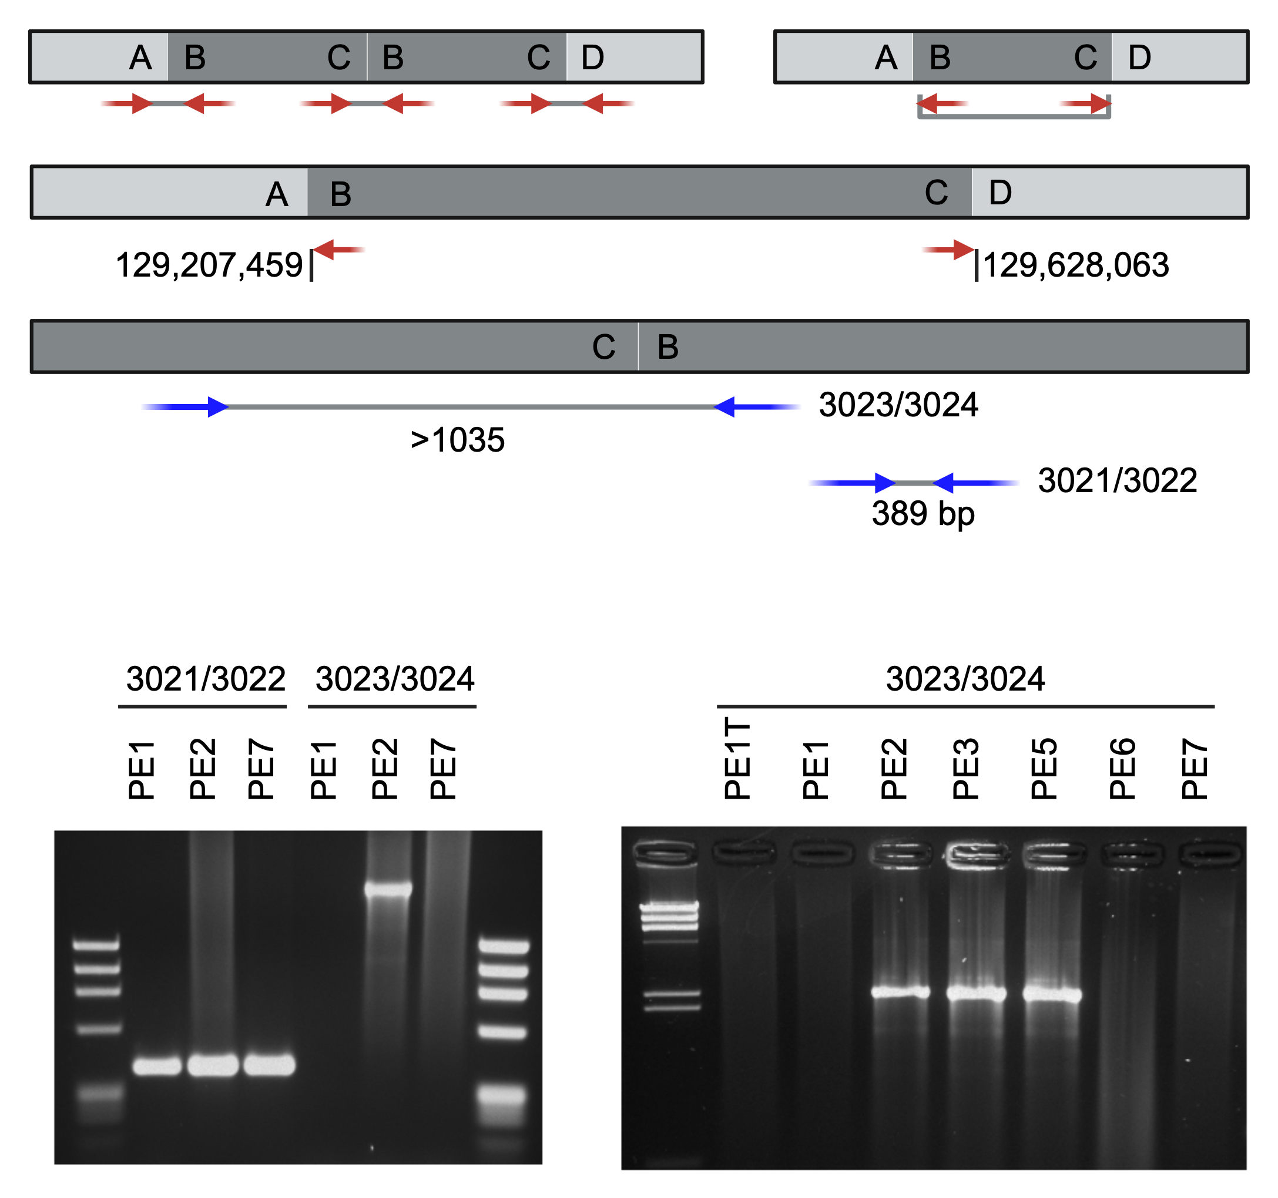
A.
B.
Supplemental Figure 4. Mapping breakpoint telomeric of MYC in MC1286 cell lines using PCR. (A) Top: scheme of mate pair reads with duplication of B-C fragment. Left: mate pairs in duplication. Right: discordant mate pairs aligned to genome. Middle: coordinates (on chromosome 8) of aligned MC1286PE cell line read pairs identified by mate-pair. Bottom: PCR primers and minimal distance between primer pairs. The o3021/3022 pair doesn’t span the breakpoint and is used as a positive control. (B) PCR assay of telomeric MYC rearrangement. Left: Primers designed on either side of the breakpoint (o3021/3022) as a positive control and across the breakpoint (o3023/3024); only MC1286PE2 (PE2) cell line is positive for the telomeric MYC breakpoint. Right: PE1T (PE1 tumor), and PE6 are gDNA derived from patient’s recurrent pleural effusion. All other lanes are derived from MC1286 cell lines (PE1, PE2, PE3, PE5, PE7). Only cell lines PE2, PE3, and PE5 have the telomeric MYC breakpoint.
Notes:
Supplemental Figure 4. Mapping breakpoint telomeric of MYC in MC1286 cell lines using PCR. (A) Top: scheme of mate pair reads with duplication of B-C fragment. Left: mate pairs in duplication. Right: discordant mate pairs aligned to genome. Middle: coordinates (on chromosome 8) of aligned MC1286PE cell line read pairs identified by mate-pair. Bottom: PCR primers and minimal distance between primer pairs. The o3021/3022 pair doesn’t span the breakpoint and is used as a positive control. (B) PCR assay of telomeric MYC rearrangement. Left: Primers designed on either side of the breakpoint (o3021/3022) as a positive control and across the breakpoint (o3023/3024); only MC1286PE2 (PE2) cell line is positive for the telomeric MYC breakpoint. Right: PE1T (PE1 tumor), and PE6 are gDNA derived from patient’s recurrent pleural effusion. All other lanes are derived from MC1286 cell lines (PE1, PE2, PE3, PE5, PE7). Only cell lines PE2, PE3, and PE5 have the telomeric MYC breakpoint.

Slide 6
MC1286 Cell Line | Pomalidomide PI
PE1* | 1.20
PE2 | 0.61
PE3* | 0.96
PE5 | 1.10
PE7 | 0.49
*Progression on IMiD therapy at time of sample collection
Supplemental Table 1: Cell line response to IMiD therapy. Patient cell lines were treated for three days with IMiD therapy, in this case pomalidomide. Proliferation index (PI) is defined as cell proliferation of treated culture (final cell number minus inoculum cell number) normalized to the proliferation of the untreated control (PI < 1 indicates sensitivity to IMiD therapy).
Notes:
Supplemental Table 1: Cell line response to IMiD therapy. Patient cell lines were treated for three days with IMiD therapy, in this case pomalidomide. Proliferation index (PI) is defined as cell proliferation of treated culture (final cell number minus inoculum cell number) normalized to the proliferation of the untreated control (PI < 1 indicates sensitivity to IMiD therapy).

Slide 7
STAT3
pSTAT3
Merged
KMS26
8226
PE1
PE7
KMS26
8226
PE1
PE7
KMS26
8226
PE1
PE7
pSTAT3
STAT3
0.00
0.37
0.14
0.66
Supplemental Figure 5. Western blot (WB) of total STAT3 (left), phosphorylated STAT3 (pSTAT3, middle), and merged (right) in cell lines KMS26 (positive control), 8226 (negative control) and MC1286 cell lines PE1 and PE7. Ratio of pSTAT3/STAT3 fluorescence signal is listed below respective cell lines.
Notes:
Supplemental Figure 5. Western blot (WB) of total STAT3 (left), phosphorylated STAT3 (pSTAT3, middle), and merged (right) in cell lines KMS26 (positive control), 8226 (negative control) and MC1286 cell lines PE1 and PE7. Ratio of pSTAT3/STAT3 fluorescence signal is listed below respective cell lines.

Slide 8
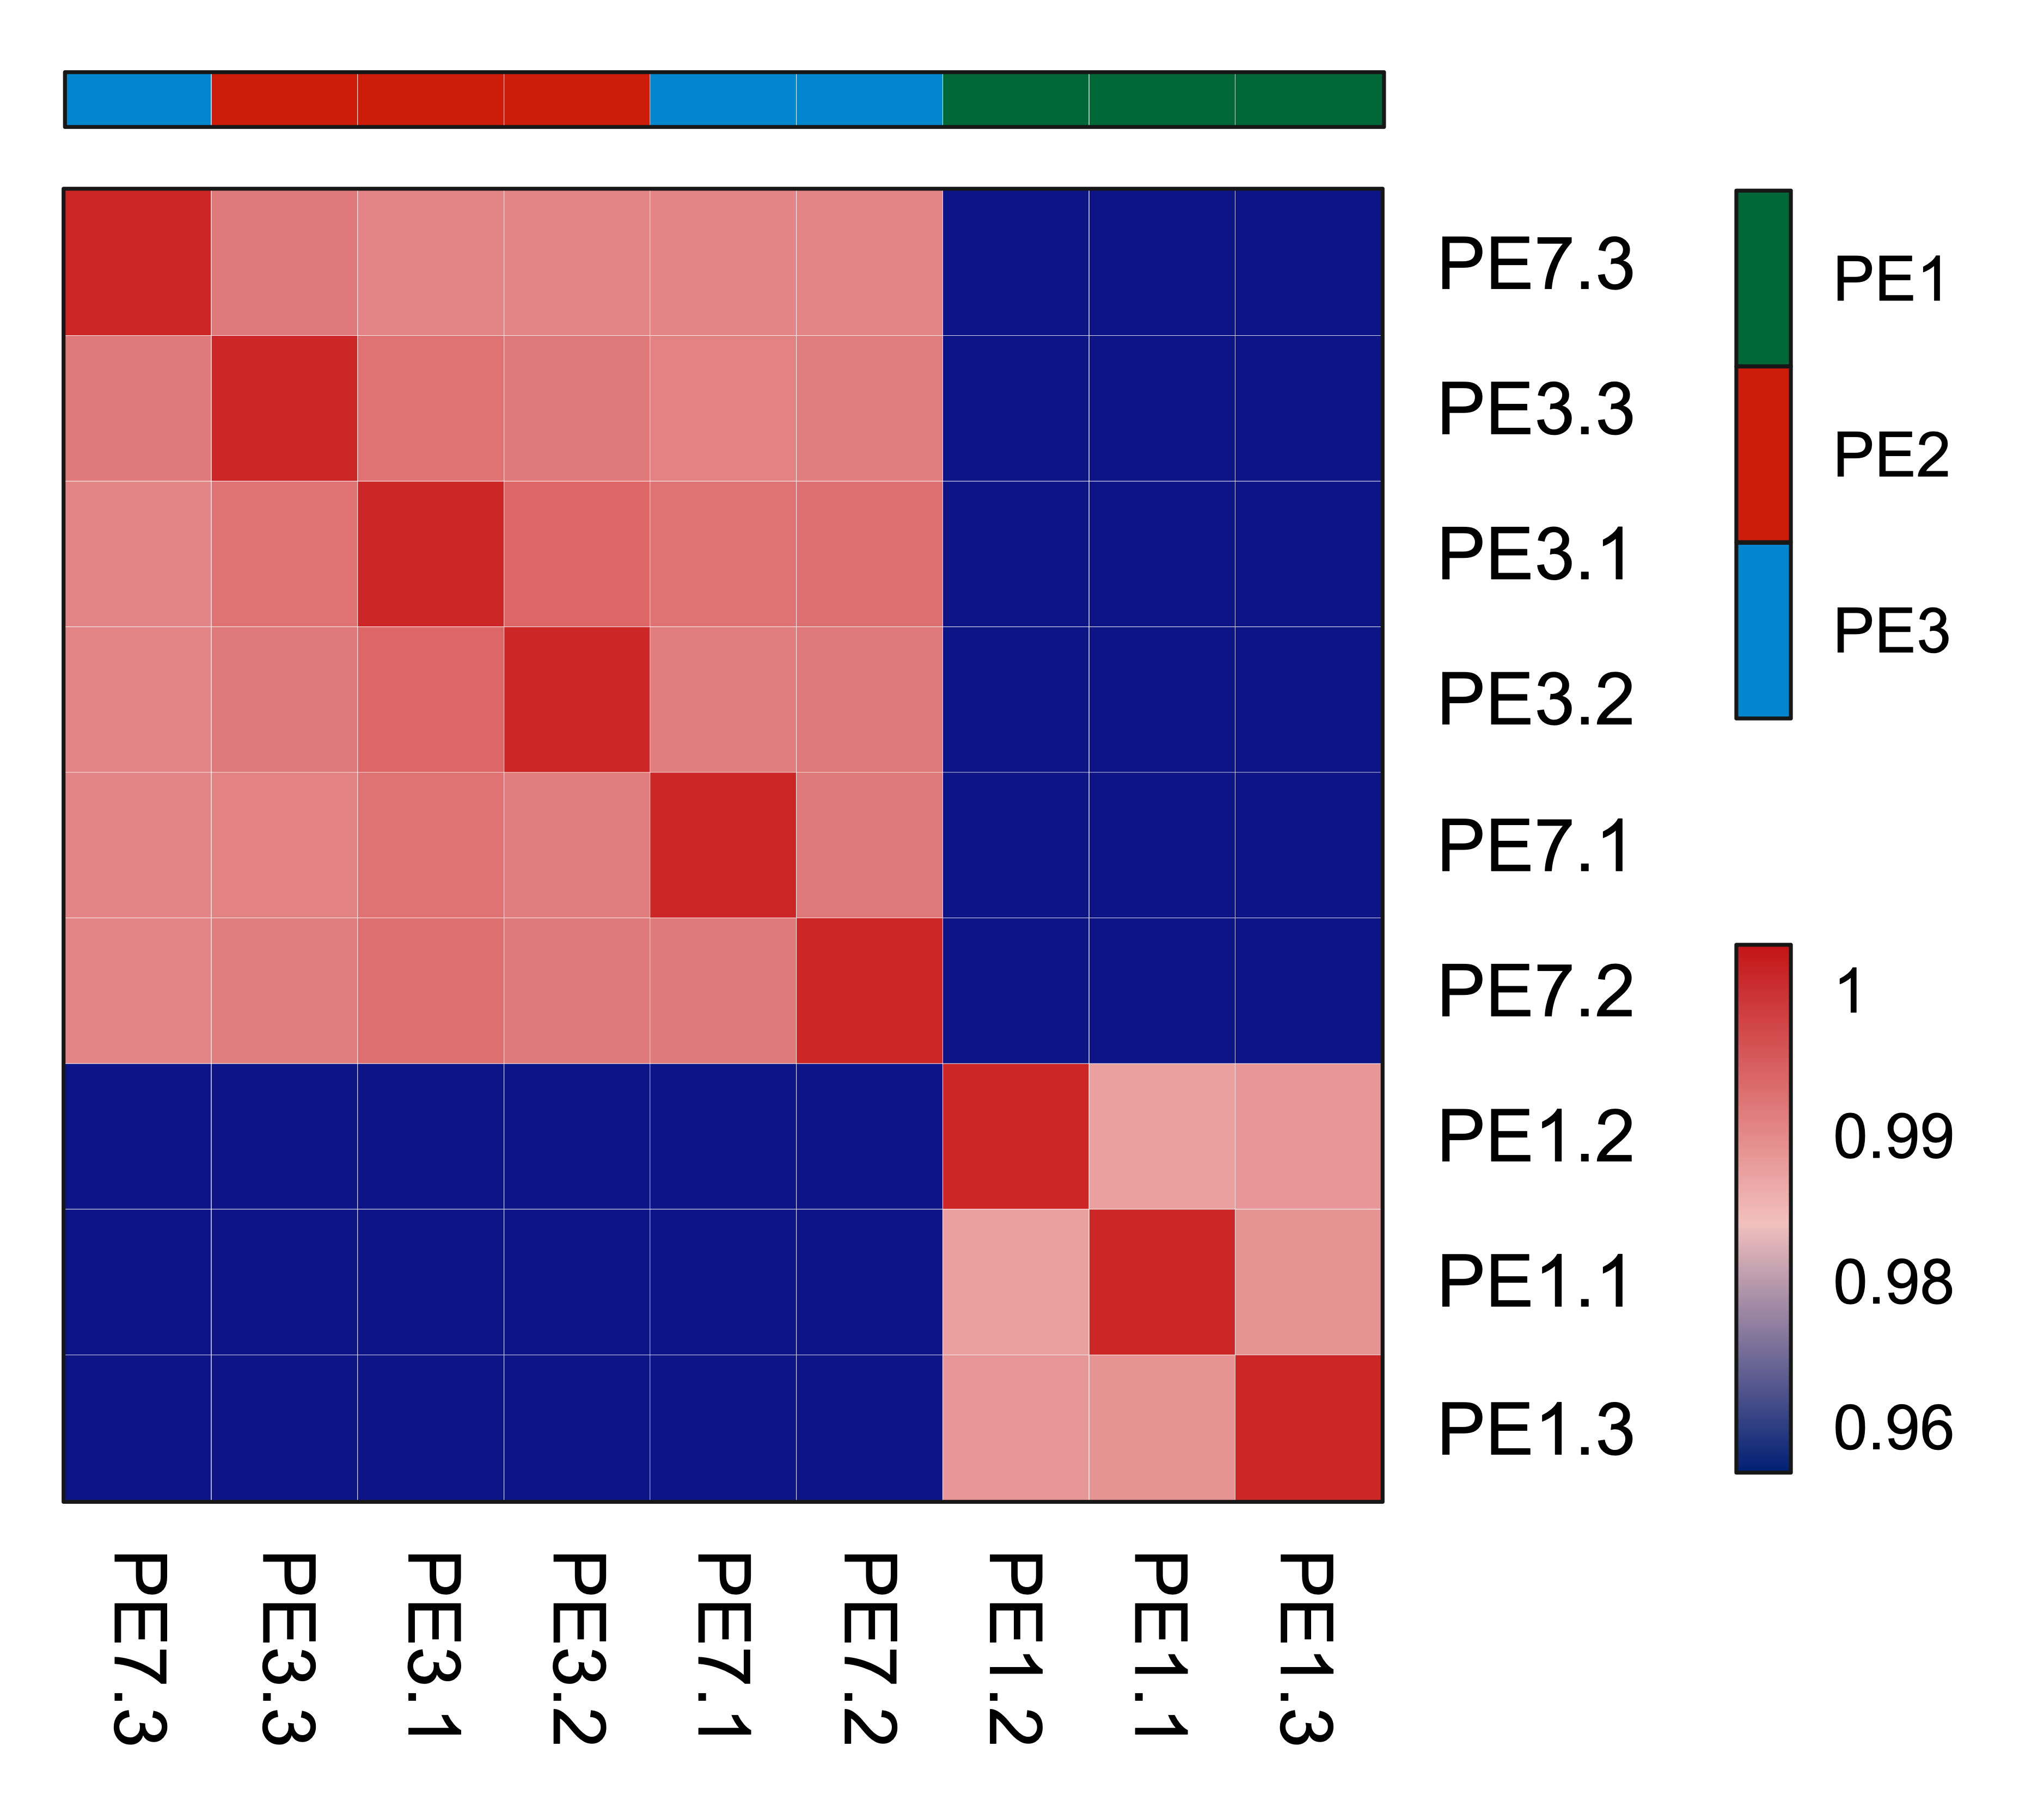
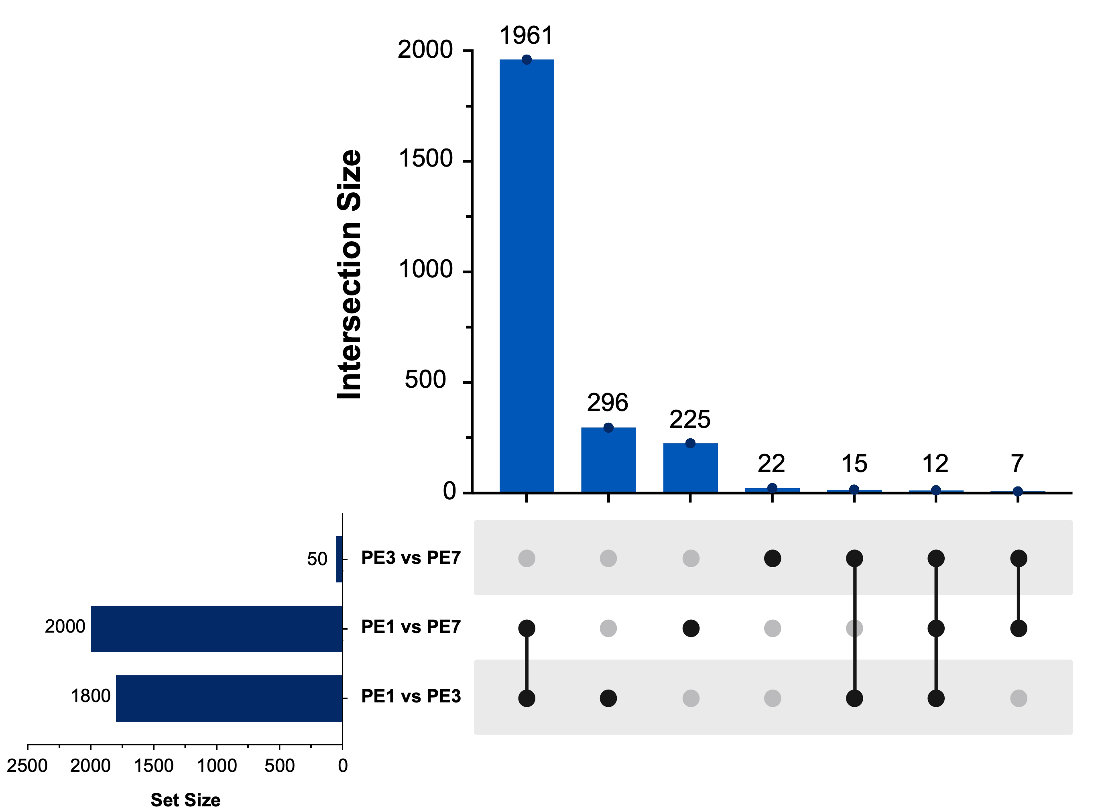
A.
B
Supplemental Figure 6. A. Sample correlation heatmap which shows the Pearson correlation coefficients between all samples. Samples are shown in triplicates (e.g. PE7.1 = MC1286PE7 one of three samples). B. UpSet plot shows the overlap of significantly differentially expressed proteins (FDR ≤ 0.05) across the three MC1286 cell line comparisons.
Notes:
Supplemental Figure 6. A. Sample correlation heatmap which shows the Pearson correlation coefficients between all samples. Samples are shown in triplicates (e.g. PE7.1 = MC1286PE7 one of three samples). B. UpSet plot shows the overlap of significantly differentially expressed proteins (FDR ≤ 0.05) across the three MC1286 cell line comparisons.

Slide 9
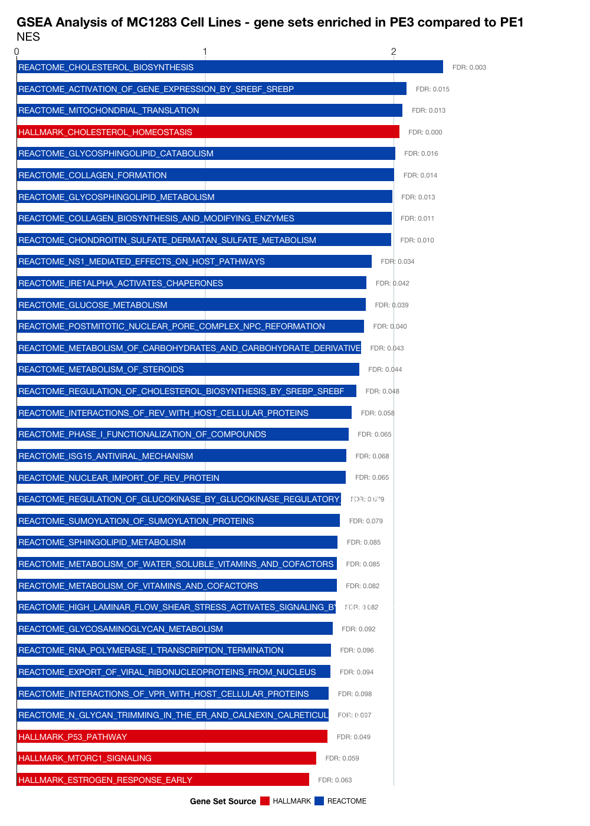
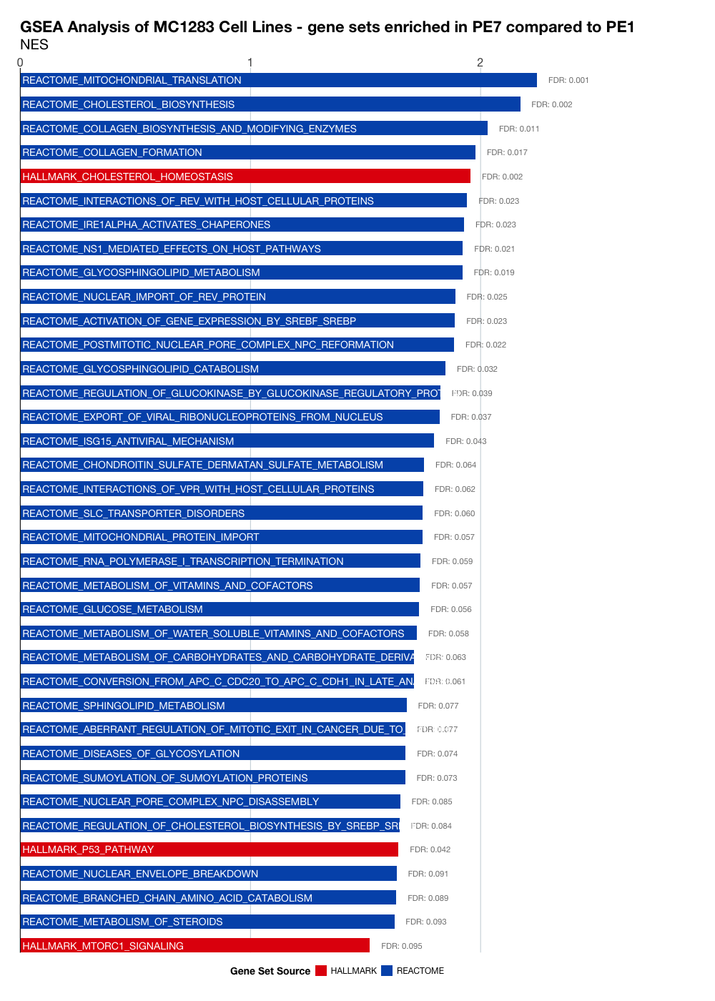
Supplemental Figure 7. GSEA HALLMARK and REACTOME analysis of MC1286PE3 compared to MC1286PE1 (left) and MC1286PE7 compared to MC1286PE1 (right).
Notes:
Supplemental Figure 7. GSEA HALLMARK and REACTOME analysis of MC1286PE3 compared to MC1286PE1 (left) and MC1286PE7 compared to MC1286PE1 (right).

