Slide 1
Fig. S1 For legend see next page.

Slide 2
Fig. S1 Expansion process validation. a Cell count (left) and adhesion rate (right) in primary cell culture after collagenase digestion of the corneal rims from 13 donors. b Cell count (left) and adhesion rate (right) in primary cell culture are independent from donor age (above) and tissue storage time (i.e. time between death of the donor and digestion of the corneal rim) (below). c Cell count of ABCB5^{high} cells (measured by flow cytometry), shown as proportion of cultured unsegregated cells of various passages from 9 donors (represented by different colors). d Mean (± SD) percentage of ABCB5^{med/high} cells (measured by flow cytometry) in unsegregated cell cultures during 14 passages (n=1–10 donors per passage), revealing a significant decrease after passage 10.

Slide 3
Fig. S2 Growth behavior of ABCB5⁺ limbal stem cells during culture. Cells from four donors were labeled with carboxyfluorescein diacetate succinimidyl ester (CFSE), and CFSE fluorescence (middle row) measured over time in parallel with cell count (top row) and confluence (bottom row).

Slide 4
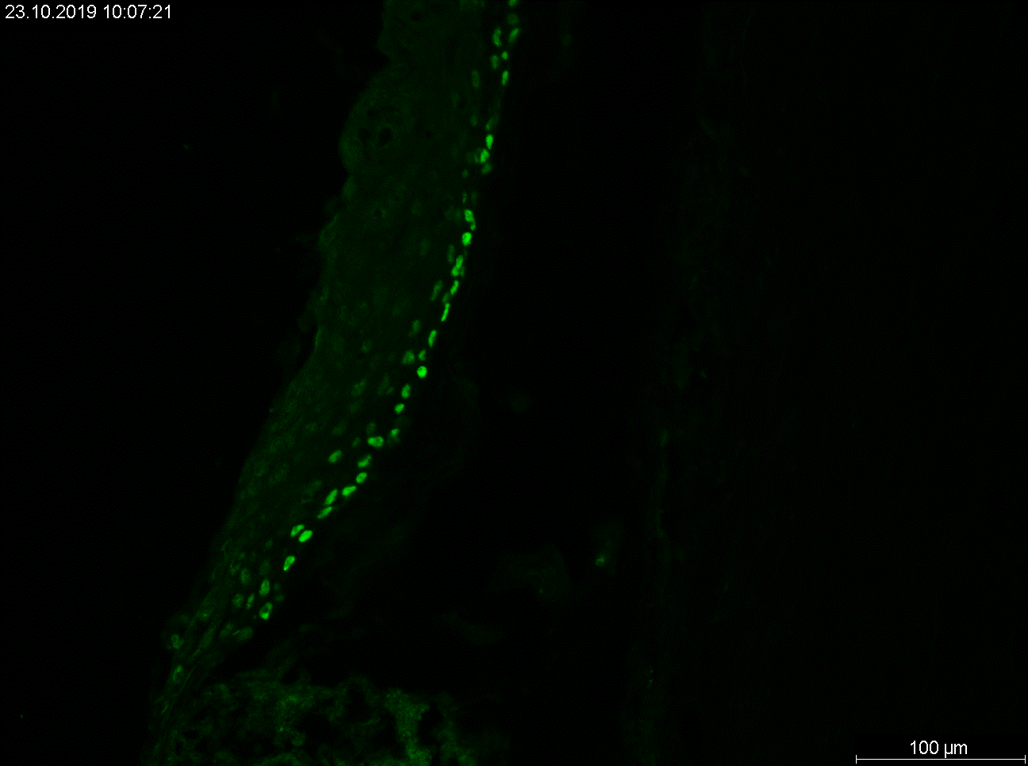
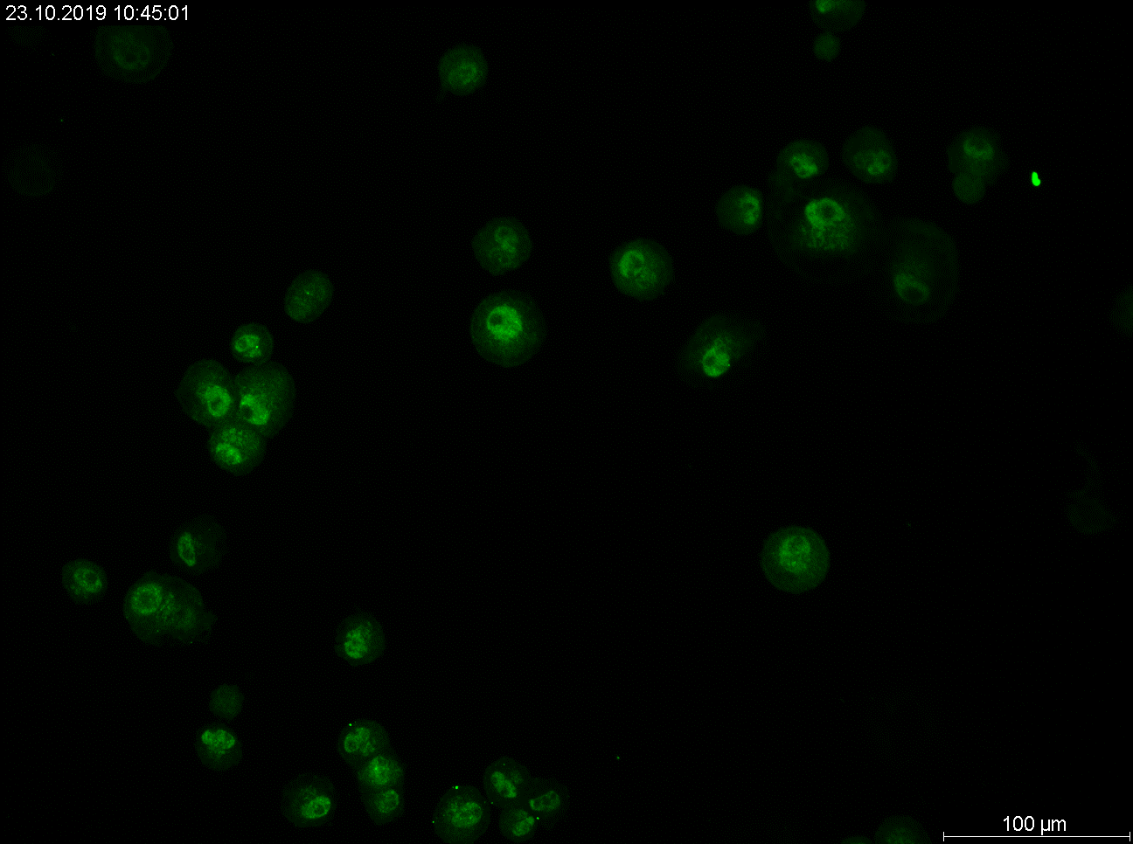
p63
DAPI
Limbus
p63
DAPI
ABCB5⁺ LSCs
Fig. S3 Immunohistochemical staining of human corneal rim cryosections for ΔNp63α (above), revealing positivity in a cell fraction in the limbal region. Immunofluorescence staining of bead-isolated ABCB5⁺ cells for ΔNp63α (below). Nuclei were counterstained with DAPI. Scale bar: 100 µm.

