Slide 1
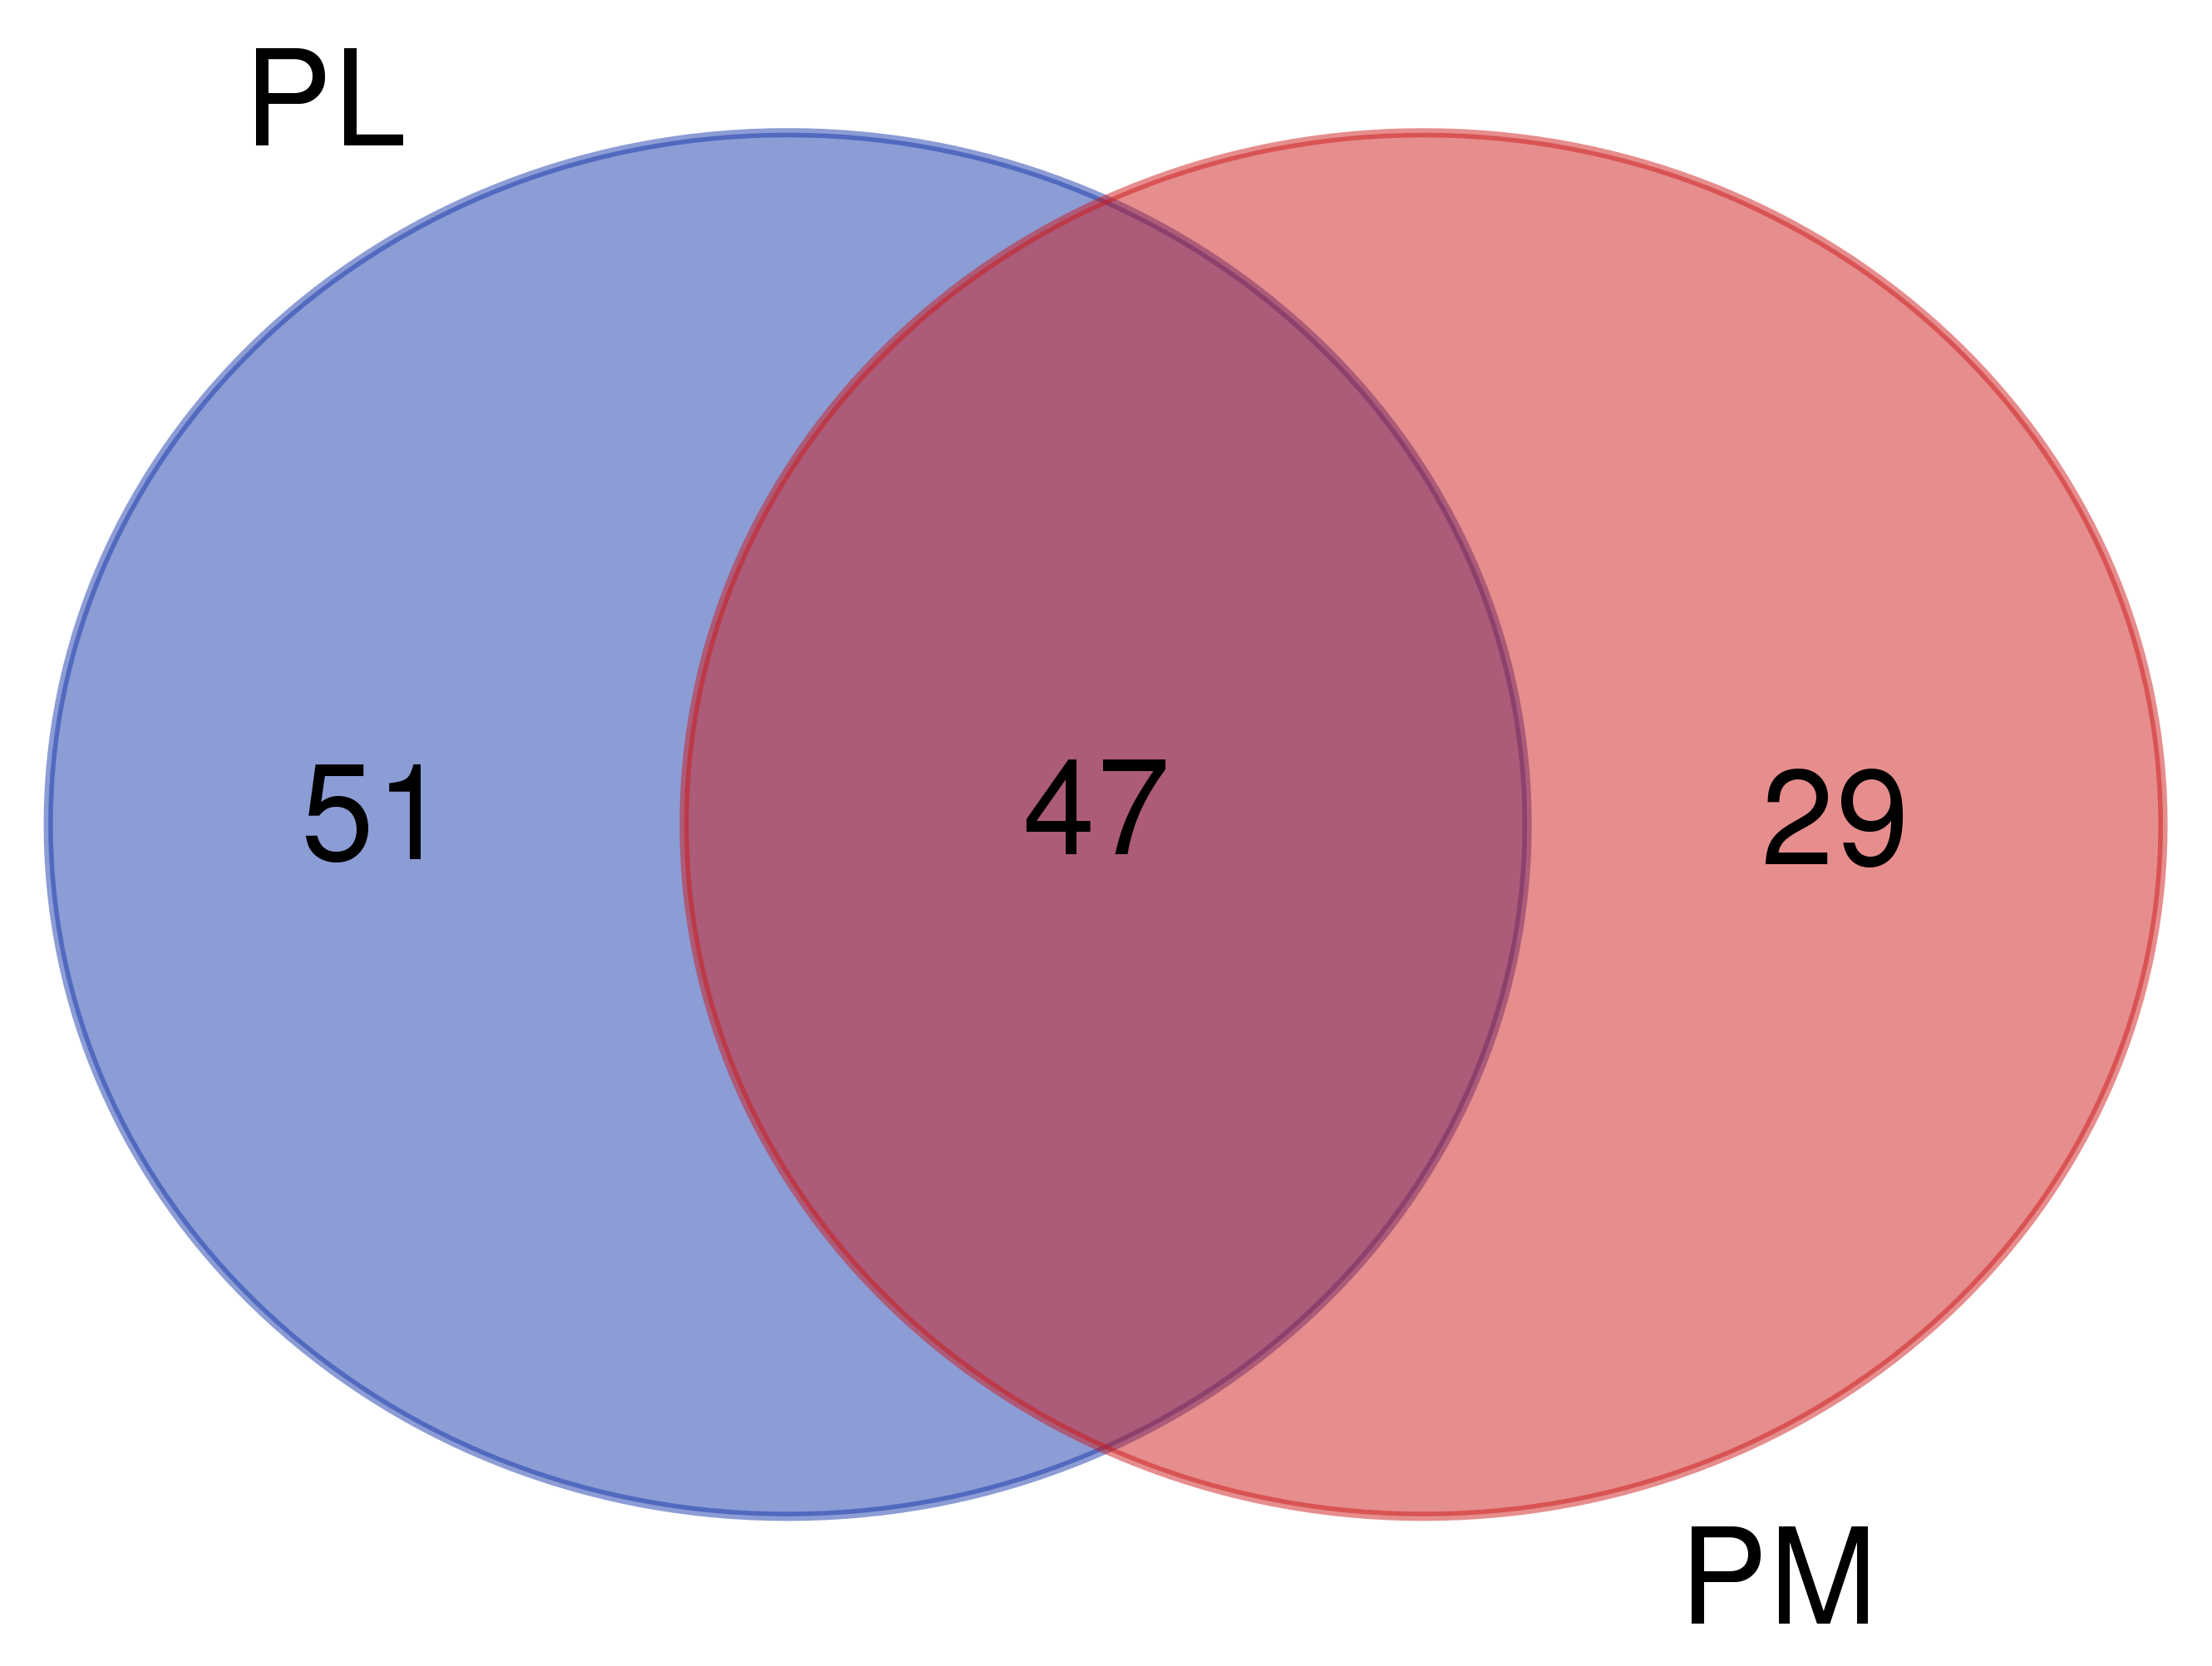
YMT
OMT
Figure S1. Venn Diagram of shared and distinct genera in YMT and OMT samples from mine tailings.

Slide 2
Table S1. Genera shared between YMT and OMT conditions, and those found only in YMT or OMT samples.
Condition | Number of genera | Genera
YMT & OMT | 47 | Thiobacillus, Novosphingobium, Thermithiobacillus, Reyranella, Georgenia, Pseudohongiella, Sphingomonas, Thioalkalimicrobium, Streptomyces, Limnobacter, Pseudomonas, Psychrobacter, Sphingopyxis, Alteromonas, Hydrogenophaga, Blastococcus, Lentibacter, Micromonospora, Pseudarthrobacter, Roseibacillus, Iamia, Planktomarina, Galbitalea, Ascidiaceihabitans, Sulfurifustis, Microbacterium, Kribbella, Lysobacter, Formosa, Nocardioides, Algoriphagus, Cyanobium_PCC-6307, Promicromonospora, Qipengyuania, Woeseia, Phenylobacterium, Thiovirga, Marinimicrobia_(SAR406_clade), Enterobacter, Devosia, Methylobacterium-Methylorubrum, Methylophaga, Bradyrhizobium, Synechococcus_CC9902, Pseudonocardia, Conexibacter, Gaiella.
YMT | 51 | Slackia, Bifidobacterium, Ochrobactrum, Amphiplicatus, Coxiella, Alcanivorax, Tabrizicola, Brevundimonas, Marinilactibacillus, Phascolarctobacterium, Paenibacillus, Pedomicrobium, Blastopirellula, Acidovorax, Oleibacter, Lentimonas, Altererythrobacter, Thauera, Aquabacterium, Bradymonadales, Roseburia, Rubripirellula, Acinetobacter, Ralstonia, Pelomonas, Tolumonas, Sphingorhabdus, Methylotenera, Herminiimonas, Silanimonas, Aquamicrobium, Agathobacter, Prevotella, Rubrobacter, Cavicella, Coraliomargarita, Faecalibacterium, Nereida, Halomonas, Stenotrophomonas, Dietzia, Arenimonas, Butyrivibrio, Microvirgula, Bacillus, Collinsella, Colwellia, Leptospira, Knoellia, Luteimonas, Blautia.
OMT | 29 | Schlesneria, Pseudolabrys, Bryobacter, Saccharomonospora, Demequina, Afipia, Marinoscillum, Pedobacter, Marmoricola, Nitrosomonas, Mesorhizobium, Angustibacter, Sphingobium, Hoeflea, Variovorax, Nitrospira, Anaerostipes, Ensifer, Solirubrobacteraceae, Vibrio, Agrococcus, Fluviicola, Actinomadura, Halothiobacillus, Parviterribacter, Agromyces, Ferrovibrio, Rheinheimera, Bosea.

Slide 3
Table S2. Bacterial genera with an effect in shaping the bacterial community of tailings of 1.5 yeasr of age (PL) versus those of 5 (PM) years of age. The effect size was calculated using a compositional approach (through ALDEx2 package).
Genus | Effect size | Expected P value of Welch´s test
Hydrogenophaga | -9.847744142 | 0.000646344
Pseudomonas | -3.87973247 | 0.01796245
Enterobacter | -3.379993184 | 0.008120655
Acidovorax | -3.293371677 | 0.031555225
Dietzia | -2.698801571 | 0.042937055
Cavicella | -2.647306011 | 0.043659306
Acinetobacter | -2.575234543 | 0.0425731
Knoellia | -2.548373781 | 0.044214984
Silanimonas | -2.442347732 | 0.043461477
Bosea | 2.516245278 | 0.0477055
Halothiobacillus | 3.005360637 | 0.034940252
Nocardioides | 3.037901751 | 0.027096425
Parviterribacter | 3.129614003 | 0.03329966
Pedobacter | 3.301536836 | 0.033040886
Marmoricola | 3.491432643 | 0.02630318
Sulfurifustis | 6.025110696 | 0.01089433
Kribbella | 8.27205011 | 0.002598011

Slide 4
Table S3. Putative functional traits with an effect in the bacterial community of tailings of 1.5 yeasr of age (PL) versus those of 5 (PM) years of age. The effect size was calculated using a compositional approach (through ALDEx2 package).
Putative functional trait | Effect size | Expected P value of Welch´s test
Dark hydrogen oxidation | -7.96628902 | 0.00140226
Methylotrophy | -4.36230716 | 0.00679294
Methanol oxidation | -4.27978403 | 0.00694717
Mammal gut | -2.89192991 | 0.01296652
Human gut | -2.85605093 | 0.01294807
Human associated | -2.79241063 | 0.01456407
Animal parasites or symbionts | -2.75380967 | 0.0144692
Nitrate reduction | -2.71235154 | 0.0462352
Dark thiosulfate oxidation | 3.06608374 | 0.03243077
Dark sulfur oxidation | 3.33509151 | 0.03254565
Aromatic compound degradation | 3.68024985 | 0.01908574

