Slide 1
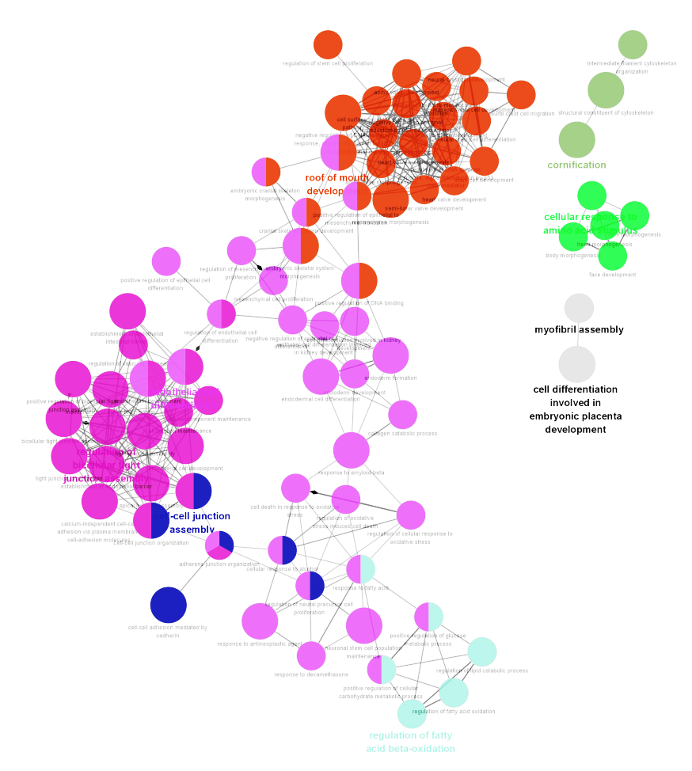
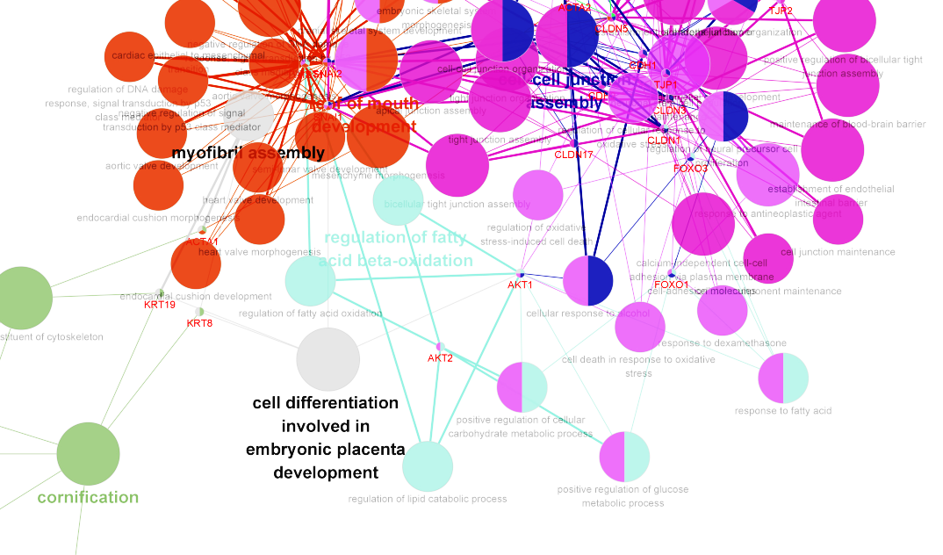
Fig.1 The possible relationship between Akt1 and starvation analyzed by software
A
EMT related
Starvation related
B
1 Oxidative stress-induced cell death
2 Glucose metabolic process
3 Carbohydrate metabolic process
4 Fatty acid beta-oxidation
5 Fatty acid oxidation
6 Lipid catabolic process
7 Response to fatty acid

Slide 2
Fig. 2 The function of EMT in PCa cells and PCa –CTCs
Loss junction
NST
EMT
Meshenchymal
Epithelial
Akt1
Motility
NST
CTCs
Circulation
Akt1
CTCs
Caspase-3
NST+Akt1
Snail
Apoptosis
Meshenchymal++
In vivo

