Slide 1

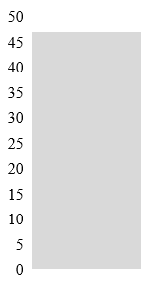

Supplemental Figure. 1
Frequency
Duration of physical restraint (h)
1
12
24
36
47
No
physical restraint
Intermittent
physical restraint
Continuous
physical restraint

