Slide 1
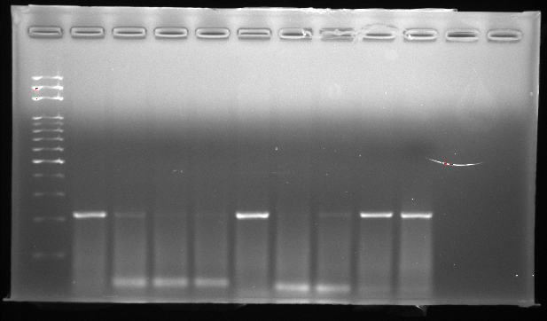
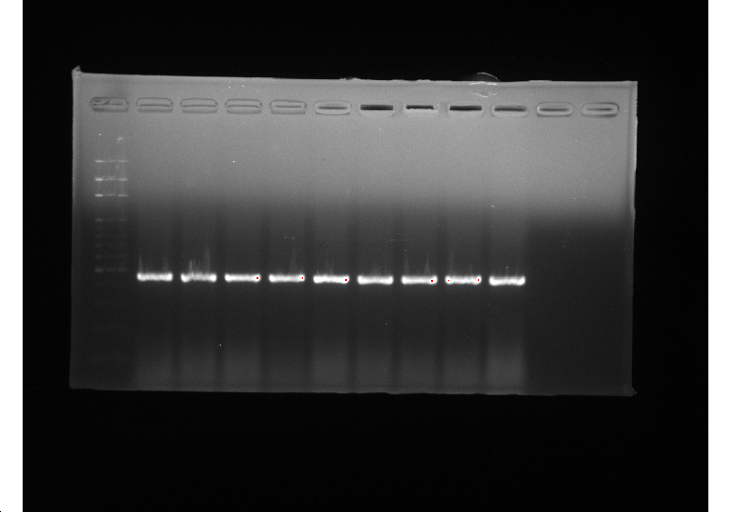
Fig. 1a
Hep3B
HT-29
HepG2
UCP2
Hep3B
HT-29
HepG2
GAPDH

Slide 2
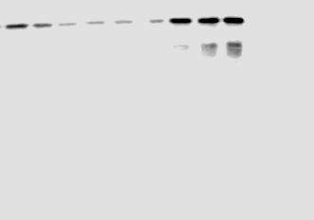
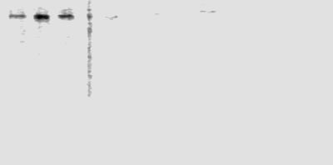

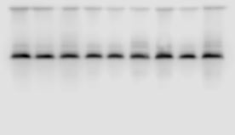

Fig. 2a
Hep3B Cells
Control
5 μM
10 μM
h
24
48
72
24
48
72
24
48
72
UCP2
Control
5 μM
10 μM
24
48
72
24
48
72
24
48
72
h
DNMT 1
Control
5 μM
10 μM
24
48
72
24
48
72
24
48
72
h
DNMT 3a
Control
5 μM
10 μM
24
48
72
24
48
72
24
48
72
h
$β−$actin

Slide 3
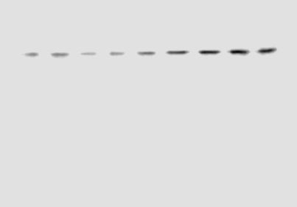

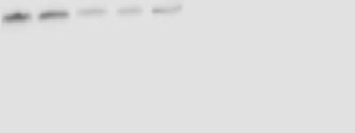
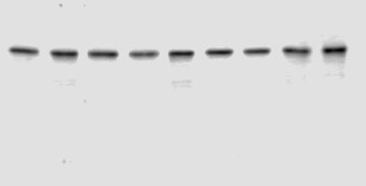

Fig. 3a
HT-29 Cells
Control
5 μM
10 μM
h
24
48
72
24
48
72
24
48
72
UCP2
Control
5 μM
10 μM
24
48
72
24
48
72
24
48
72
h
DNMT 1
Control
5 μM
10 μM
24
48
72
24
48
72
24
48
72
h
DNMT 3a
Control
5 μM
10 μM
24
48
72
24
48
72
24
48
72
h
$β−$actin

Slide 4
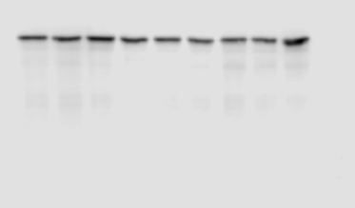

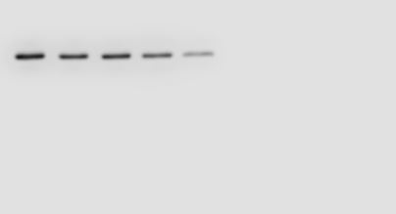
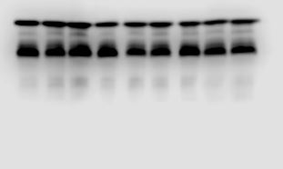

Fig. 4a
HepG2 Cells
Control
5 μM
10 μM
h
24
48
72
24
48
72
24
48
72
UCP2
Control
5 μM
10 μM
24
48
72
24
48
72
24
48
72
h
DNMT 1
Control
5 μM
10 μM
24
48
72
24
48
72
24
48
72
h
DNMT 3a
Control
5 μM
10 μM
24
48
72
24
48
72
24
48
72
h
$β−$actin

Slide 5
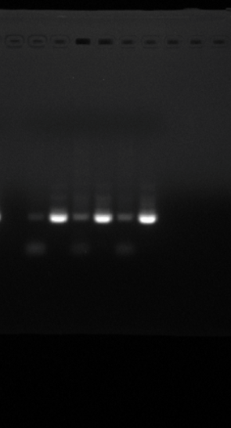
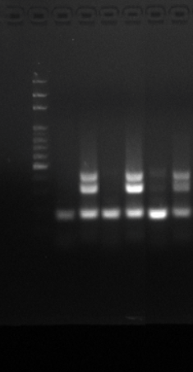
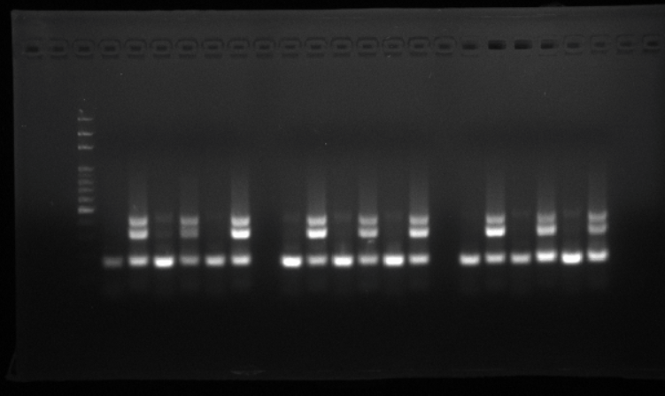
Fig. 5
a
b
c
UCP2
UCP2
UCP2
5 μM
Control
10 μM
10 μM
10 μM
Control
5 μM
U
Control
5 μM
U
M
M
U
U
M
U
M
M
U
U
M
U
M
M
U
M
Hep3B
HT-29
HepG2

