Slide 1
48 hr
72 hr
Supplemental Figure 1. Effect of Sapanisertib vs. Torin2 in growth of index DLBCL cell lines; (WSU)-DLCL2, (WSU)-DLCL2-PR, TMD8, and JP). Results of MTT conversion assay with the four DLBCL-patient derived cell lines after 48-hour and 72-hour incubation in vehicle (DMSO) or the depicted concentrations of Sapaniseritinib. Torin2, applied at matching concentrations, served as a control.

Slide 2
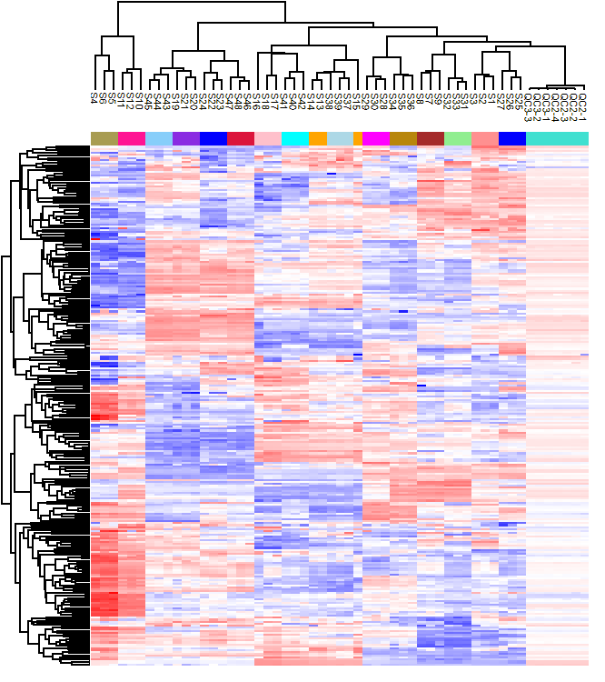
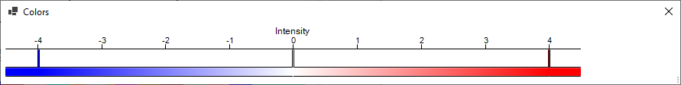
Supplemental Figure 2.
Summary of the metabolomic analysis of the four index DLBCL cell lines: (WSU)-DLCL2, (WSU)-DLCL2-PR, TMD8, and JP).
LCMS# | Sample
S1 | DLCL2_Ctrl_12h
S2 | DLCL2_Ctrl_12h
S3 | DLCL2_Ctrl_12h
S4 | DLCL2_Torin_12h
S5 | DLCL2_Torin_12h
S6 | DLCL2_Torin_12h
S7 | DLCL2-PR_Ctrl_12h
S8 | DLCL2-PR_Ctrl_12h
S9 | DLCL2-PR_Ctrl_12h
S10 | DLCL2-PR_Torin_12h
S11 | DLCL2-PR_Torin_12h
S12 | DLCL2-PR_Torin_12h
S13 | DLCL2_Ctrl_24h
S14 | DLCL2_Ctrl_24h
S15 | DLCL2_Ctrl_24h
S16 | DLCL2_Torin_24h
S17 | DLCL2_Torin_24h
S18 | DLCL2_Torin_24h
S19 | DLCL2-PR_Ctrl_24h
S20 | DLCL2-PR_Ctrl_24h
S21 | DLCL2-PR_Ctrl_24h
S22 | DLCL2-PR_Torin_24h
S23 | DLCL2-PR_Torin_24h
S24 | DLCL2-PR_Torin_24h
S25 | JP_Ctrl_12h
S26 | JP_Ctrl_12h
S27 | JP_Ctrl_12h
S28 | JP_Torin_12h
S29 | JP_Torin_12h
S30 | JP_Torin_12h
S31 | TMD8_Ctrl_12h
S32 | TMD8_Ctrl_12h
S33 | TMD8_Ctrl_12h
S34 | TMD8_Torin_12h
S35 | TMD8_Torin_12h
S36 | TMD8_Torin_12h
S37 | JP_Ctrl_24h
S38 | JP_Ctrl_24h
S39 | JP_Ctrl_24h
S40 | JP_Torin_24h
S41 | JP_Torin_24h
S42 | JP_Torin_24h
S43 | TMD8_Ctrl_24h
S44 | TMD8_Ctrl_24h
S45 | TMD8_Ctrl_24h
S46 | TMD8_Torin_24h
S47 | TMD8_Torin_24h
S48 | TMD8_Torin_24h

Slide 3
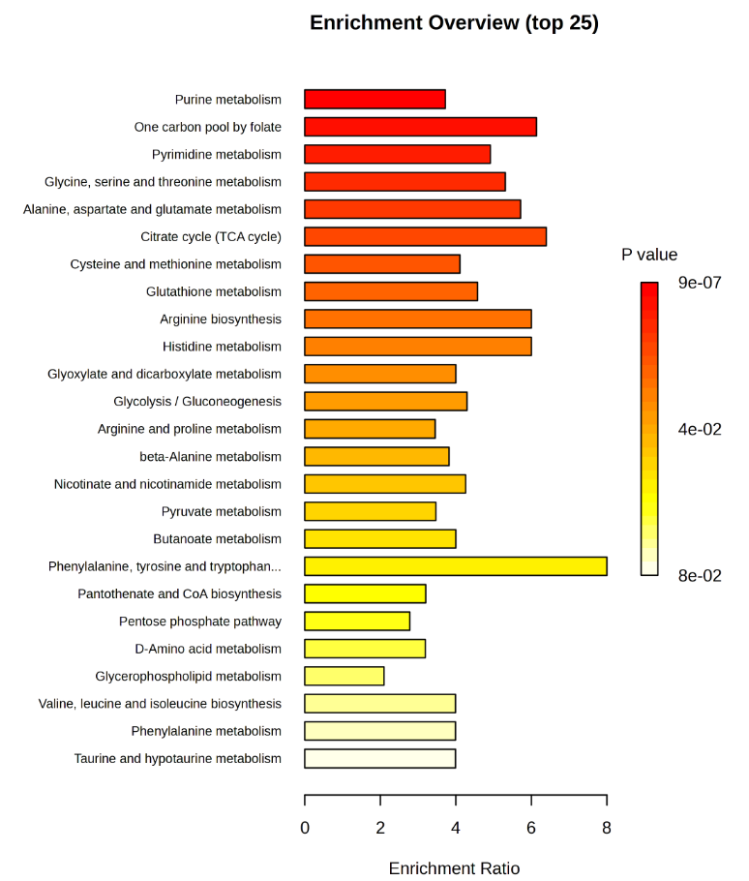
Supplemental Figure 3. mTOR-mediated regulation of cell metabolism. Key metabolic pathways modulated in WSU-DLCL2 cells upon their 24 hr exposure to Torin2 vs. drug vehicle, detected by whole transcriptome RNA Sequencing and Hallmark pathways analysis program.

Slide 4
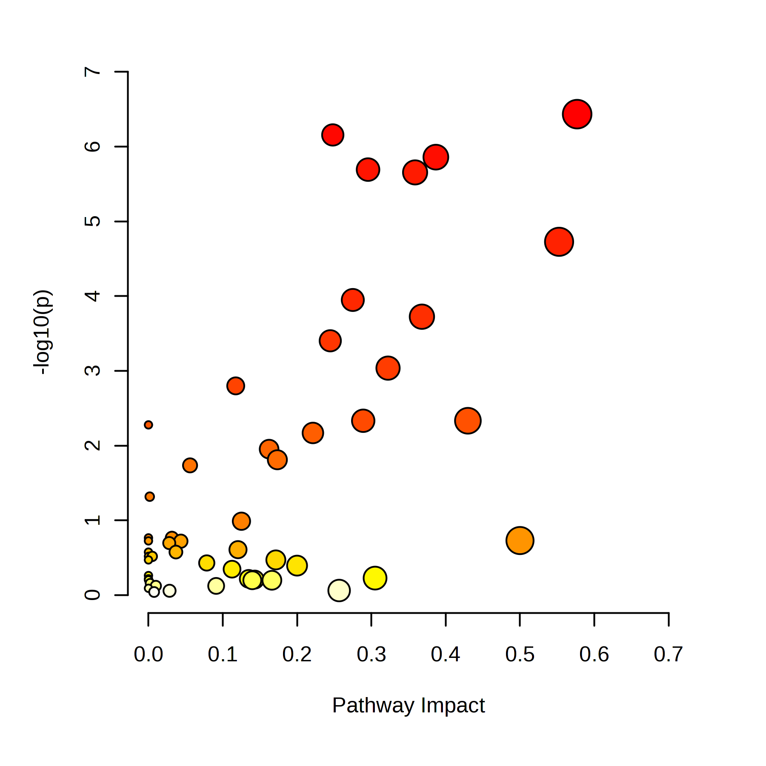
Alanine, aspartate and
glutamate metabolism
Purine metabolism
Alanine, aspartate and
glutamate metabolism
GDP;
5-Phospho-alpha-D-ribose 1-diphosphate;
AMP;
Adenosine;
dAMP;
Deoxyinosine;
Xanthosine;
GMP;
Hypoxanthine;
Inosine;
Guanine;
GTP;
alpha-D-Ribose 1-phosphate;
Adenine;
dATP;
N-Acetyl-L-aspartate;
L-Aspartate;
L-Asparagine; D-Aspartate;
N-(L-Arginino)succinate;
L-Glutamate;
Citrate;
Pyruvate;
Succinate;
2-Oxoglutarate;
D-Glucosamine 6-phosphate;
Purine metabolism
One carbon pool by folate
Pyrimidine metabolism
Citrate cycle (TCA cycle)
Glycine, serine, and
threonine metabolism
Glycolysis
Pyrimidine metabolism
UDP
Orotidine 5'-phosphate;
Uridine;
CMP;
dCMP;
Deoxycytidine;
dTDP;
dTMP;
Orotate;
5-Phospho-alpha-D-ribose 1-diphosphate;
Uracil;
Supplemental Figure 4. Impact of mTOR inhibition on cell metabolism. The depicted metabolic pathways and the related metabolites inhibited in (WSU)-DLCL2 cells exposed to Torin2 vs. drug vehicle for 12 hr. identified by LC-MS analysis and metabolome-targeting bioinformatics.

Slide 5
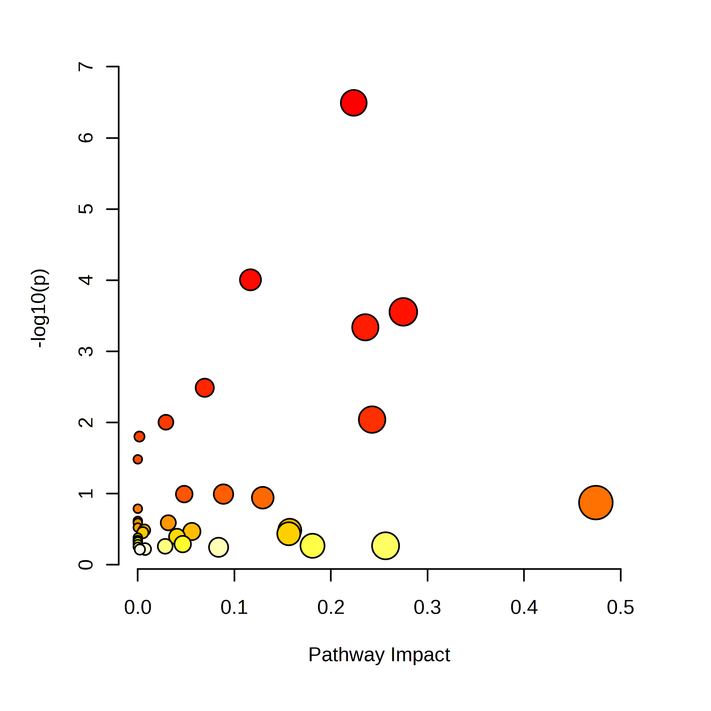
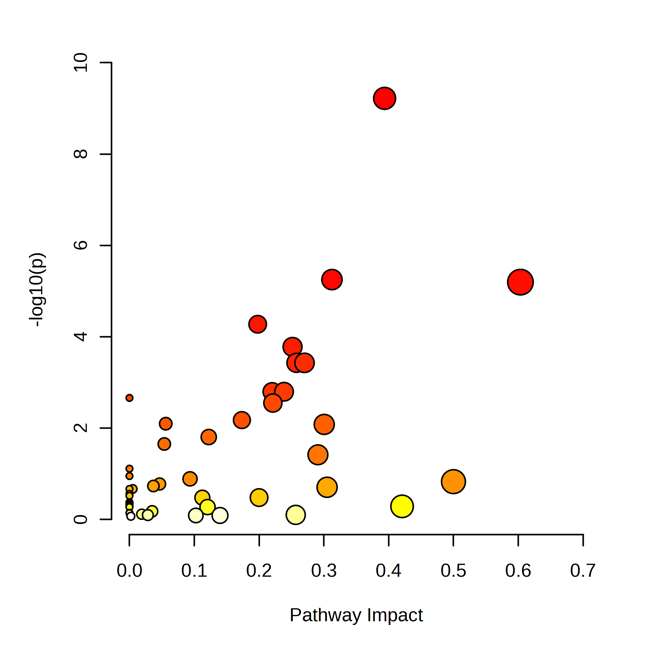
Pyrimidine metabolism
Pyrimidine metabolism
One carbon
pool by folate
Alanine, aspartate and
glutamate metabolism
Glyoxylate
metabolism
Citrate cycle (TCA cycle)
Citrate cycle (TCA cycle)
Purine metabolism
Alanine, aspartate and
glutamate metabolism
Glycolysis
Glycine, serine and
threonine metabolism
Supplemental Figure 5. Impact of mTOR inhibition on cell metabolism. The depicted metabolic pathways and the related metabolites inhibited in TMD8 cells exposed to Torin2 vs. drug vehicle for 12 hr (left panel) and JP cells treated with Torin2 vs. its vehicle for 24 hr (right panel), detected by LC-MS analysis and metabolome-targeting bioinformatics.

Slide 6
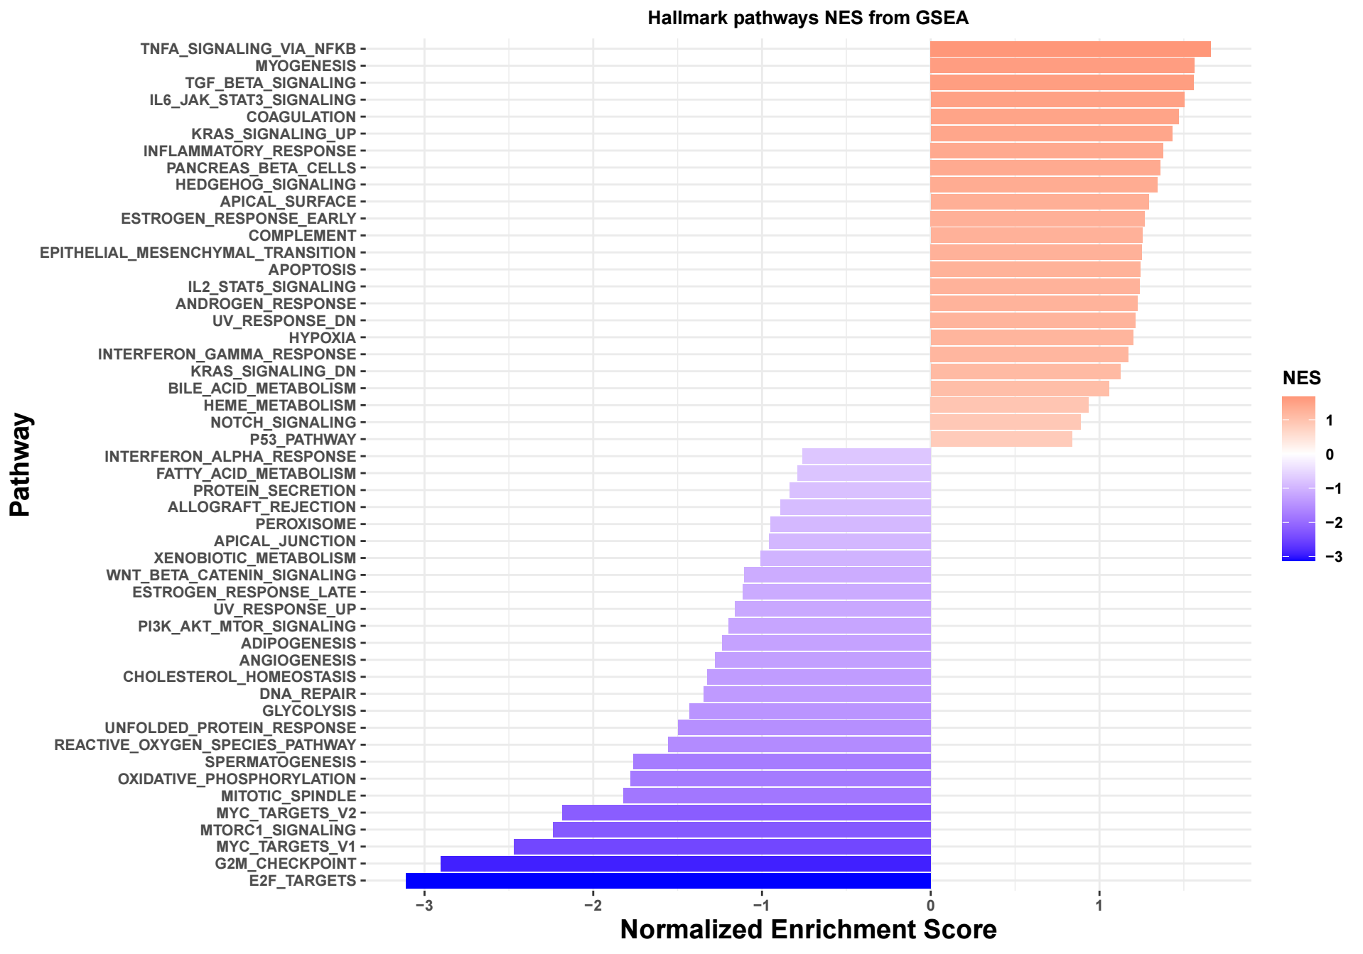
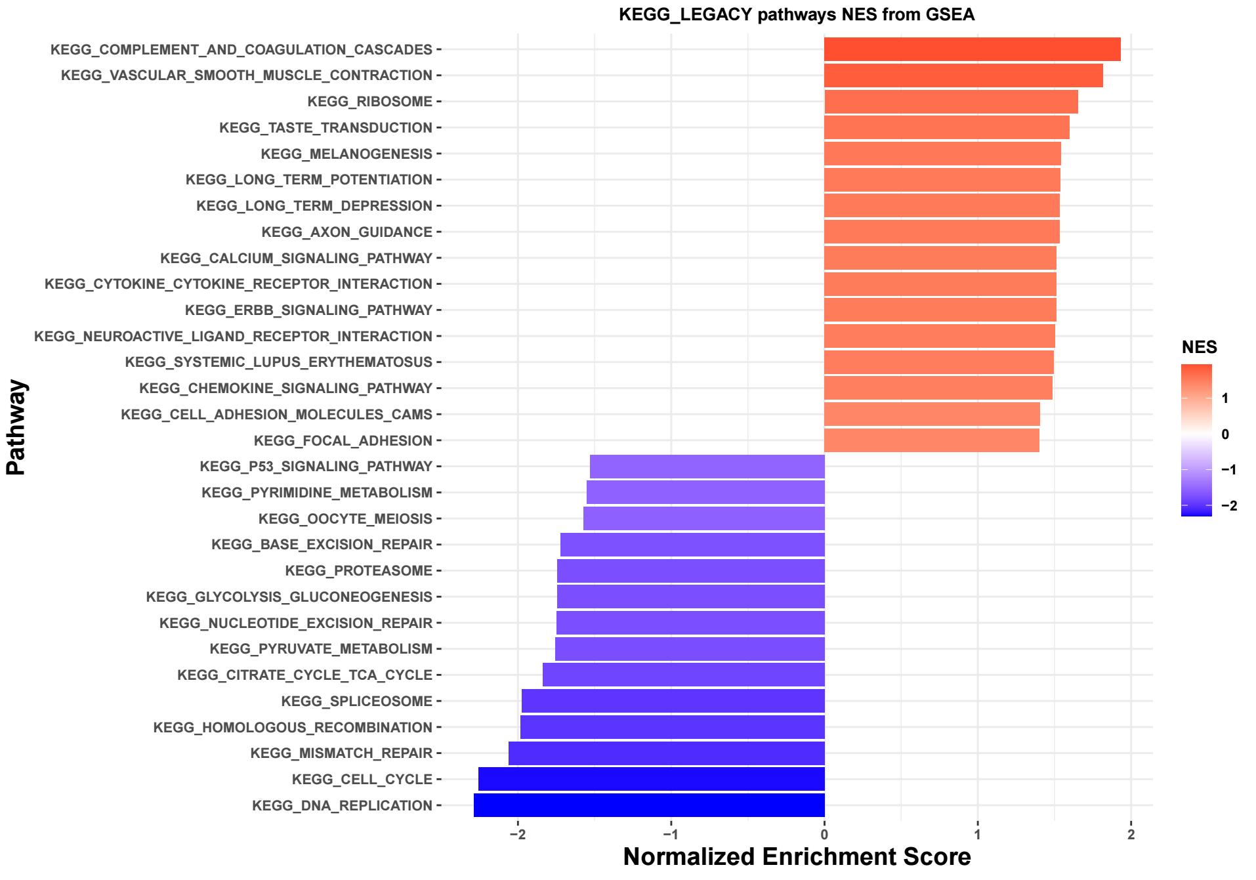
Supplementary Fig 6. Impact of mTOR inhibition on gene-expression profile. Key functional programs and pathways affected by exposure of DLCL2 cells to Torin2 for 24 hr, detected by whole transcriptome RNA sequencing, followed by Hallmark and KEGG pathways analyses.

Slide 7
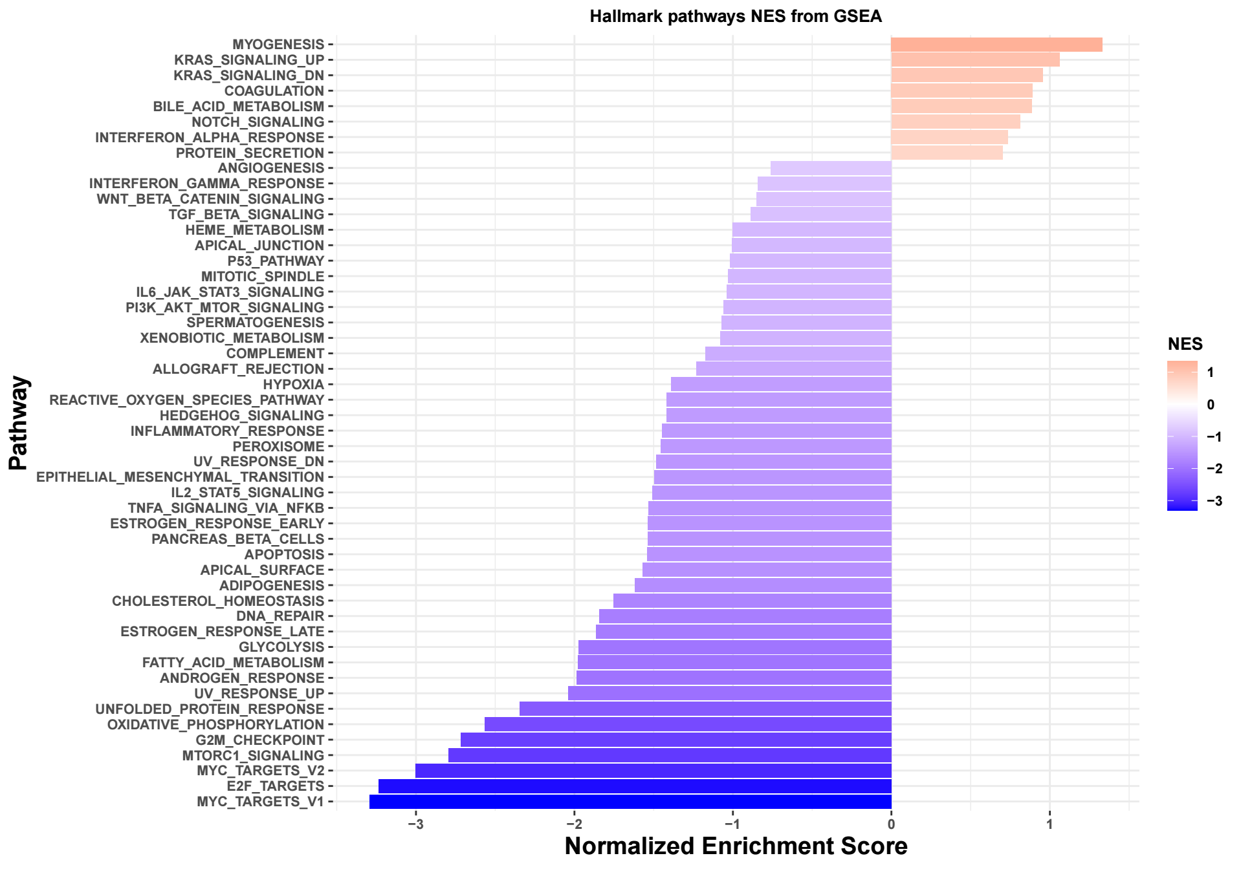
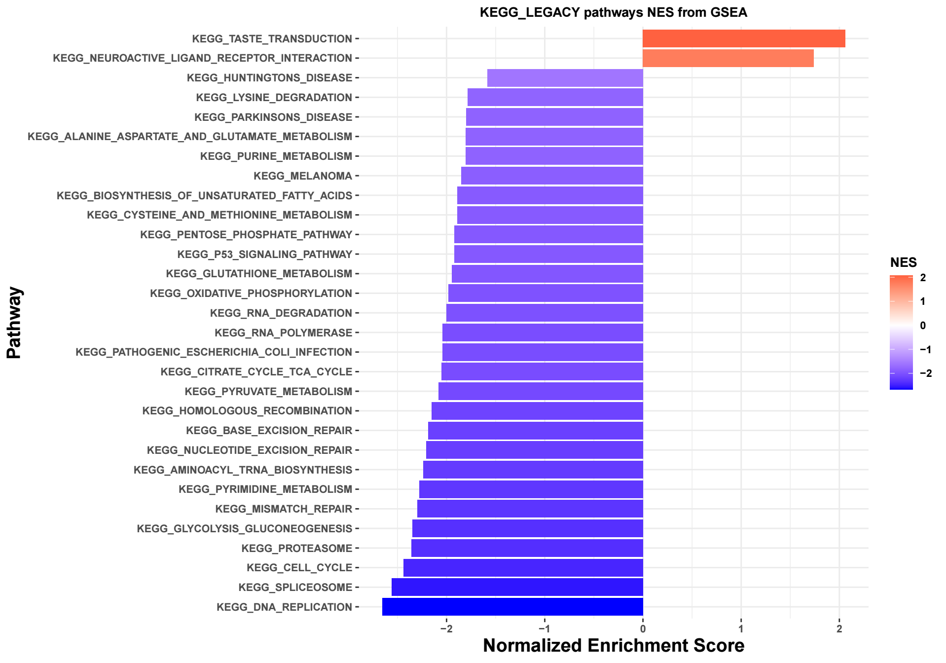
Supplementary Fig 7. Impact of mTOR inhibition on gene-expression profile. Key functional programs and pathways affected by exposure of TMD8 cells to Torin2 for 12 hr, detected by whole transcriptome RNA sequencing, followed by Hallmark and KEGG pathways analyses.

Slide 8
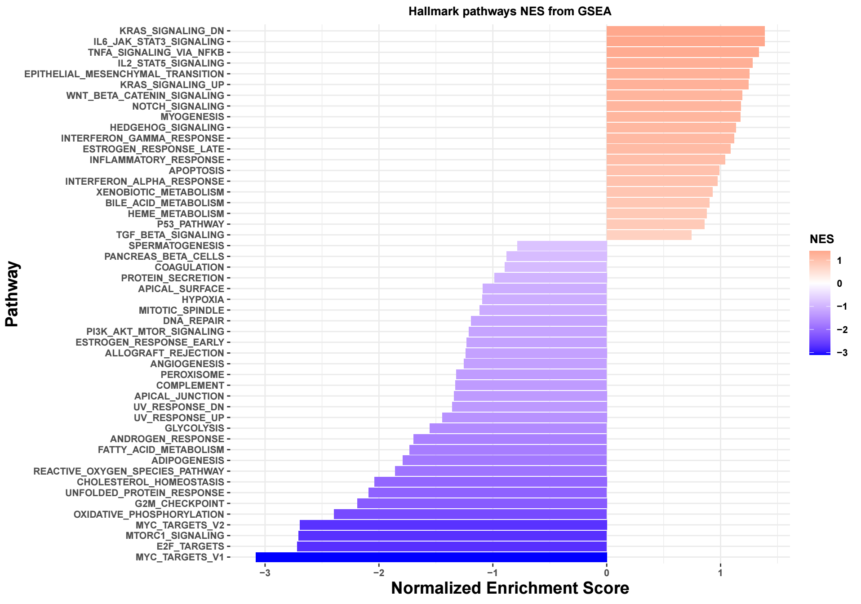
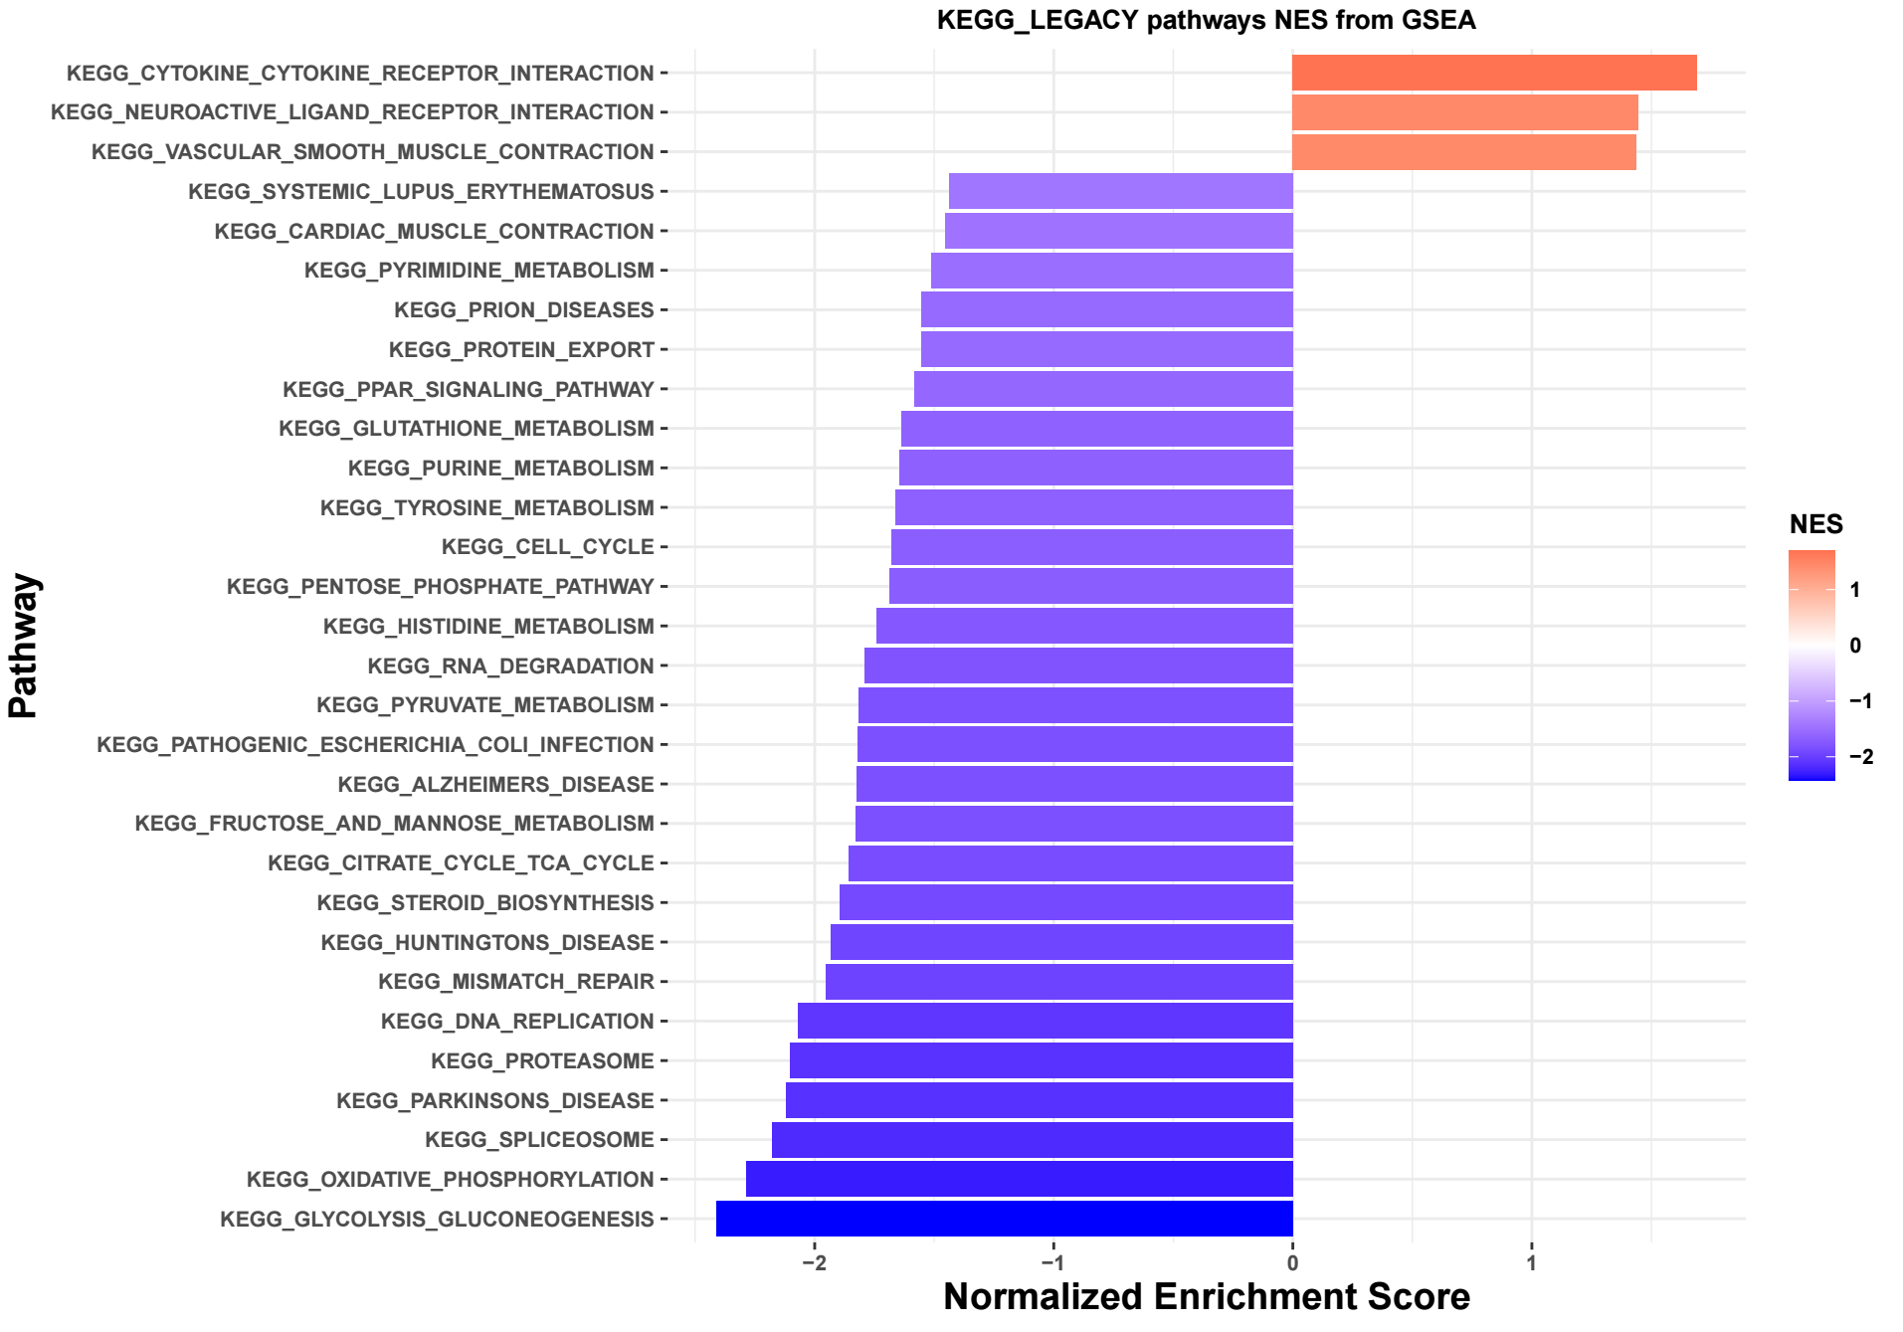
Supplementary Fig 8. Impact of mTOR inhibition on gene-expression profile. Key functional programs and pathways affected by exposure
of JP cells to Torin2 for 12 hr, detected by whole transcriptome RNA sequencing and followed by Hallmark and KEGG pathways analyses.

