Slide 1
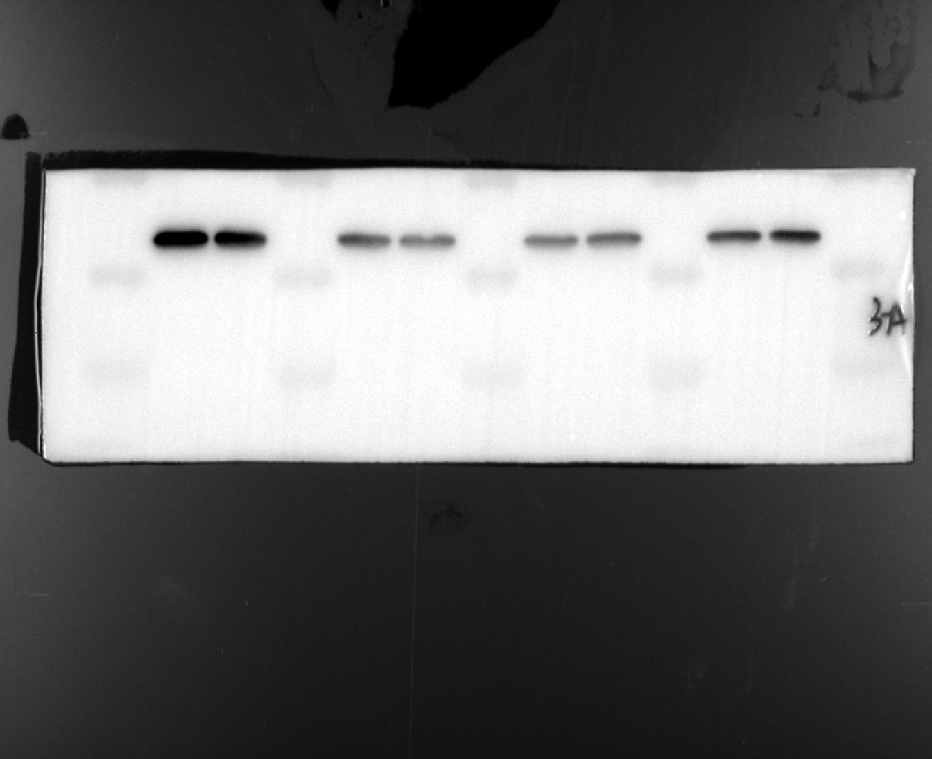
Supplemental Figure : full Western blots related to Figure 2D
Day 0
Day 3
Day 7
Day 14
180 kDa
RUX2 55 kDa
130 kDa
100 kDa
OSX 45 kDa
70 kDa
55 kDa
ALP 39 kDa
40 kDa
35 kDa
GAPDH 37 kDa
25 kDa
10-15 kDa

Slide 2
Supplemental Figure : full Western blots related to Figure 6A
Vinculin 124 kDa
P-JNK 54 kDa
JNK 54 kDa
P-Erk 42/44 kDa
Erk 42/44 kDa
P-P38 38 kDa
P38 38 kDa
180 kDa
130 kDa
100 kDa
70 kDa
55 kDa
40 kDa
35 kDa
25 kDa
10-15 kDa

Slide 3
Supplemental Figure : full Western blots related to Figure 6C
180 kDa
Vinculin 124 kDa
130 kDa
100 kDa
70 kDa
55 kDa
40 kDa
35 kDa
25 kDa
10-15 kDa
P-P38 38 kDa
P38 38 kDa

Slide 4
Supplemental Figure : full Western blots related to Figure 6F
180 kDa
Vinculin 124 kDa
130 kDa
100 kDa
RUX2 55 kDa
70 kDa
55 kDa
40 kDa
OSX 45 kDa
35 kDa
25 kDa
ALP 39 kDa
10-15 kDa

