Slide 1
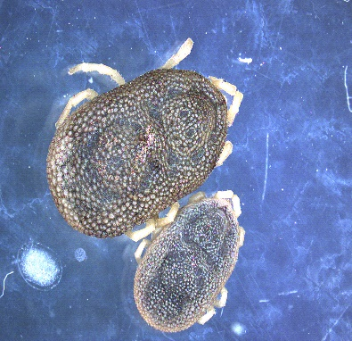
0
Female saliva
Female saliva
Male saliva
Ornithodoros erraticus
In-gel
digestion
In-solution
digestion
Female
gel slices
Female
pool
Male
pool
Female and male
individual samples
LC-MS/MS
SWATH-MS
Protein Pilot
Peak View
(Quantification)
Database search (Ornithodoros erraticus sialotranscriptome)
Proteomics informed by transcriptomics

