Slide 1
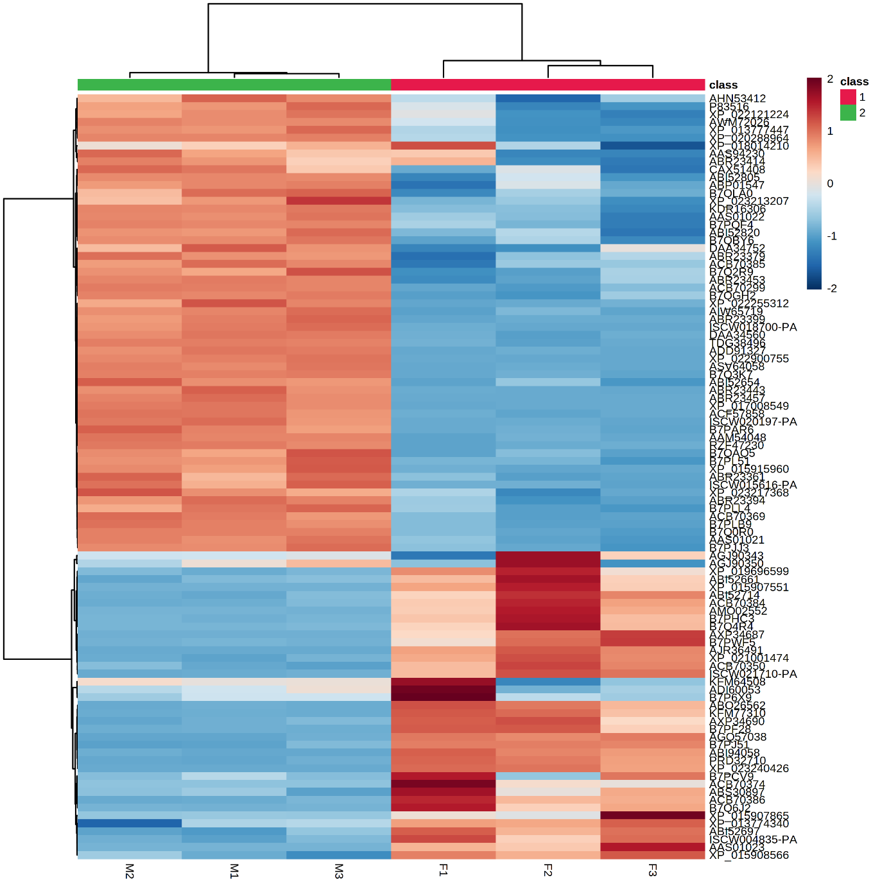
Additional file 6. Fig. S1. Heat map, showing levels of differentially expressed proteins (P < 0.05) among female and male biological replicated samples, and hierarchical clustering, showing two main clusters comprising F1–F3 samples and M1–M3 samples, corresponding to female and male saliva, respectively.

