Slide 1
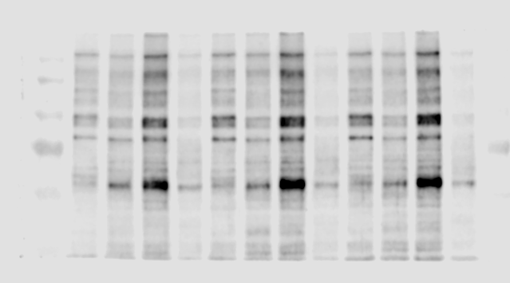
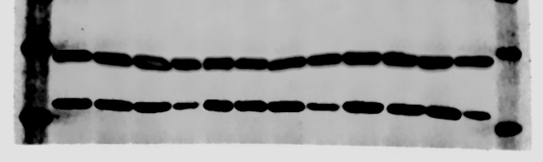
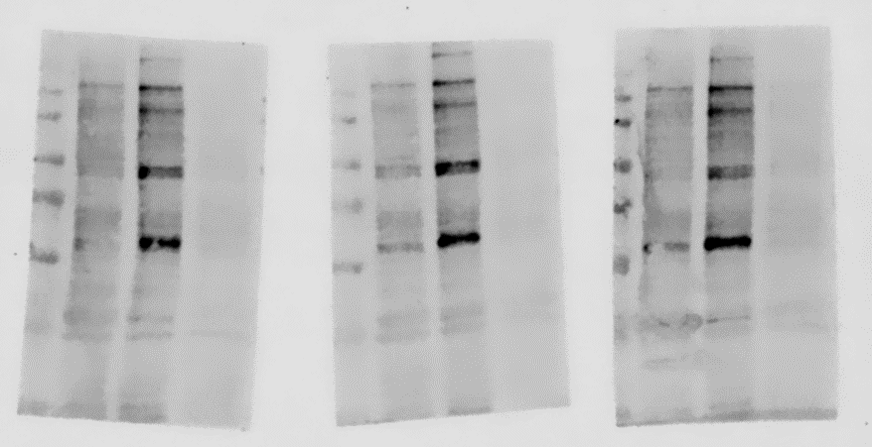
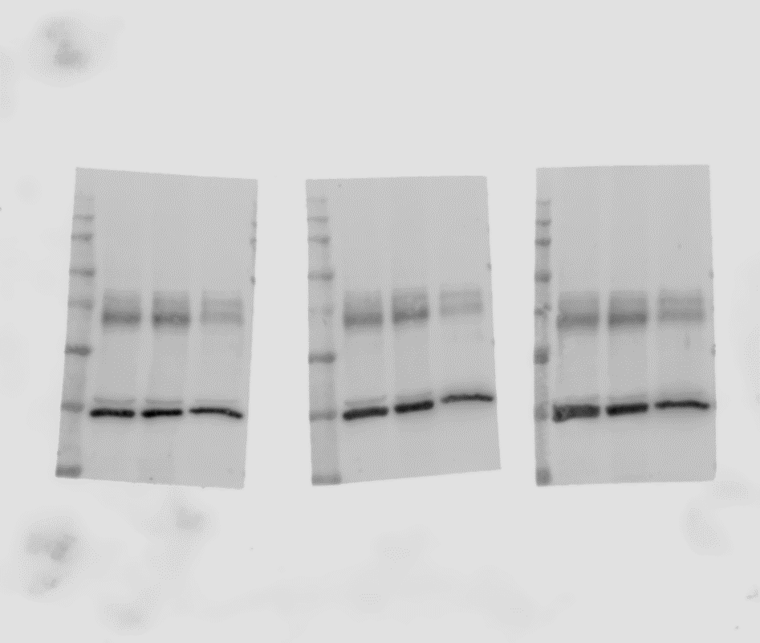
Figure. 1.
A
Expt. 1
Expt. 2
Expt. 3
O-GlcNAc
(RL2)
β-actin
C
Expt. 1
Expt. 2
Expt. 3
O-GlcNAc
(RL2)
β-actin

Slide 2
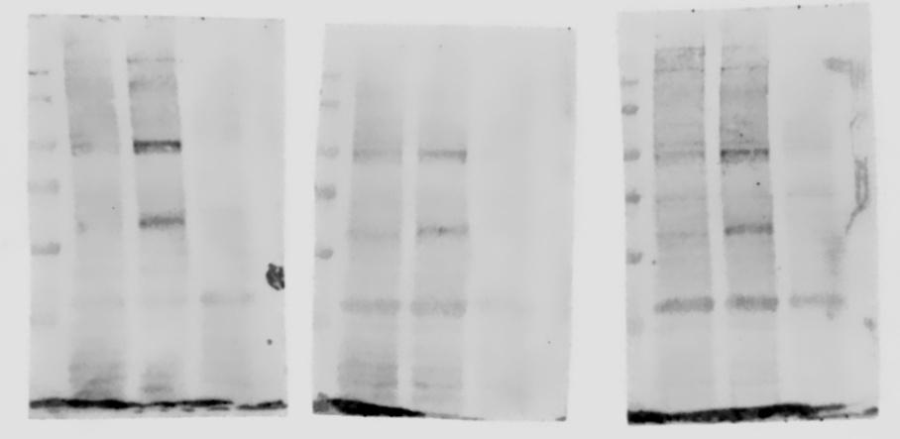
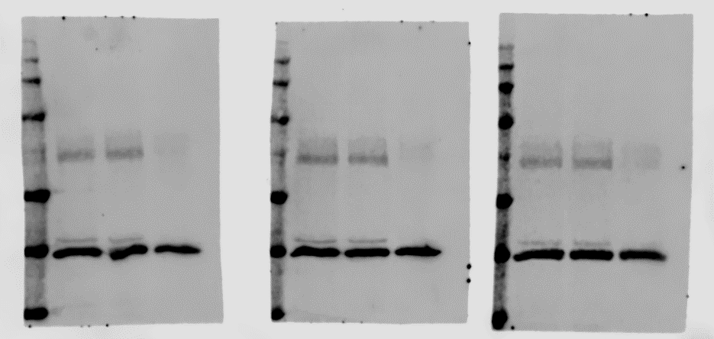
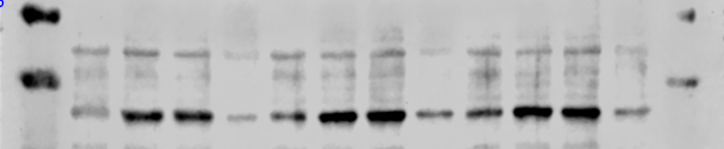
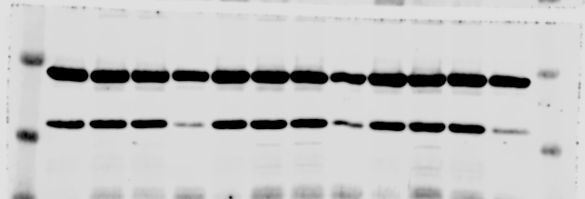
Figure. 1.
E
Expt. 1
Expt. 2
Expt. 3
O-GlcNAc
(RL2)
β-actin
Figure. 2.
B
Expt. 1
Expt. 2
Expt. 3
c-Myc
O-GlcNAc
(RL2)
β-actin

Slide 3
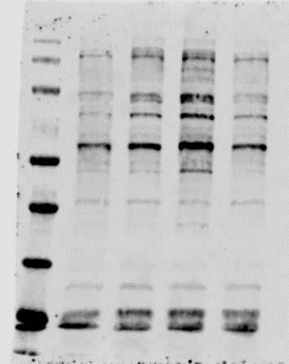
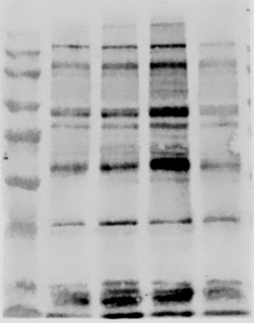
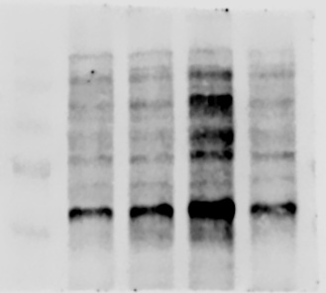
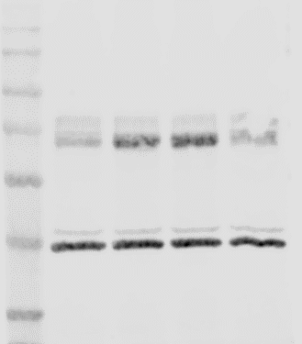
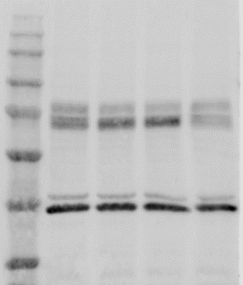
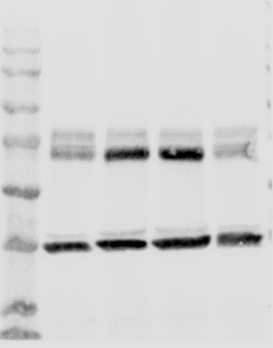
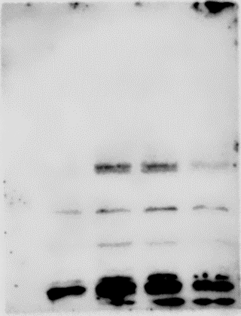
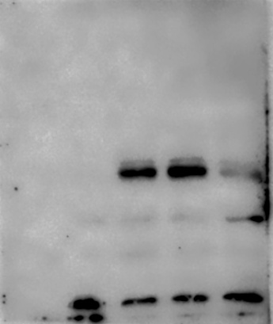
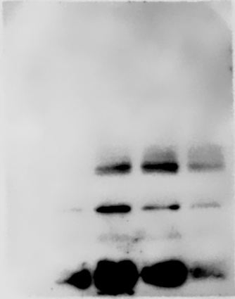
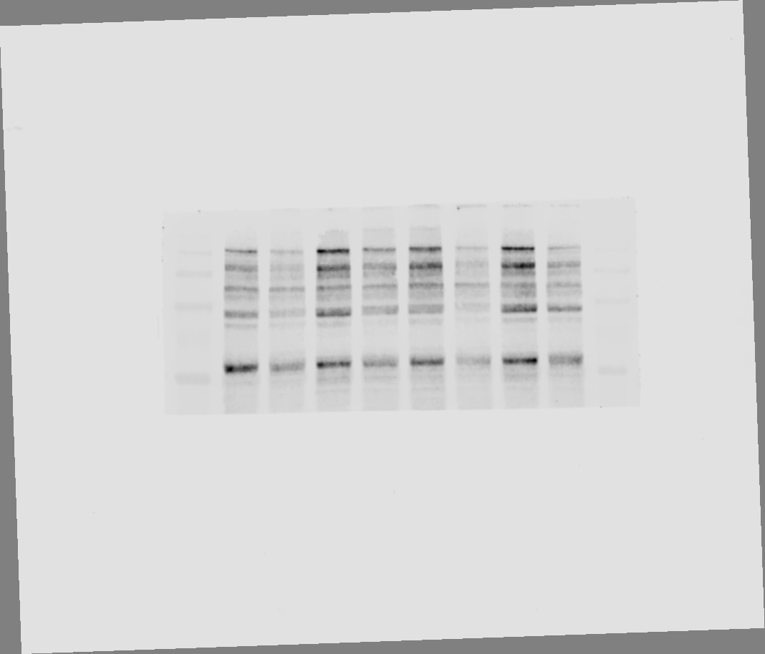
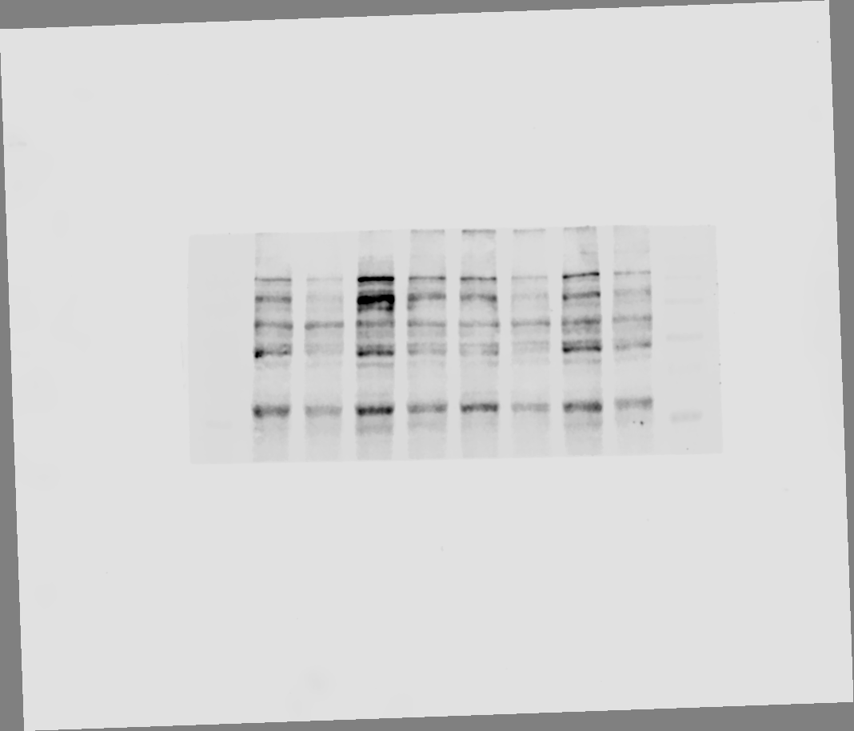
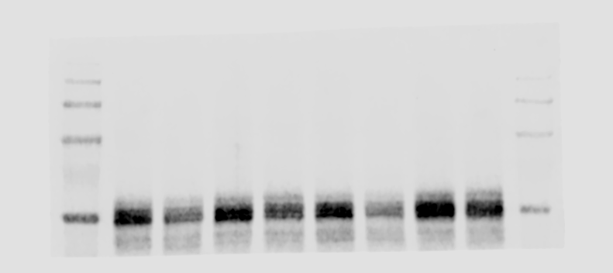
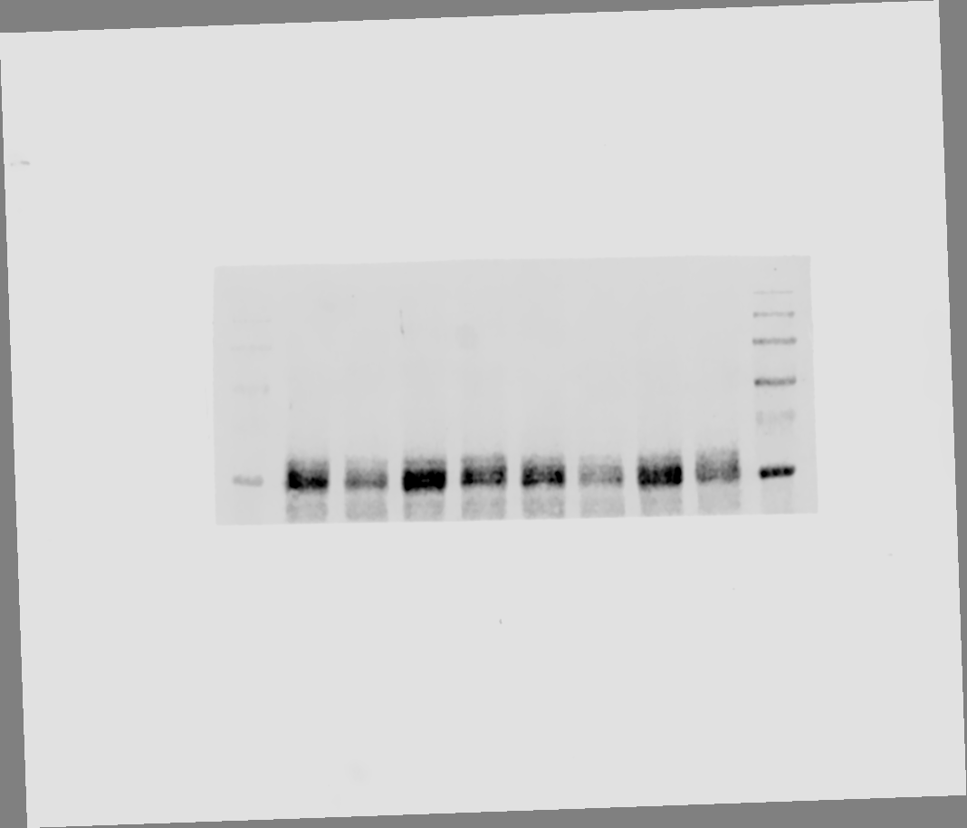
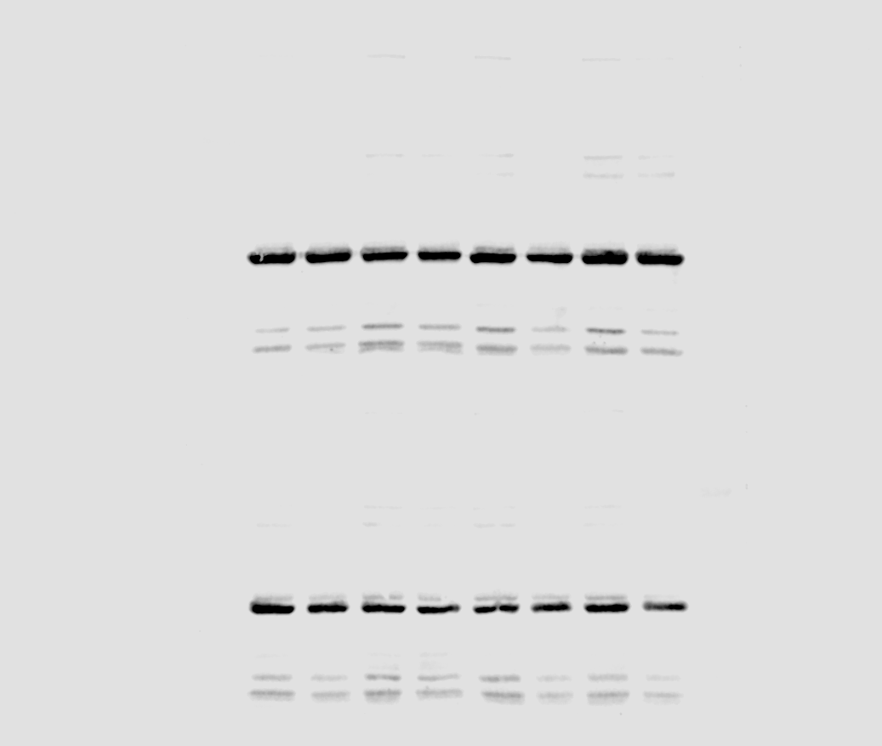
Figure. 3.
C
Expt. 1
Expt. 2
Expt. 3
O-GlcNAc
(RL2)
IgM
β-actin
IgA
G
Expt. 1
Expt. 2
Expt. 3
O-GlcNAc
(RL2)
c-Myc
β-actin

Slide 4
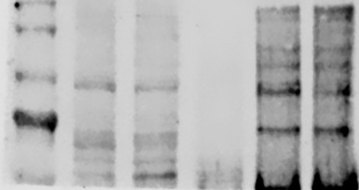
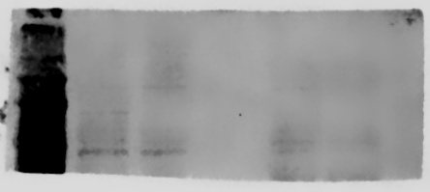
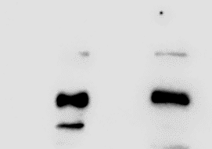
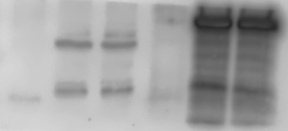
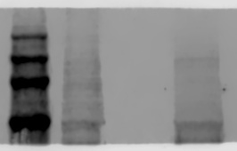
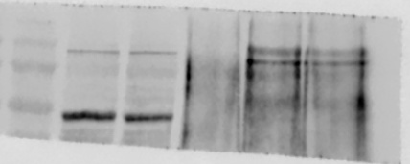
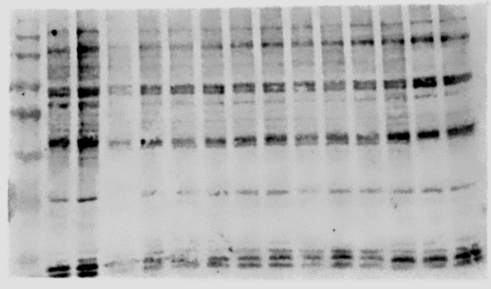
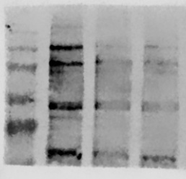
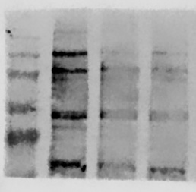
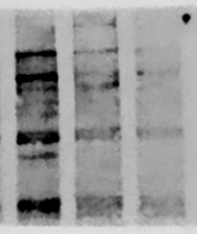
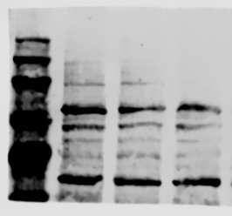
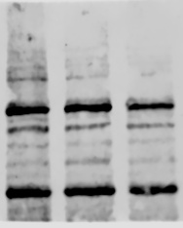
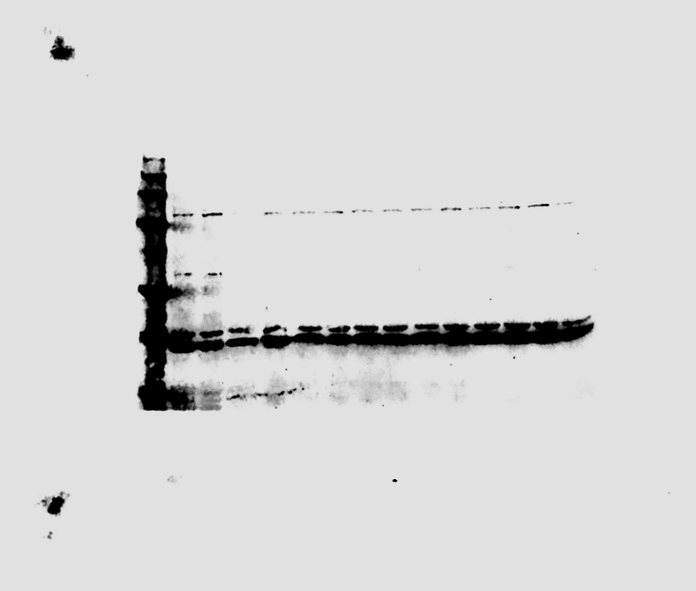
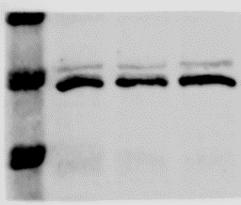
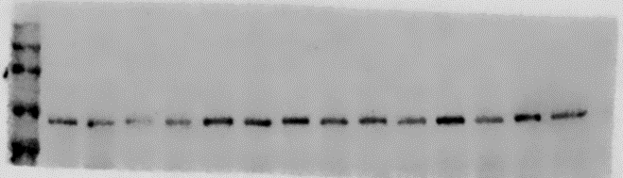
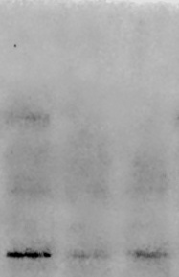
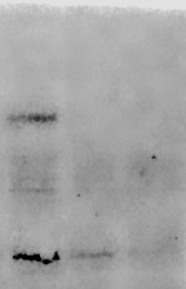
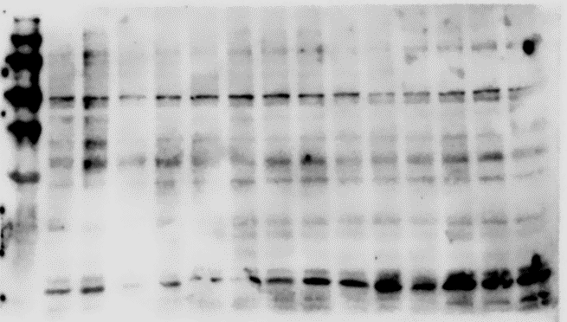
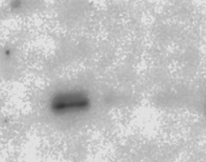
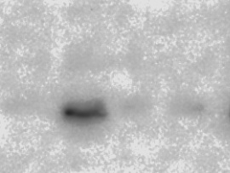
Figure. 4
C
B
OCT-1
OCT-1
OCA-B
OCA-B
O-GlcNAc
(CTD110.6)
β-actin
G
Expt. 1
Expt. 2
Expt. 3
O-GlcNAc
(RL2)
OGT
β-actin
OCT-1
OCA-B

Slide 5
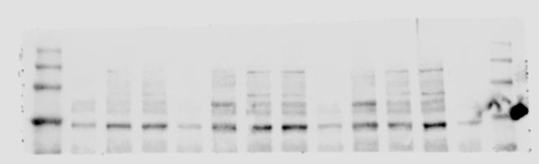
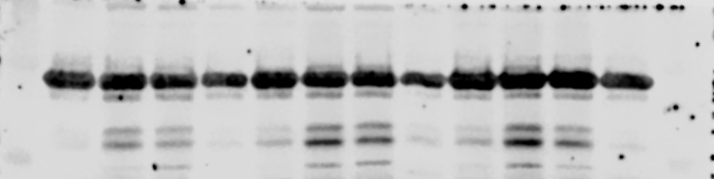
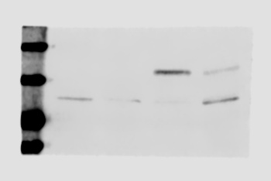
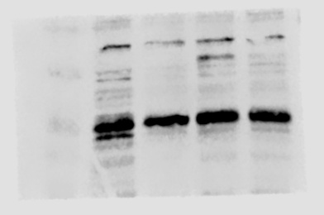
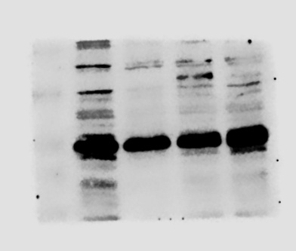
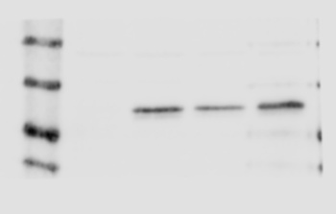
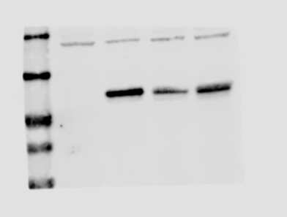
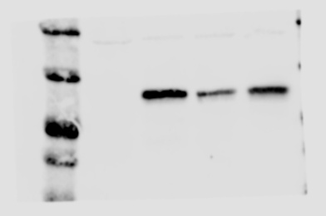



Figure. 4
I
Expt. 1
Expt. 2
Expt. 3
OCT-1
β-actin
β-actin
OCA-B
Figure. 5
B
Expt. 1
Expt. 2
Expt. 3
FLAG
GFP
β-actin

Slide 6



Figure. 5
D
Expt. 1
Expt. 2
Expt. 3
OCA-B
O-GlcNAc
(RL2)
IgM
IgA
β-actin

Slide 7










Figure. 5
F
Expt. 1
Expt. 2
Expt. 3
OCA-B
IgM
IgA
O-GlcNAc
(RL2)
c-Myc
GAPDH

Slide 8





Figure. 7
Mice
B
#1
#2
#3
#4
#5
V: Vehicle
V
OS
OS: OSMI-1
V
OS
V
OS
V
OS
V
OS
O-GlcNAc
(RL2)
IgM
OCT-1
OCA-B
GAPDH

Slide 9







Figure. S2.
O-GlcNAc
(RL2)
β-actin
Figure. S3.
O-GlcNAc
(RL2)
OCA-B
β-actin
Ubiquitin
OCT-1

Slide 10


Figure. S4.
A
Expt. 1
Expt. 2
Expt. 3
OCT-1
OCA-b
β-actin

Slide 11


Figure. S4.
B
Expt. 1
Expt. 2
Expt. 3
OCT-1
OCA-b
β-actin

Slide 12



Figure. S6.
A
Expt. 1
Expt. 2
Expt. 3
OCA-b
FLAG
β-actin

