Slide 1
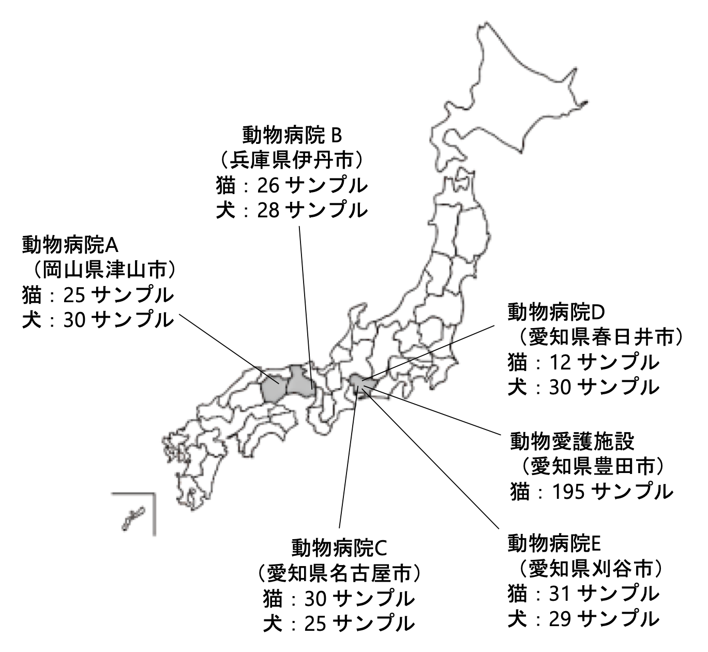
Fig. S1
Veterinary Clinic B
(Itami, Hyogo)
Domestic cat samples: 26
Veterinary Clinic A
(Tsuyama, Okayama)
Domestic cat samples: 25
Veterinary Clinic D
(Kasugai, Aichi)
Domestic cat samples: 12
Animal Welfare Center
(Toyota, Aichi)
Stray cat samples: 195
Veterinary Clinic C
(Nagoya, Aichi)
Domestic cat samples: 30
Veterinary Clinic E
(Kariya, Aichi)
Domestic cat samples: 31
Supplementary Figure S1. Map of sampling regions in the current study. Stool samples from asymptomatic cats were collected from an animal shelter in Aichi Prefecture and five animal hospitals in the Okayama, Hyogo, and Aichi Prefectures. The numbers of samples collected from the animal shelter and animal hospitals are shown.

Slide 2
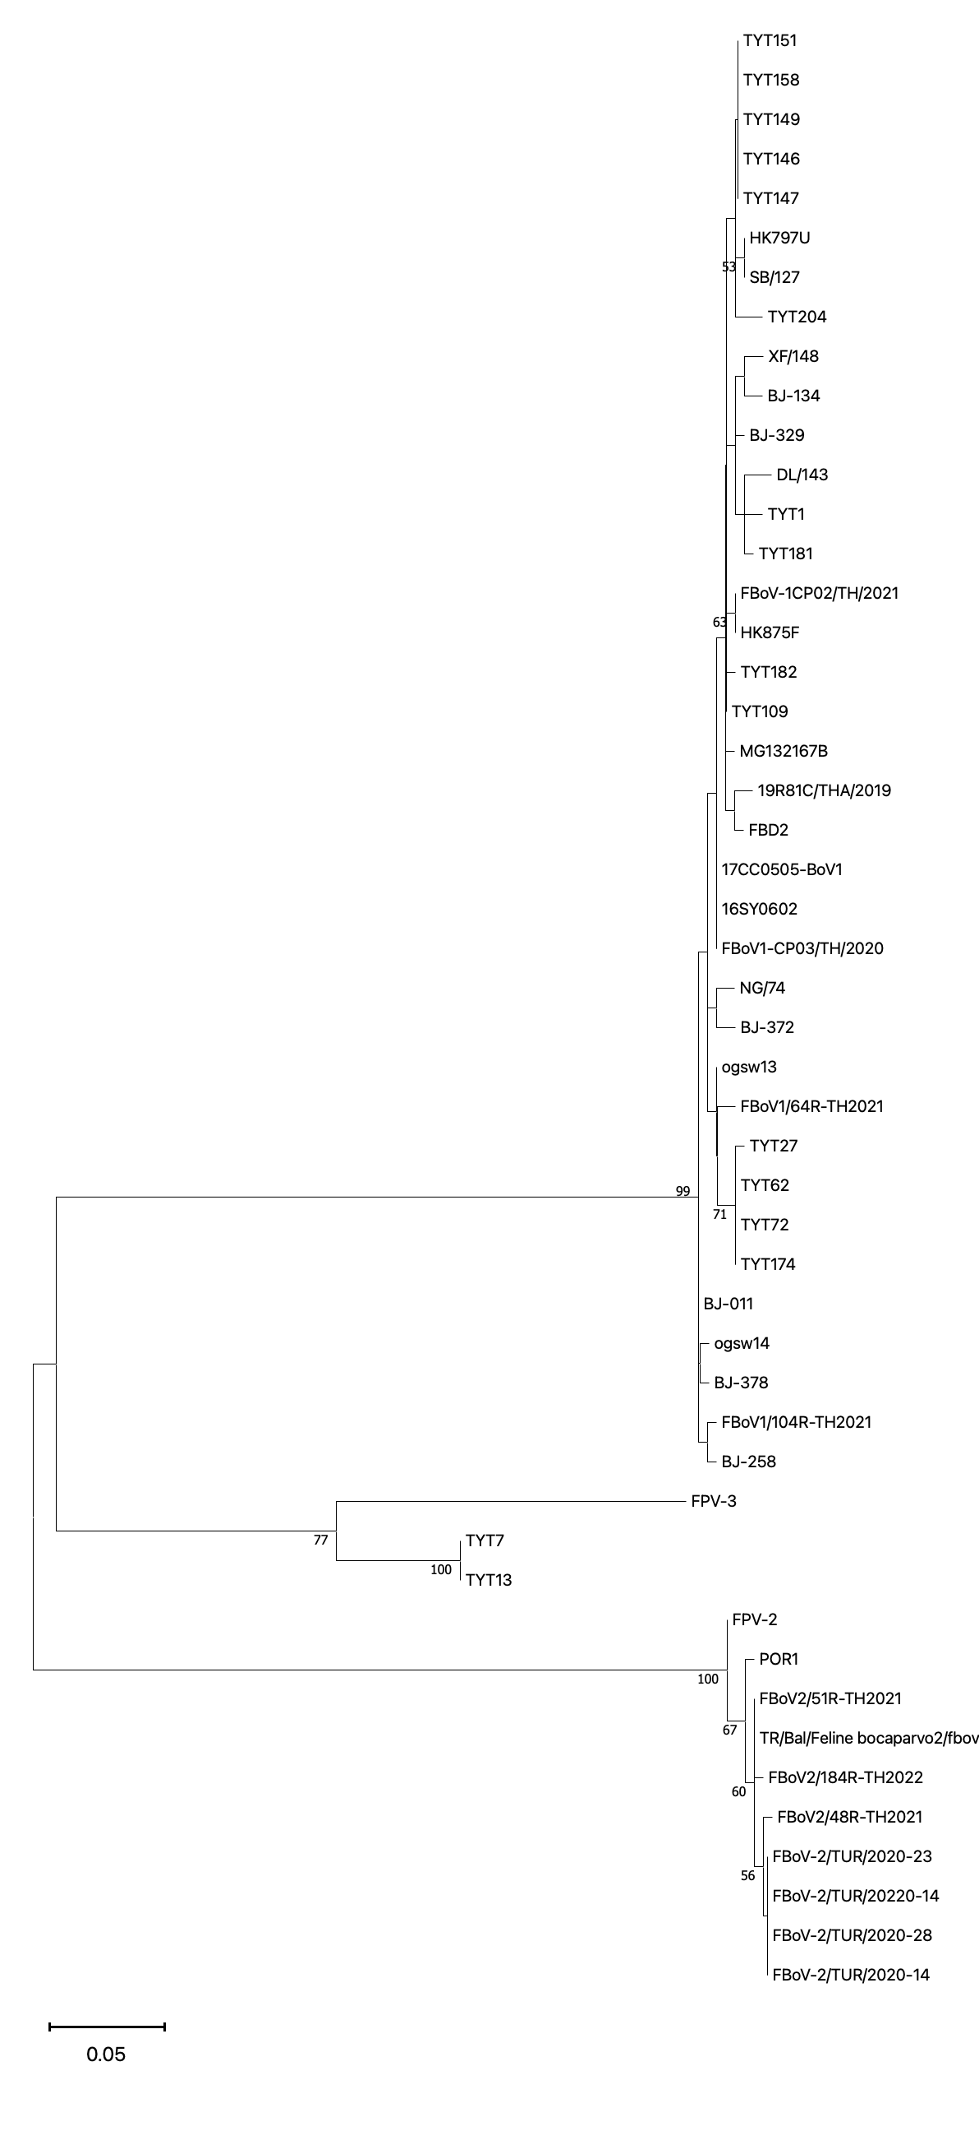
Fig. S2
Genotype Ⅰ
Genotype Ⅲ
Genotype Ⅱ
Supplementary Figure S2. Phylogenetic Analysis Based on the Nucleotide of the FBoV NP1 Gene. Sequences detected from domestic cats in this study are highlighted with red circles, and those detected from stray cats are highlighted with blue circles. Information on previously reported viral strains and their corresponding genotypes (1–3) is indicated to the right of each sequence ID. The accession numbers of FBoV sequences generated in this study and the viral sequences used for phylogenetic tree construction are listed in Supplemental Table S6.

Slide 3
Table S1
Supplementary Table S1. Overview of individual information for domestic cats.
Sample Names | Collection Date | Sex | Age | Breed | Housing | Co-housed Cats | Result of RT semi-nested PCR | Result of RT-nested PCR | Result of PCR
 |  |  |  |  |  |  | FAstV | FCoV | FBoV
Kuro-12 | 2019/9/26 | Female | 15 years | Non-purebred | Indoor | Yes | Negative | Negative | Negative
Kuro-29 | 2019/10/24 | Male | 6 months | Non-purebred | Indoor | Yes | Negative | Positive | Negative
Kuro-30 | 2019/10/1 | Female | 1 month | Non-purebred | Outdoor | Yes | Negative | Negative | Positive
Kuro-31 | 2019/10/14 | Male | 3 months | Munchkin | Indoor | Yes | Negative | Positive | Negative
Kuro-32 | 2019/10/11 | Male | 6 months | Non-purebred | Indoor | Yes | Negative | Positive | Negative
Kuro-33 | 2019/10/10 | Female | 21 year | Non-purebred | Indoor | Yes | Negative | Positive | Negative
Kuro-34 | 2019/10/14 | Female | 7 months | American Shorthair | Indoor | Yes | Negative | Negative | Negative
Kuro-35 | 2019/10/4 | Female | 1 year | Non-purebred | Indoor | Yes | Negative | Positive | Negative
Kuro-37 | 2019/10/28 | Female | 1 month | Non-purebred | Outdoor | Yes | Negative | Negative | Negative
Kuro-38 | 2019/10/28 | Male | 2 months | Non-purebred | Outdoor | Yes | Negative | Negative | Negative
Kuro-39 | 2019/10/24 | Male | 2 months | Non-purebred | Indoor | Yes | Negative | Negative | Negative
Kuro-40 | 2019/10/5 | Male | 3 years | Non-purebred | Indoor | Yes | Negative | Negative | Negative
Kuro-41 | 2019/10/1 | Male | 16 years | Non-purebred | Indoor | Yes | Negative | Positive | Negative
Kuro-42 | 2019/10/24 | Female | 2 months | Non-purebred | Indoor | Yes | Negative | Negative | Negative
Kuro-43 | 2019/11/24 | Female | 3 years | Non-purebred | Indoor | Yes | Negative | Negative | Negative
Kuro-44 | 2019/11/22 | Female | 8 months | Non-purebred | Indoor | Yes | Negative | Positive | Negative
Kuro-46 | 2019/11/21 | Female | 6 months | Non-purebred | Indoor | Yes | Negative | Negative | Negative
Kuro-55 | 2019/12/7 | Female | 8 months | Non-purebred | Indoor | Single | Negative | Negative | Negative
Kuro-56 | 2019/12/6 | Female | 9 years | Non-purebred | Indoor | Single | Negative | Negative | Negative
Kuro-57 | 2019/12/17 | Male | 5 months | Munchkin | Indoor | Yes | Negative | Negative | Negative
Kuro-62 | 2020/1/27 | Male | 1 year | Non-purebred | Indoor | Yes | Negative | Positive | Negative
Kuro-63 | 2020/1/9 | Female | 9 months | Non-purebred | Indoor | Yes | Negative | Positive | Negative
Kuro-64 | 2020/1/26 | Female | 4 months | Non-purebred | Indoor | Yes | Negative | Positive | Negative
Kuro-65 | 2020/1/21 | Male | 2 months | Scottish Fold | Indoor | Single | Negative | Positive | Negative
Kuro-69 | 2020/2/11 | Female | 10 months | Non-purebred | Indoor | Yes | Negative | Positive | Negative
Kuro-70 | 2020/2/6 | Male | 1 year | Non-purebred | Outdoor | Yes | Negative | Negative | Negative
Kuro-76 | 2020/2/22 | Male | 4 months | Non-purebred | Indoor | Single | Negative | Positive | Negative
Kuro-77 | 2020/2/25 | Male | 3 years | Non-purebred | Indoor | Single | Negative | Negative | Negative
Kuro-78 | 2020/3/9 | Male | 6 months | Non-purebred | Indoor | Yes | Negative | Positive | Negative
Kuro-79 | 2020/3/2 | Male | 3 years | Non-purebred | Outdoor | Single | Negative | Negative | Negative

Slide 4
Table S1 (continued)
Sample Names | Collection Date | Sex | Age | Breed | Housing | Co-housed Cats | Result of RT semi-nested PCR | Result of RT-nested PCR | Result of PCR
 |  |  |  |  |  |  | FAstV | FCoV | FBoV
ogsw-9 | 2019/8/18 | Male | 1 month | Non-purebred | Indoor | Unknown | Negative | Negative | Negative
ogsw-10 | 2019/8/26 | Male | 2 years | Non-purebred | Indoor | Yes | Negative | Negative | Negative
ogsw-11 | 2019/8/26 | Female | 2 years | Non-purebred | Indoor | Yes | Negative | Negative | Negative
ogsw-12 | 2019/9/3 | Male | 3 months | Non-purebred | Indoor | Yes | Negative | Positive | Negative
ogsw-13 | 2019/9/19 | Male | 9 years | Non-purebred | Indoor | Yes | Negative | Negative | Positive
ogsw-14 | 2019/9/25 | Female | 2 months | Non-purebred | Indoor | Single | Negative | Negative | Positive
ogsw-15 | 2019/10/1 | Male | Unknown | Non-purebred | Indoor | Yes | Negative | Negative | Negative
ogsw-16 | 2019/10/3 | Female | 2 months | Non-purebred | Indoor | Yes | Negative | Negative | Negative
ogsw-17 | Unknown | Female | 5 months | Sphynx | Indoor | Yes | Negative | Positive | Negative
ogsw-18 | Unknown | Female | 5 months | Sphynx | Indoor | Yes | Negative | Positive | Negative
ogsw-19 | Unknown | Male | 1 year | Sphynx | Indoor | Yes | Negative | Negative | Negative
ogsw-39 | 2019/11/5 | Female | 8 years | Non-purebred | Indoor | Yes | Negative | Positive | Negative
ogsw-40 | 2019/10/19 | Female | 3 months | Maine Coon | Indoor | Unknown | Negative | Positive | Negative
ogsw-41 | 2019/11/2 | Female | 1 year | Non-purebred | Indoor | Yes | Negative | Negative | Negative
ogsw-42 | 2019/10/18 | Female | Unknown | Non-purebred | Outdoor | Unknown | Negative | Negative | Negative
ogsw-43 | 2019/10/26 | Female | 1 year | Non-purebred | Indoor | Single | Negative | Negative | Negative
ogsw-44 | 2019/10/28 | Male | 10 years | Non-purebred | Indoor | Yes | Negative | Negative | Negative
ogsw-57 | 2019/11/26 | Male | 3 months | Non-purebred | Outdoor | Unknown | Negative | Negative | Negative
ogsw-58 | 2020/1/14 | Male | 6 months | Non-purebred | Indoor | Single | Negative | Negative | Negative
ogsw-59 | 2019/11/22 | Male | 2 months | Non-purebred | Indoor | Unknown | Negative | Positive | Negative
ogsw-60 | 2019/12/6 | Female | 9 months | Norwegian Forest Cat | Indoor | Single | Negative | Positive | Negative
ogsw-61 | 2019/11/26 | Male | 7 months | Norwegian Forest Cat | Indoor | Single | Negative | Positive | Negative
ogsw-62 | 2020/1/10 | Unknown | 3 months | Non-purebred | Indoor | Yes | Negative | Positive | Negative
ogsw-63 | 2020/1/14 | Male | 5 months | Non-purebred | Indoor | Single | Negative | Positive | Negative
ogsw-64 | 2019/12/28 | Female | 1 year | Scottish Fold | Indoor | Yes | Negative | Negative | Negative
ogsw-65 | 2019/11/22 | Female | 2 months | Non-purebred | Indoor | Unknown | Negative | Positive | Negative
ogsw-66 | 2020/1/13 | Female | 1 year | British Shorthair | Indoor | Yes | Negative | Positive | Negative
ogsw-67 | 2020/2/22 | Male | 10 years | Non-purebred | Indoor | Single | Negative | Negative | Negative
ogsw-70 | 2020/2/17 | Female | 11 month | Non-purebred | Indoor | Yes | Negative | Positive | Negative
ogsw-72 | 2020/2/17 | Female | 11 month | Non-purebred | Indoor | Yes | Negative | Positive | Negative
ogsw-87 | 2020/4/24 | Female | 7 months | Scottish Fold | Indoor | Single | Negative | Positive | Negative
Oji-42 | Unknown | Female | 12 years< | Non-purebred | Indoor | Yes | Negative | Negative | Negative
Oji-43 | 2019/9/16 | Male | 1 year | Non-purebred | Indoor | Yes | Negative | Negative | Negative
Oji-44 | 2019/9/9 | Male | 1 year | British Shorthair | Indoor | Single | Negative | Positive | Negative
Oji-45 | 2019/9/6 | Female | Unknown | Non-purebred | Outdoor | Single | Negative | Negative | Negative
Oji-46 | 2019/9/1 | Female | 9 years< | Non-purebred | Indoor | Single | Negative | Negative | Negative
Oji-47 | 2019/9/16 | Male | 1 year | Non-purebred | Outdoor | Yes | Negative | Positive | Negative
Oji-69 | 2019/10/23 | Female | Unknown | Non-purebred | Outdoor | Single | Negative | Negative | Negative
Oji-70 | 2019/10/30 | Female | 3 months | Bengal | Indoor | Single | Negative | Positive | Negative
Oji-71 | 2019/9/26 | Male | 2 months | Maine Coon | Indoor | Yes | Negative | Negative | Negative
Oji-72 | 2019/10/29 | Male | 3 years | Raggamuffin | Indoor | Yes | Negative | Negative | Negative
Oji-73 | 2019/10/4 | Female | 5 years | Himalayan | Indoor | Yes | Negative | Negative | Negative
Oji-74 | 2019/10/19 | Male | 11 year | Abyssinian | Outdoor | Single | Negative | Negative | Negative

Slide 5
Table S1 (continued)
Sample Names | Collection Date | Sex | Age | Breed | Housing | Co-housed Cats | Result of RT semi-nested PCR | Result of RT-nested PCR | Result of PCR
 |  |  |  |  |  |  | FAstV | FCoV | FBoV
Run-1 | 2019/9/19 | Male | 2 years | Non-purebred | Indoor | Yes | Negative | Negative | Negative
Run-2 | 2019/9/18 | Female | 2 years | Non-purebred | Indoor | Yes | Negative | Negative | Negative
Run-3 | 2019/9/18 | Male | 2 years | Non-purebred | Outdoor | Yes | Negative | Negative | Negative
Run-4 | 2019/9/21 | Male | 1 year | Non-purebred | Indoor | Yes | Negative | Negative | Negative
Run-5 | 2019/9/19 | Female | 1 year | Non-purebred | Outdoor | Yes | Negative | Negative | Negative
Run-6 | 2019/9/12 | Male | 13 years | Non-purebred | Outdoor | Yes | Negative | Negative | Negative
Run-7 | 2019/9/12 | Female | 1 year | Non-purebred | Indoor | Yes | Negative | Negative | Negative
Run-8 | 2019/9/6 | Male | 2 years | Non-purebred | Outdoor | Yes | Negative | Negative | Negative
Run-9 | 2019/9/21 | Female | 3 years | Non-purebred | Outdoor | Yes | Negative | Negative | Negative
Run-10 | 2019/9/16 | Female | 4 months | Non-purebred | Indoor | Single | Negative | Negative | Negative
Run-11 | 2019/9/19 | Male | 16 years | Non-purebred | Outdoor | Yes | Negative | Negative | Negative
Run-12 | 2019/9/7 | Male | 4 months | Non-purebred | Outdoor | Unknown | Negative | Negative | Negative
Run-13 | 2019/9/8 | Male | 2 months | Non-purebred | Indoor | Single | Negative | Negative | Negative
Run-14 | 2019/9/11 | Female | 1 year | Non-purebred | Outdoor | Yes | Negative | Negative | Negative
Run-15 | 2019/9/18 | Female | 6 months | Non-purebred | Indoor | Yes | Negative | Negative | Negative
Run-16 | 2019/9/8 | Male | 2 years | Norwegian Forest Cat | Indoor | Single | Negative | Positive | Negative
Run-17 | 2019/9/9 | Male | 12 years | Scottish Fold | Indoor | Single | Negative | Negative | Negative
Run-18 | 2019/9/10 | Female | 12 years | Non-purebred | Outdoor | Single | Negative | Negative | Negative
Run-19 | 2019/9/21 | Female | 6 months | Non-purebred | Indoor | Yes | Negative | Negative | Negative
Run-20 | 2019/9/21 | Male | 1 year | Non-purebred | Indoor | Yes | Negative | Negative | Negative
Run-21 | 2019/9/9 | Female | 6 months | Non-purebred | Outdoor | Single | Negative | Negative | Negative
Run-22 | 2019/9/11 | Female | 2 years | Non-purebred | Outdoor | Yes | Negative | Negative | Negative
Run-23 | 2019/9/14 | Male | 7 months | American Shorthair | Indoor | Single | Negative | Negative | Negative
Run-24 | 2019/9/10 | Male | 4 years | Non-purebred | Outdoor | Yes | Negative | Negative | Negative
Run-25 | 2019/9/6 | Female | 11 year | Non-purebred | Outdoor | Single | Negative | Negative | Negative
With-11 | 2019/10/1 | Male | 8 years | Bengal | Indoor | Single | Negative | Negative | Negative
With-12 | 2019/9/16 | Male | 3 months | Non-purebred | Indoor | Yes | Negative | Negative | Negative
With-13 | 2019/10/9 | Female | 2 years | Norwegian Forest Cat | Indoor | Single | Negative | Negative | Negative
With-14 | 2019/9/13 | Female | 1 year | Non-purebred | Indoor | Single | Negative | Negative | Negative
With-15 | 2019/9/28 | Male | Unknown | Non-purebred | Indoor | Single | Negative | Negative | Negative
With-16 | 2019/9/28 | Male | 6 years | Norwegian Forest Cat | Indoor | Single | Negative | Negative | Negative
With-17 | 2019/9/27 | Male | 5 years | Non-purebred | Indoor | Yes | Negative | Negative | Negative
With-28 | 2019/11/24 | Male | 2 years | Persian | Indoor | Yes | Negative | Positive | Negative
With-29 | 2019/10/26 | Male | 13 years | Russian Blue | Indoor | Yes | Negative | Negative | Negative
With-30 | 2019/10/25 | Male | 4 years | Non-purebred | Indoor | Single | Negative | Negative | Negative
With-31 | 2019/10/18 | Male | 13 years | Non-purebred | Indoor | Yes | Negative | Negative | Negative
With-32 | 2019/11/19 | Female | 5 years | American Shorthair | Indoor | Yes | Negative | Negative | Negative
With-33 | 2019/11/18 | Female | 9 years | Non-purebred | Indoor | Single | Negative | Positive | Negative
With-34 | 2019/11/22 | Male | 11 year | Non-purebred | Indoor | Single | Negative | Negative | Negative
With-35 | 2019/11/11 | Male | 16 years | Non-purebred | Indoor | Single | Negative | Negative | Negative
With-41 | 2019/12/9 | Female | 4 months | Non-purebred | Indoor | Single | Negative | Positive | Negative
With-42 | 2019/1/13 | Female | 7 years | Scottish Fold | Indoor | Single | Negative | Positive | Negative
With-43 | 2019/1/17 | Female | 3 months | Scottish Fold | Indoor | Yes | Negative | Positive | Negative
With-44 | 2020/1/4 | Female | 2 years | Scottish Fold | Indoor | Yes | Negative | Positive | Negative
With-45 | 2020/2/2 | Male | 20 years | Non-purebred | Indoor | Single | Negative | Positive | Negative
With-46 | 2020/1/24 | Male | 15 years | Non-purebred | Indoor | Yes | Negative | Positive | Negative
With-57 | 2020/3/29 | Male | 2 years | Scottish Fold | Indoor | Yes | Negative | Positive | Negative
With-80 | 2020/2/23 | Female | 6 months | Non-purebred | Indoor | Single | Negative | Positive | Negative
With-81 | 2020/2/17 | Female | 19 years | Non-purebred | Indoor | Single | Negative | Negative | Negative
With-82 | 2020/3/11 | Male | 2 years | Bengal | Indoor | Yes | Negative | Positive | Negative
With-85 | 2020/3/7 | Male | 3 years | Non-purebred | Indoor | Yes | Negative | Negative | Negative

Slide 6
Table S2
Supplementary Table S2. Overview of individual information for stray cats.
Sample Names | Collection Date | Sex | Result of RT semi-nested PCR | Result of RT-nested PCR | Result of PCR
 |  |  | FAstV | FCoV | FBoV
TYT-1 | 2019/10/2 | Male | Negative | Negative | Positive
TYT-2 | 2019/10/2 | Female | Negative | Negative | Negative
TYT-3 | 2019/10/2 | Female | Negative | Positive | Negative
TYT-4 | 2019/10/2 | Female | Negative | Negative | Negative
TYT-5 | 2019/10/2 | Female | Negative | Positive | Positive
TYT-6 | 2019/10/2 | Female | Negative | Negative | Negative
TYT-7 | 2019/10/2 | Unknown | Positive | Negative | Positive
TYT-8 | 2019/10/2 | Female | Negative | Negative | Negative
TYT-9 | 2019/10/2 | Female | Negative | Positive | Positive
TYT-10 | 2019/10/2 | Unknown | Negative | Negative | Positive
TYT-11 | 2019/10/2 | Female | Negative | Negative | Negative
TYT-12 | 2019/10/2 | Female | Negative | Positive | Negative
TYT-13 | 2019/10/2 | Female | Positive | Negative | Positive
TYT-14 | 2019/10 | Unknown | Positive | Negative | Negative
TYT-15 | 2019/10 | Male | Negative | Positive | Negative
TYT-16 | 2019/10 | Unknown | Negative | Negative | Positive
TYT-17 | 2019/10 | Unknown | Negative | Negative | Negative
TYT-18 | 2019/10 | Female | Negative | Negative | Negative
TYT-19 | 2019/10 | Male | Negative | Positive | Negative
TYT-20 | 2019/10 | Male | Negative | Negative | Negative
TYT-21 | 2019/10 | Male | Negative | Negative | Negative
TYT-22 | 2019/10 | Female | Negative | Negative | Negative
TYT-23 | 2019/10 | Female | Negative | Negative | Negative
TYT-24 | 2019/10 | Female | Negative | Negative | Negative
TYT-25 | 2019/10 | Male | Negative | Negative | Negative
TYT-26 | 2019/10 | Female | Negative | Negative | Negative
TYT-27 | 2019/10 | Female | Negative | Negative | Positive
TYT-28 | 2019/10 | Male | Negative | Negative | Negative
TYT-29 | 2019/10 | Female | Negative | Negative | Negative
TYT-30 | 2019/10 | Male | Negative | Negative | Negative
TYT-31 | 2019/10 | Female | Negative | Negative | Negative
TYT-32 | 2019/10 | Male | Negative | Negative | Negative
TYT-33 | 2019/10 | Female | Negative | Negative | Negative
TYT-34 | 2019/10 | Female | Negative | Negative | Negative
TYT-35 | 2019/10 | Female | Negative | Negative | Negative
TYT-36 | 2019/10 | Female | Negative | Negative | Negative
TYT-37 | 2019/10 | Male | Negative | Negative | Negative
TYT-38 | 2019/10 | Female | Negative | Negative | Negative
TYT-39 | 2019/10 | Female | Negative | Negative | Negative
TYT-40 | 2019/10 | Male | Negative | Positive | Negative
TYT-41 | 2019/10 | Female | Negative | Negative | Negative
TYT-42 | 2019/10 | Unknown | Negative | Negative | Negative
TYT-43 | 2019/10 | Male | Negative | Negative | Negative
TYT-44 | 2019/10 | Unknown | Negative | Negative | Negative
TYT-45 | 2019/10 | Unknown | Negative | Negative | Negative
TYT-46 | 2019/10 | Female | Negative | Negative | Negative
TYT-47 | 2019/10 | Female | Negative | Negative | Negative
TYT-48 | 2019/10 | Male | Negative | Negative | Negative
TYT-49 | 2019/10 | Male | Negative | Negative | Negative
TYT-50 | 2019/10 | Female | Negative | Negative | Negative

Slide 7
Table S2 (continued)
Sample Names | Collection Date | Sex | Result of RT semi-nested PCR | Result of RT-nested PCR | Result of PCR
 |  |  | FAstV | FCoV | FBoV
TYT-51 | 2019/10 | Female | Negative | Negative | Negative
TYT-52 | 2019/10 | Male | Negative | Negative | Negative
TYT-53 | 2019/10 | Male | Negative | Positive | Negative
TYT-54 | 2019/10 | Unknown | Negative | Negative | Negative
TYT-55 | 2019/10 | Female | Negative | Negative | Negative
TYT-56 | 2019/10 | Male | Negative | Negative | Negative
TYT-57 | 2019/10 | Unknown | Negative | Negative | Negative
TYT-58 | 2019/10 | Female | Negative | Negative | Negative
TYT-59 | 2019/10 | Male | Negative | Negative | Negative
TYT-60 | 2019/10 | Male | Negative | Negative | Negative
TYT-61 | 2019/10 | Female | Negative | Negative | Negative
TYT-62 | 2019/10 | Male | Negative | Negative | Positive
TYT-63 | 2019/10 | Female | Negative | Negative | Negative
TYT-64 | 2019/11 | Male | Negative | Negative | Negative
TYT-65 | 2019/11 | Unknown | Negative | Negative | Negative
TYT-66 | 2019/11 | Male | Negative | Negative | Negative
TYT-67 | 2019/11 | Male | Negative | Negative | Negative
TYT-68 | 2019/11 | Female | Negative | Negative | Negative
TYT-69 | 2019/11 | Female | Negative | Negative | Negative
TYT-70 | 2019/11 | Female | Negative | Negative | Negative
TYT-71 | 2019/11 | Female | Negative | Negative | Negative
TYT-72 | 2019/11 | Female | Negative | Negative | Positive
TYT-73 | 2019/11 | Female | Negative | Negative | Negative
TYT-74 | 2019/11 | Female | Negative | Negative | Negative
TYT-75 | 2019/11 | Female | Negative | Negative | Negative
TYT-76 | 2019/11 | Female | Negative | Negative | Negative
TYT-77 | 2019/11 | Unknown | Negative | Negative | Negative
TYT-78 | 2019/11 | Female | Negative | Negative | Negative
TYT-79 | 2019/11 | Female | Negative | Negative | Negative
TYT-80 | 2019/11 | Male | Negative | Negative | Negative
TYT-81 | 2019/11 | Male | Negative | Negative | Negative
TYT-82 | 2019/11 | Female | Negative | Negative | Negative
TYT-83 | 2019/11 | Female | Negative | Negative | Negative
TYT-84 | 2019/11 | Unknown | Negative | Negative | Negative
TYT-85 | 2019/11 | Female | Negative | Negative | Negative
TYT-86 | 2019/11 | Male | Negative | Negative | Negative
TYT-87 | 2019/11 | Female | Negative | Negative | Negative
TYT-88 | 2019/11 | Female | Negative | Negative | Negative
TYT-89 | 2019/11 | Male | Negative | Negative | Negative
TYT-90 | 2019/11 | Male | Negative | Negative | Negative
TYT-91 | 2019/11 | Female | Negative | Negative | Negative
TYT-92 | 2019/11 | Male | Negative | Negative | Negative
TYT-93 | 2019/11 | Female | Negative | Negative | Negative
TYT-94 | 2019/11 | Female | Negative | Negative | Negative
TYT-95 | 2019/11 | Female | Negative | Negative | Negative
TYT-96 | 2019/11 | Female | Negative | Negative | Negative
TYT-97 | 2019/11 | Male | Negative | Negative | Negative
TYT-98 | 2019/11 | Female | Negative | Negative | Negative
TYT-99 | 2019/11 | Female | Negative | Negative | Negative
TYT-100 | 2019/11 | Female | Positive | Positive | Negative

Slide 8
Table S2 (continued)
Sample Names | Collection Date | Sex | Result of RT semi-nested PCR | Result of RT-nested PCR | Result of PCR
 |  |  | FAstV | FCoV | FBoV
TYT-101 | 2019/11 | Female | Positive | Positive | Negative
TYT-102 | 2019/11 | Female | Positive | Positive | Negative
TYT-103 | 2019/11 | Female | Negative | Negative | Negative
TYT-104 | 2019/11 | Female | Negative | Positive | Negative
TYT-105 | 2019/11 | Male | Negative | Negative | Negative
TYT-106 | 2019/11 | Female | Negative | Negative | Negative
TYT-107 | 2019/11 | Female | Negative | Negative | Negative
TYT-108 | 2019/11 | Female | Negative | Negative | Negative
TYT-109 | 2019/11 | Female | Negative | Positive | Positive
TYT-110 | 2019/11 | Female | Negative | Negative | Negative
TYT-122 | 2019/12/8-12 | Female | Negative | Negative | Negative
TYT-123 | 2019/12/8-12 | Male | Negative | Negative | Negative
TYT-124 | 2019/12/8-12 | Male | Negative | Negative | Negative
TYT-125 | 2019/12/8-12 | Male | Negative | Negative | Negative
TYT-126 | 2019/12/8-12 | Female | Negative | Positive | Negative
TYT-127 | 2019/12/8-12 | Unknown | Negative | Negative | Negative
TYT-128 | 2019/12/8-12 | Female | Negative | Positive | Negative
TYT-129 | 2019/12/8-12 | Male | Negative | Negative | Negative
TYT-130 | 2019/12/8-12 | Male | Negative | Negative | Positive
TYT-131 | 2019/12/8-12 | Female | Negative | Positive | Negative
TYT-132 | 2019/12/8-12 | Male | Negative | Negative | Negative
TYT-133 | 2019/12/8-12 | Male | Negative | Negative | Negative
TYT-134 | 2019/12/8-12 | Female | Negative | Negative | Negative
TYT-135 | 2019/12/8-12 | Female | Negative | Negative | Negative
TYT-136 | 2019/12/8-12 | Male | Negative | Negative | Negative
TYT-137 | 2019/12/8-12 | Female | Negative | Negative | Negative
TYT-138 | 2019/12/8-12 | Female | Negative | Negative | Negative
TYT-139 | 2019/12/8-12 | Male | Negative | Negative | Negative
TYT-140 | 2019/12/8-12 | Female | Negative | Negative | Negative
TYT-141 | 2019/12/15 | Female | Negative | Negative | Negative
TYT-142 | 2019/12/15 | Unknown | Negative | Negative | Negative
TYT-143 | 2019/12/17 | Female | Negative | Negative | Negative
TYT-144 | 2019/12/17 | Unknown | Negative | Negative | Negative
TYT-145 | 2019/12/21-27 | Female | Negative | Negative | Negative
TYT-146 | 2019/12/21-27 | Male | Negative | Negative | Positive
TYT-147 | 2019/12/21-27 | Female | Negative | Negative | Positive
TYT-148 | 2019/12/21-27 | Male | Negative | Negative | Positive
TYT-149 | 2019/12/21-27 | Male | Negative | Negative | Positive
TYT-150 | 2019/12/21-27 | Female | Negative | Negative | Negative
TYT-151 | 2019/12/21-27 | Male | Negative | Negative | Positive
TYT-152 | 2019/12/21-27 | Female | Negative | Negative | Negative
TYT-153 | 2019/12/21-27 | Male | Negative | Positive | Negative
TYT-154 | 2019/12/21-27 | Male | Negative | Negative | Negative
TYT-155 | 2019/12/21-27 | Male | Negative | Negative | Negative
TYT-156 | 2019/12/21-27 | Female | Negative | Negative | Negative
TYT-157 | 2019/12/21-27 | Female | Negative | Negative | Negative
TYT-158 | 2019/12/21-27 | Female | Negative | Negative | Positive
TYT-159 | 2019/12/21-27 | Male | Negative | Negative | Negative
TYT-160 | 2019/12/21-27 | Male | Negative | Negative | Negative
TYT-161 | 2019/12/21-27 | Male | Negative | Negative | Negative
TYT-162 | 2019/12/21-27 | Male | Negative | Negative | Negative

Slide 9
Table S2 (continued)
Sample Names | Collection Date | Sex | Result of RT semi-nested PCR | Result of RT-nested PCR | Result of PCR
 |  |  | FAstV | FCoV | FBoV
TYT-163 | 2019/12/21-27 | Male | Negative | Negative | Negative
TYT-164 | 2019/12/21-27 | Male | Negative | Negative | Negative
TYT-165 | 2019/12/21-27 | Female | Negative | Negative | Negative
TYT-166 | 2019/12/21-27 | Male | Negative | Negative | Negative
TYT-167 | 2019/12/21-27 | Female | Negative | Negative | Negative
TYT-168 | 2019/12/21-27 | Female | Negative | Positive | Negative
TYT-169 | 2019/12/21-27 | Female | Negative | Negative | Negative
TYT-170 | 2019/12/21-27 | Male | Negative | Negative | Negative
TYT-171 | 2019/12/21-27 | Female | Negative | Negative | Negative
TYT-172 | 2019/12/21-27 | Female | Negative | Negative | Negative
TYT-173 | 2019/12/21-27 | Female | Negative | Negative | Negative
TYT-174 | 2019/12/21-27 | Female | Negative | Negative | Positive
TYT-175 | 2020/1/9 | Female | Negative | Positive | Negative
TYT-176 | 2020/1/9 | Female | Negative | Negative | Negative
TYT-177 | 2020/1/9 | Female | Negative | Negative | Negative
TYT-178 | 2020/1/7 | Female | Negative | Negative | Negative
TYT-179 | 2020/1/7 | Female | Negative | Negative | Negative
TYT-180 | 2020/1/7 | Female | Negative | Negative | Negative
TYT-181 | 2020/1/12 | Female | Negative | Negative | Positive
TYT-182 | 2020/1/14 | Unknown | Negative | Positive | Positive
TYT-183 | 2020/1/23 | Female | Negative | Positive | Negative
TYT-184 | 2020/1/23 | Male | Negative | Positive | Negative
TYT-185 | 2020/1/23 | Male | Negative | Negative | Negative
TYT-186 | 2020/1/23 | Male | Negative | Positive | Negative
TYT-187 | 2020/1/23 | Female | Negative | Positive | Negative
TYT-188 | 2020/1/23 | Male | Negative | Negative | Negative
TYT-189 | 2020/1/23 | Female | Negative | Negative | Negative
TYT-190 | 2020/1/23 | Female | Negative | Positive | Negative
TYT-191 | 2020/2/3 | Male | Negative | Negative | Negative
TYT-192 | 2020/2/3 | Male | Negative | Negative | Negative
TYT-193 | 2020/2/3 | Male | Negative | Positive | Negative
TYT-194 | 2020/2/4 | Female | Negative | Negative | Negative
TYT-195 | 2020/2/6 | Male | Negative | Negative | Negative
TYT-196 | 2020/2/6 | Male | Negative | Positive | Negative
TYT-197 | 2020/2/9 | Male | Negative | Positive | Negative
TYT-198 | 2020/2/14 | Female | Negative | Positive | Negative
TYT-199 | 2020/2/20 | Female | Negative | Positive | Negative
TYT-200 | 2020/2/20 | Female | Negative | Negative | Negative
TYT-201 | 2020/2/20 | Male | Negative | Positive | Negative
TYT-202 | 2020/2/20 | Male | Negative | Negative | Negative
TYT-203 | 2020/2/20 | Female | Negative | Negative | Negative
TYT-204 | 2020/2/20 | Male | Negative | Negative | Positive
TYT-205 | 2020/2/20 | Male | Negative | Negative | Negative
TYT-206 | 2020/2/20 | Female | Negative | Negative | Negative

Slide 10
Table S3
Table S3. Information on primers used in the current study.
Target Genes | Primer Names | Primer Sequences (5’–3’) | Product Size | Primer Concentrations | References
FAstV ORF2 | FAV1F | ATGGCTAGCAAGCTGGAAAGAAG | 2,431 bp | 10 μM | Yi S., et al., Plos One., 2018
 | FAV1R | GCGTGGCCTCGGCTCTCAA
 | FAV2F | GGCATCTGAGTGGTGCTTCACCGGCT | 1,682 bp |  | This study
FBoV NP1 | FBoV-F | AGAACCRCCRATCACARTCCACT | 465 bp |  | Qian Z., et al., Arch Virol., 2019
 | FBoV-R | TGGCRACCGCYAGCATTTCA

Slide 11
Table S4
Table S4. Information on PCR in the current study.
PCR Applications | Primer Names |  | Initial Denaturation |  | Denaturation |  | Annealing |  | Extension |  | Final Extension |  | Cycle Number
 |  |  | Temperature (℃) | Duration | Temperature (℃) | Duration | Temperature (℃) | Duration | Temperature (℃) | Duration | Temperature (℃) | Duration
FAstV ORF2 gene detection | 1st | FAV1F /FAV1R | ー | ー | 94 | 30 sec | 58 | 30 sec | 72 | 72 sec | ー | ー | 40
 | 2nd | FAV2F /FAV1R |  |  |  |  | 68 |  |  | 50 sec
FBoV NP1 gene detection |  | FAV1F /FAV1R | 94 | 30 sec |  | 45 sec | 51 | 45 sec |  | 30 sec | 72 | 10 min | 35

Slide 12
Table S5
Supplementary Table S5. Accession numbers of sequences of the MAstV-2 capsid gene used for phylogenetic analysis.
Accession Number | Regions with detcted viral genes
KM017742.1 | USA
AF056197 | UK
ON595826.1 | Australia
ON595832.1
PQ435244.1 | Thailand
PQ435238.1
PQ435245.1
PQ435242.1
PQ435247.1
PQ435239.1
OP6811601 | China
OP681159.1
MK671309.1
MK671260.1
MH253872.1
MH253862.1
MH253865.1
MH253864.1
MN148428.1
PV847575.1
LC918944 | Japan
LC918945
LC778163
LC778161

Slide 13
Table S6
Supplementary Table S6. Accession numbers of sequences of the FBoV NP1 gene used for phylogenetic analysis.
Accession Number | Regions with detcted viral genes
MH155949.1 | China
MH155946.1
PP541568.1
JQ692586.1
JQ692587.1
OR544352.1
OR544348.1
PP541564.1
OR544350.1
PP541560.1
OR544349.1
PP541570.1
PP541567.1
PP541569.1
OR690117.1 | Turkey
MZ042260.1
MZ042259.1
MZ042261.1
MZ0422591
ON478335.1 | Thailand
MN127777.1
PP592979.1
ON478336.1
PP592974.1
PP592984.1
PP592985.1
PP592983.1
NC_022800.1 | Portugl
ON595887.1 | Australia
ON595896.1
KP769860.1 | Belgium
KM017745.1 | USA

Slide 14
Table S6
Table S6 (continued)
Accession Number | Regions with detcted viral genes
LC918918 | Japan
LC918919
LC918920
LC918921
LC918922
LC918923
LC918924
LC918925
LC918926
LC918927
LC918928
LC918929
LC918930
LC918931
LC918932
LC918933
LC918934
LC918935

