Slide 1
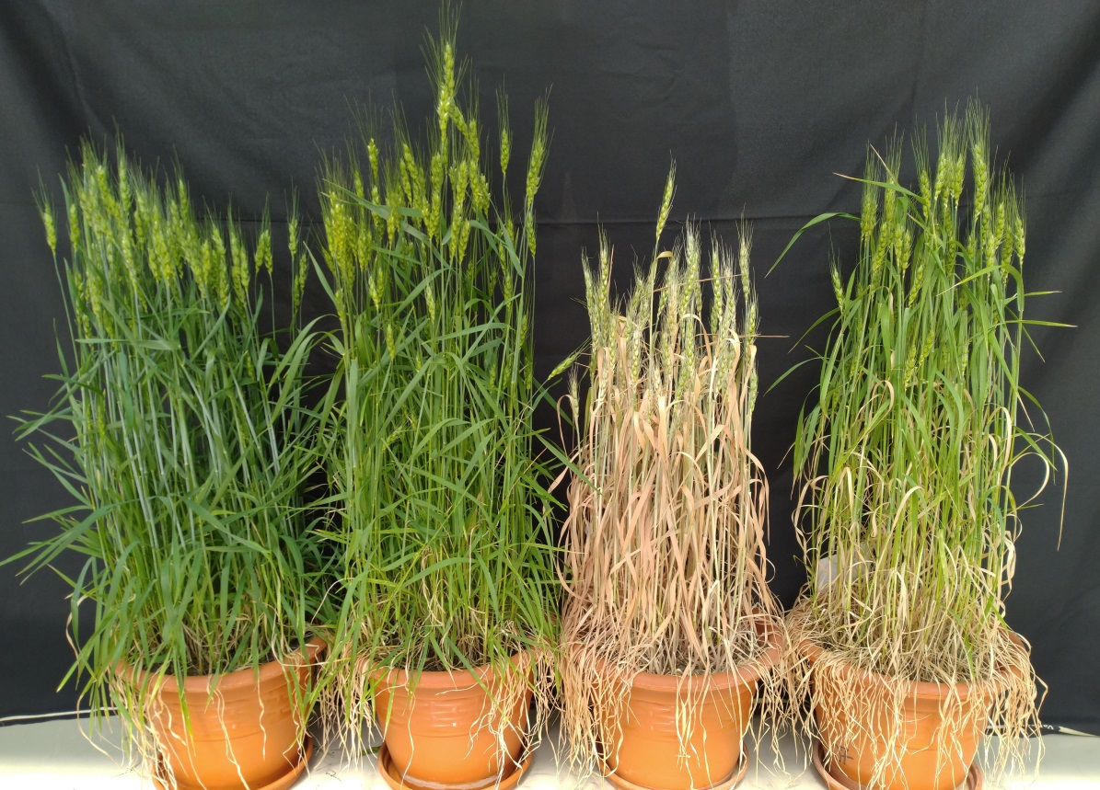
A
Sowing
Anthesis
Fig. S1. Schematic presentation of experimental layout for evaluating the effect of Moringa leaf extract (MLE) on drought stress tolerance in wheat during the anthesis stage. Dotted arrows indicate the sampling stages (anthesis) for the wheat plants under different experimental conditions (A). Representative image showing phenotype of the considered wheat genotype under different experimental conditions (Control, MLE, Drought, Drought+MLE).
10 d
Treatment
(MLE/ Drought/ Drought+MLE)
Sampling
B
Control
MLE
Drought
Drought+MLE

