Slide 1

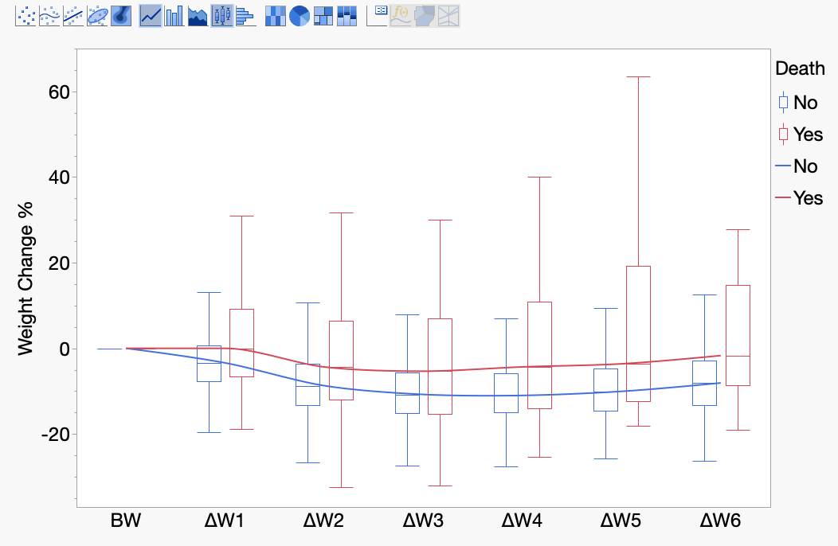
Weight Changes and Variability in the First Week of Life: Associations with Mortality in Extremely Preterm Newborns
AIM: To evaluate whether percentage weight change (ΔW%) from birth weight (BW) and first week weight variability were independently associated with death by postnatal day 7 in extremely low gestational age newborns (ELGANs) and to identify optimal thresholds.
COHORT
N=805 ELGANs
<28w GA, BW ≥400 g
UAB NICU (2014–2021)
EXPOSURES (first week)
Day-3 ΔW% from BW
Minimum ΔW% from BW
Weight variability
OUTCOME
Death by postnatal day 7
55/805 (6.8%)
RESULTS
Even after controlling for multiple potential confounders, non-survivors showed blunted early weight loss and greater weight instability during the first postnatal week when compared to survivors:
Day 3 ΔW% from BW:
Median −5.3% vs −10.7% (p<0.01); cutoff −6.4% (Sensitivity = 57%, Specificity = 72%)
aOR 1.05 (95% CI 1.02–1.08)
Minimum ΔW% from BW:
Median −9.5% vs −13.7% (p<0.001); cutoff −5.3% (Sensitivity = 45%, Specificity = 89%)
aOR 1.08 (95% CI 1.05–1.12)
Normalized Total Fluctuation*: (mean absolute day-to-day change in ΔW% in the first postnatal week).
Median 7.1% vs 4.0% (p<0.0001); cutoff 5.31% (Sensitivity = 76%, Specificity = 74%)
aOR 1.45 (95% CI 1.29–1.65)
*Total fluctuation was one of the strongest variability predictors and may be easy to implement clinically
CONCLUSION: ELGANs who do not lose 5%–7% of BW by postnatal day 3 or exhibit an average day-to-day weight fluctuation >5 % are at increased risk of early mortality.
Vigezzi et al. 2026

