Slide 1
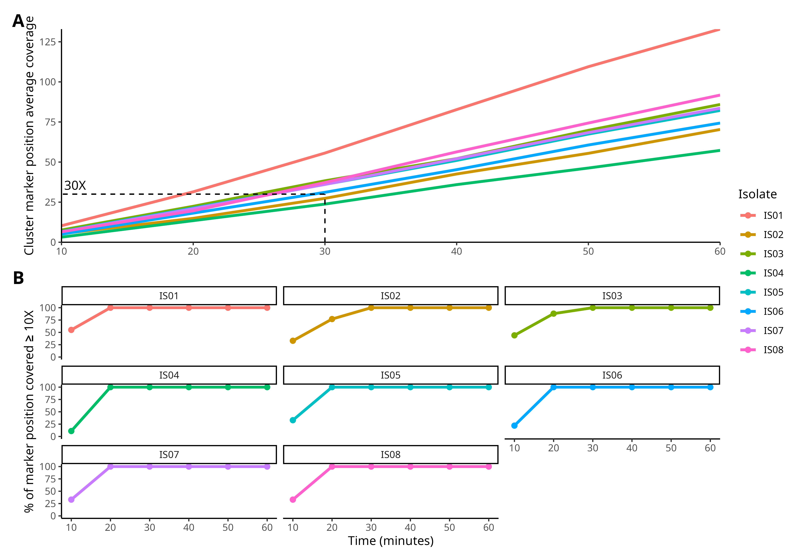
Supplem-entary Figure
Notes:
Supplementary Figure: Rapid detection of cluster-specific marker positions in eight isolates during the first hour of sequencing. (A) Mean coverage of the nine amplicons across the sequencing run (minutes).
(B) Percentage of marker positions with coverage ≥5× for reference or alternative alleles over the course of the run.

