Slide 1
A
B
Supplemental Figure 1. Expression profiles of MIR156 family members in rice under salt stress.
A, Expression analysis of MIR156 family members in rice under salt stress at the indicated time points (0, 1, 3, 6, and 12 hours). Error bars indicate SD (n = 3). B, Expression analysis of mature miR156e under salt stress after 3 hours of salt treatment. Error bars indicate SD (n = 3). Asterisks indicate significant differences compared with the corresponding control group (*, P < 0.05; **, P < 0.01).

Slide 2
A
Effector
35S
Myc
35S
miPEP156e
Reporter
35S
REN
pOsmiR156e
LUC
B
C
Supplemental Figure 2. Transcriptional activation of miR156e by miPEP156e.
A, miPEP156e enhances the promoter activity of MIR156e. Left panel: Schematic diagram of vector construction in Dual-LUC experiments. Right panel: quantification of firefly LUC activity normalized to Renilla luciferase activity. An empty vector was used as a negative control. Error bars represent SD (n = 3). B, Expression levels of pri-miR156e and miR156e in the seedlings treated for 6 h with water or synthetic miPEP156e. Error bars indicate SD (n = 3). C, Effect of 0.7 μM exogenous miPEP156e on pri‑miR156e expression under salt stress. Error bars indicate SD (n = 3). Asterisks indicate significant differences compared with the corresponding control group (*, P < 0.05; **, P < 0.01).

Slide 3
A
B
Supplemental Figure 3. Antioxidant effect of exogenous miPEP156e application under salt stress.
A, Changes in malondialdehyde (MDA) content in leaf sheaths and roots of rice seedlings treated with different concentrations of miPEP156e under 120 mM NaCl stress. Error bars represent SD (n = 3). B, Changes in superoxide dismutase (SOD) activity in leaf sheaths and roots of rice seedlings treated with different concentrations of miPEP156e under 120 mM NaCl stress. Error bars represent SD (n = 3). Asterisks indicate significant differences compared with the corresponding control group (*, P < 0.05; **, P < 0.01).

Slide 4
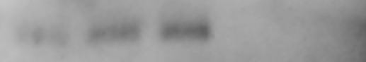
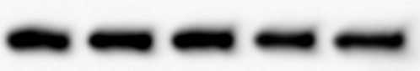
A
B
WT OE5 OE9 Cr1 Cr2
Anti-miPEP156e
Anti-Actin
Supplemental Figure 4. Expression levels of miR156e and miPEP156e in transgenic rice lines.
A, Abundance of mature miR156e in wild-type, miPEP156e-OE, and miPEP156e-Cr lines. Error bars represent SD (n = 3). B, Western blot analysis of miPEP156e protein abundance in wild-type, miPEP156e-OE, and miPEP156e-Cr lines using an endogenous miPEP156e-specific antibody. For miPEP156e antibody production, a synthetic peptide (MHGAQPPRQTPTNPPDHRDGNPSPAPFPVELAAATC) conjugated to KLH was used as an immunogen to generate a polyclonal antibody in rabbits. Immunoblotting with an anti-Actin antibody served as the loading control. "Cr" represents the miPEP156e-Cr mutants; "OE" represents the miPEP156e-OE lines. Asterisks indicate significant differences compared with the corresponding control group (*, P < 0.05; **, P < 0.01).

Slide 5
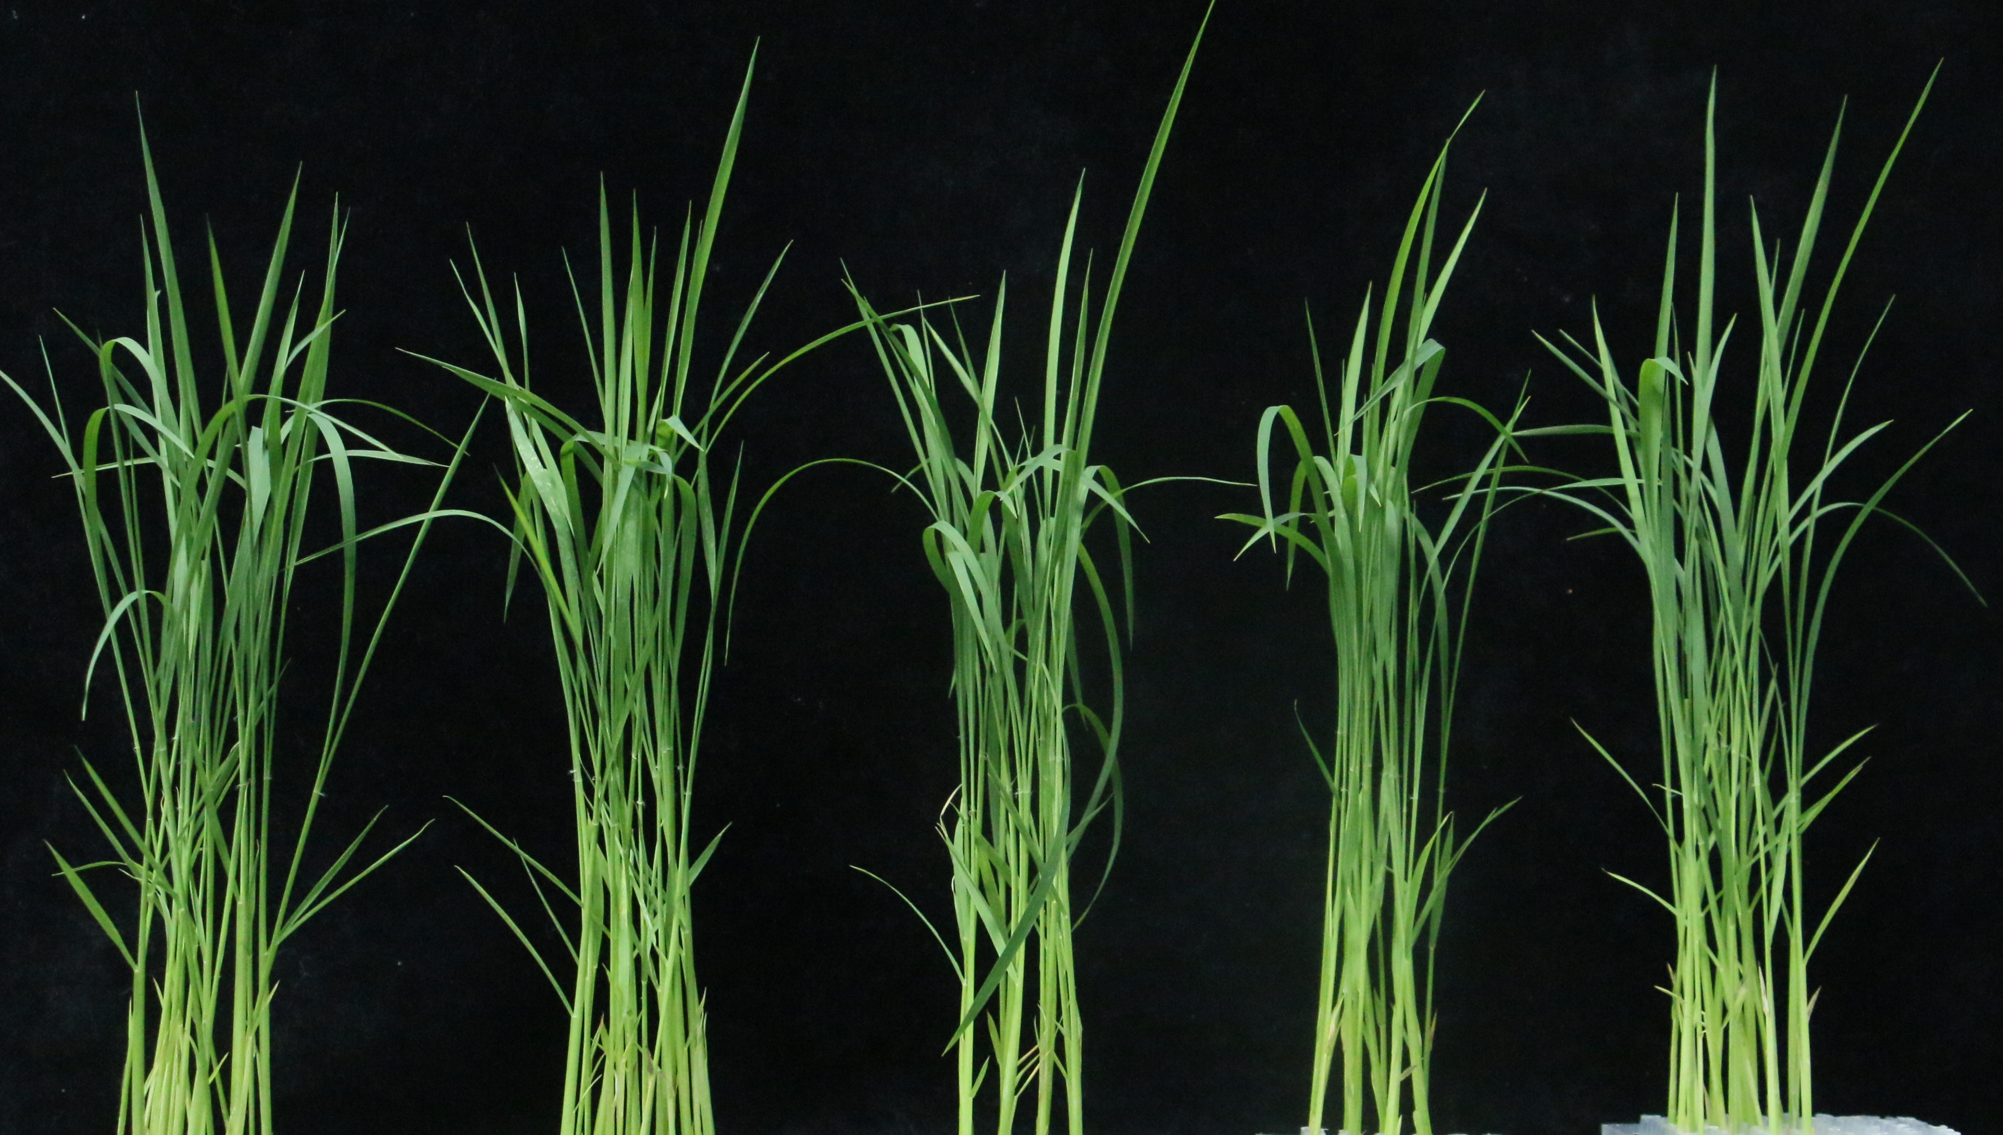
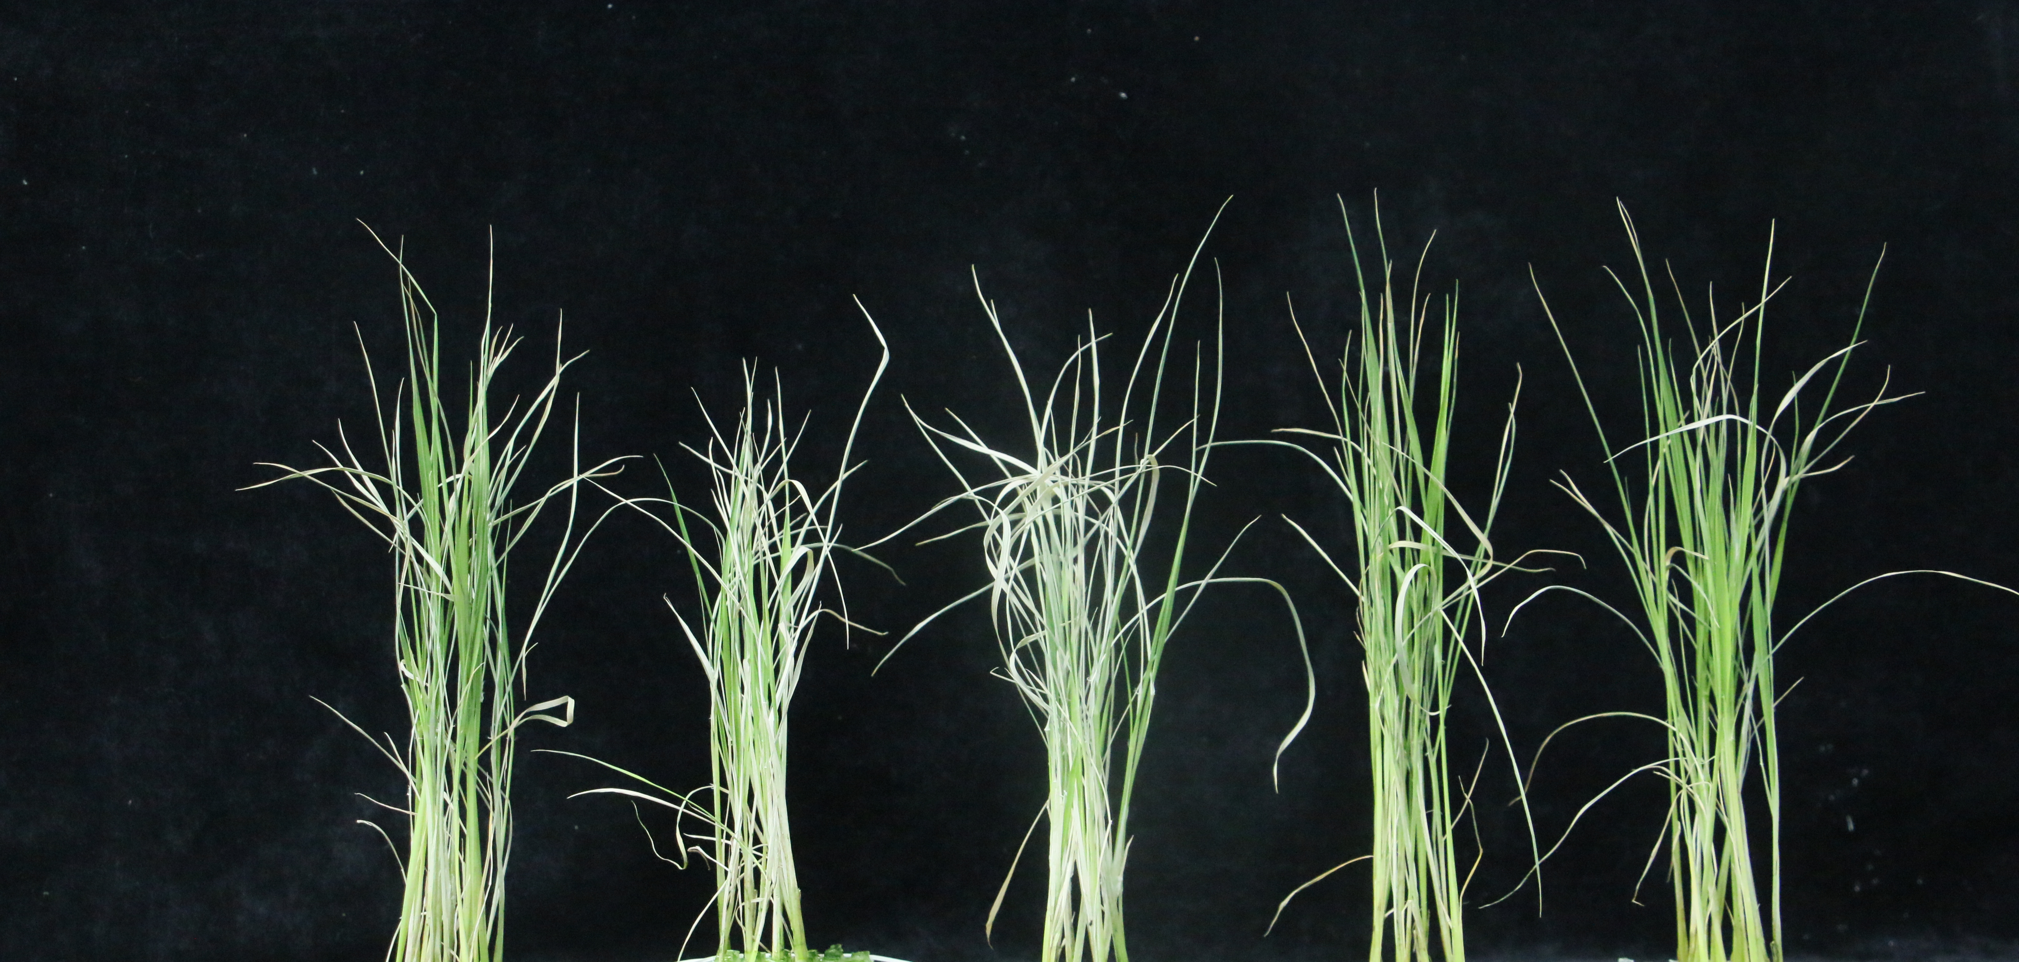
A
Before treatment
NaCl treatment for 7 days
B
Nip
Cr1
Cr2
Cr1
Cr2
Nip
Cr1
Cr2
Cr1
Cr2
Mock
miPEP156e
Mock
miPEP156e
Supplemental Figure 5. Exogenous miPEP156e application rescues the salt-sensitive phenotype of miPEP156e-Cr mutants.
A, Phenotypes of wild-type and two miPEP156e-Cr mutant lines treated with mock or synthetic miPEP156e under 120 mM NaCl for 7 days. Scale bar = 10 cm. B, Survival of the indicated seedlings after salt stress treatment. Error bars represent SD (n = 3). "Cr" represents the miPEP156e-Cr mutants. Asterisks indicate significant differences compared with the corresponding control group (*, P < 0.05; **, P < 0.01).

Slide 6
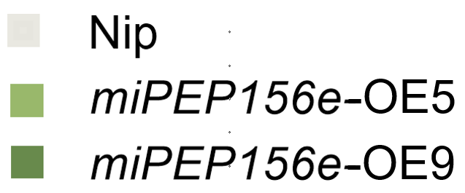
Supplemental Figure 6. qRT-PCR validation of salt-responsive genes in miPEP156e-OE lines.
Data are presented as the mean ± standard deviation (SD) of three biological replicates. Asterisks indicate significant differences compared with the corresponding control group (*, P < 0.05; **, P < 0.01).

Slide 7
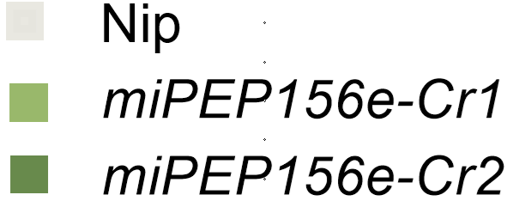
A
B
C
Supplemental Figure 7. Expression patterns of SPL family members.
A, Expression of SPL genes in the miPEP156e mutants under salt stress. Error bars represent standard deviation (n = 3). B, Effect of exogenous miPEP156e application on SPL2 transcript levels. Error bars represent standard deviation (n = 3). C, SPL2 expression levels in miR156-OE and miPEP156e-OE lines. Error bars represent SD (n = 3). Asterisks indicate significant differences compared to the corresponding control group (*, P < 0.05; **, P < 0.01).

Slide 8
A
Effector
B
C
35S
Myc
35S
miPEP156e
35S
miR156e
Reporter
35S
REN
LUC
CDS_{SPL2}
35S
REN
LUC
CDS_{mspl2}
Supplemental Figure 8. miPEP156e suppresses OsSPL2 expression via a miR156-dependent mechanism.
A, Schematic representation of the effector and reporter constructs used in the dual-luciferase assay. The effectors consist of Myc (control), miPEP156e, and miR156e under the control of the 35S promoter. The reporters contain the luciferase (LUC) gene fused with either the wild-type sequence of SPL2 containing the miR156 target site (CDS_{SPL2}​ : 5'-TGTGCTCTCTCTCTTCTGTCA-3') or a mutated version (CDS_{mspl2}​ : 5'-TaTGaTaTaTcTTTaCaGTtA-3', mutated bases are shown in lowercase). B, Relative LUC/REN activity in rice protoplasts co-transfected with the CDS_{SPL2}​ reporter and indicated effectors. Overexpression of either miPEP156e or miR156e significantly suppressed the luciferase activity. Error bars represent SD (n = 3). C, Relative LUC/REN activity in rice protoplasts co-transfected with the CDS_{mspl2} ​ reporter and indicated effectors. The inhibitory effects of miPEP156e and miR156e were abolished when the miR156 target site was mutated. Error bars represent SD (n = 3). Asterisks indicate significant differences compared to the corresponding control group (*, P < 0.05; **, P < 0.01).

Slide 9
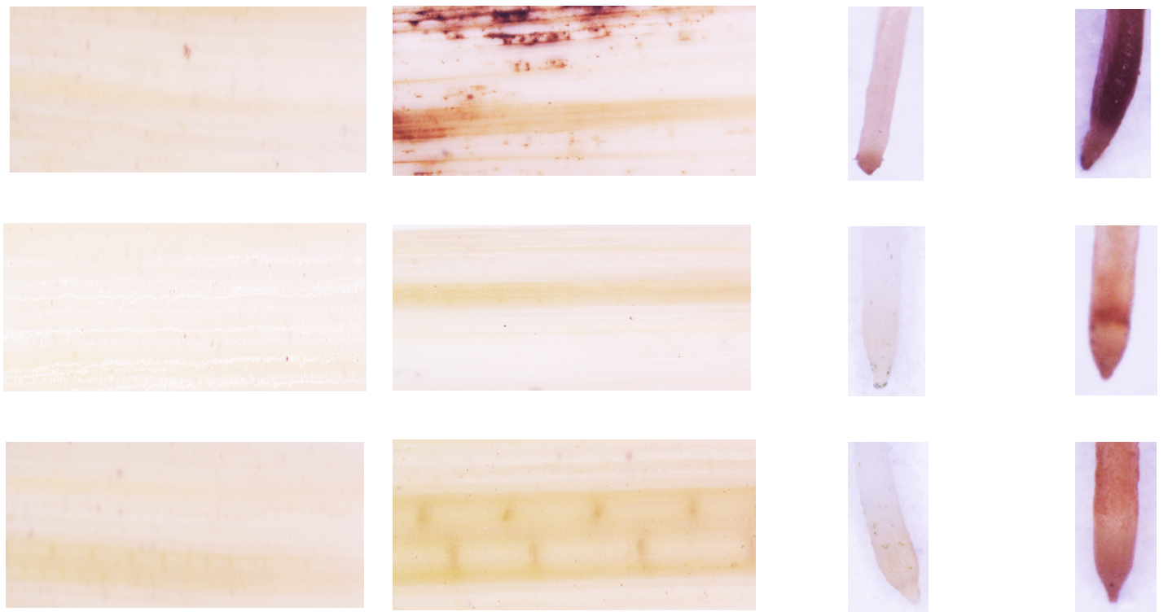
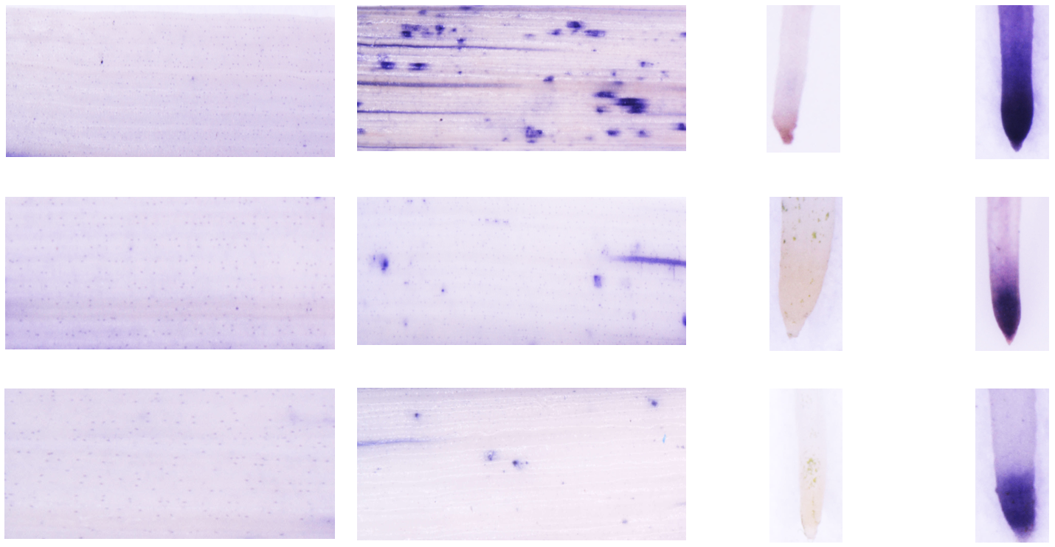
A
B
-Na
+Na
-Na
+Na
-Na
+Na
-Na
+Na
ZH11
ZH11
spl2-1
spl2-1
spl2-2
spl2-2
bar= 0.5 cm
bar= 0.5 cm
bar= 0.5 cm
bar= 0.5 cm
C
D
Supplemental Figure 9. The spl2 mutation enhances salt tolerance by reducing ROS accumulation and maintaining ion homeostasis.
A, DAB staining of leaves and roots of wild-type and spl2 rice seedlings after NaCl treatment. The brown color indicates H₂O₂ level in each leaf and root. B, NBT staining of leaves and roots of wild-type and spl2 rice seedlings after NaCl treatment. The blue color indicates O₂^{•-} level in each leaf and root. C, Na⁺, K⁺ levels, and Na⁺/K⁺ ratio in the shoots of wild-type and spl2 rice seedlings under 120 mM NaCl stress for 7 days. Error bars represent SD (n = 3). D, Na⁺, K⁺ levels, and Na⁺/K⁺ ratio in the roots of wild-type and spl2 rice seedlings under 120 mM NaCl stress for 7 days. Error bars represent SD (n = 3). Asterisks indicate significant differences compared to the corresponding control group (*, P < 0.05; **, P < 0.01).

