Slide 1
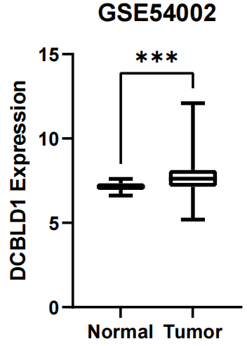
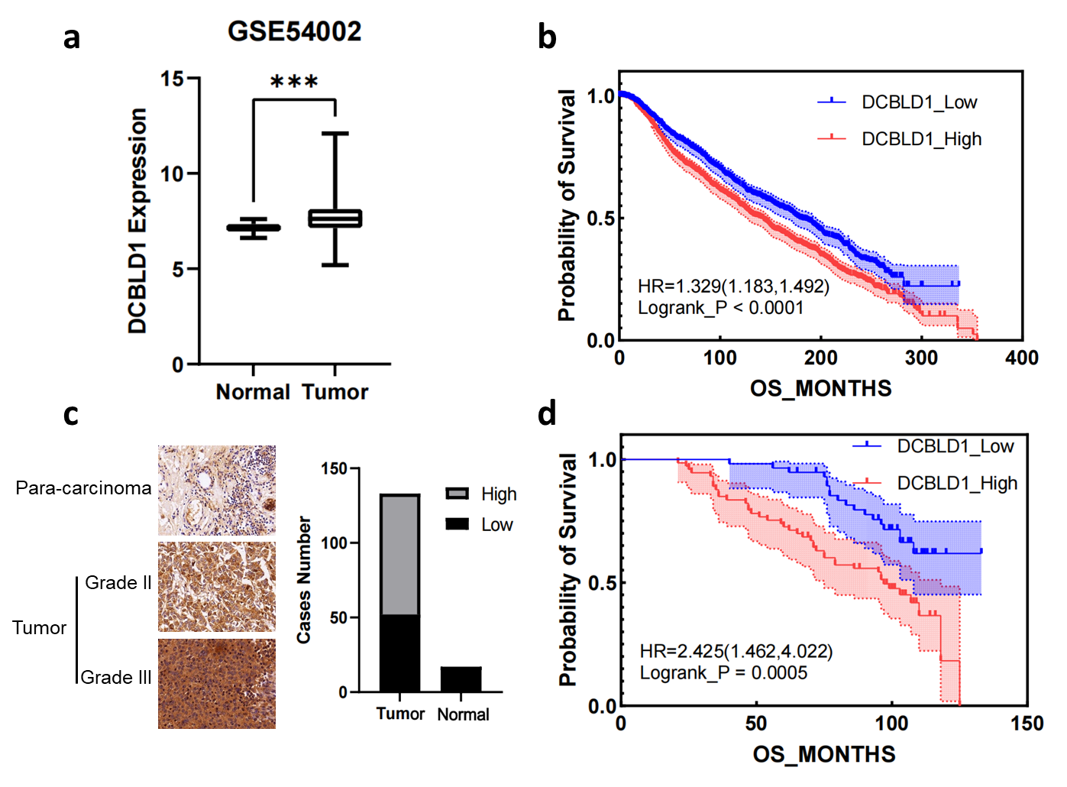
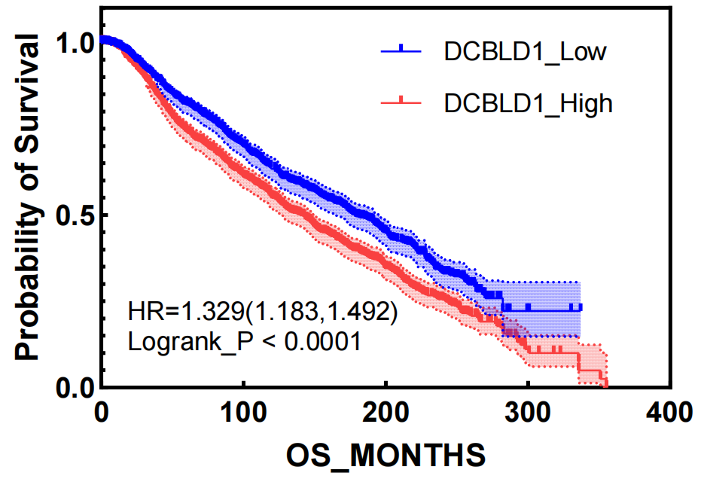
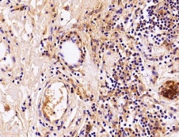
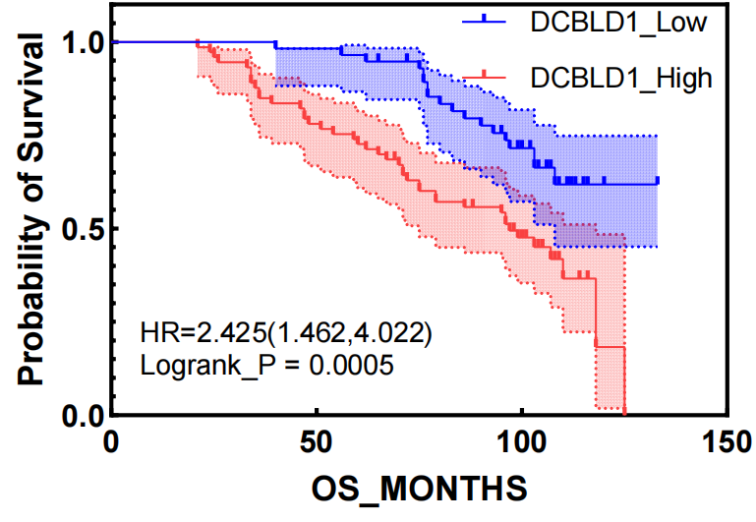
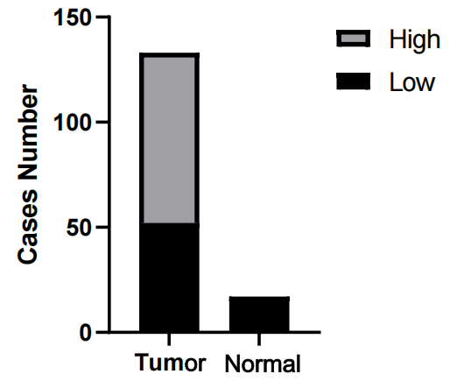
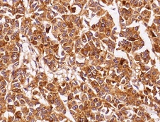
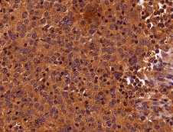
Figure 1
a
b
c
d
Para-carcinoma
Grade II
Tumor
Grade III
Notes:
Fig.1 DCBLD1 is highly expressed in breast cancer and correlates with unfavorable prognosis. a DCBLD1 expression in breast cancer tissues and normal tissues in GSE54002 (P-value = 0.0113; adjusted P-value [Padj] = 0.0225, Benjamini-Hochberg corrected). The log2 Fold Change (log2FC) of DCBLD1 expression between cancerous and normal tissues was 0.536, indicating a notable upregulation in tumors. b Survival analysis of breast cancer samples from the METABRIC database in high DCBLD1 high expression vs low expressions. high DCBLD1 expression in breast cancer was significantly associated with poorer overall survival (Log-rank P = 1.93e-06; HR = 1.33, 95% CI: 1.18-1.49). c DCBLD1 expression in breast cancer tissues and para-carcinoma tissues on human tissue microarrays. d Survival analysis of breast cancer samples from the human tissue microarrays in high DCBLD1 high expression vs low expressions (Log-rank P = 0.0005; HR = 2.43, 95% CI: 1.46-4.02).

Slide 2
Table 1. Relationship between DCBLD1 expression and tumor characteristics in patients with breast cancer.
Characteristic | No. of patients | DCBLD1 expression |  | p value
 |  | Low | High
All patients | 133 | 52 | 81
Age (years) |  |  |  | 0.945
≤47 | 67 | 26 | 41
＞47 | 66 | 26 | 40
Grade |  |  |  | P＜0.001
II | 75 | 48 | 27
III | 58 | 4 | 54
tumor size (cm) |  |  |  | 0.574
＜3.5 | 68 | 25 | 43
≥3.5 | 65 | 27 | 38
T stage |  |  |  | 0.174
T1 | 20 | 6 | 14
T2 | 82 | 31 | 51
T3 | 31 | 15 | 16
Nodal Staging（N） |  |  |  | 0.723
N0 | 42 | 16 | 26
N1 | 40 | 17 | 23
N2 | 46 | 19 | 27
N3 | 5 | 0 | 5
Metastasis Staging |  |  |  | 0.009
M0 | 115 | 50 | 65
M1 | 18 | 2 | 16
Notes:
Correlation of DCBLD1 Expression with Clinicopathological Factors in Breast Cancer

Slide 3
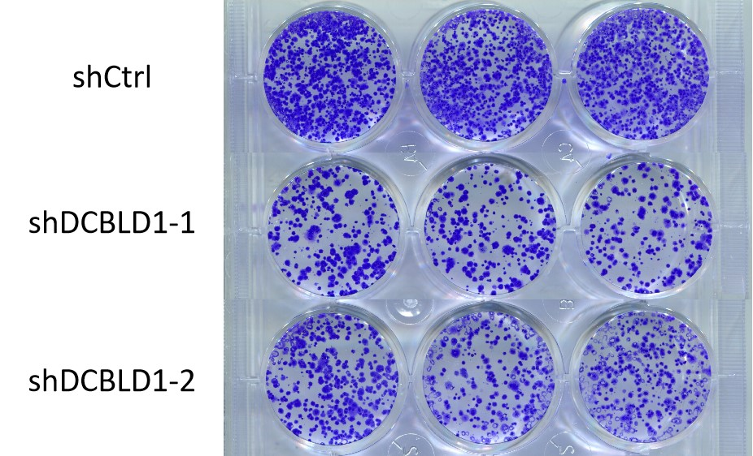
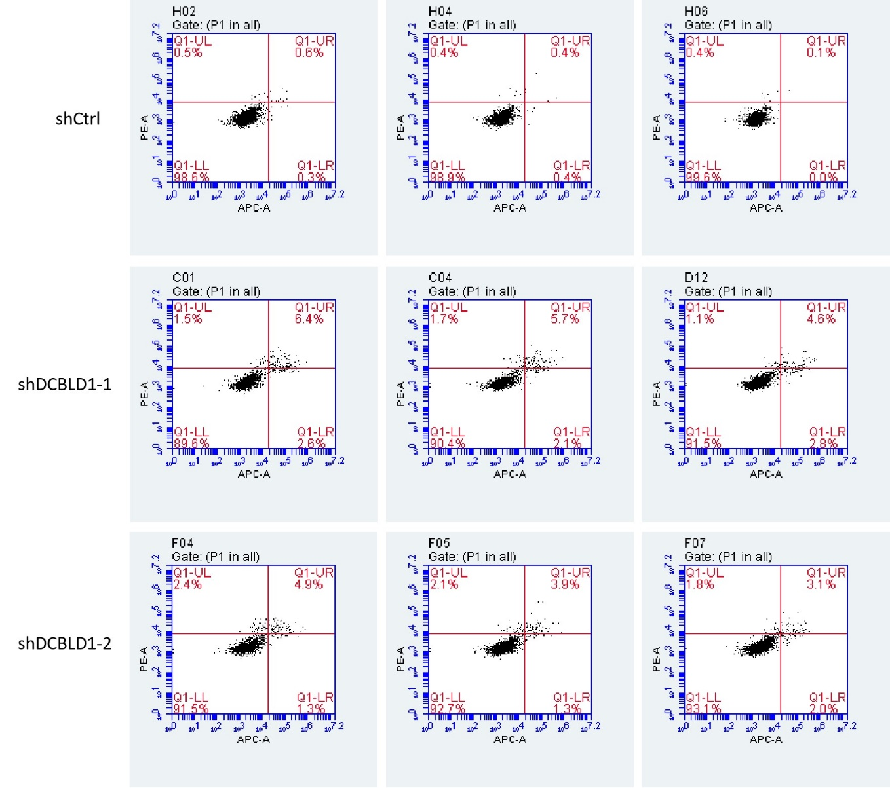
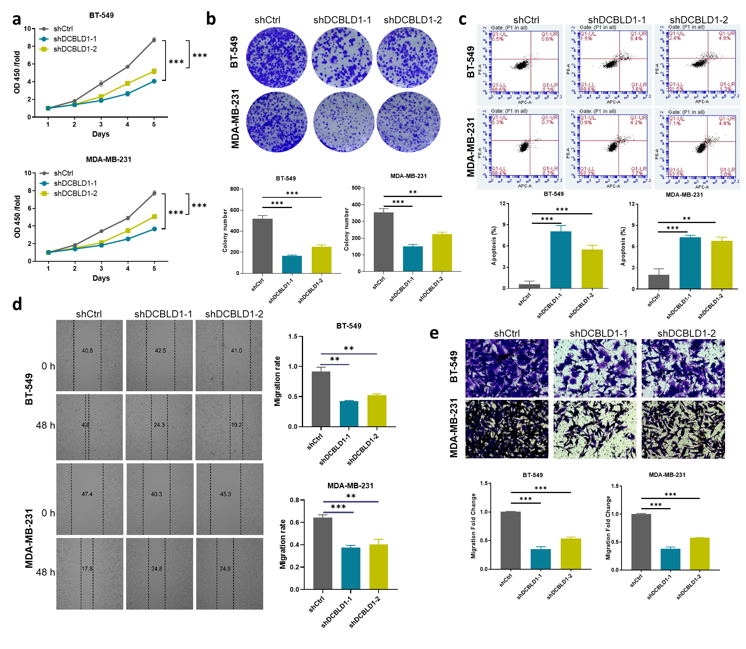
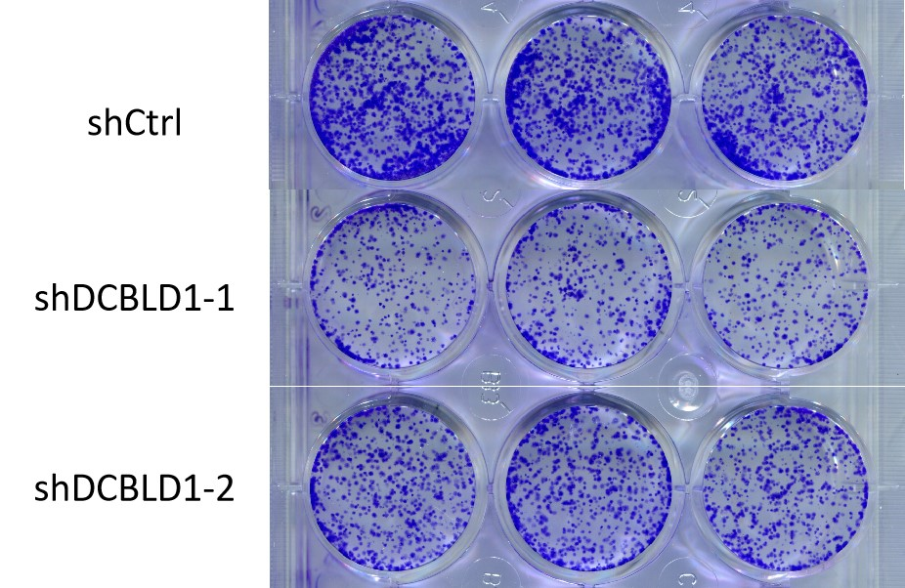
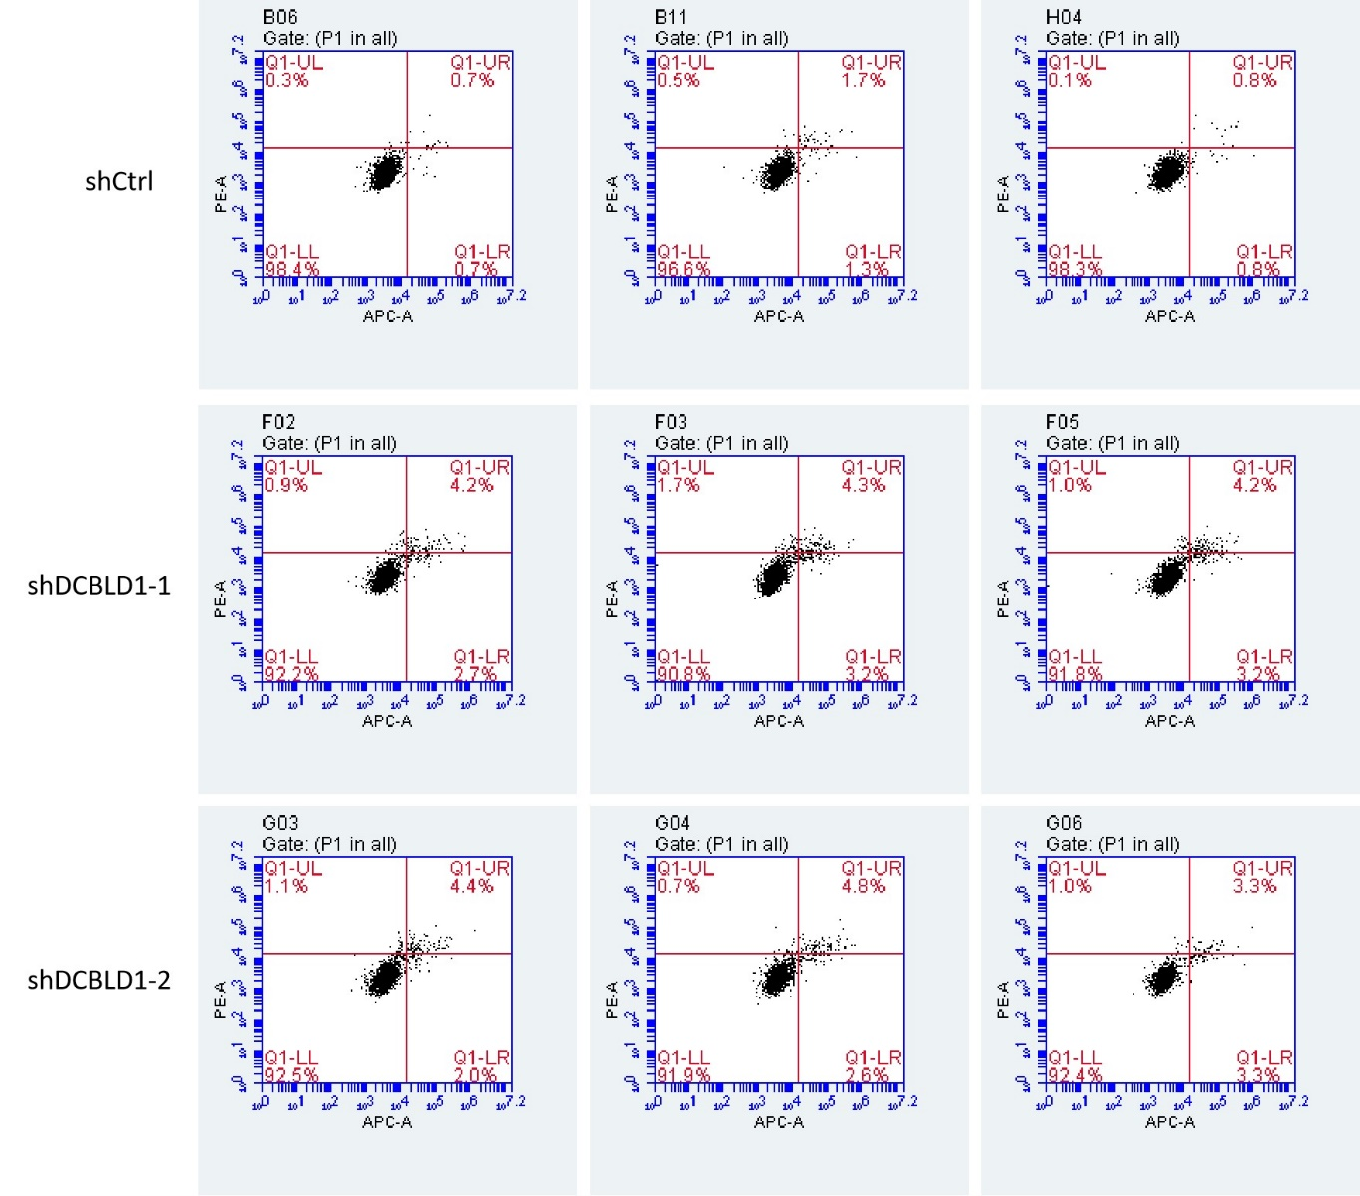
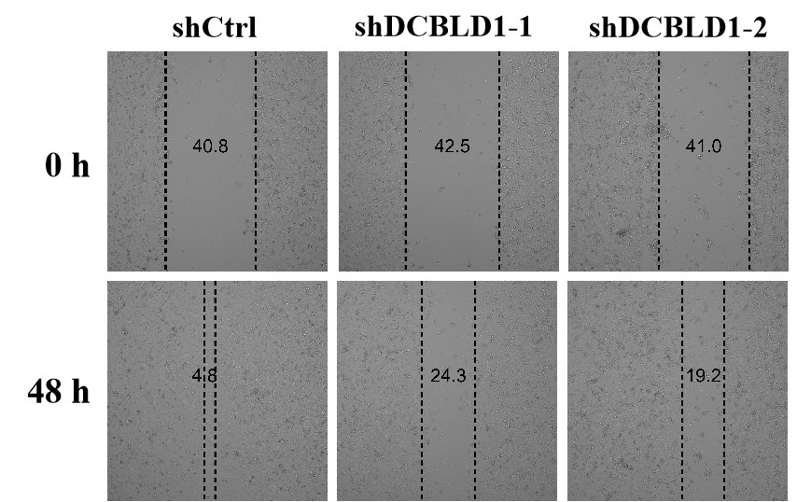
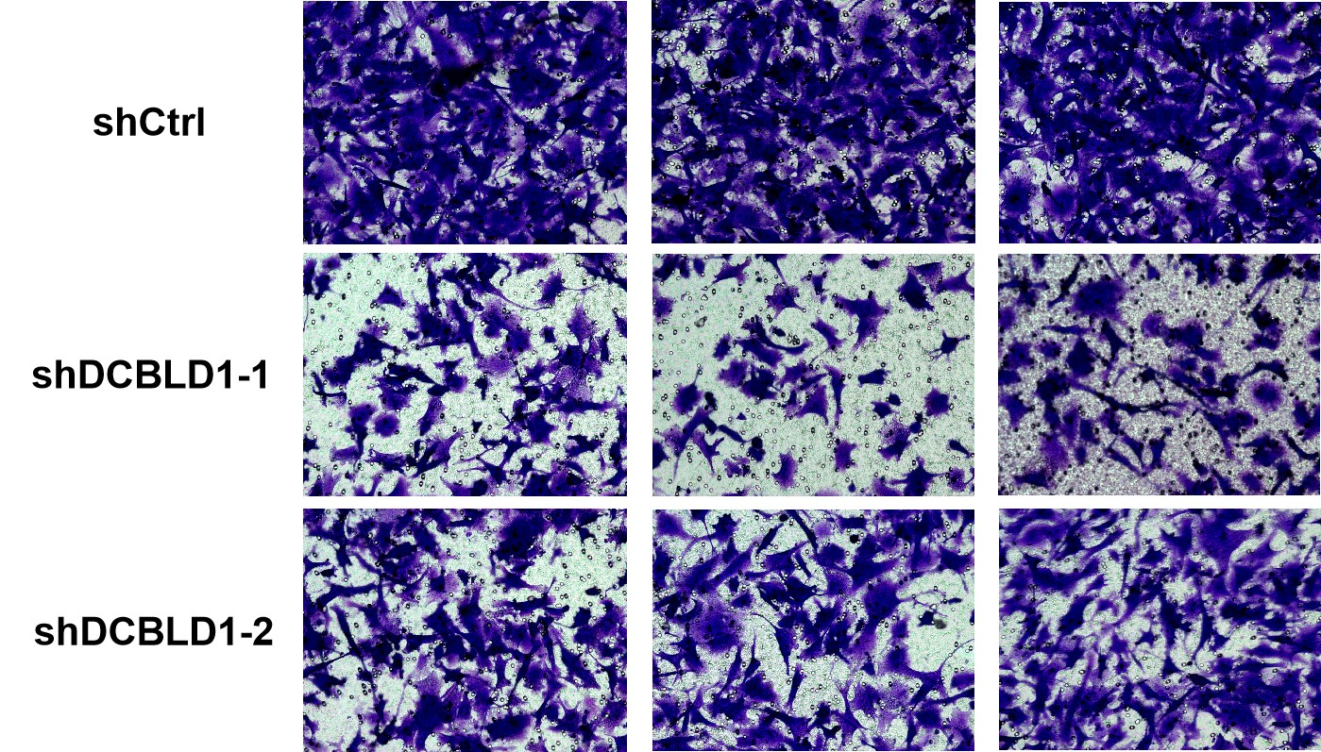
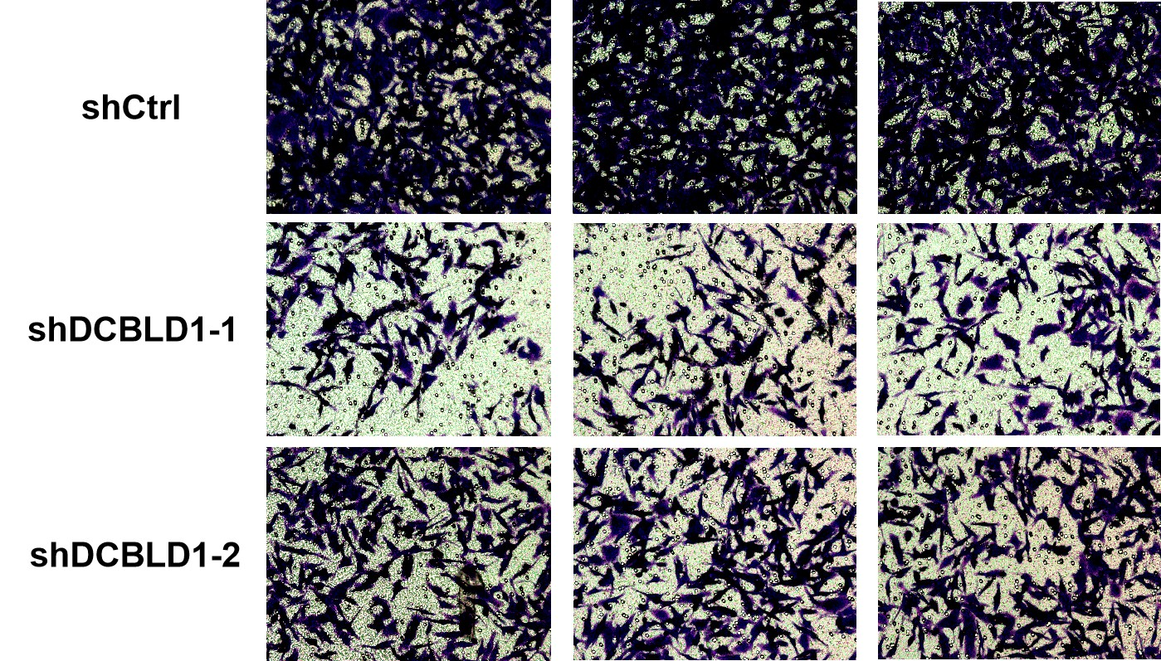
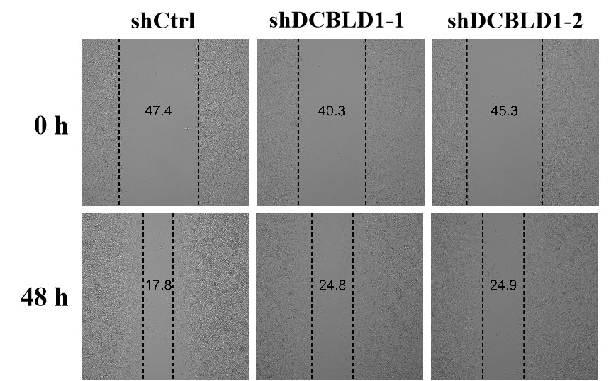
a
b
shCtrl
shDCBLD1-1
shDCBLD1-2
c
shCtrl
shDCBLD1-1
shDCBLD1-2
Figure 2
BT-549
BT-549
MDA-MB-231
MDA-MB-231
d
shCtrl
shDCBLD1-1
shDCBLD1-2
e
shCtrl
shDCBLD1-1
shDCBLD1-2
BT-549
0 h
48 h
BT-549
MDA-MB-231
0 h
48 h
MDA-MB-231
Notes:
Fig. 2 DCBLD1 knockdown inhibits malignant phenotypes of breast cancer cells. a Cell proliferation was evaluated using the Cell Counting Kit-8 (CCK-8) assay measured by the absorbance of OD450. b Cell proliferative capacity was assessed using a colony formation assay. c Cell apoptosis assessment via flow cytometry. d Assessing cell migration and invasion using a wound healing assay. e Assessing the migratory and invasive capabilities of tumor cells using a Transwell assay.

Slide 4
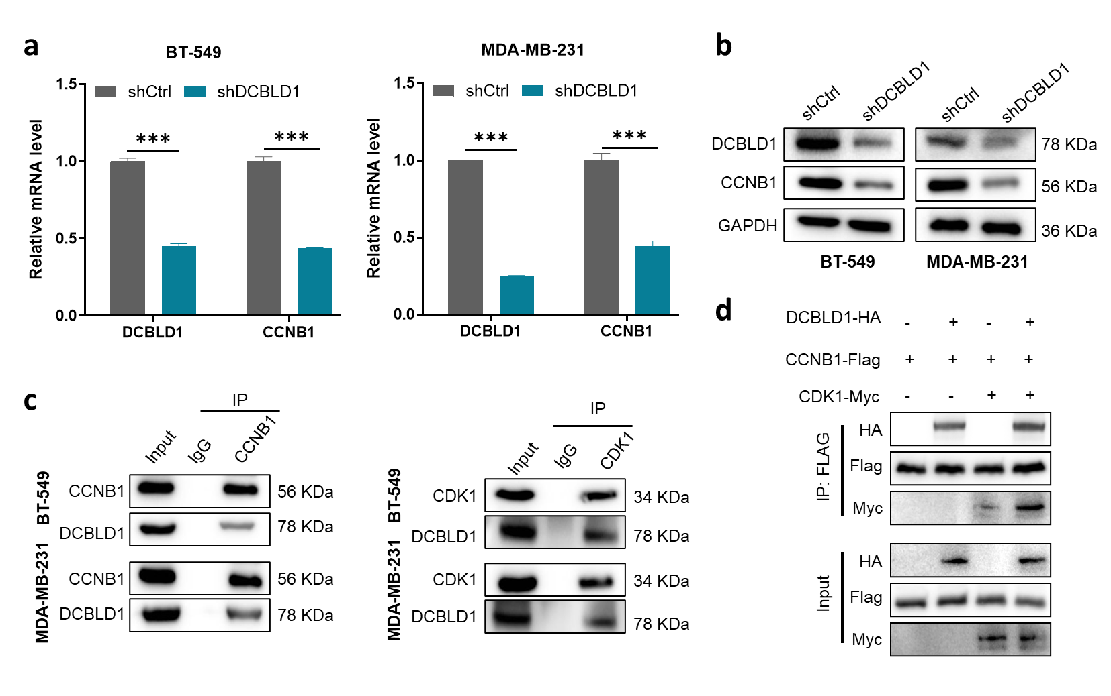




















Figure 3
a
b
shCtrl
shDCBLD1
shCtrl
shDCBLD1
DCBLD1
78 KDa
CCNB1
56 KDa
GAPDH
36 KDa
BT-549
MDA-MB-231
d
DCBLD1-HA
- + - +
CCNB1-Flag
+ + + +
c
IP
CDK1-Myc
- - + +
IP
CCNB1
CDK1
HA
Input
IgG
Input
IgG
IP: FLAG
Flag
BT-549
CCNB1
56 KDa
BT-549
CDK1
34 KDa
Myc
DCBLD1
78 KDa
DCBLD1
78 KDa
HA
CCNB1
56 KDa
CDK1
34 KDa
Input
MDA-MB-231
MDA-MB-231
Flag
DCBLD1
78 KDa
DCBLD1
78 KDa
Myc
Notes:
Fig.3 DCBLD1 regulates CCNB1 expression and interacts with the CCNB1-CDK1 complex. a mRNA level analysis of CCNB1 in DCBLD1-knockdown cells by qPCR. b Western blot analysis of CCNB1 expression in DCBLD1-knockdown cells. c Co-IP experiment to analyze the relationship between DCBLD1 and CCNB1 or CDK1 in HEK293T cells. d Co-IP experiment to analyze the relationship between DCBLD1 and the CCNB1-CDK1 complex in HEK293T cells.

Slide 5
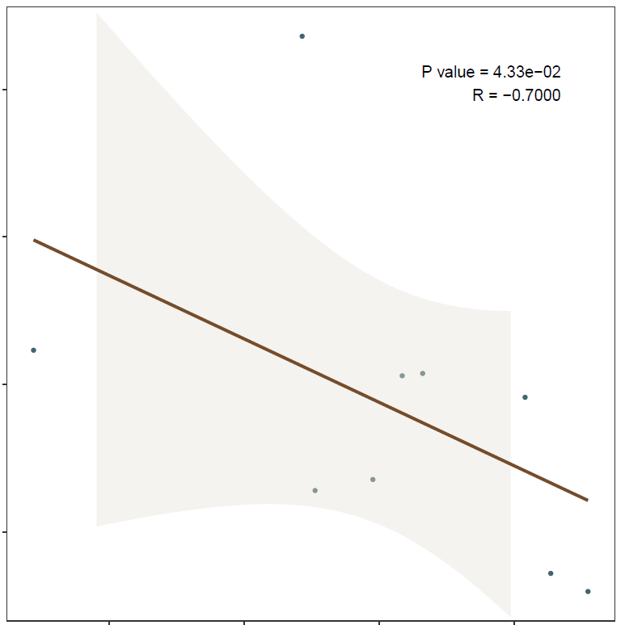
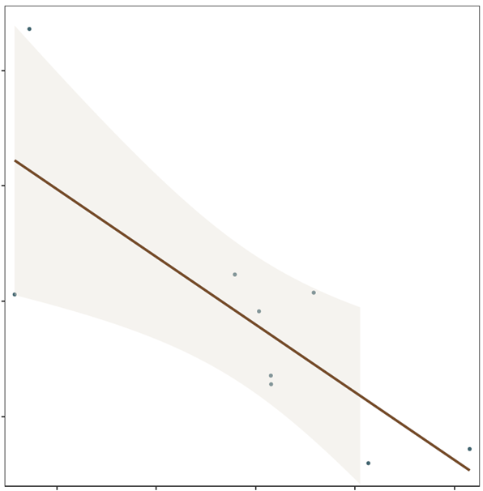
















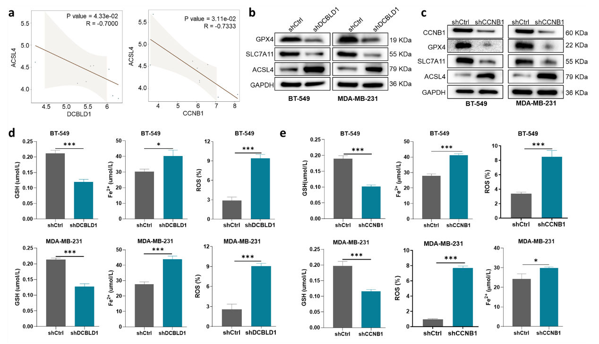


Figure 4
a
b
c
P value = 4.33e-02
R = -0.7000
P value = 3.11e-02
R = -0.7333
shDCBLD1
shDCBLD1
shCtrl
shCCNB1
shCtrl
shCCNB1
5.5
5.0
4.5
4.0
5.5
5.0
4.5
4.0
shCtrl
shCtrl
CCNB1
60 KDa
GPX4
19 KDa
22 KDa
GPX4
ACSL4
ACSL4
SLC7A11
55 KDa
SLC7A11
55 KDa
ACSL4
79 KDa
ACSL4
79 KDa
GAPDH
36 KDa
GAPDH
36 KDa
BT-549
MDA-MB-231
BT-549
MDA-MB-231
4.5 5.0 5.5 6
DCBLD1
5 6 7 8
CCNB1
d
e
Notes:
Fig.4 DCBLD1 and CCNB1 regulate ferroptosis pathway activity. a Spearman correlation analysis between DCBLD1/ CCNB1 and ACSL4 in GSE54002.b Western blot analysis of ferroptosis-related proteins (GPX4/SLC7A11/ACSL4) expression in DCBLD1-knockdown cells. c Western blot analysis of ferroptosis-related proteins (GPX4/SLC7A11/ACSL4) expression in CCNB1-knockdown cells. d Analysis of key ferroptotic metabolic indicators (GSH/intracellular iron/reactive oxygen species) level in DCBLD1-knockdown cells. e Analysis of key ferroptotic metabolic indicators (GSH/intracellular iron/reactive oxygen species) level in CCNB1-knockdown cells.

Slide 6
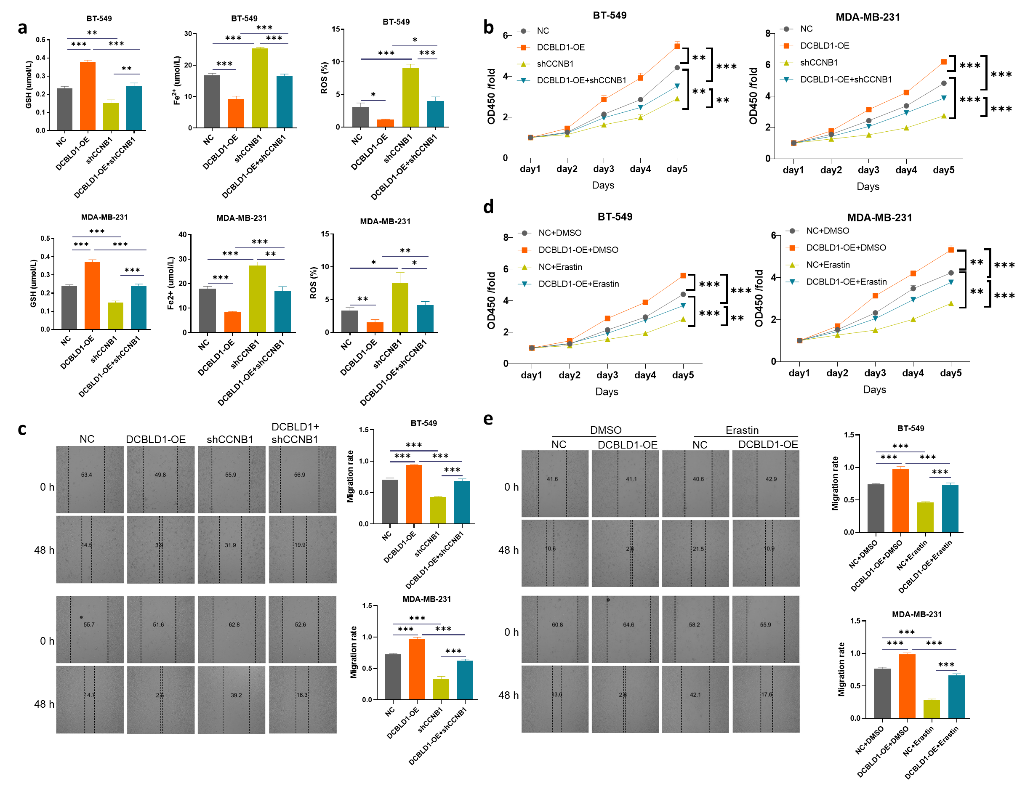
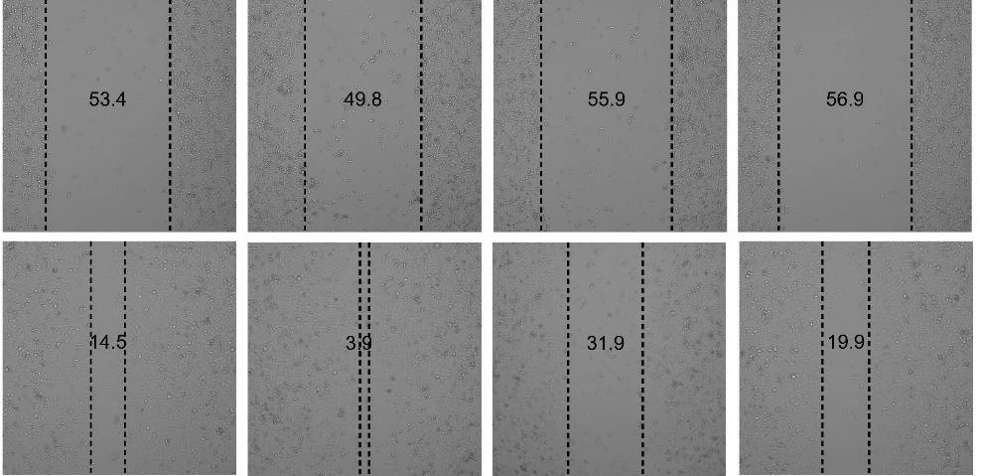
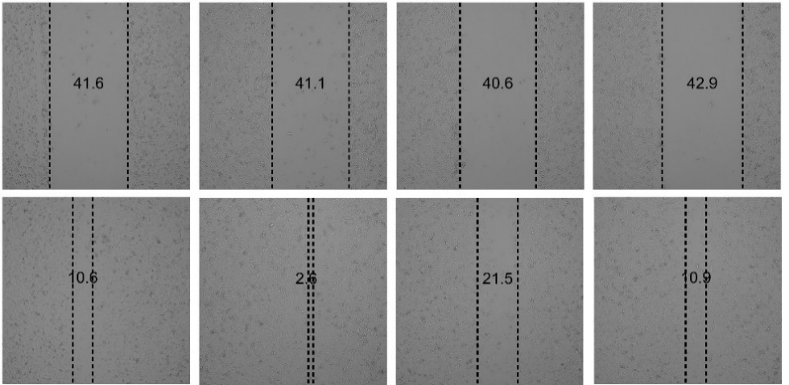
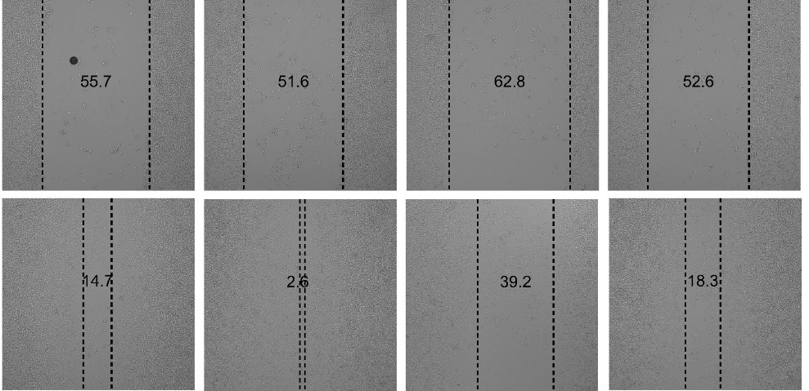
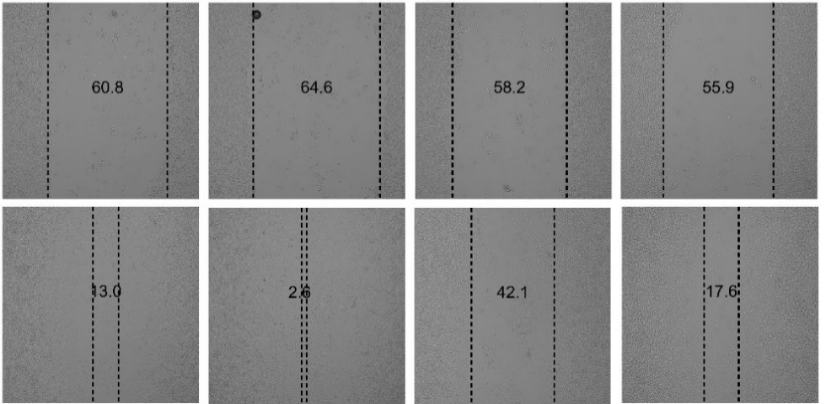
Figure 5
a
b
d
e
c
DCBLD1+
shCCNB1
DMSO
Erastin
NC
DCBLD1-OE
shCCNB1
NC
DCBLD1-OE
NC
DCBLD1-OE
0 h
48 h
0 h
48 h
0 h
48 h
0 h
48 h
Notes:
Fig.5 DCBLD1-CCNB1 signaling axis-mediated ferroptosis suppression drives breast cancer. a GSH concentration, intracellular labile iron (Fe2+) content, and ROS accumulation in DCBLD1 overexpression, CCNB1 knockdown, and DCBLD1 overexpression + CCNB1 knockdown breast cancer cells. b Cell proliferation quantified by the CCK-8 assay in DCBLD1 OE, CCNB1 KD, DCBLD1 OE + CCNB1 KD, and DCBLD1 OE cells treated with Erastin (ferroptosis inducer). c Cell proliferation measured by the colony formation assay in DCBLD1 OE, CCNB1 KD, DCBLD1 OE + CCNB1 KD, and DCBLD1 OE cells treated with Erastin. d Cell proliferation quantified by the CCK-8 assay in DCBLD1 OE, CCNB1 KD, and DCBLD1 OE cells treated with Erastin (ferroptosis inducer). e Cell migration measured by the Transwell assay in DCBLD1 OE, CCNB1 KD, DCBLD1 OE + CCNB1 KD, and DCBLD1 OE cells treated with Erastin.

Slide 7
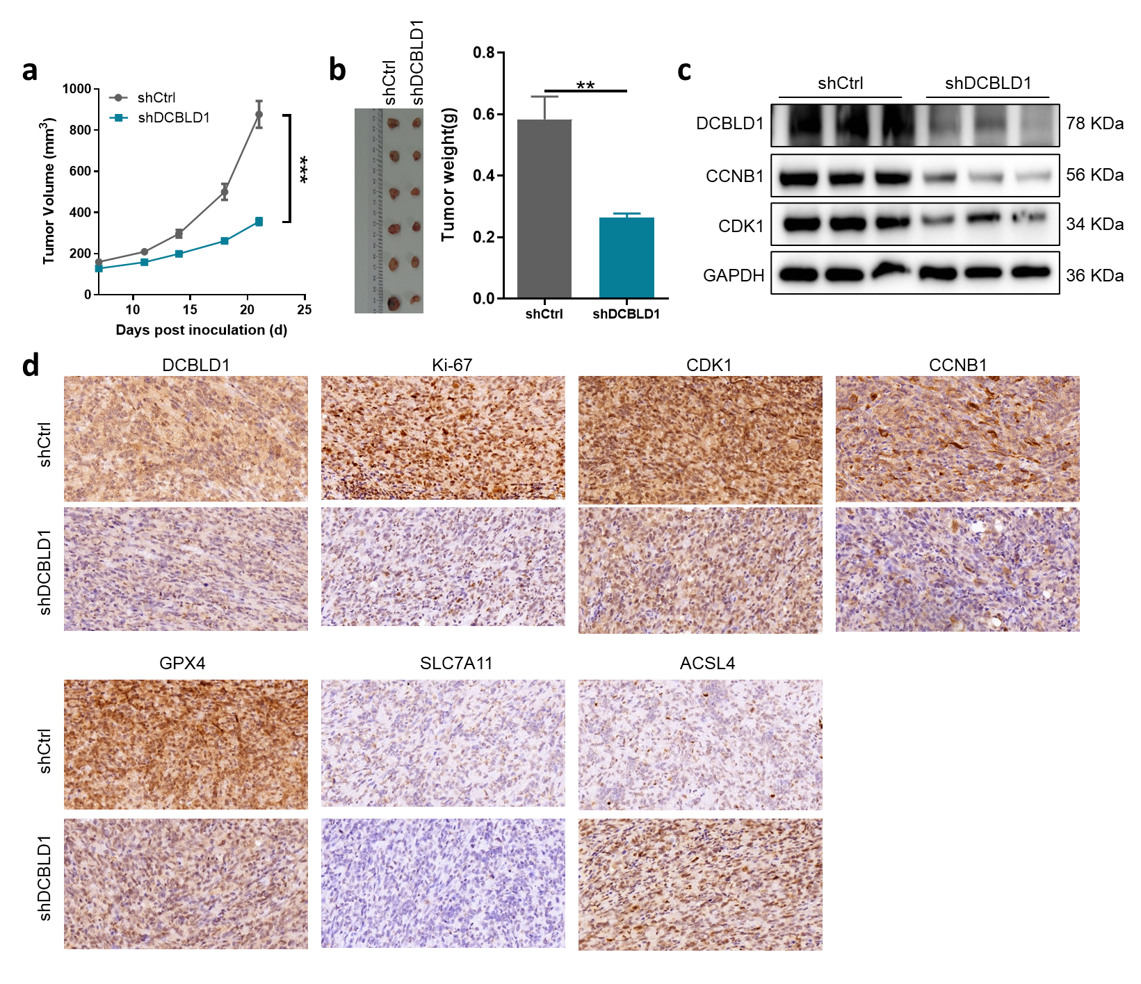

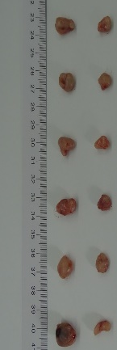


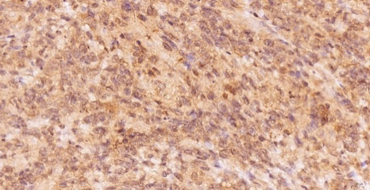
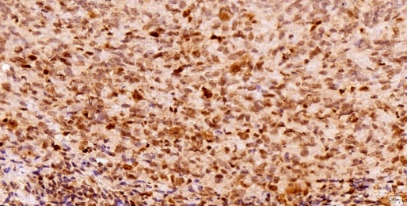
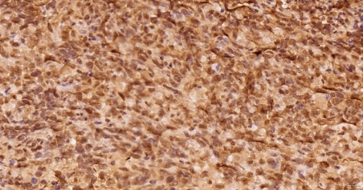
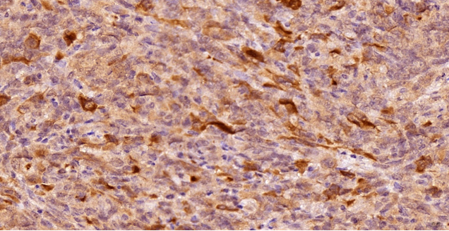
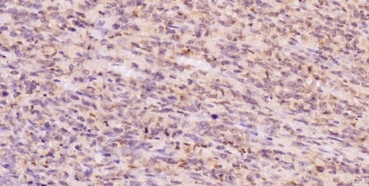
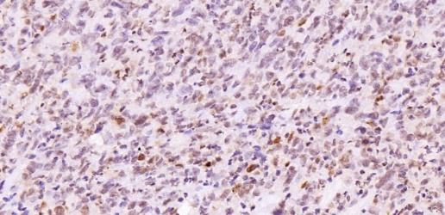
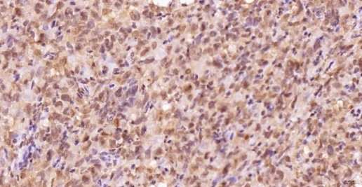
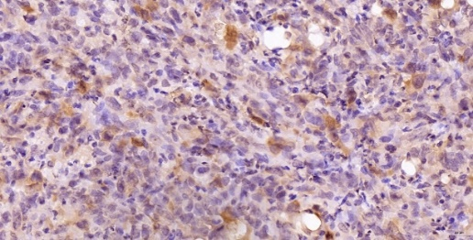
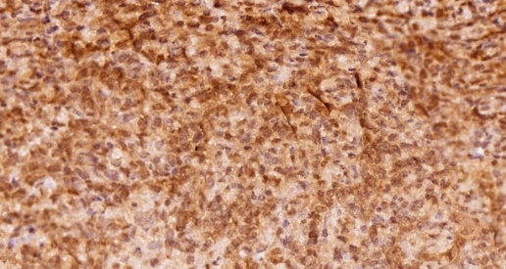
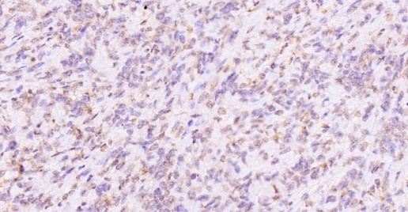
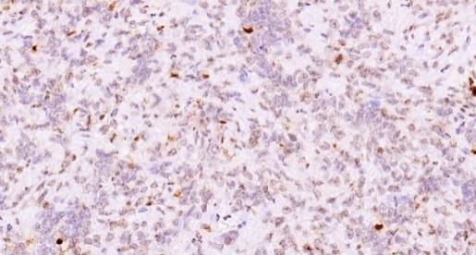
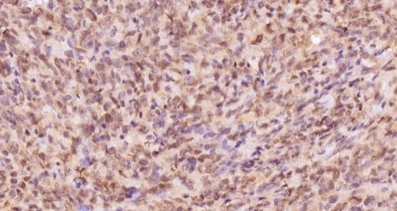
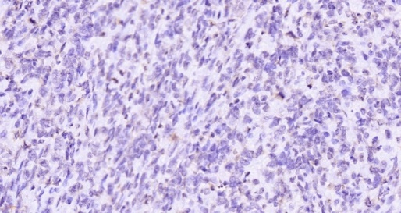
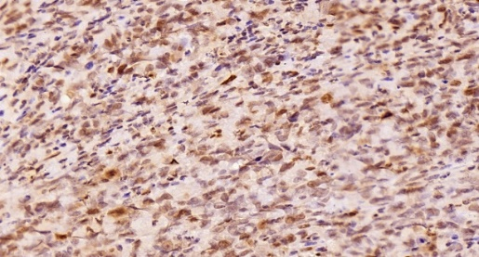
Figure 6
a
b
c
shCtrl
shDCBLD1
shCtrl
shDCBLD1
DCBLD1
78 KDa
CCNB1
56 KDa
CDK1
34 KDa
GAPDH
36 KDa
d
DCBLD1
Ki-67
CDK1
CCNB1
shCtrl
shDCBLD1
GPX4
SLC7A11
ACSL4
shCtrl
shDCBLD1
Notes:
Fig.6 In vivo validation of the DCBLD1-CCNB1 axis promoting malignant cancer progression. Tumor growth and Western blot analysis: a Tumor volume monitored over the designated experimental period. b Macroscopic size and weight of tumors harvested at the study endpoint. c Western blot analysis of DCBLD1, CCNB1, and CDK1 expression in harvested tumor tissues. Immunohistochemistry (IHC) Analysis: The expression levels of the indicated proteins were assessed using Immunohistochemistry (IHC) analysis on paraffin-embedded tumor tissue samples. d DCBLD1 expression. e Ki67 expression (proliferation marker). f CDK1 expression. g CCNB1 expression. h GPX4 expression. i SLC7A11 expression. j ACSL4 expression.

Slide 8




Figure S1
a
b
c
d
shDCBLD1-1
shDCBLD1-2
shDCBLD1-2
shDCBLD1-1
shCtrl
shCtrl
DCBLD1
68 KDa
GAPDH
36 KDa
BT-549
MDA-MB-231

Slide 9
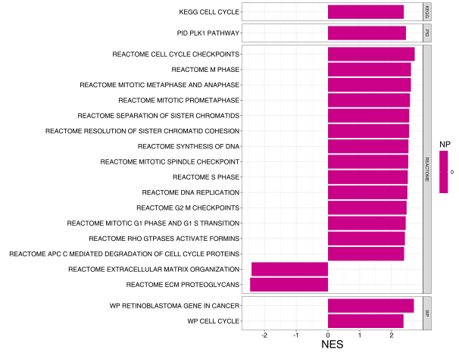
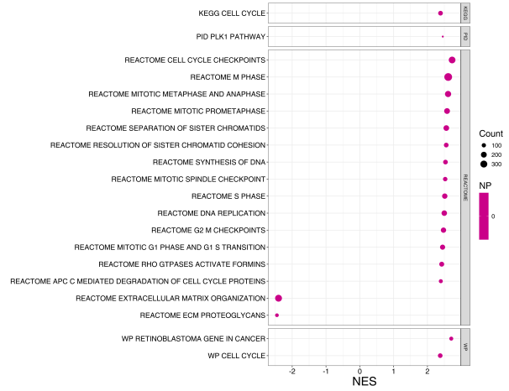
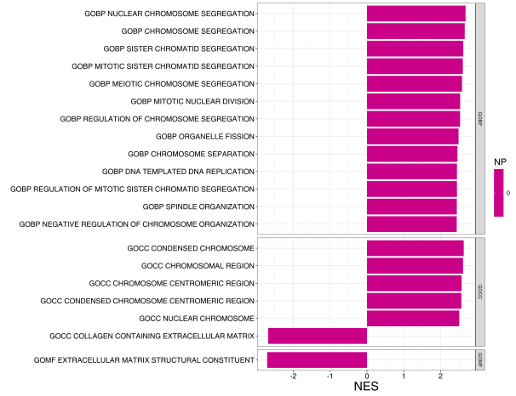
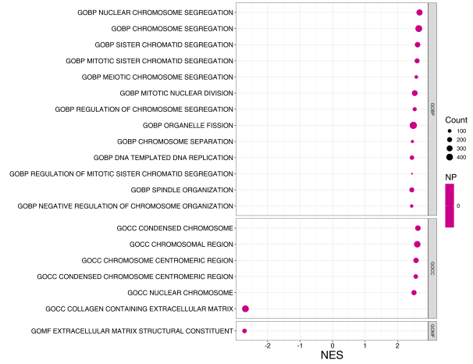
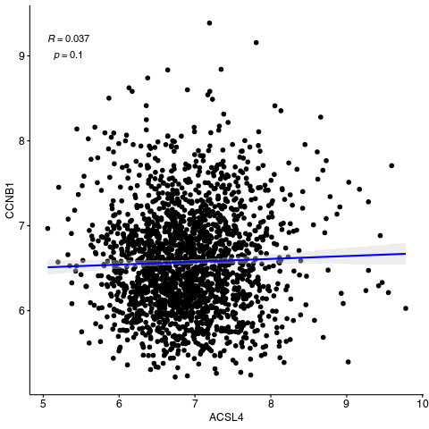
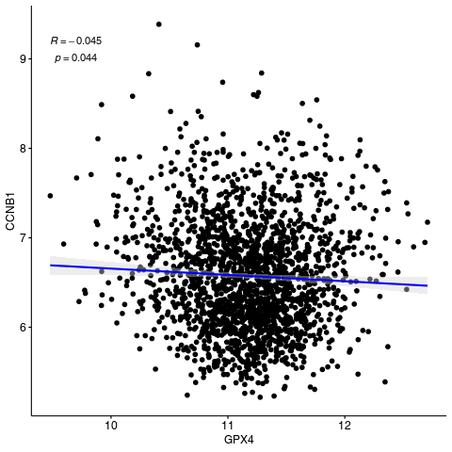
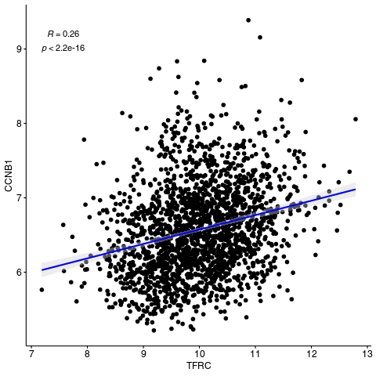
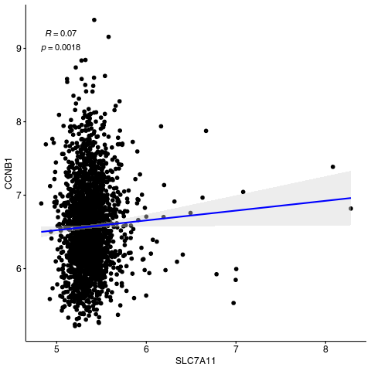

Fig. S2:
a
b
c
d
e
f
g
h
i

Slide 10

Fig. S3:

