Slide 1




Protein level of the target is detected by Western blot
DCBLD1
DCBLD1
GAPDH
GAPDH
BT-549
MDA-MB-231

Slide 2
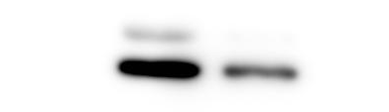

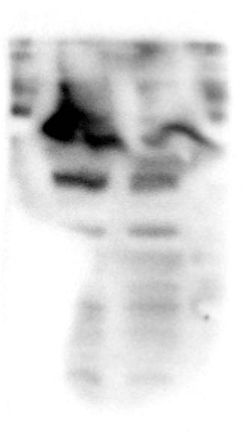
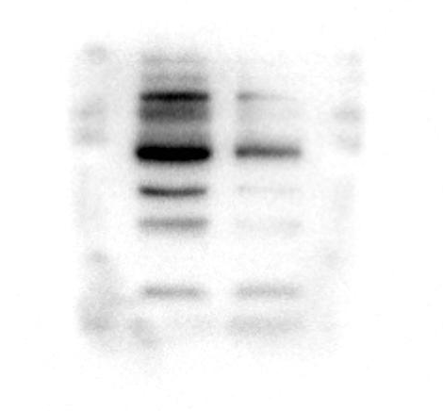

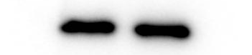
Clarify the regulation of transcription and translation levels of CCNB1 by DCBLD1
BT-549
MDA-MB-231
CCNB1
CCNB1
DCBLD1
DCBLD1
GAPDH
GAPDH

Slide 3
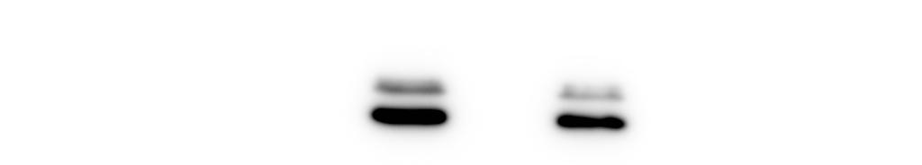
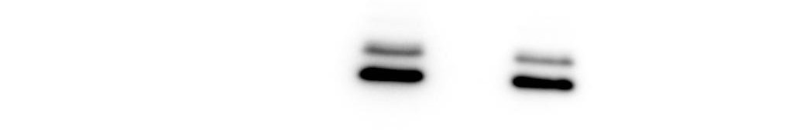
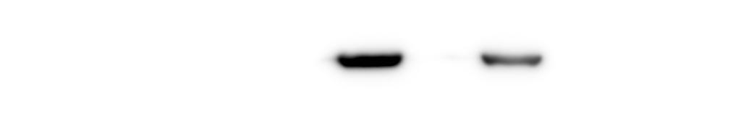

Clarify the interaction between DCBLD1 and CCNB1
Co-IP MDA-MB-231 CCNB1
Co-IP BT-549 CCNB1
CCNB1
CCNB1
DCBLD1
DCBLD1

Slide 4

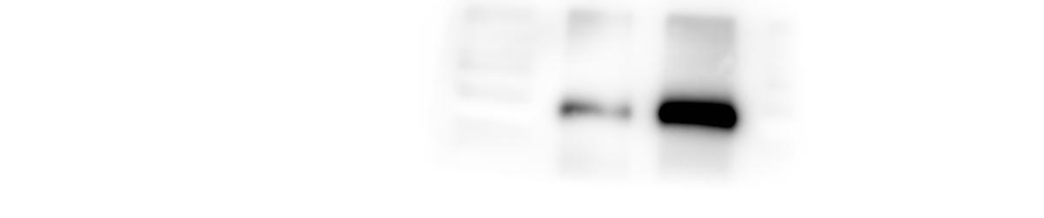

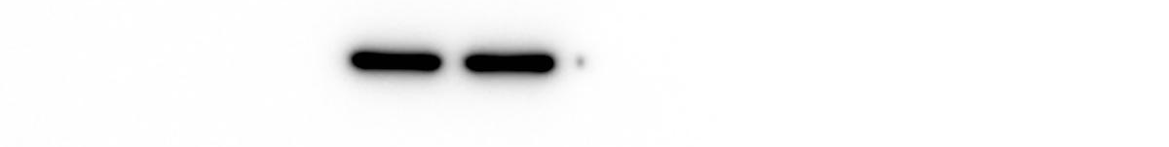
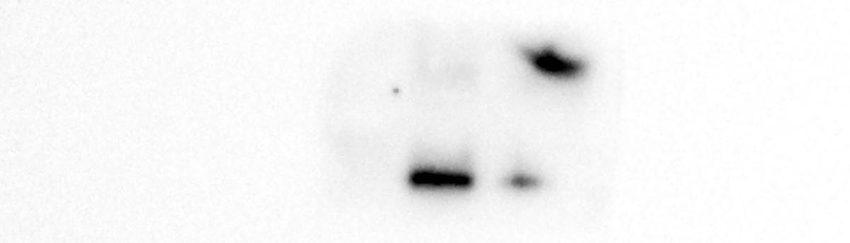
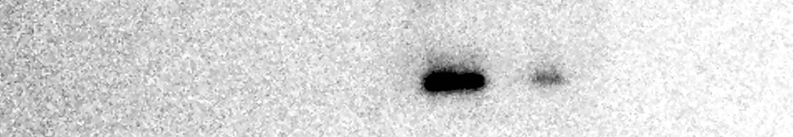
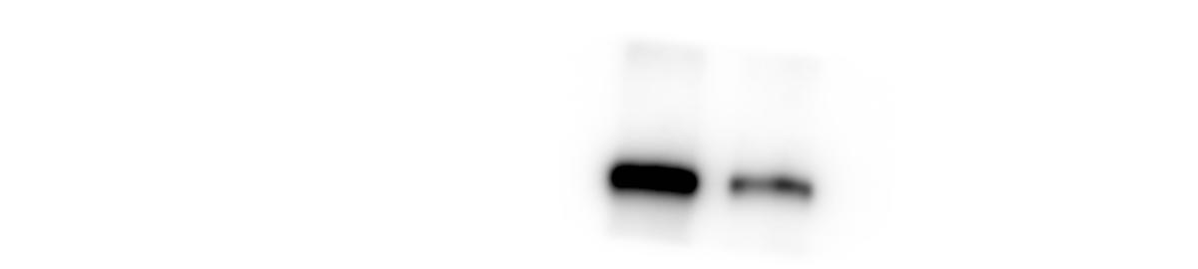
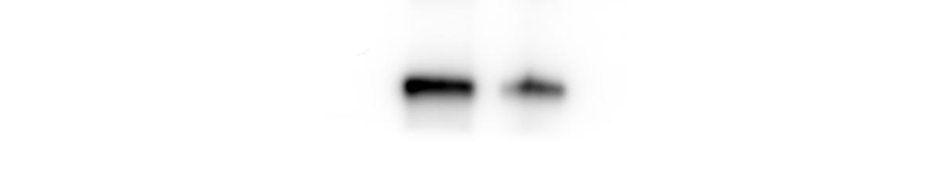
Clarify the regulation of CCNB1 on the iron death process
BT-549
MDA-MB-231
ACSL4
ACSL4
GAPDH
GAPDH
GPX4
GPX4
SLC7A11
SLC7A11

Slide 5


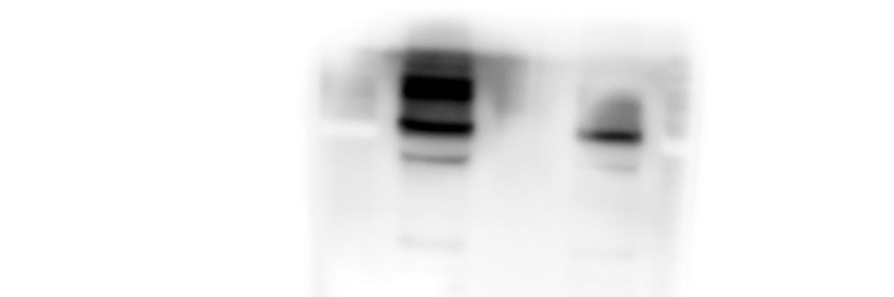
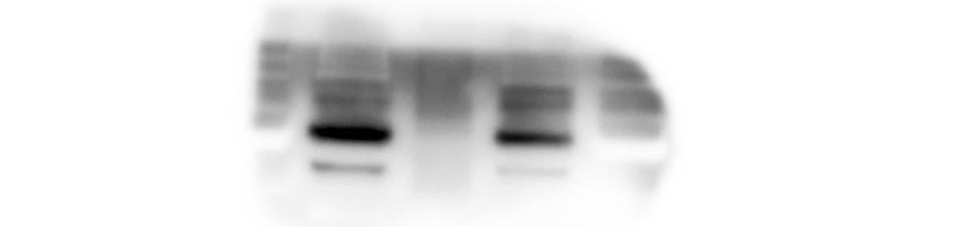
1. Clarify the interaction between DCBLD1 and CDK1
Co-IP MDA-MB-231 CDK1
Co-IP BT-549 CDK1
CDK1
CDK1
DCBLD1
DCBLD1

Slide 6

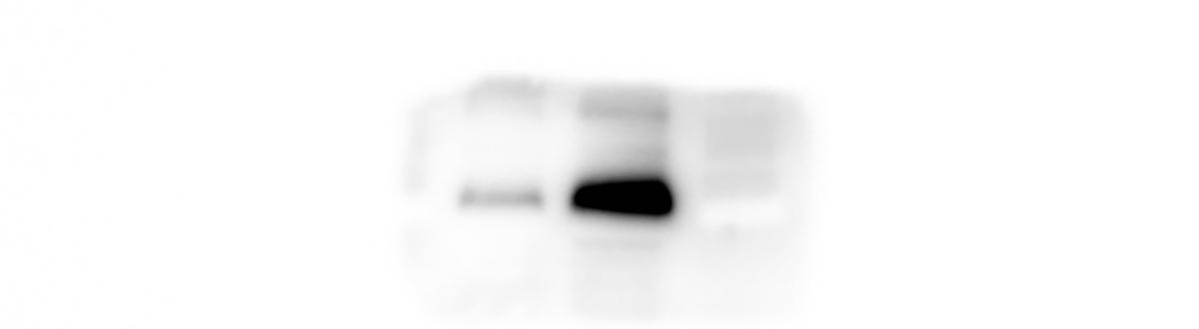
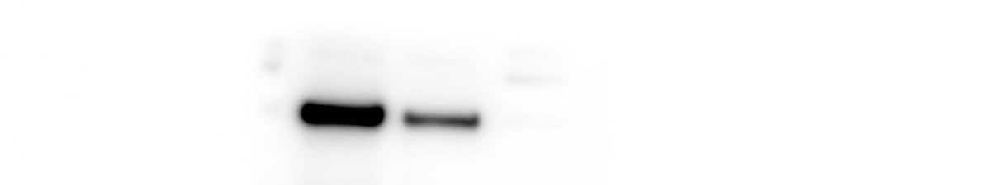
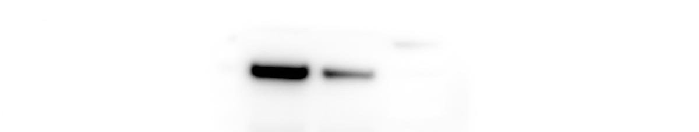

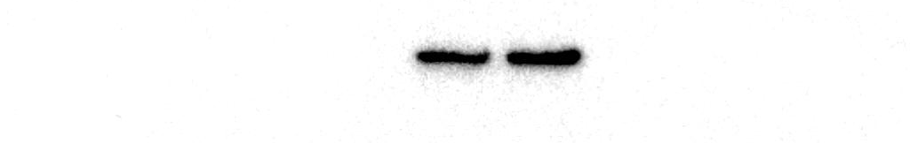
3. Clarify the regulation of CCNB1 on iron death protein ACSL4
BT-549
MDA-MB-231
ACSL4
ACSL4
CCNB1
CCNB1
β-Actin
β-Actin

Slide 7
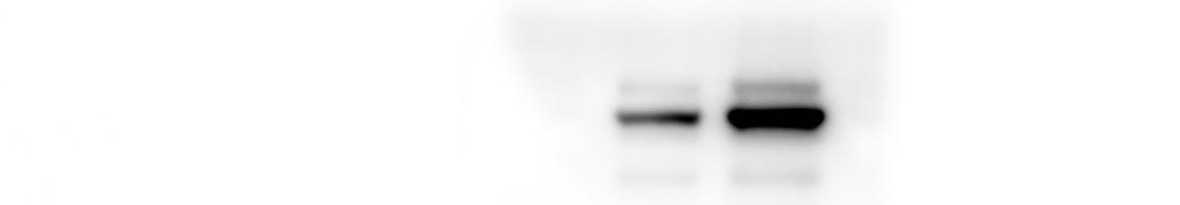
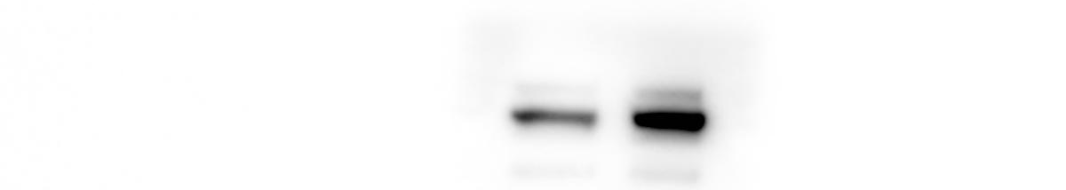


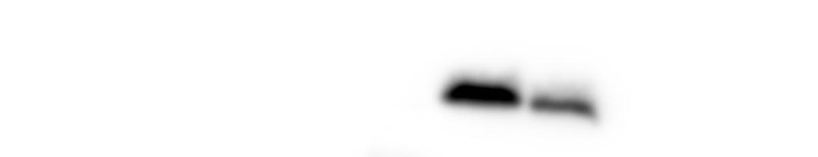
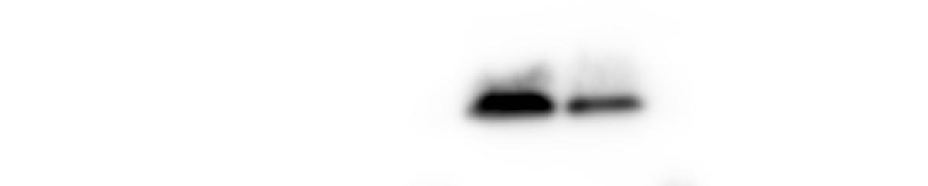


4. Clarify the regulation of iron death protein ACSL4 by DCBLD1
BT-549
MDA-MB-231
ACSL4
ACSL4
GAPDH
GAPDH
GPX4
GPX4
SLC7A11
SLC7A11

Slide 8
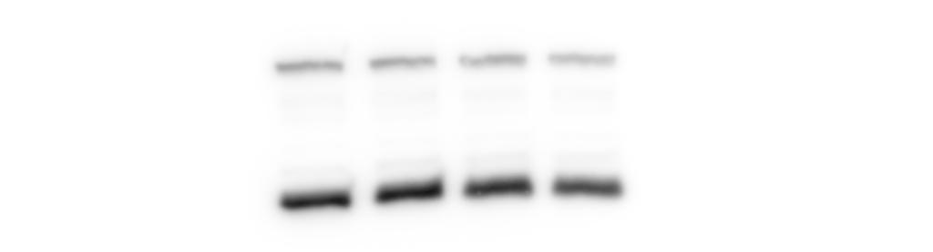
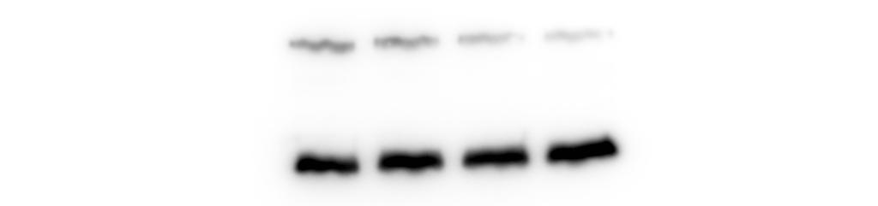
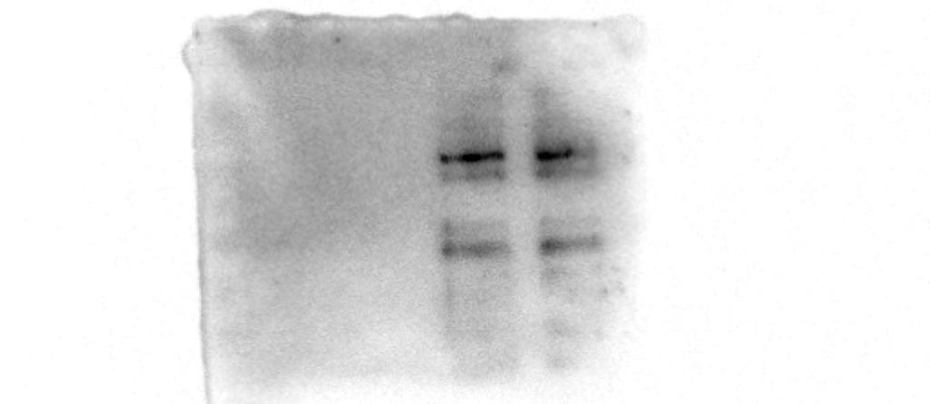
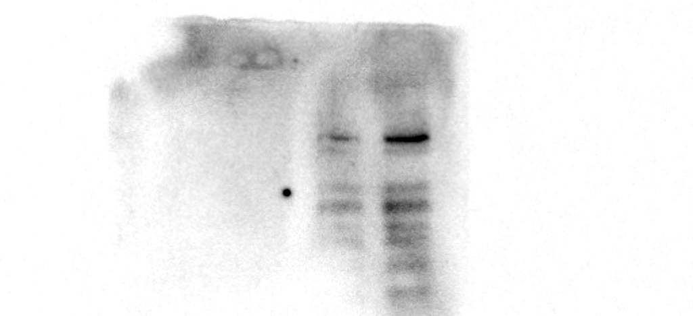
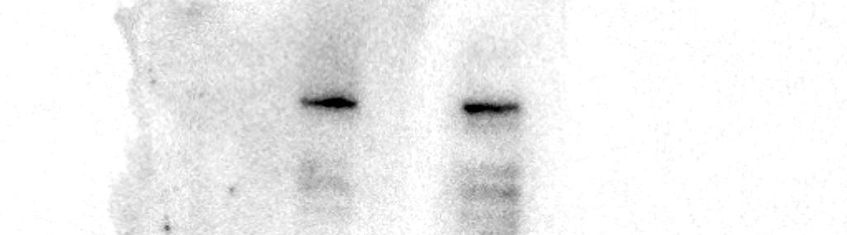
9.COIP
INPUT
IP
CCNB1-FLAG
CCNB1-FLAG
CDK1-MYC
CDK1-MYC
DCBLD1- HA
DCBLD1- HA

Slide 9
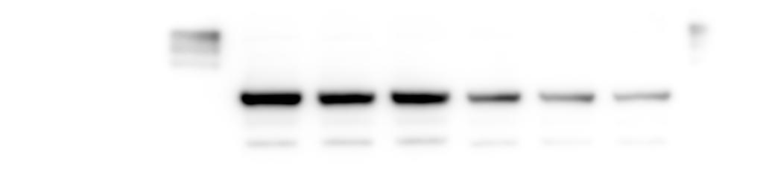

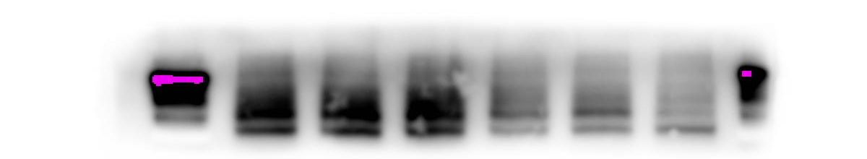
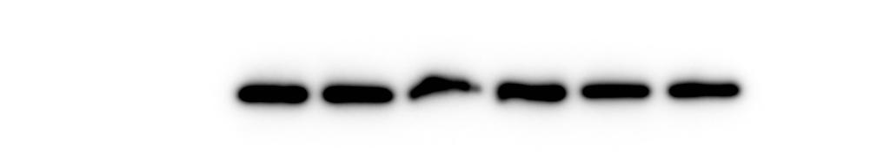
Tumor formation in nude mice
CCNB1
CDK1
DCBLD1
GAPDH

