Slide 1
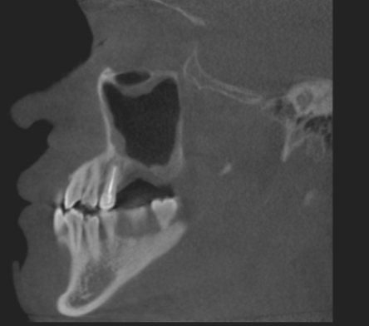
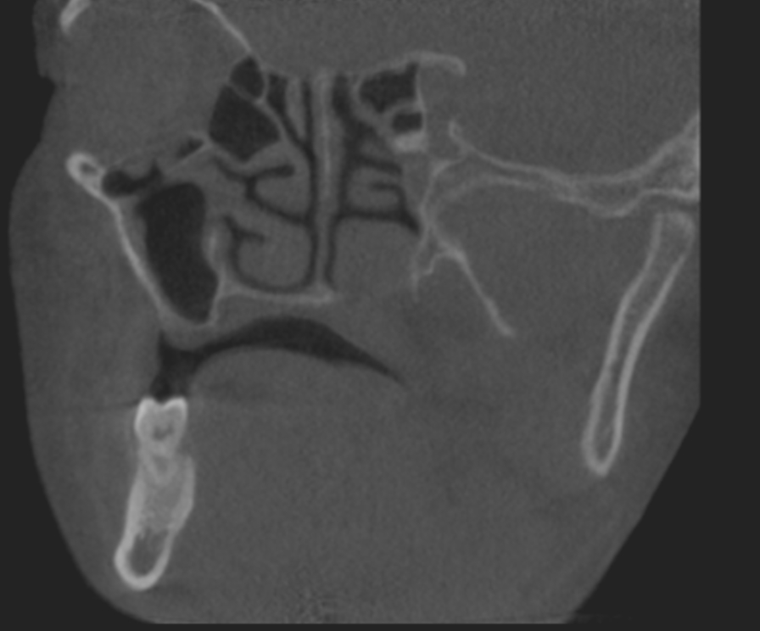
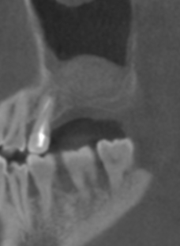
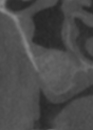
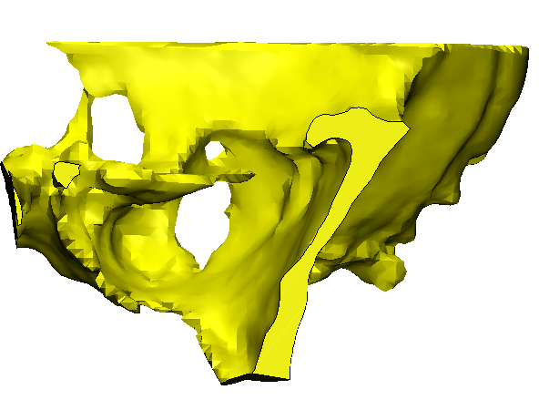
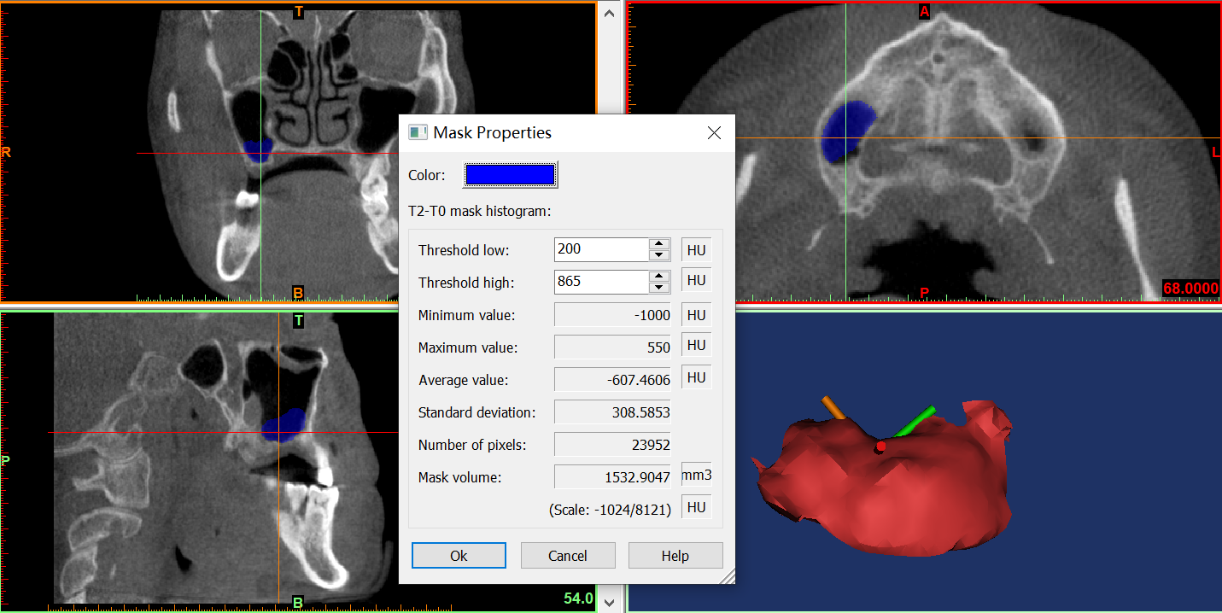
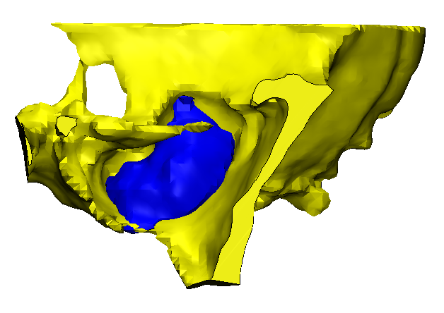
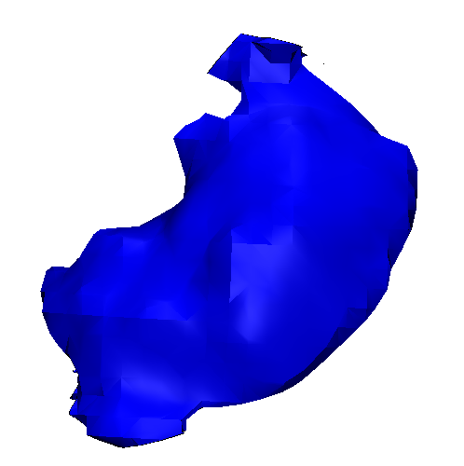
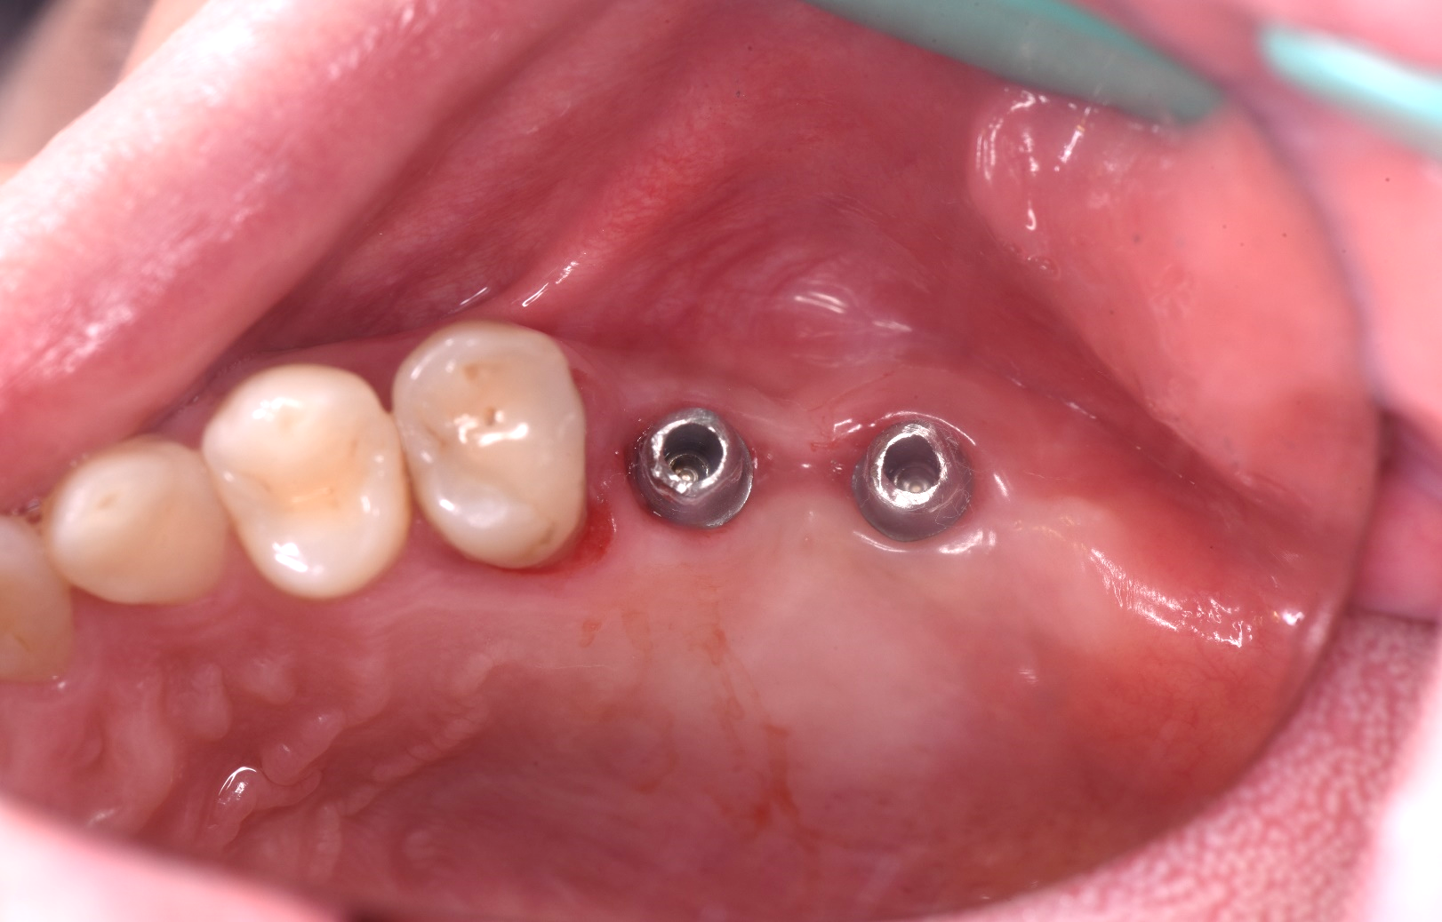
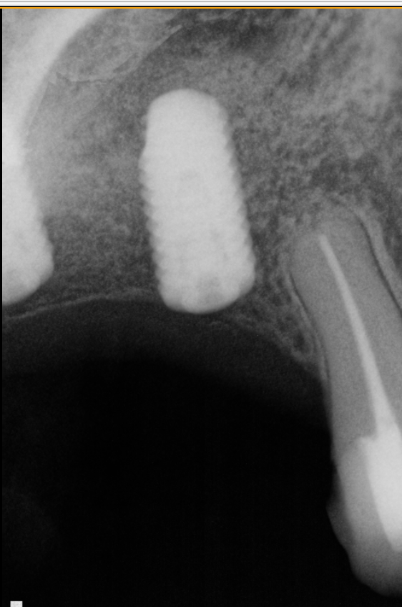
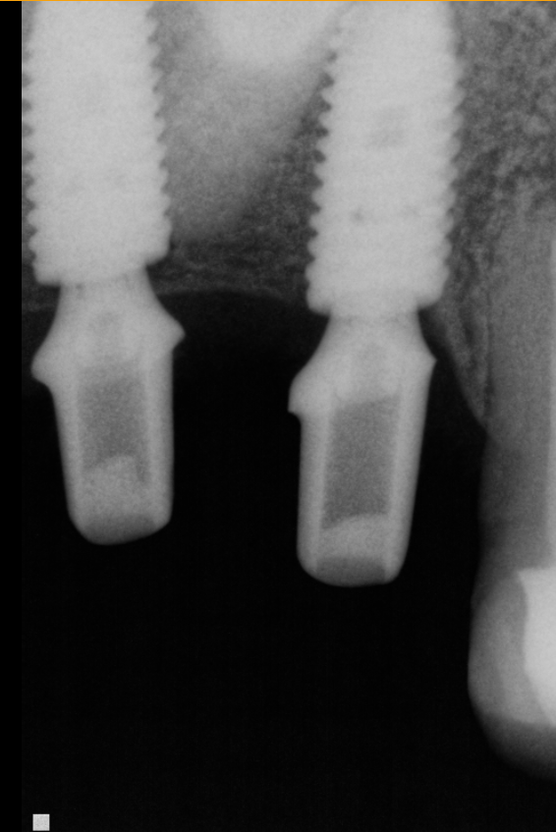
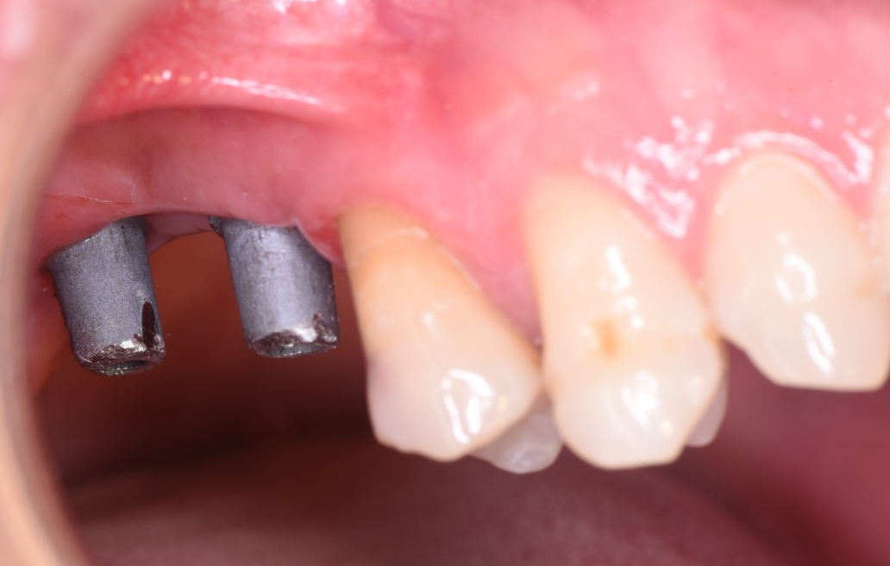
A
V
T0
T2
B
C
T0
T2-T0
T2
T2-T0
D
E
F
Figure legend. The fully digital workflow of the failed implant. (A) CBCT images at T0 and T2. (B) Volume of augmented bone. (C) Mineral density changes compared T2 to T0. (D) The frontal and occlusal view after abutment placement. (E) Periapical X-rays before impression and after abutment placement. (F) Histological analysis with H&E staining revealed poor bone regeneration. T0, preoperatively. T2, before implantation.
Notes:
补充失败种植体图，密度图

