Slide 1
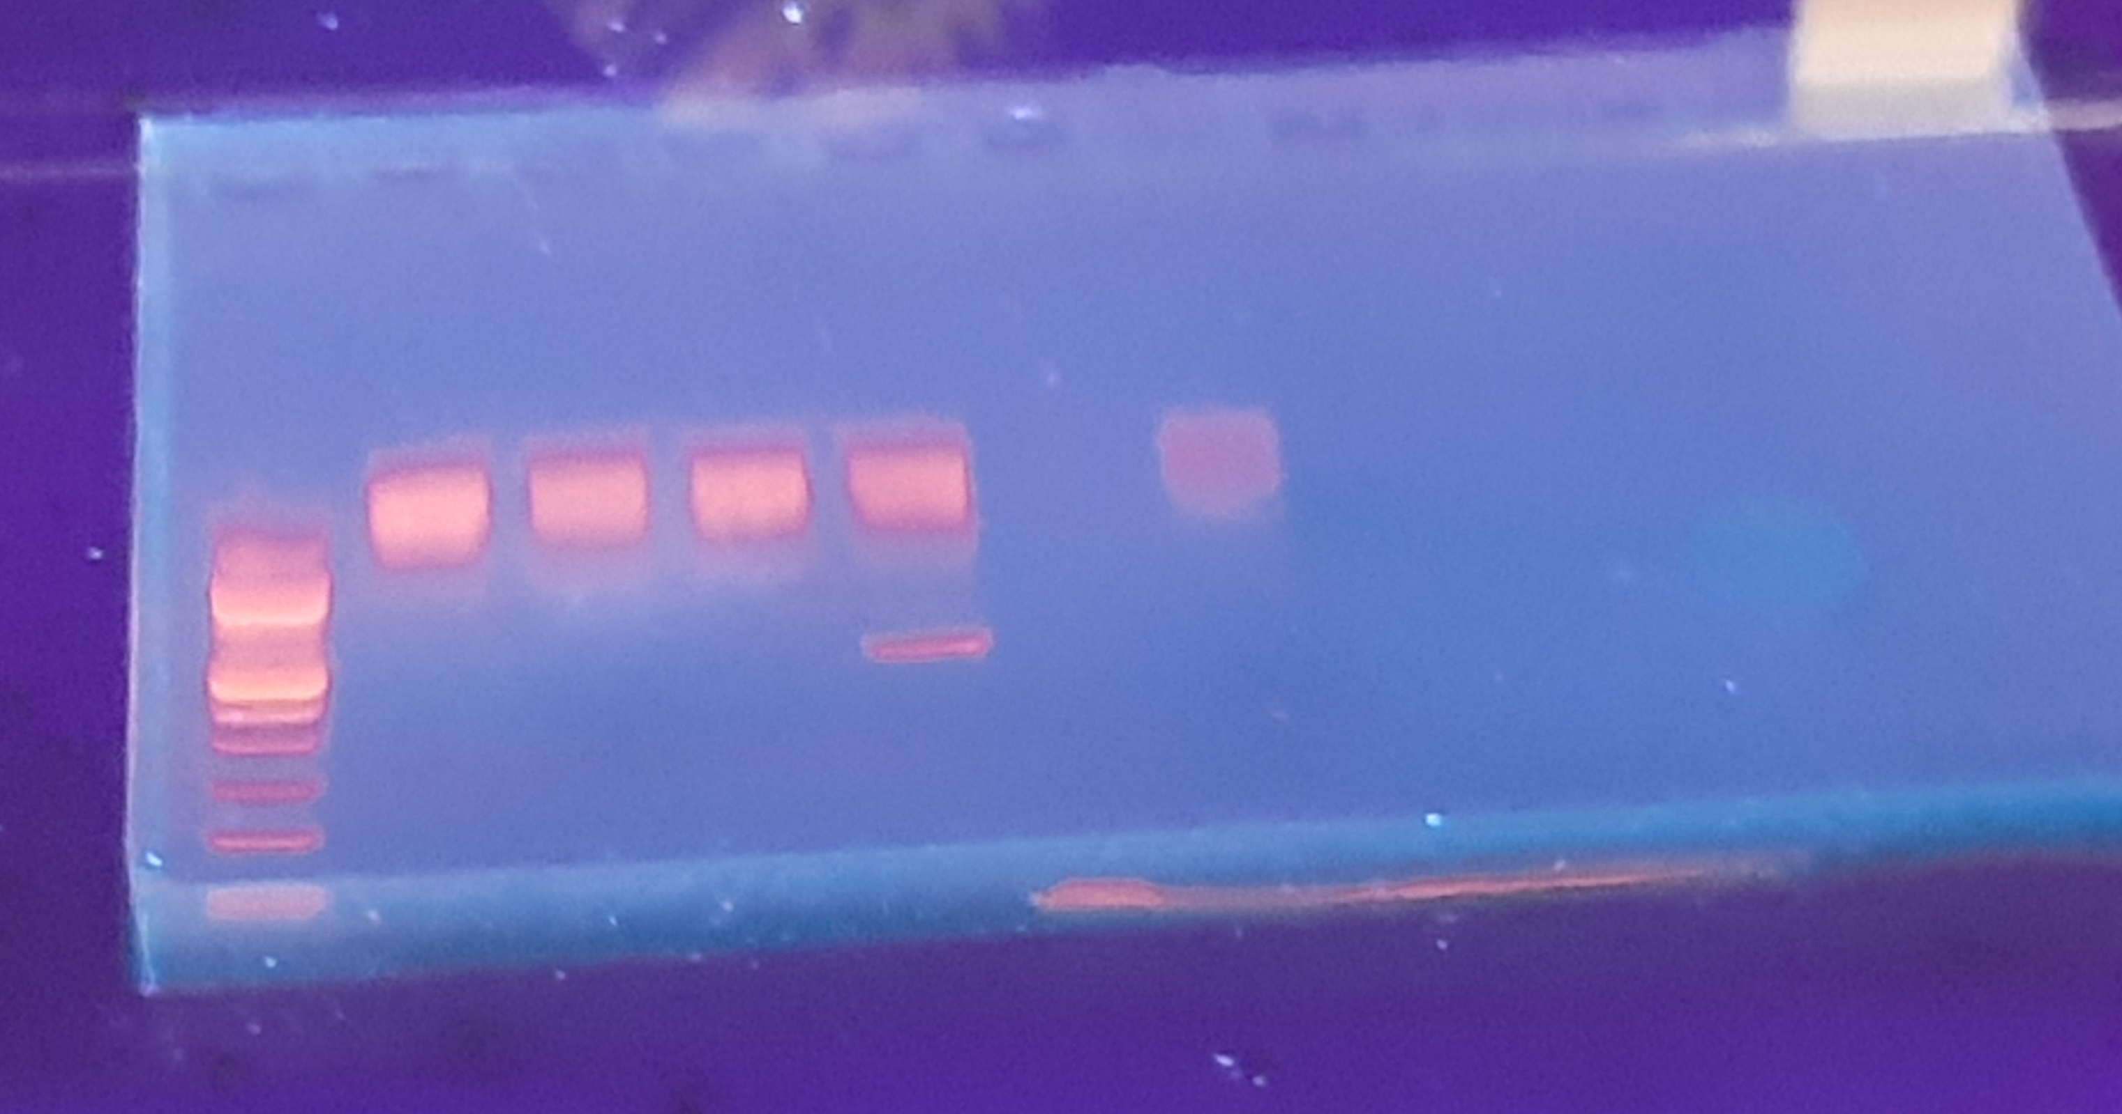
1- 100 bp ladder
2 – HM011
3- HM048
4- MGH-001
5- GARH-004
6- Nothing
7- HM011
1 2 3 4 5 6 7
Lanes 2 , 3 and 7 are not part of my samples but HDV positive samples for another study
Lane 4 is one of the 2 HDV positive samples with sample ID MGH-001 detected but did not amplify
Lane 5 is the HDV sample with ID GHARH-004 that was amplified with a band size of around 400 base pairs.

