Slide 1
Taenia sp. Vulpes vulpes, Taenia sp. Vulpes vulpes & Rhombomys opimus, Taenia polyacantha-like and Mesocestoides sp. Vulpes vulpes in our work

Slide 2
Taenia sp. Vulpes vulpes
― The first Taenia species in this study

Slide 3
Scolex of Taenia sp. Vulpes vulpes

Slide 4
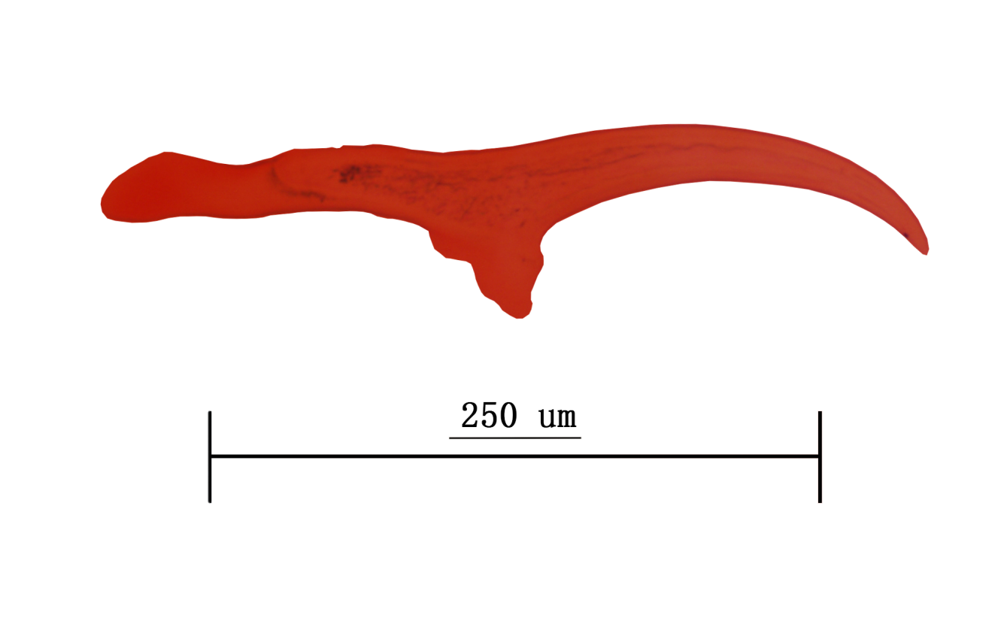
Large rostellar hook of Taenia sp. Vulpes vulpes

Slide 5
Pairwise comparisons of the shape of the large rostellar hooks in Taenia sp. Vulpes vulpes and related species.
Taenia endothoracicus
Taenia macrocystis
Taenia krepkogorski
References
[1] Verster A. A toxonomic revision of the genus Taenia Linnaeus, 1758 S. str. Onderstepoort J Vet Res. 1969, 36(1):3-58.
[2] Chen XR, Yu YR, Cao HL. The Preliminary Investigation on the Cestode Larva in the Rodents in Xinjiang, China. Endem Dis Bull. 2000. 15:46-47 (Chinese).

Slide 6
Taenia sp. Vulpes vulpes & Rhombomys opimus
― The second Taenia species in this study

Slide 7
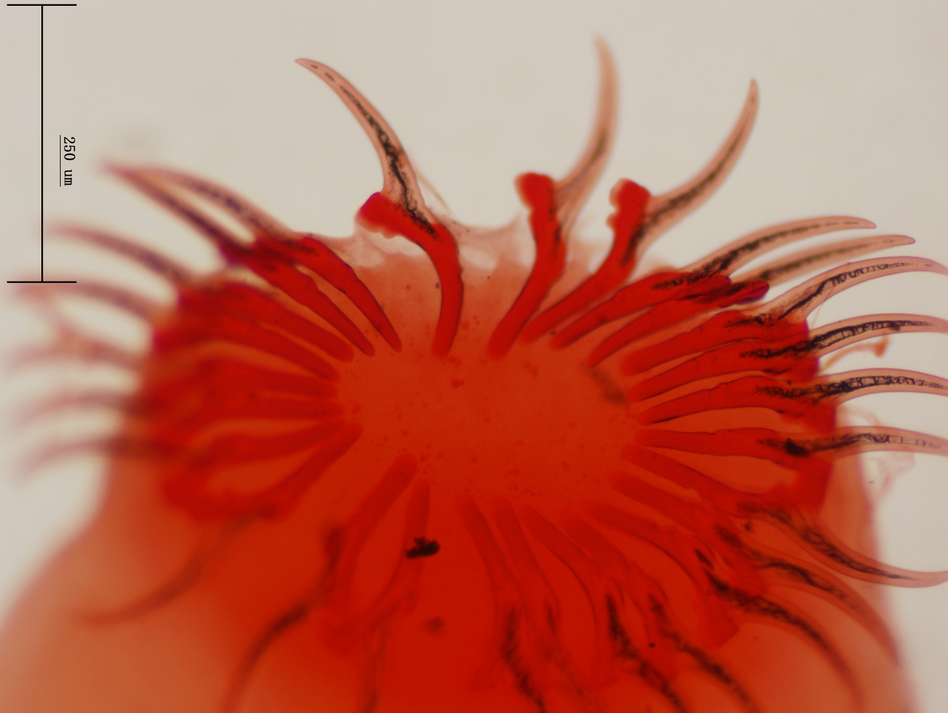
Scolex of Taenia sp. Vulpes vulpes & Rhombomys opimus (Large rostellar hook=26)

Slide 8
Large rostellar hook of Taenia sp. Vulpes vulpes & Rhombomys opimus

Slide 9
Pairwise comparisons of the shape of the large rostellar hooks in Taenia sp. Vulpes vulpes & Rhombomys opimus and related species.
Taenia endothoracicus
Taenia macrocystis
Taenia krepkogorskii
Taenia endothoracicus
Taenia macrocystis
Taenia krepkogorskii
References
[1] Verster A. A toxonomic revision of the genus Taenia Linnaeus, 1758 S. str. Onderstepoort J Vet Res. 1969;36:3-58.
[2] Chen XR, Yu YR, Cao HL. The Preliminary Investigation on the Cestode Larva in the Rodents in Xinjiang, China. Endem Dis Bull. 2000. 15:46-47 (Chinese).

Slide 10
Taenia polyacantha-like
― The third Taenia species in this study

Slide 11
Scolex of Taenia polyacantha-like

Slide 12
Large rostellar hook of Taenia polyacantha-like

Slide 13
Shape of the large rostellar hooks comparison of Taenia polyacantha and Taenia polyacantha-like
References
[1] Verster A. A toxonomic revision of the genus Taenia Linnaeus, 1758 S. str. Onderstepoort J Vet Res. 1969, 36(1):3-58.

Slide 14
Mesocestoides sp. Vulpes vulpes
― The Mesocestoides species in this study

Slide 15
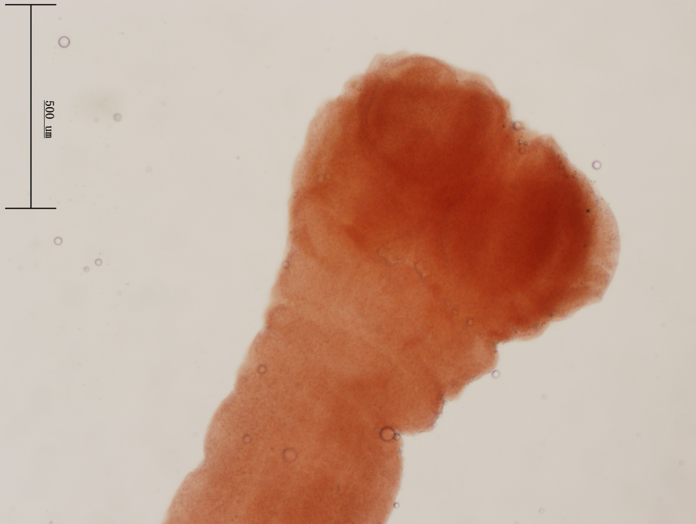
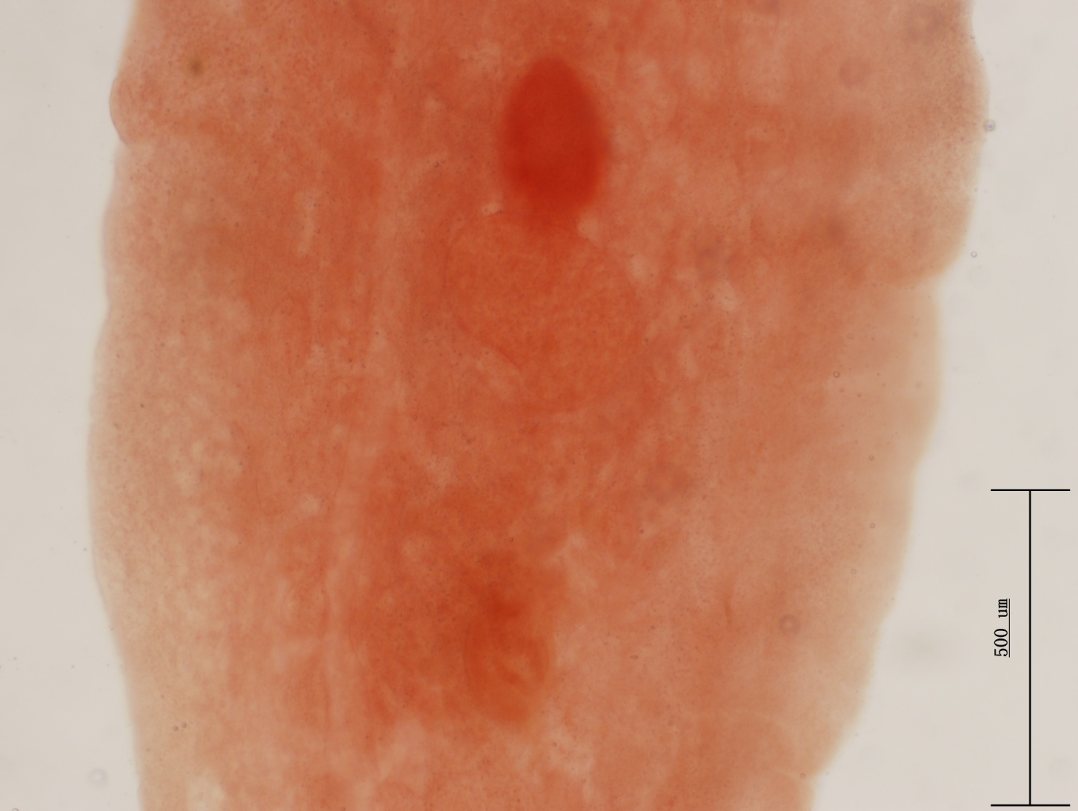
Mesocestoides sp. Vulpes vulpes

