Slide 1
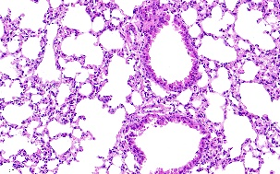
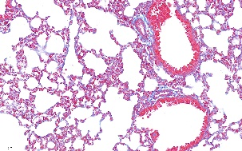
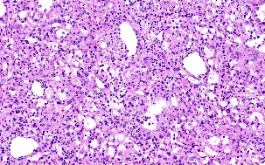
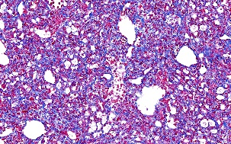
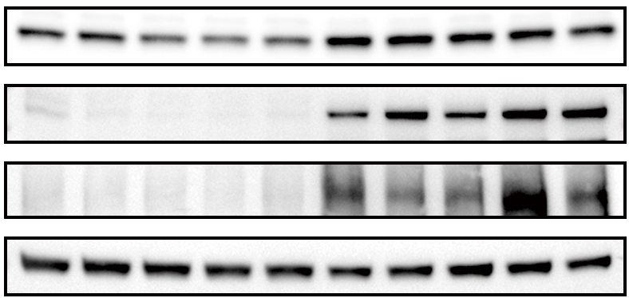
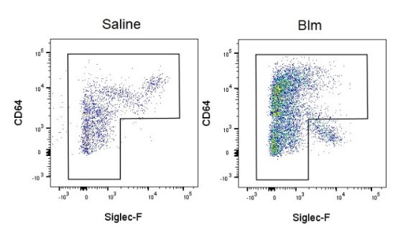
supplementary Figure 1
A
B
HE
Masson
C
Saline
100μm
Blm
D
E
Saline
Blm
F
LDHa
Col1a1
Fn1
Tubulin
G

Slide 2
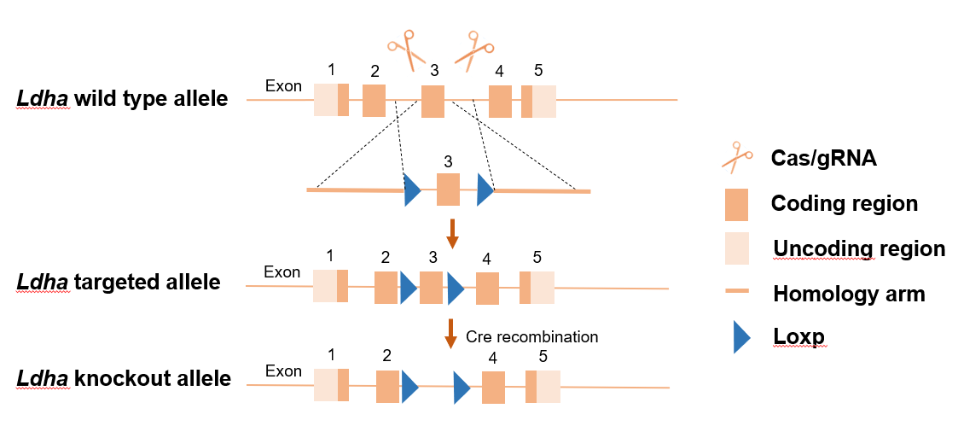
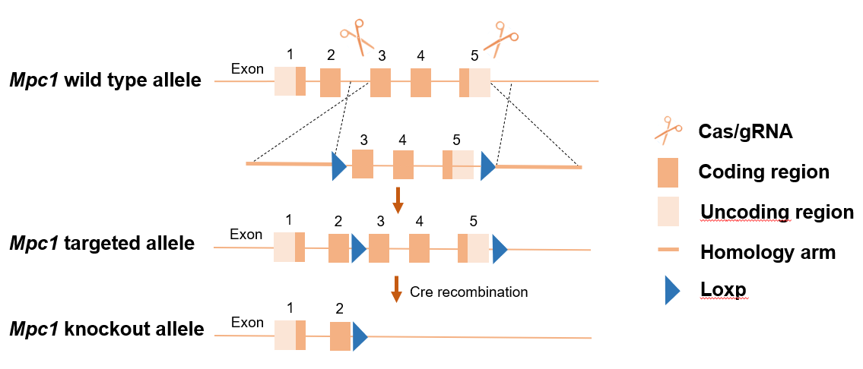
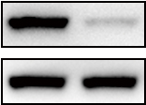
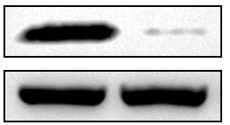
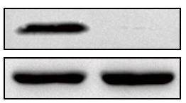
supplementary Figure 2
A
B
C
D
Ldha^{fl/fl}
Ldha^{Δlysm}
LDHA
Tubulin
E
F
Mpc1^{fl/fl}
Mpc1^{Δlysm}
MPC1
Tubulin
Mpc1^{fl/fl}
Mpc1^{Δlysm}
MPC2
Tubulin

Slide 3
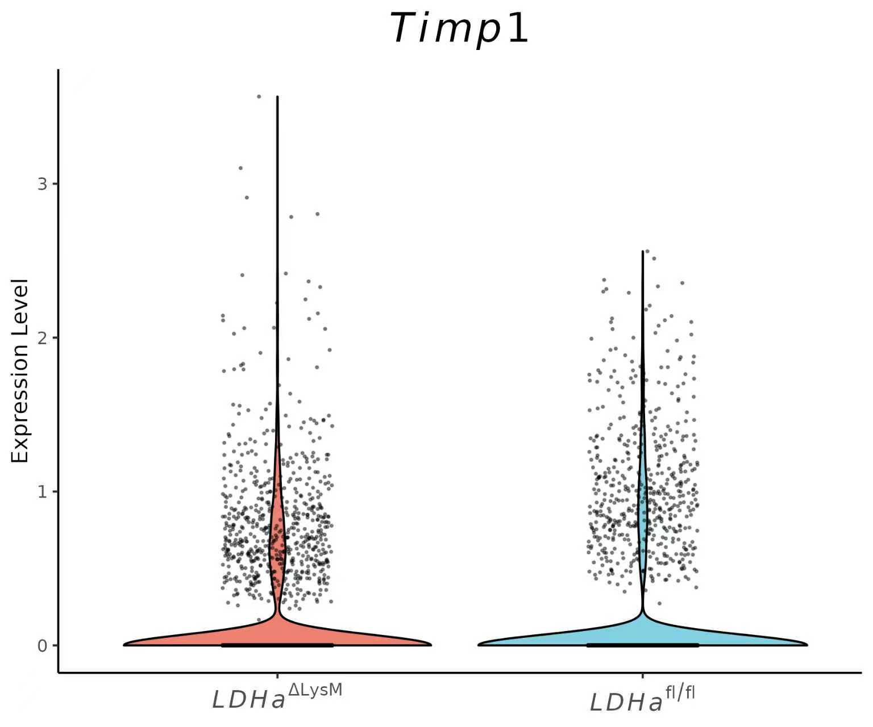
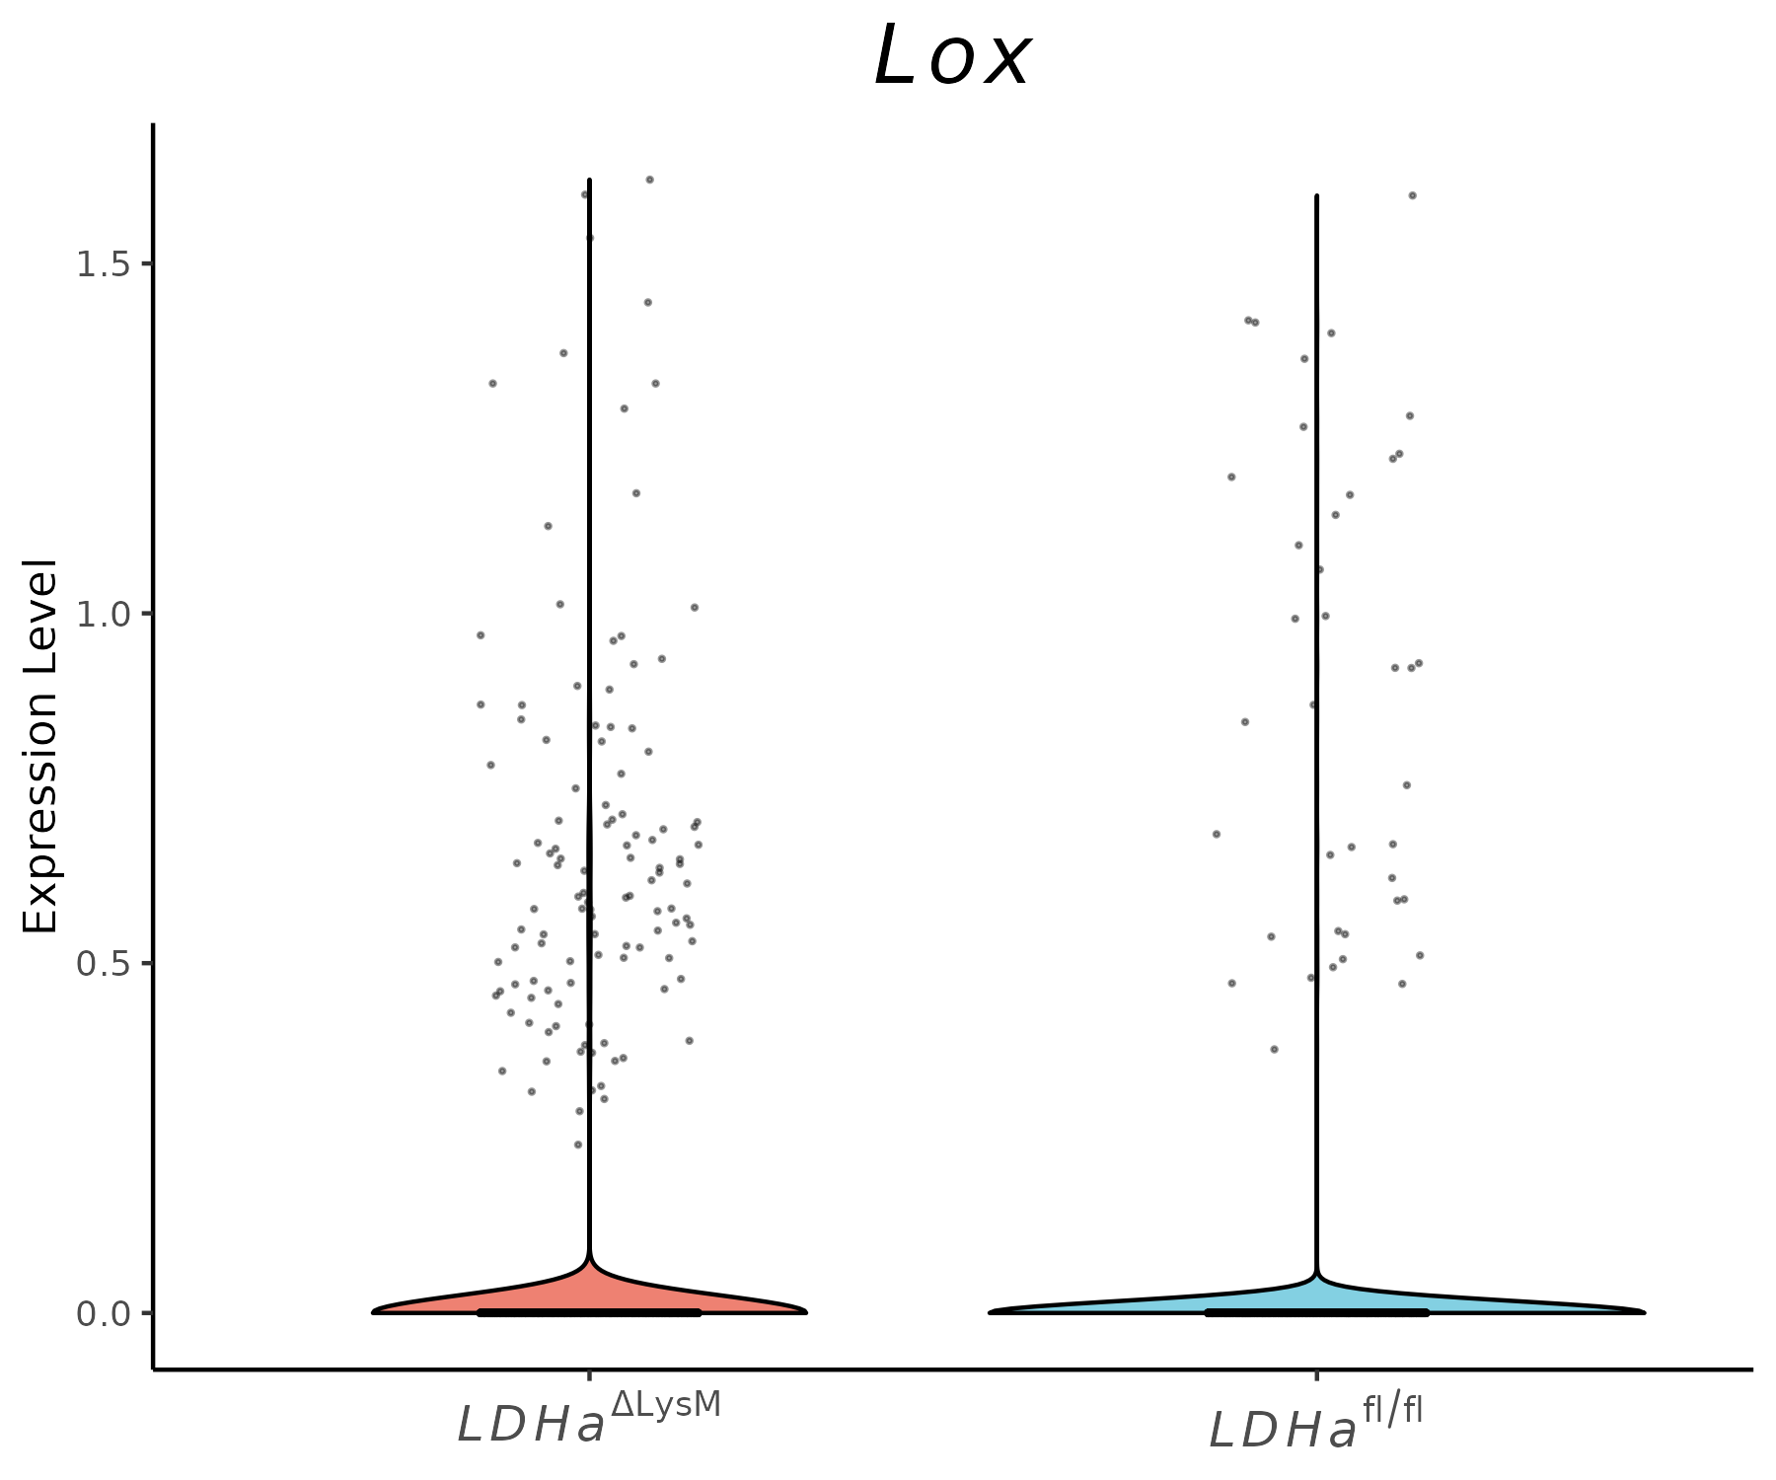
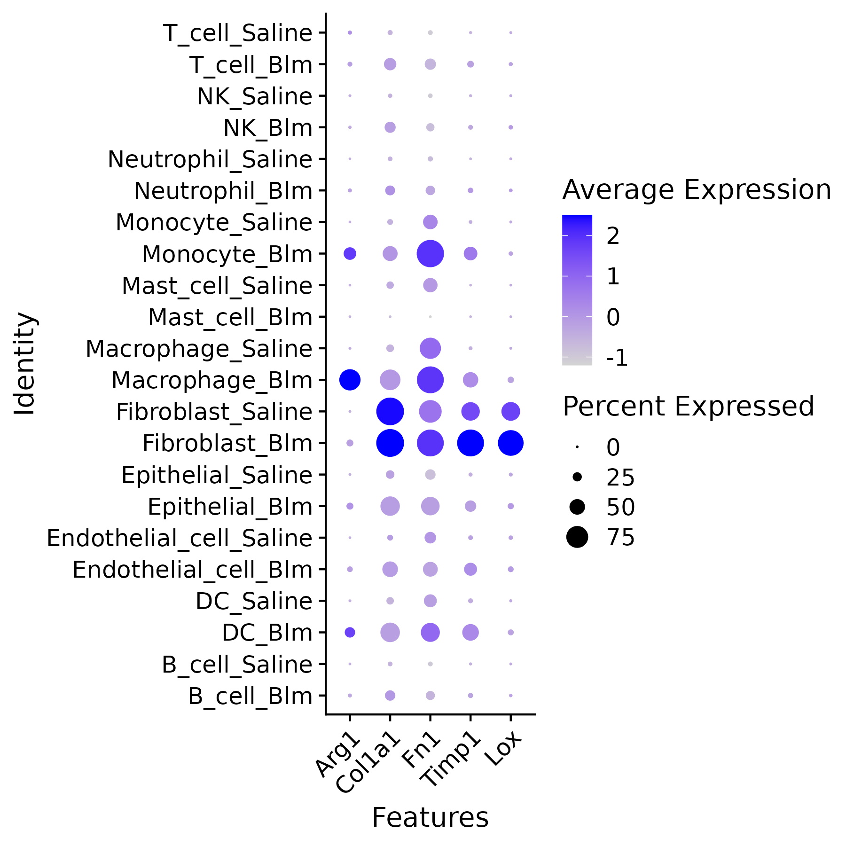
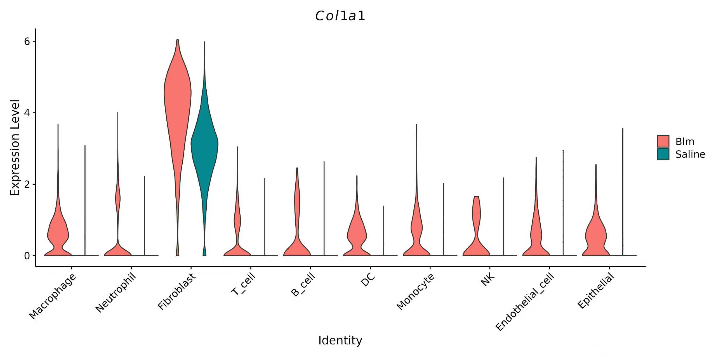
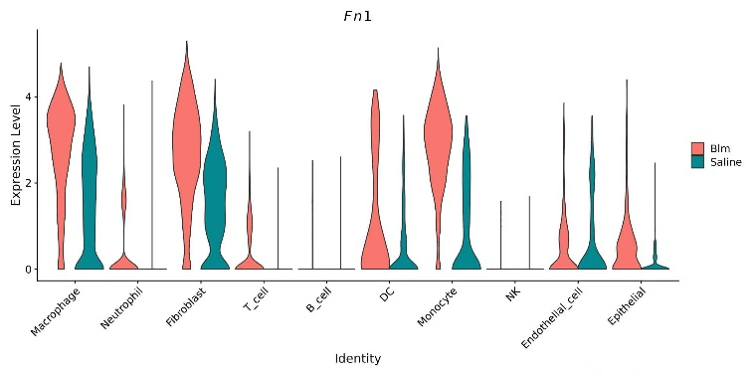
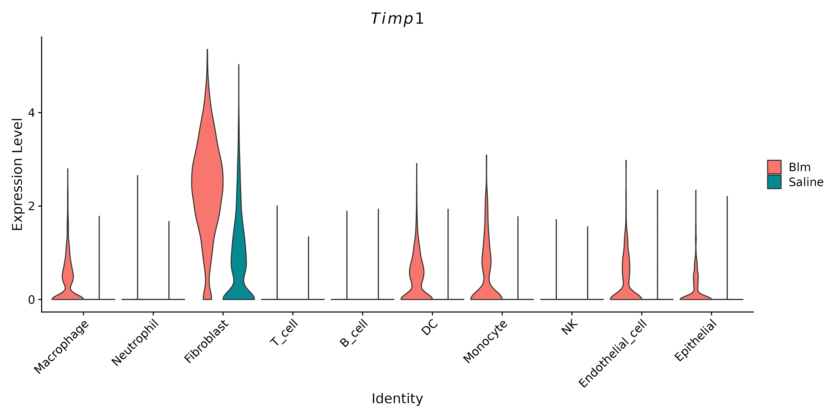
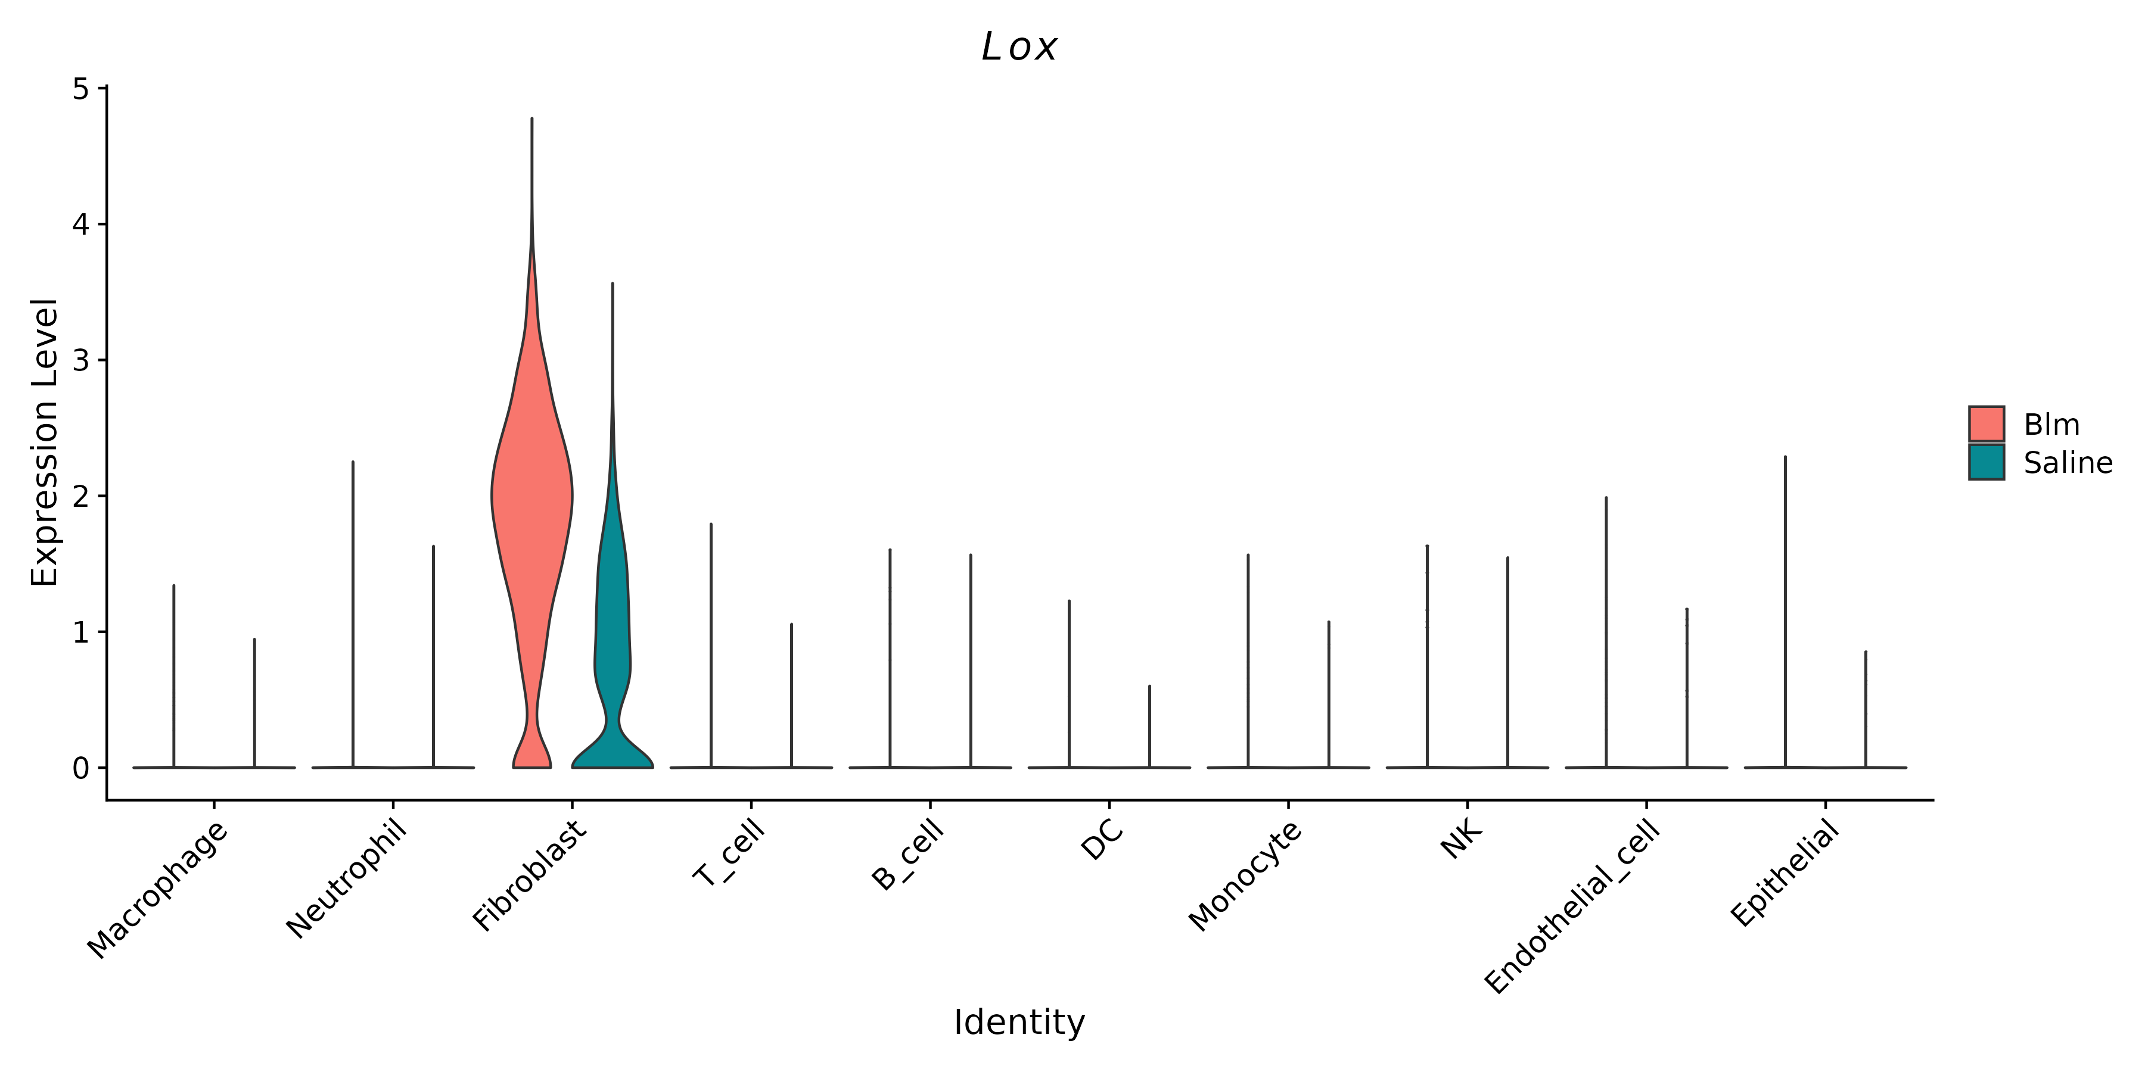
supplementary Figure 3
A
B
C
D
LDHa^{fl/fl}
LDHa^{Δlysm}
Saline
Blm

Slide 4
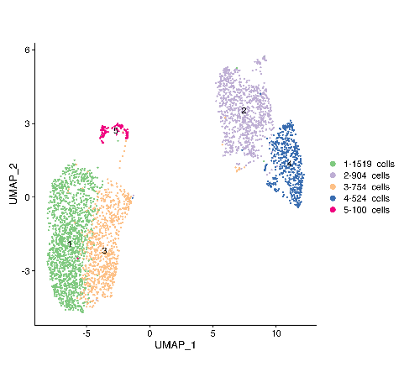
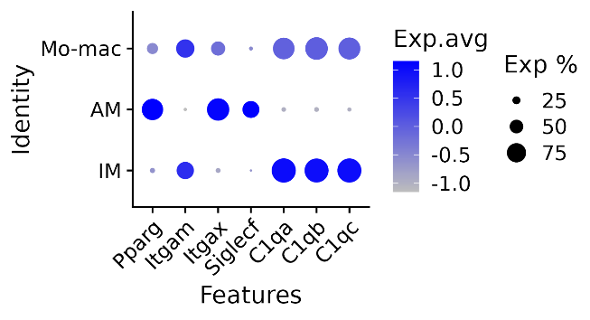
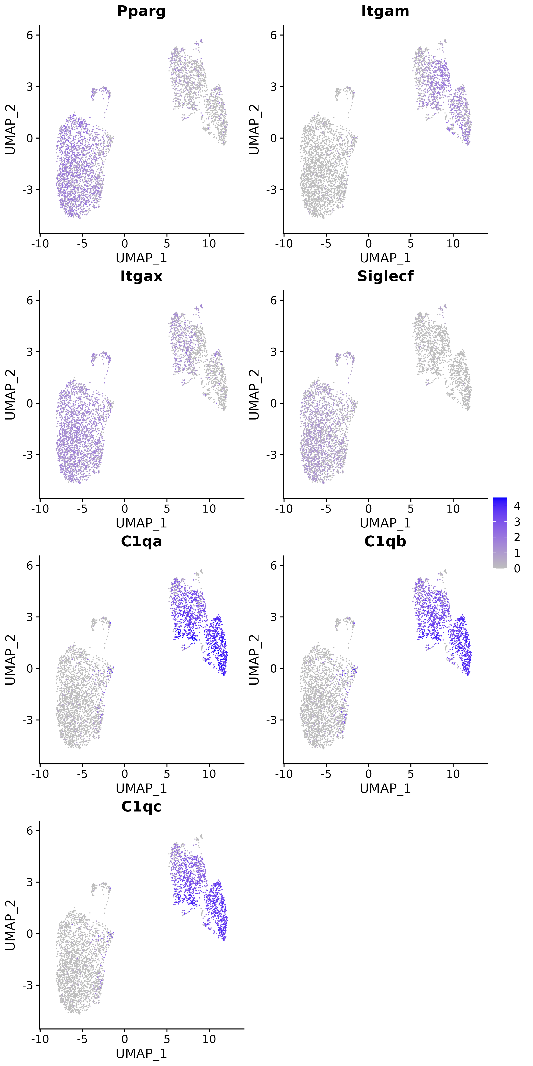
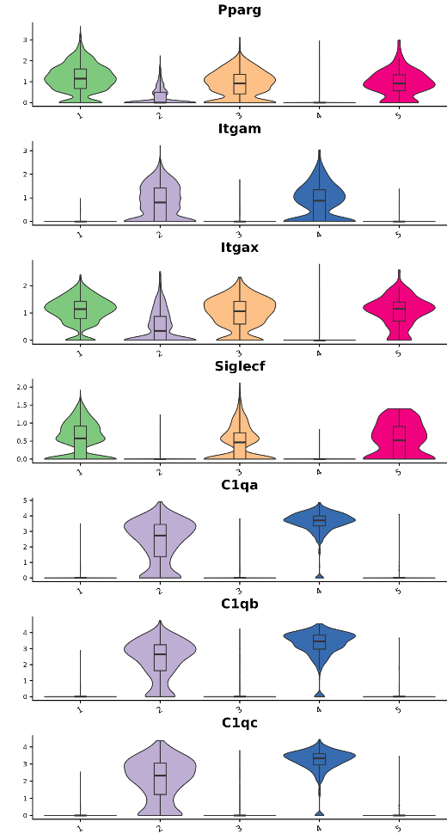
A
Macrophages
B
supplementary Figure 4
C
D
E
F
G

Slide 5
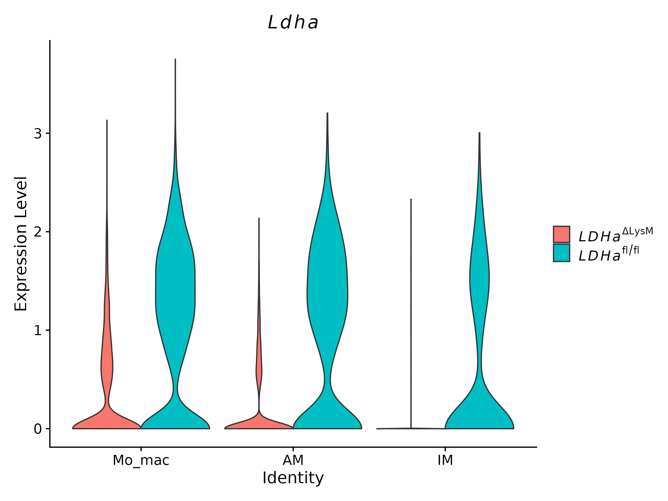
supplementary Figure 4
H
I
J

Slide 6
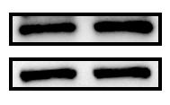

supplementary Figure 5
A
B
AM
Ldha^{fl/fl}
Ldha^{Δms4a3}
LDHA
Tubulin
C
D
BMDM
Ldha^{fl/fl}
Ldha^{Δms4a3}
LDHA
Tubulin

