Slide 1
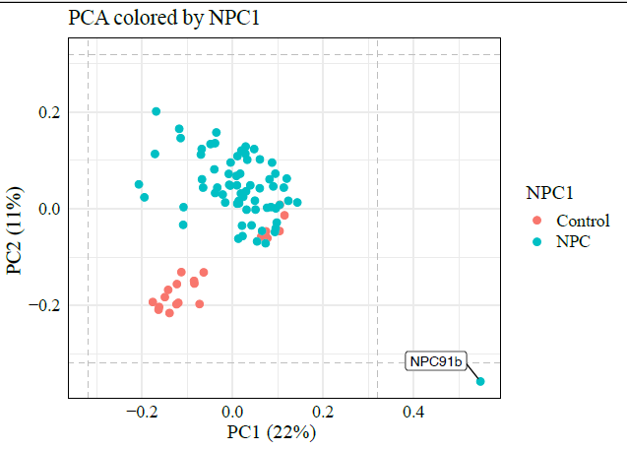
Additional Figure 1
Additional Figure 2
(a)
(b)
p = 0.1091
Notes:
Additional Figure 1: PCA plot based on NPX values to examine the clustering of samples and identify any potential outliers. Only one NPC1 individual, NPC91b a 29.7-year-old male was an outlier and therefore removed from the downstream analysis.
Additional Figure 2 ELISA measurements from NPC1 and control samples (a) DSCAM levels in serum samples, and (b) CEND1 levels in serum samples

Slide 2
Additional Figure 3
Notes:
Additional Figure 3: Expression levels of proteins based on miglustat treatment ELISA assays: there were no differences in the expression level of (a) TREM2, (b) HSD17B14, (c) GPNMB, (d) NPY , (e) Cathepsin L, (f) CCL18, (g) AgRP, (h) BDNF, (i) DSCAM, and (j) CEND1. p-values are from an unpaired t - test

Slide 3
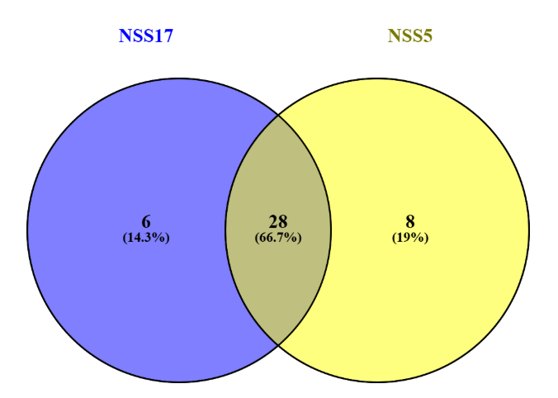
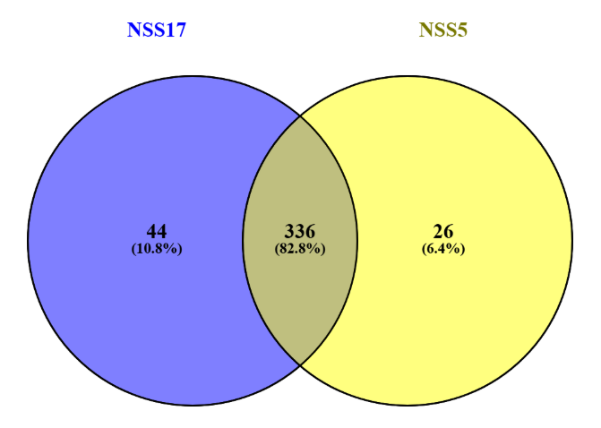
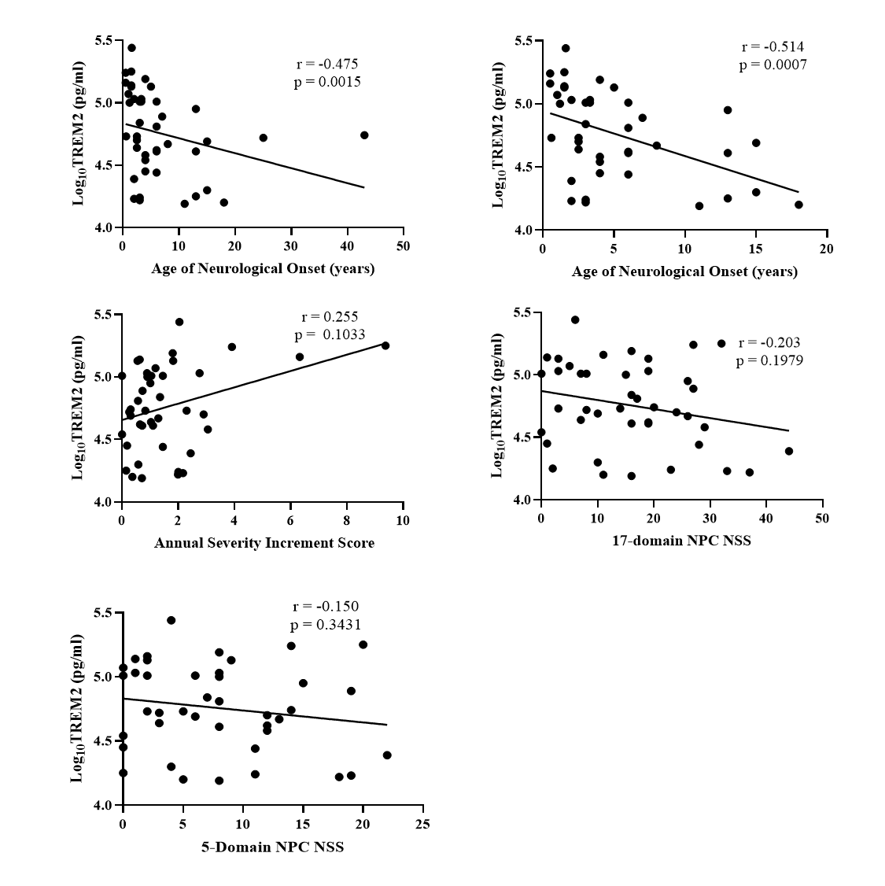
Additional Figure 4
(a)
(b)
Additional Figure 5
(a)
(b)
(c)
(d)
Notes:
Additional Figure 4: Overlapping protein correlations between NSS17 and NSS5 (a) Overlap between positively correlated proteins, and (b) Overlap between negatively correlated proteins
Additional Figure 5: Spearman Correlation of NPC1 serum TREM 2 levels with NPC1 clinical phenotypes (a) age of neurological onset, >20 years excluded from the analysis. (b) annual severity increment score, (c) 17-domain NPC neurological severity score, and (d) 5 domain NPC neurological severity score.

Slide 4
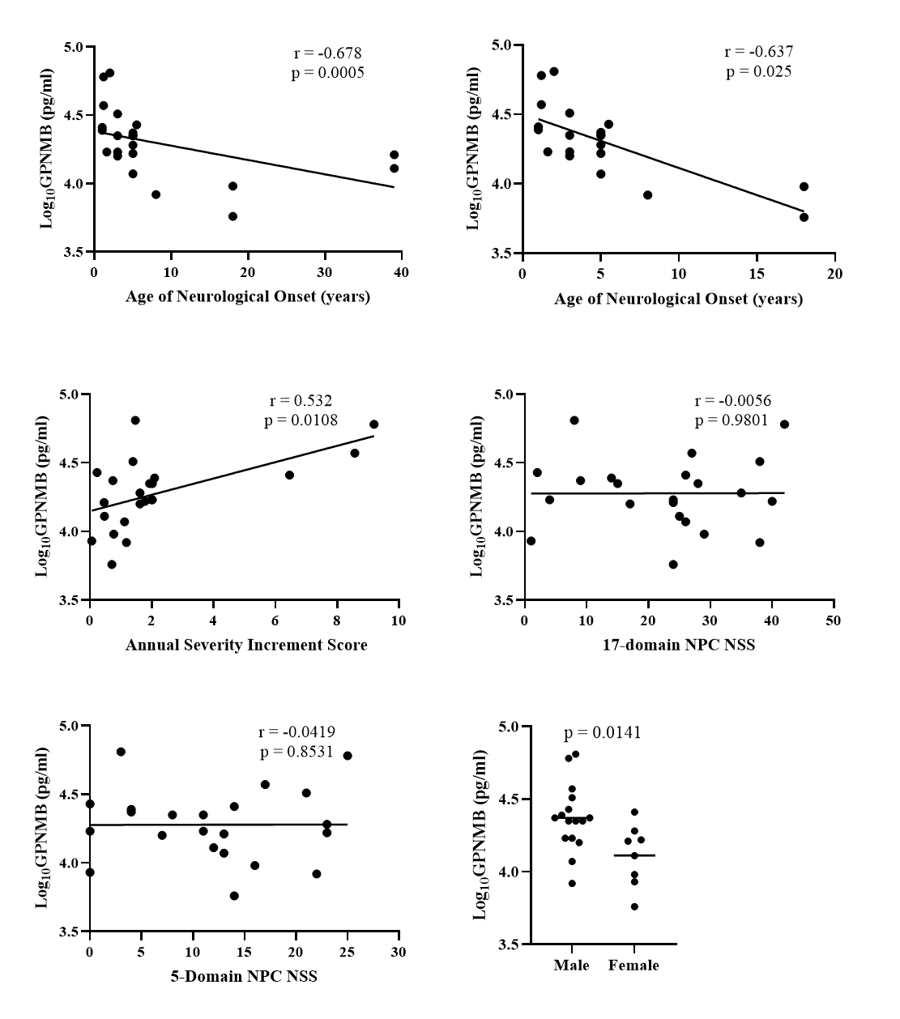
Additional Figure 6
(a)
(b)
Notes:
Additional Figure 6: Spearman correlation of NPC1 serum GPNMB levels with NPC1 clinical phenotypes (a) 17-domain NPC neurological severity score, and (b) 5 domain NPC neurological severity score.

Slide 5
Additional Figure 7
(a)
(b)
(c)
(d)
(e)
(f)
(g)
Notes:
Additional Figure 7: ELISA expression levels of proteins based on gender: there were no gender-based differences in the expression level of (a) TREM2, (b) HSD17B14,(c) NPY, (d) Cathepsin L, (e) CCL18, (f) AgRP, and (g) BDNF.

Slide 6
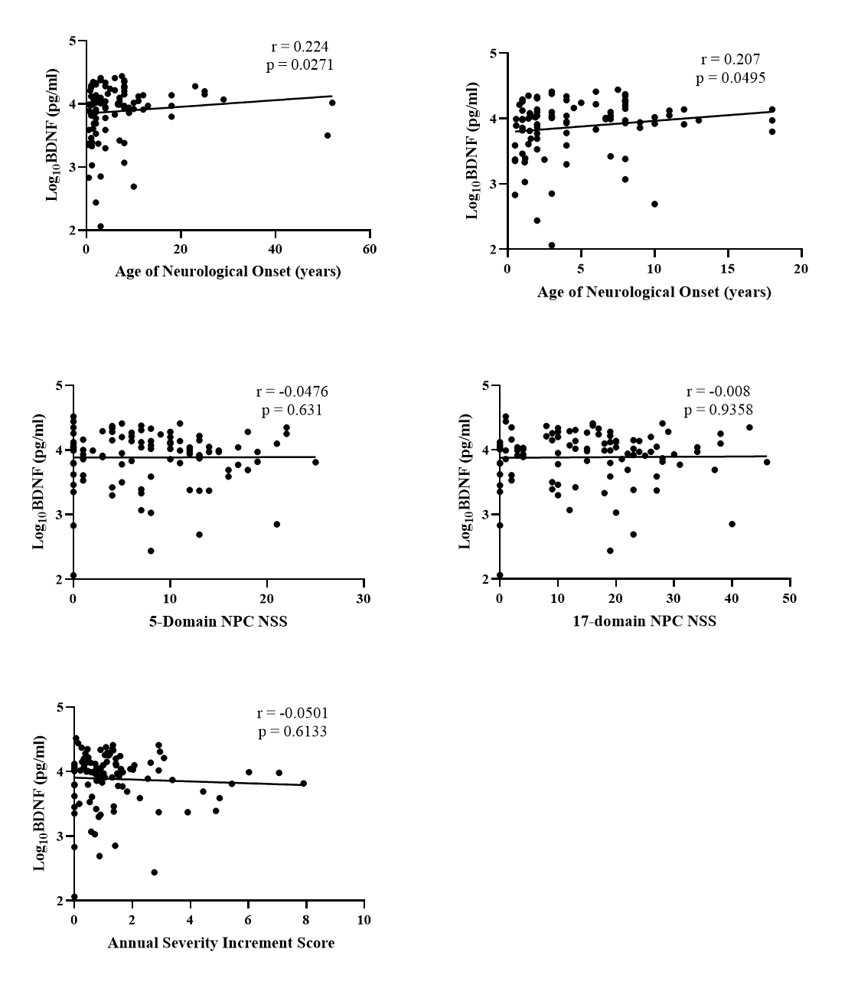
Additional Figure 8
(a)
(b)
(c)
Notes:
Additional Figure 8: Spearman correlation of NPC1 serum BDNF levels with NPC1 clinical phenotypes (a) annual severity increment score, (b) 17-domain NPC neurological severity score, and (c) 5 domain NPC neurological severity score.

Slide 7
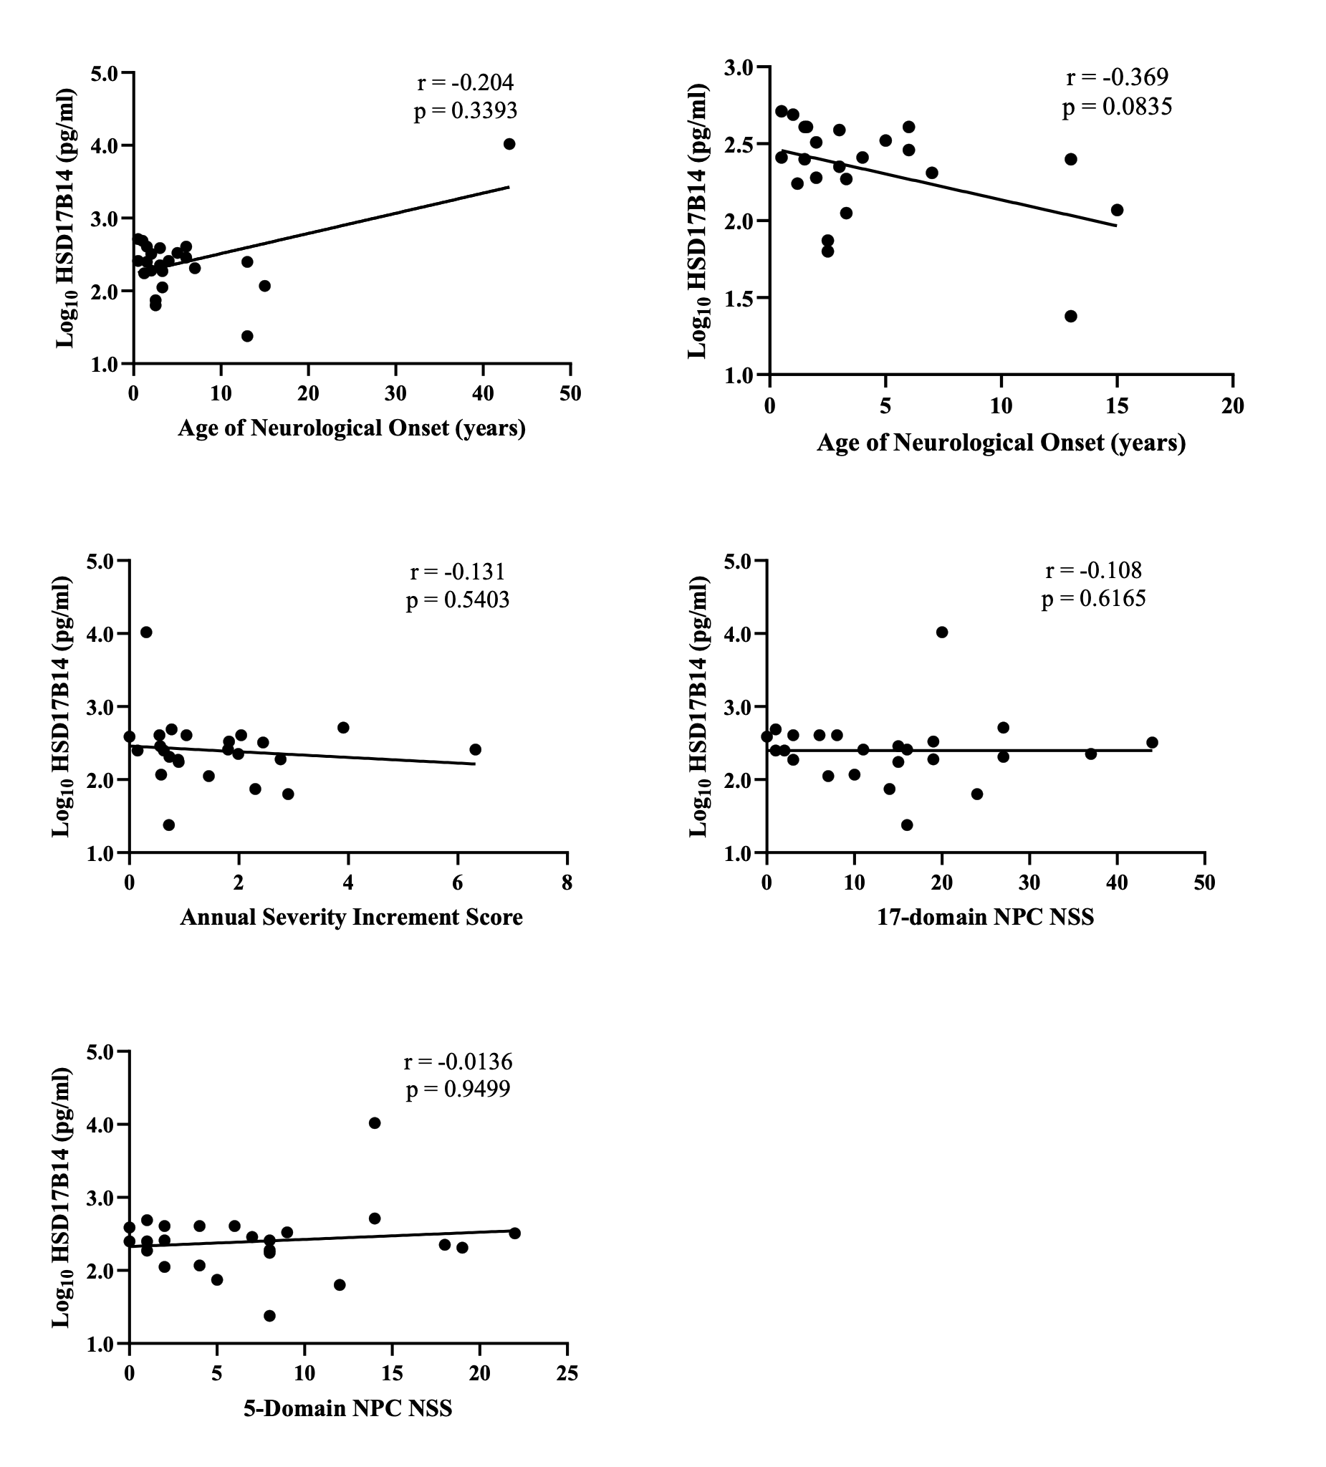
Additional Figure 9
(a)
(b)
(c)
(d)
(e)
Notes:
Additional Figure 9: Spearman correlation of NPC1 serum HSD17B14 levels with NPC1 clinical phenotypes (a) age of neurological onset (b) age of neurological onset, >20 years excluded from the analysis. (c) annual severity increment score, (d) 17-domain NPC neurological severity score, and (e) 5 domain NPC neurological severity score.

Slide 8
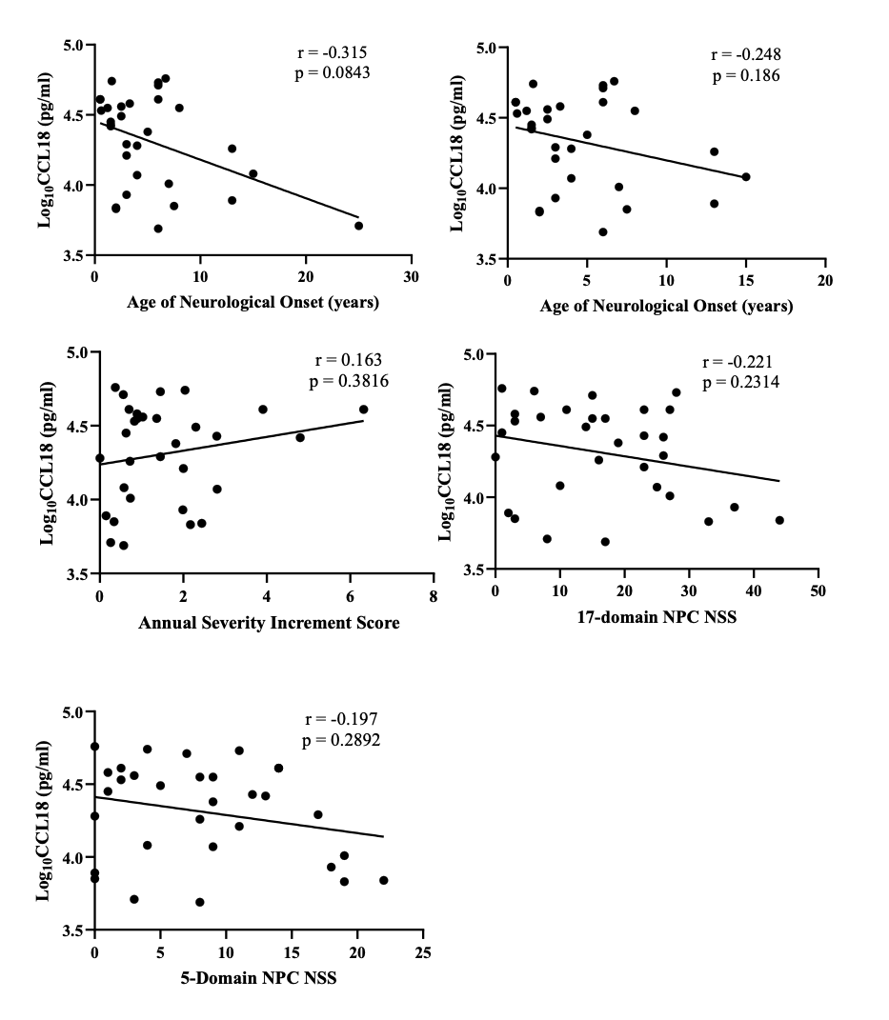
Additional Figure 10
(a)
(b)
(c)
(d)
(e)
Notes:
Additional Figure 10: Spearman correlation of NPC1 serum CCL18 levels with NPC1 clinical phenotypes Serum CCL18 levels did not correlate with (a) age of neurological onset, (b) Individuals with age of neurological onset >20 years excluded from the analysis. (c) Annual severity increment score, (d) 17-domain NPC neurological severity score, and (e) 5-domain NPC neurological severity score.

Slide 9
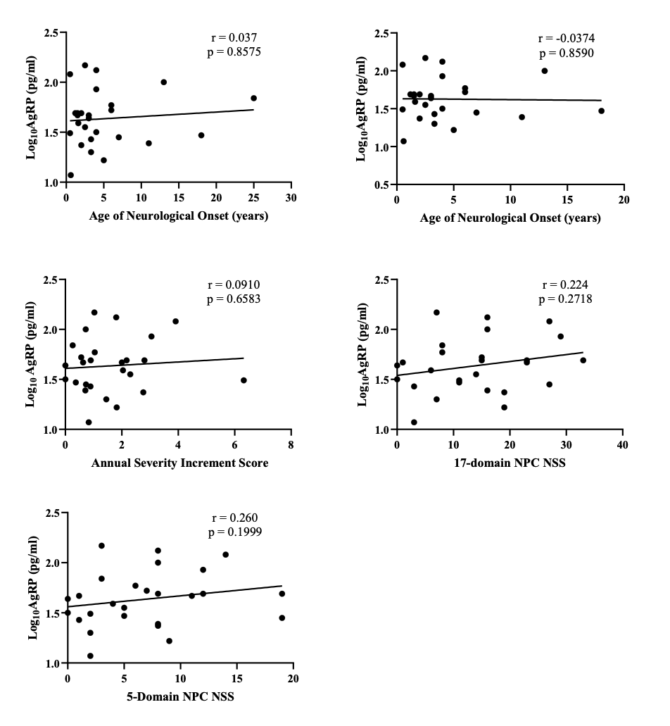
Additional Figure 11
(a)
(b)
(c)
(d)
(e)
Notes:
Additional Figure 11: Spearman correlation of NPC1 serum AgRP levels with NPC1 clinical phenotypes Serum AgRP levels did not correlate with (a) age of neurological onset, (b) Individuals with age of neurological onset >20 years excluded from the analysis. (c) Annual severity increment score, (d) 17-domain NPC neurological severity score, and (e) 5 domain severity score.

Slide 10
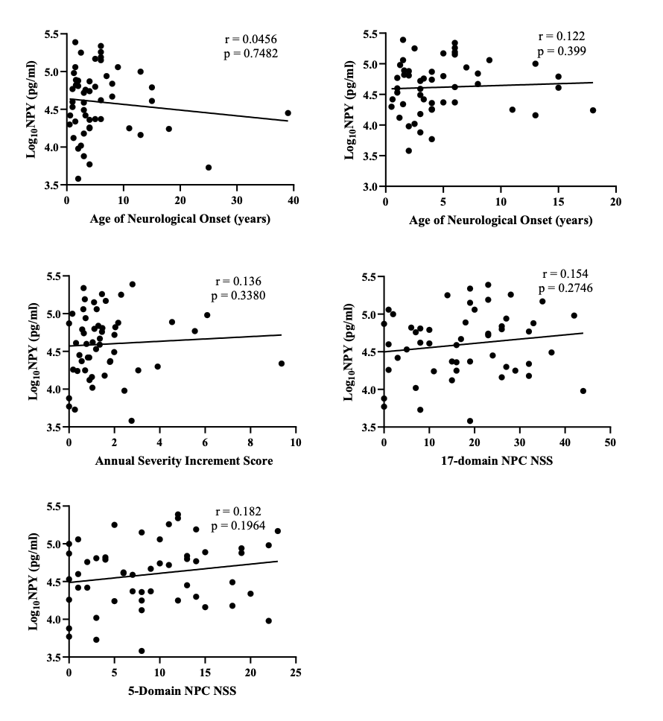
Additional Figure 12
(a)
(b)
(c)
(d)
(e)
Notes:
Additional Figure 12: Spearman correlation of NPC1 serum NPY levels with NPC1 clinical phenotypes Serum NPY levels did not correlate with (a) age of neurological onset, (b) Individuals with age of neurological onset >20 years excluded from the analysis. (c) Annual severity increment score, (d) 17-domain NPC neurological severity score, and (e) 5 domain severity score.

Slide 11
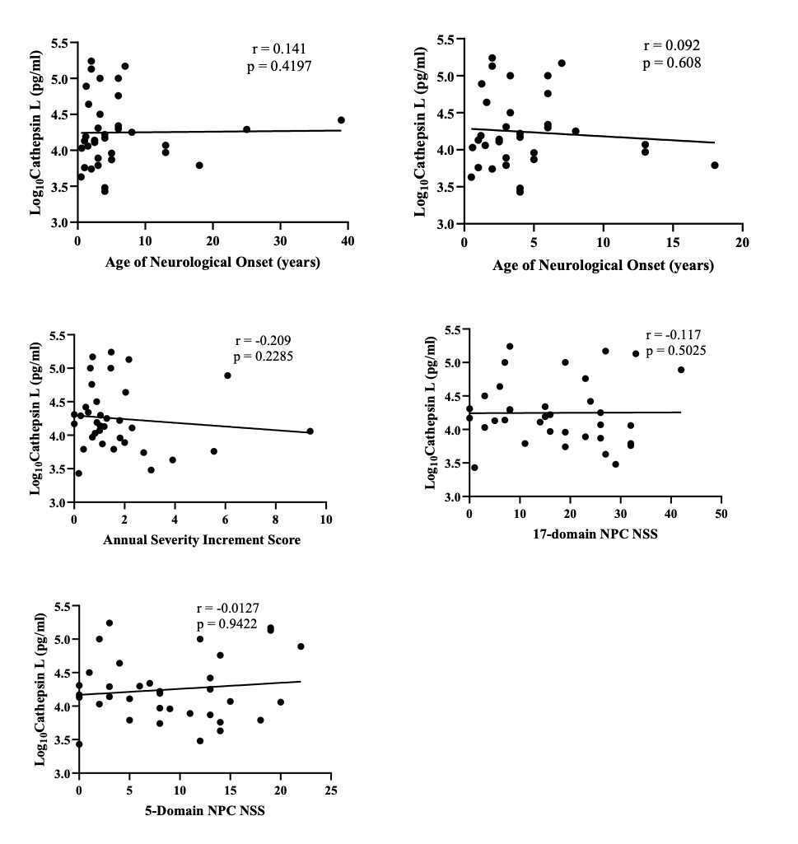
Additional Figure 13
(a)
(b)
(c)
(d)
(e)
Notes:
Additional Figure 13: Spearman correlation of NPC1 serum Cathepsin L levels with NPC1 clinical phenotypes Serum Cathepsin L levels did not correlate with (a) age of neurological onset, (b) Individuals with age of neurological onset >20 years excluded from the analysis. (c) Annual severity increment score, (d) 17-domain NPC neurological severity score, and (e) 5 domain severity score.

Slide 12
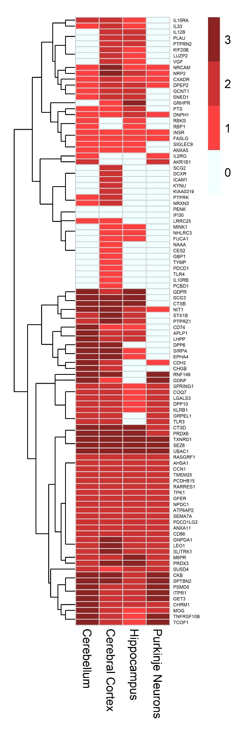
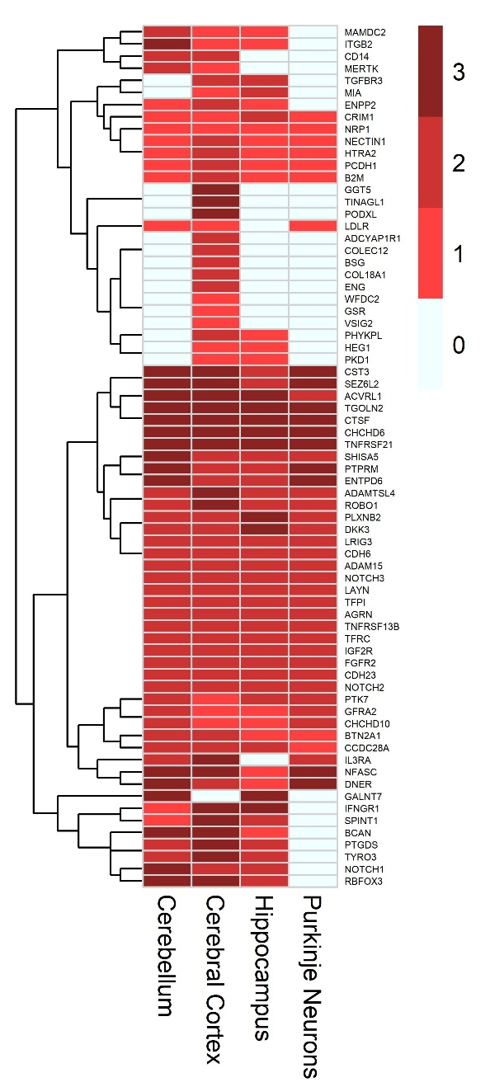
Additional Figure 14
(a)
(b)
Notes:
Additional Figure 14: Graphical representation of the annotation of significantly increased proteins in NPC1 detected in the Human Protein atlas (a) Increased with adjusted log2FC > = 0.5 and <1 and (b) Increased with adjusted log2FC <0.5. Score 0,1,2, and 3, represent “not detected”, “low”, “medium” and “high” expression, respectively, in the HPA dataset.

Slide 13
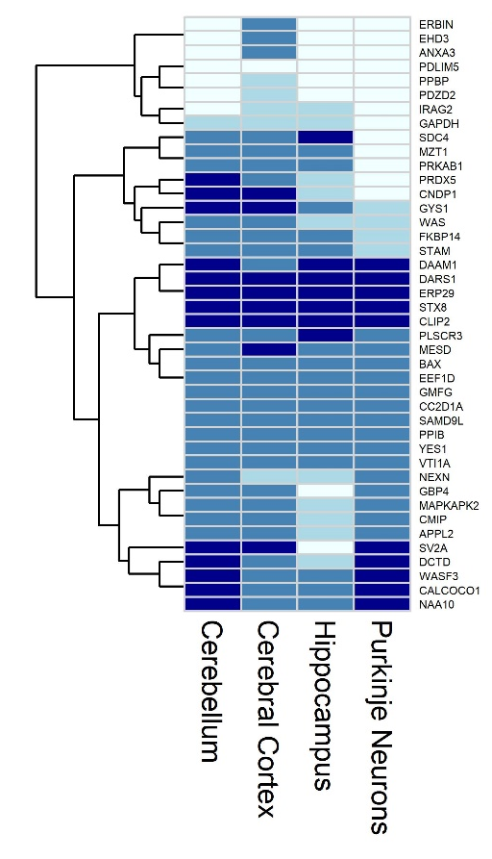
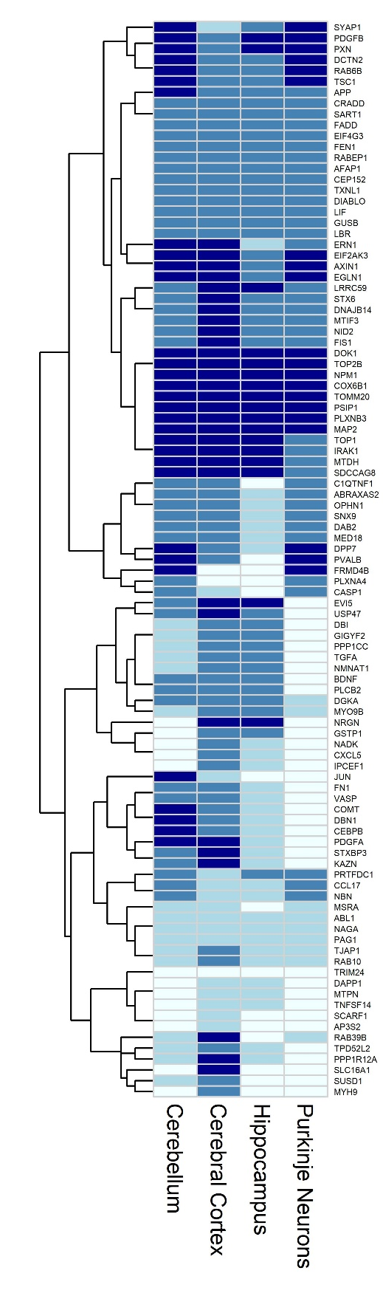
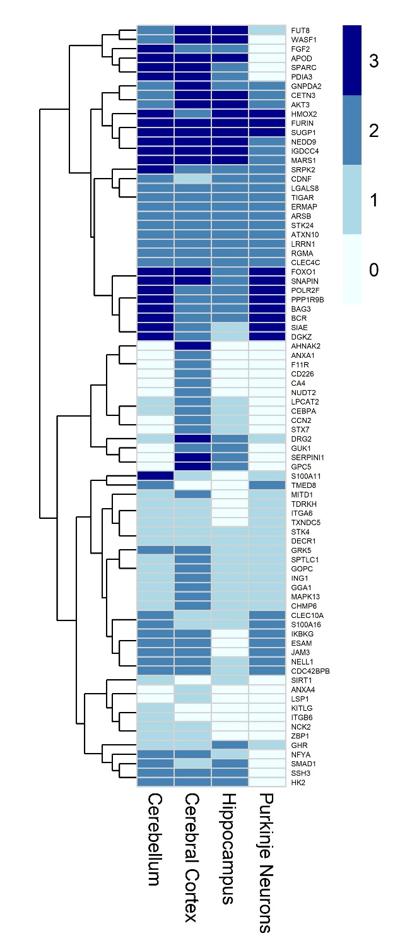
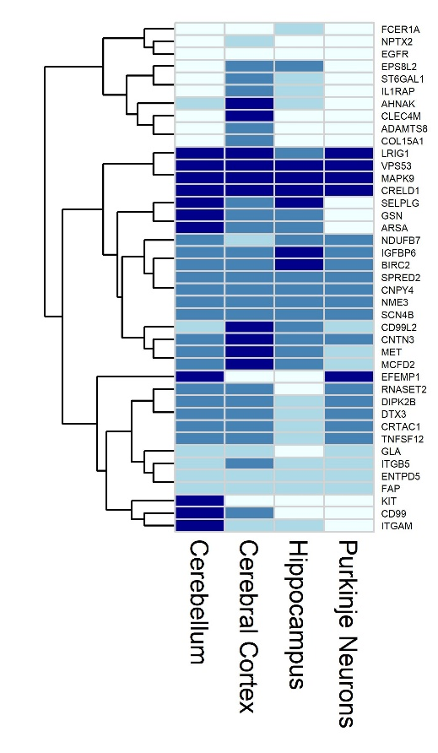
Additional Figure 15
(a)
(b)
(c)
(d)
Notes:
Additional Figure 15: Graphical representation of the annotation of significantly decreased proteins in NPC1 detected in the Human Protein atlas (a) decreased with adjusted log2FC <= -1.5 and > -2 , (b) decreased with adjusted log2FC <= -1 and > -1.5, (c) decreased with adjusted log2FC <=-0.5 and > -1, and (d) decreased with adjusted log2FC > -0.5. Score 0,1,2, and 3, represent “not detected”, “low”, “medium” and “high” expression, respectively, in the HPA dataset.

