Slide 1
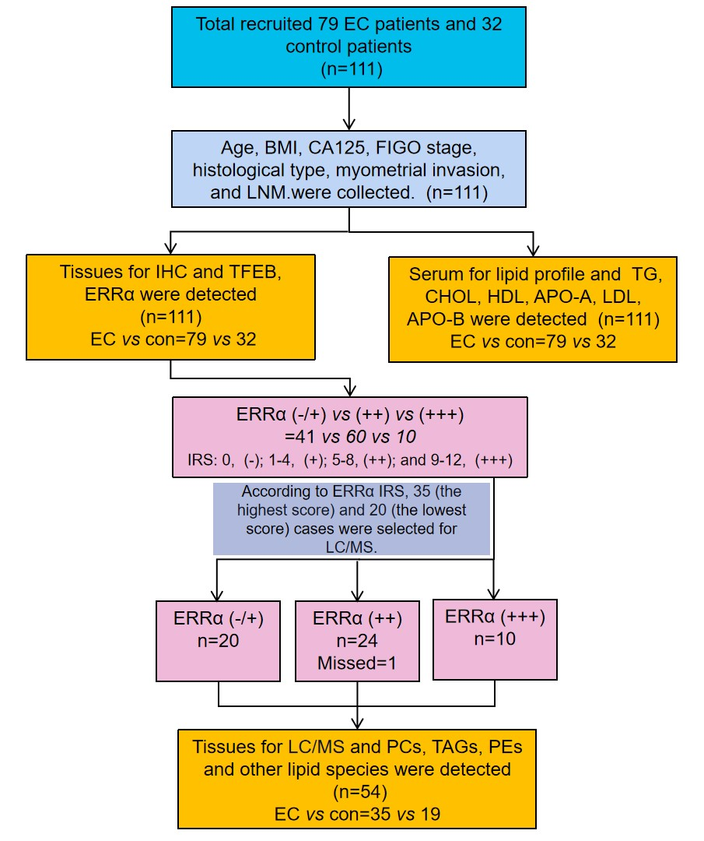
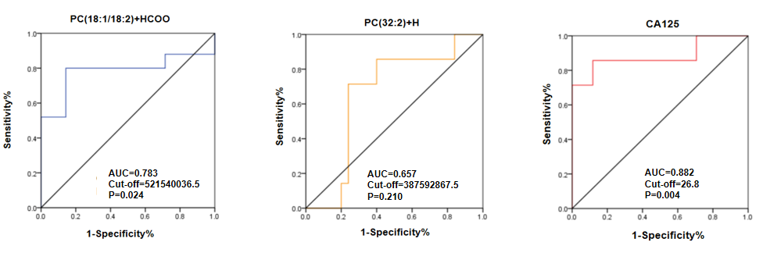
Supplement Figure 1
Supplement Figure 2
A
B
C

Slide 2
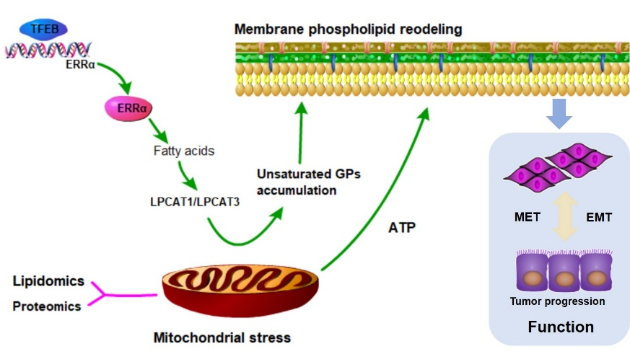
Supplement Figure 3

