Slide 1
A
B
Kang, et al. 2021 Fig.S1

Slide 2
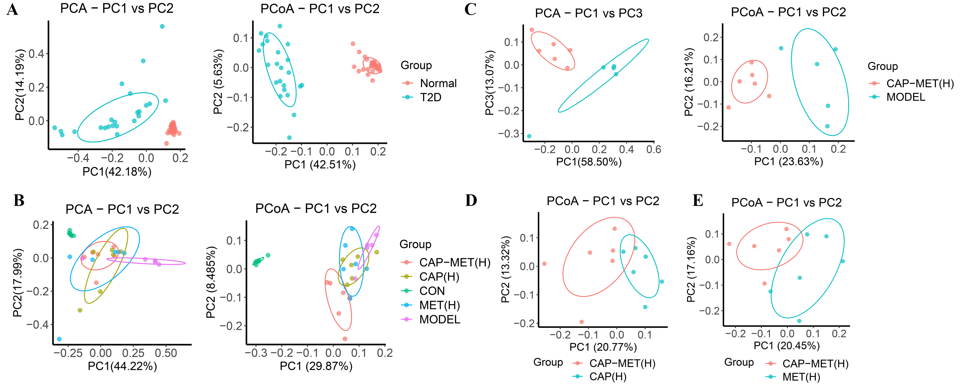
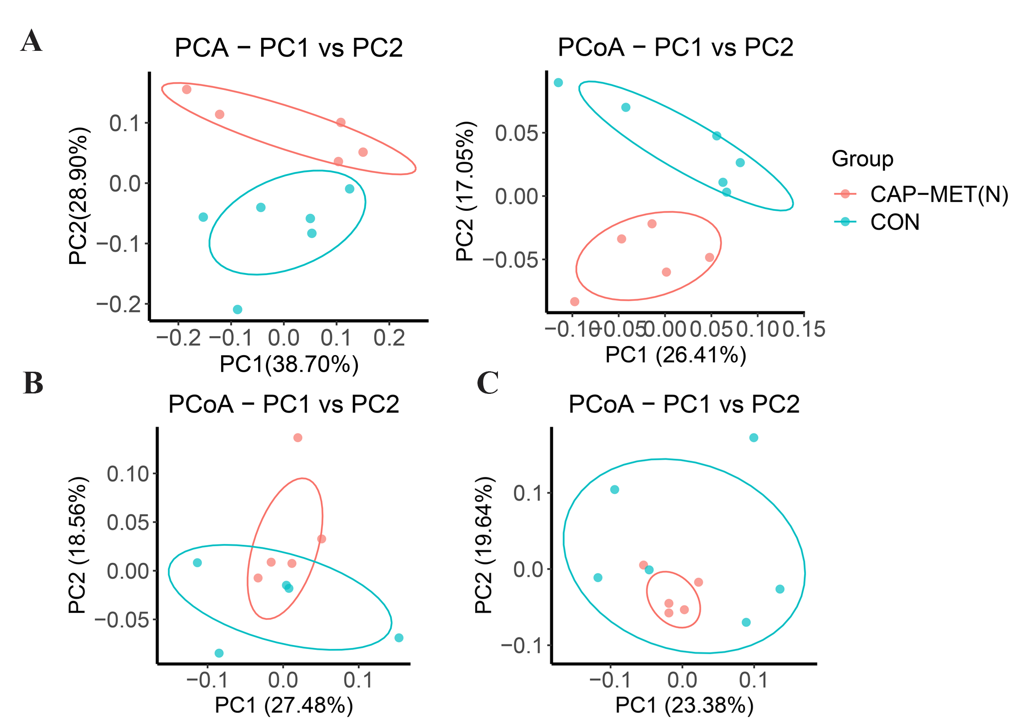
A
PCA-PC1 VS PC2
PCoA-PC1 VS PC2
B
PCA-PC1 VS PC2
PCoA-PC1 VS PC2
C
PCoA-PC1 VS PC2
D
PCoA-PC1 VS PC2
Kang, et al. 2021 Fig.S2

Slide 3
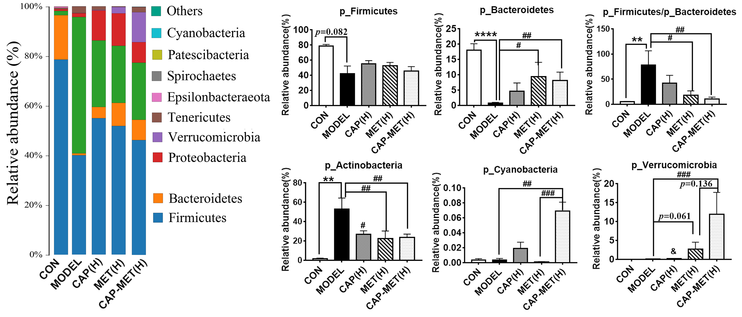
Kang, et al. 2021 Fig.S3

Slide 4
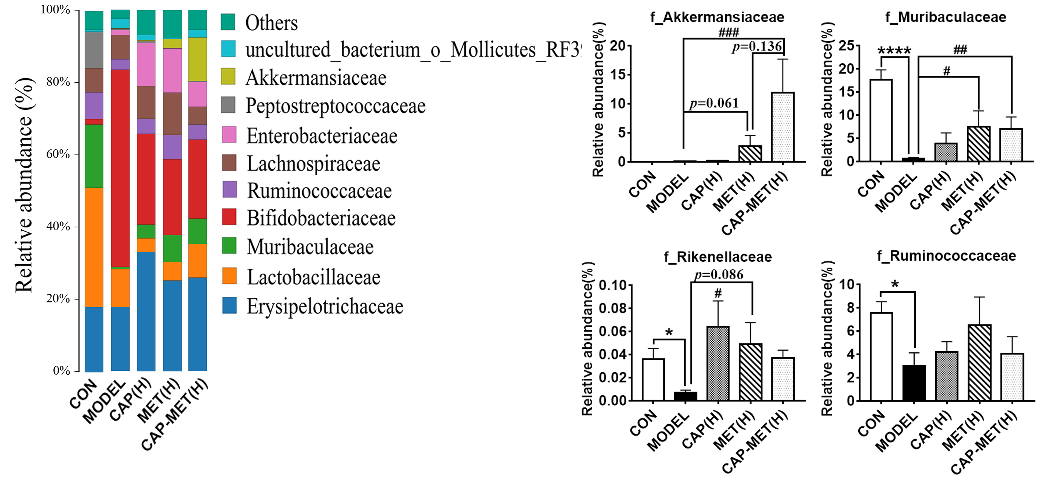
Kang, et al. 2021 Fig. S4

