Slide 1
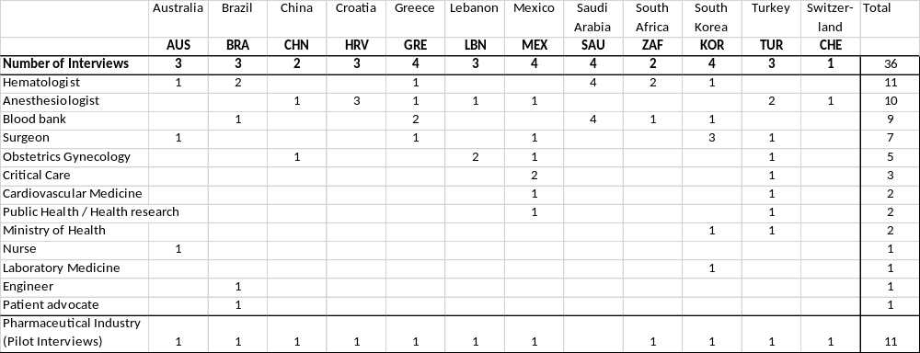
Table 1: Demographics of the interviewees. (1 expert could represent more than 1 perspectives. Therefore, the numbers in the columns can add up to more than the number of experts). The survey was piloted with representatives of pharmaceutical companies being actively involved in Patient Blood Management (Abdi Ibrahim, Genesis Pharma, Hikma, Sandoz Pharma, Takeda, Vifor Pharma)

