Slide 1
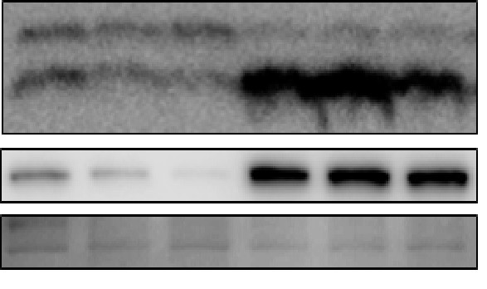
Panel A represents western blot analysis shown in Figure 2A
(n=1)
100 µM TMZ-NR
100 µM TMZ-R
24h
48h
72h
24h
48h
72h
LC3B-I (16 kDa)
LC3B-II (18 kDa)
SQSTM1 (62 kDa)
Ponceau S

Slide 2
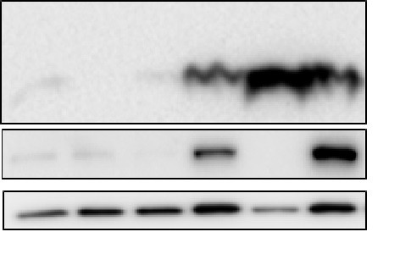
Panel A represents western blot analysis shown in Figure 2A
(n=2)
100 µM TMZ-NR
100 µM TMZ-R
24h
48h
72h
24h
48h
72h
LC3B-I (16 kDa)
LC3B-II (18 kDa)
SQSTM1 (62 kDa)
GAPDH

Slide 3
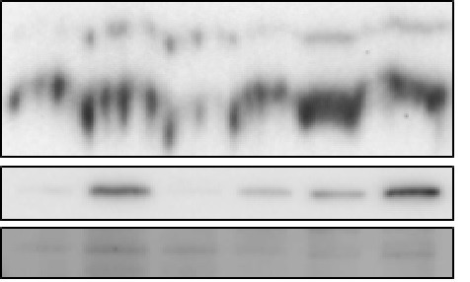
Panel A represents western blot analysis shown in Figure 2A
(n=3)
100 µM TMZ-NR
100 µM TMZ-R
24h
48h
72h
24h
48h
72h
LC3B-I (16 kDa)
LC3B-II (18 kDa)
SQSTM1 (62 kDa)
Ponceau S

Slide 4
Panel A represents western blot analysis shown in Figure 2A
LC3-n=1
LC3 n=2
SQSTM1-n=1
SQSTM1-n=2

Slide 5
Panel A represents western blot analysis shown in Figure 2A
Ponceau S n=1
Ponceau S n=3

Slide 6
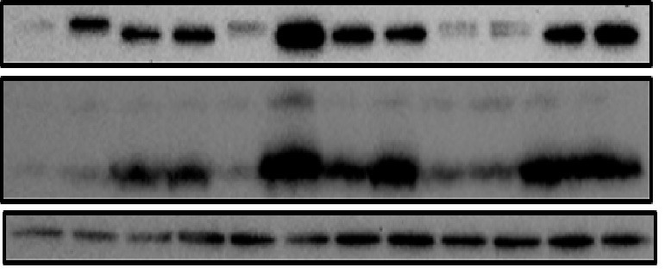
(n=1)
Panel B represents western blot analysis shown in Figure 2D
(n=2)
(n=3)
100 µM TMZ-NR
100 µM TMZ-R
100 µM TMZ-NR
100 µM TMZ-R
100 µM TMZ-NR
100 µM TMZ-R
-
-
-
-
-
-
Baf A₁ (5 nM)
+
+
+
+
+
+
SQSTM1 (62 kDa)
LC3B-I (16 kDa)
LC3B-II (18 kDa)
GAPDH (37 kDa)

Slide 7
Panel B represents western blot analysis shown in Figure 2D
LC3B-I (16 kDa)
LC3B-II (18 kDa)
GAPDH (37 kDa)
GAPDH (37 kDa)
SQSTM1 (62 kDa)
SQSTM1 (62 kDa)

Slide 8
(n=1)
Panel C represents western blot analysis shown in Figure 3A
(n=2)
100 µM TMZ-NR
100 µM TMZ-R
100 µM TMZ-NR
100 µM TMZ-R
24h
48h
72h
24h
48h
72h
24h
48h
72h
24h
48h
72h
Bcl2L13 (~75kDa)
Bcl2L13 (~75kDa)
GAPDH (37kDa)
GAPDH (37kDa)
(n=3)
100 µM TMZ-NR
100 µM TMZ-R
24h
48h
72h
24h
48h
72h
Bcl2L13 (~75kDa)
GAPDH (37kDa)
Notes:
Decide what bands are being quantified.

Slide 9
Panel C represents western blot analysis shown in Figure 3A
GAPDH (37kDa)
GAPDH (37kDa)
Bcl2L13 (~75kDa)

Slide 10
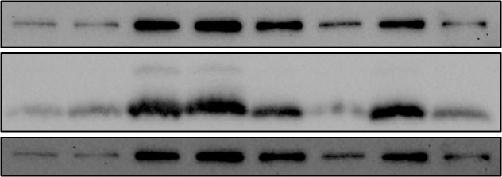
(n=1)
Panel D represents western blot analysis shown in Figure 3F
100 µM TMZ-NR
100 µM TMZ-R
-
-
-
-
+
+
+
+
Baf A₁ (5 nM)
WT/WT
WT/WT
WT/WT
KD/KD
KD/KD
KD/KD
BCL2L13
WT/WT
KD/KD
SQSTM1 (62 kDa)
LC3B-I (16 kDa)
LC3B-II (18 kDa)
Ponceau S

Slide 11
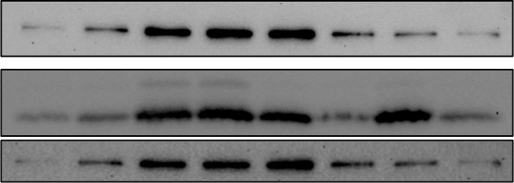
(n=2)
Panel D represents western blot analysis shown in Figure 3F
100 µM TMZ-NR
100 µM TMZ-R
-
-
-
-
+
+
+
+
Baf A₁ (5 nM)
WT/WT
WT/WT
WT/WT
KD/KD
KD/KD
KD/KD
BCL2L13
WT/WT
KD/KD
SQSTM1 (62 kDa)
LC3B-I (16 kDa)
LC3B-II (18 kDa)
Ponceau S

Slide 12
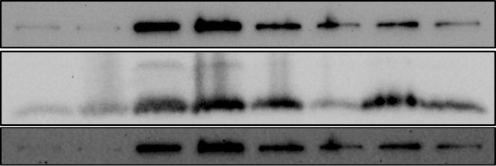
(n=3)
Panel D represents western blot analysis shown in Figure 3F
100 µM TMZ-NR
100 µM TMZ-R
-
-
-
-
+
+
+
+
Baf A₁ (5 nM)
WT/WT
WT/WT
WT/WT
KD/KD
KD/KD
KD/KD
BCL2L13
WT/WT
KD/KD
SQSTM1 (62 kDa)
LC3B-I (16 kDa)
LC3B-II (18 kDa)
Ponceau S

Slide 13
Panel D represents western blot analysis shown in Figure 3F
SQSTM1 (62 kDa)
LC3B-II (18 kDa)
SQSTM1 (62 kDa)
SQSTM1 (62 kDa)
LC3B-II (18 kDa)
LC3B-II (18 kDa)

Slide 14
Panel D represents western blot analysis shown in Figure 3F
Ponceau S

