Slide 1
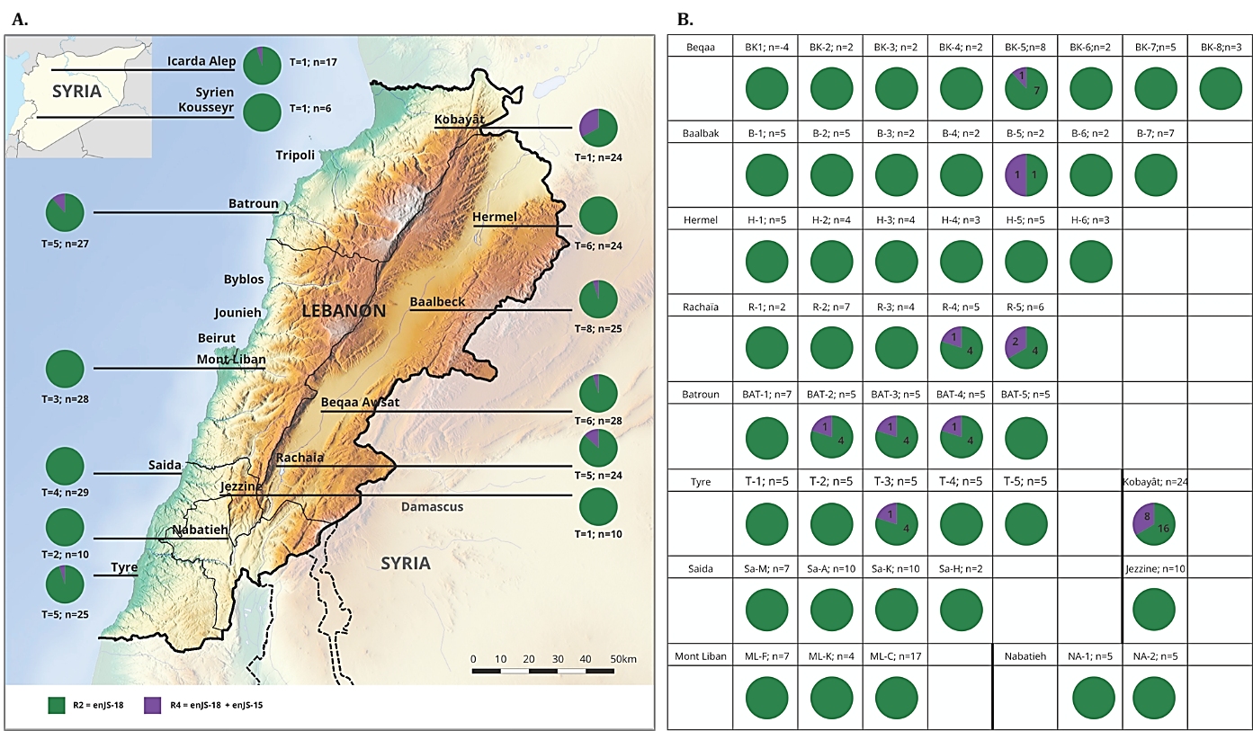
Figure S 1: Frequency and geographical distribution of the R2 (in green) and RA retrotypes (in purple).

Slide 2
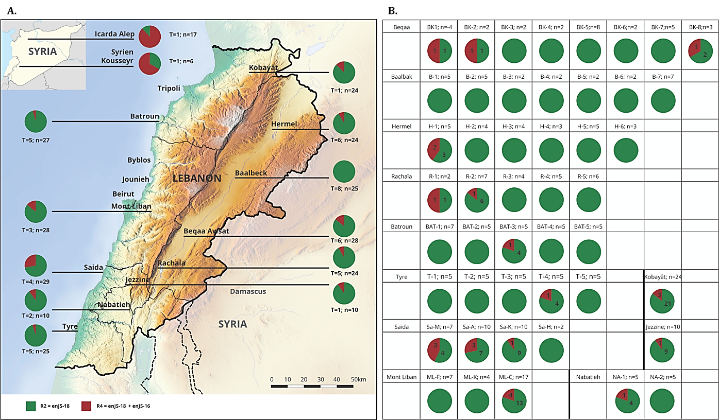
Figure S 2: Frequency and geographical distribution of the R2 (in green) and RB retrotypes (in Red)

Slide 3
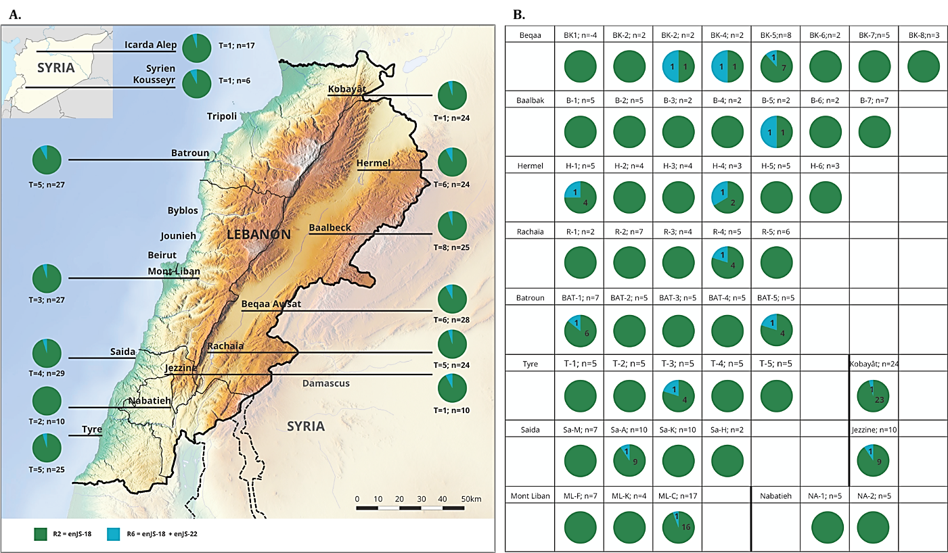
Figure S 3: Frequency and geographical distribution of the R2 (in green) and R6 retrotypes (in Blue).

Slide 4
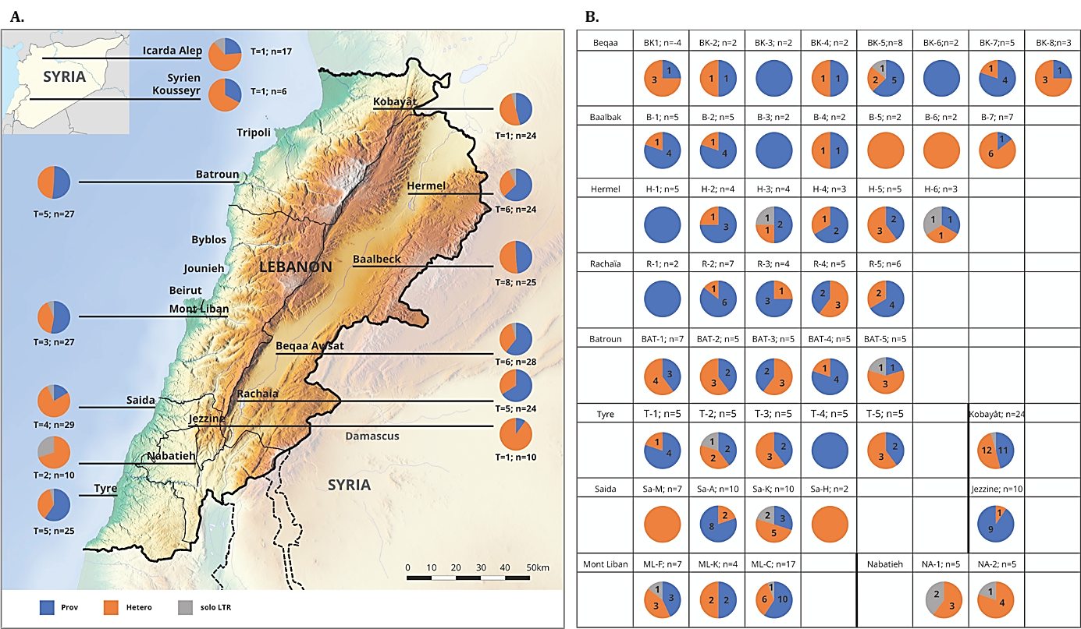
Figure S 4: Frequency and geographical distribution of the different types of zygoty found for enJSRV-6 in the genome of Awassi populations in Lebanon

