Slide 1
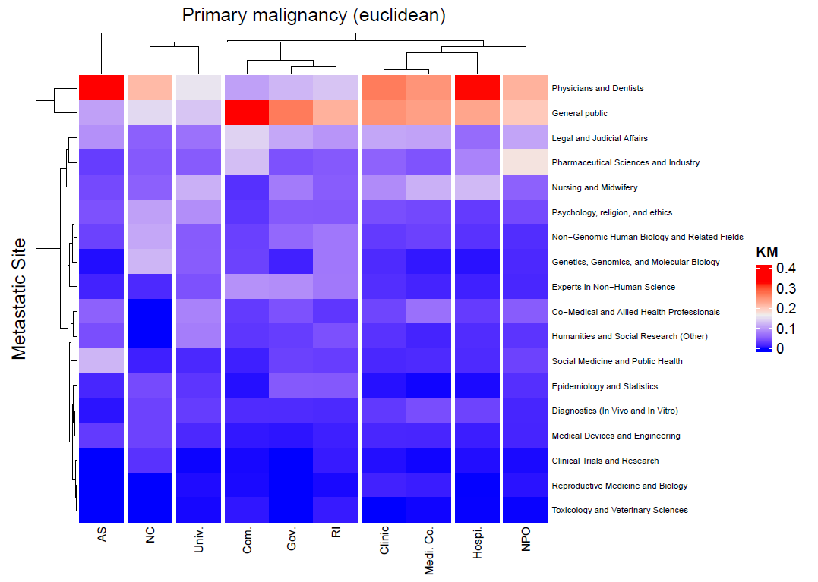
Suppｌ. Fig. 1
Non-hierarchical clustering (K-mean method)

