Slide 1
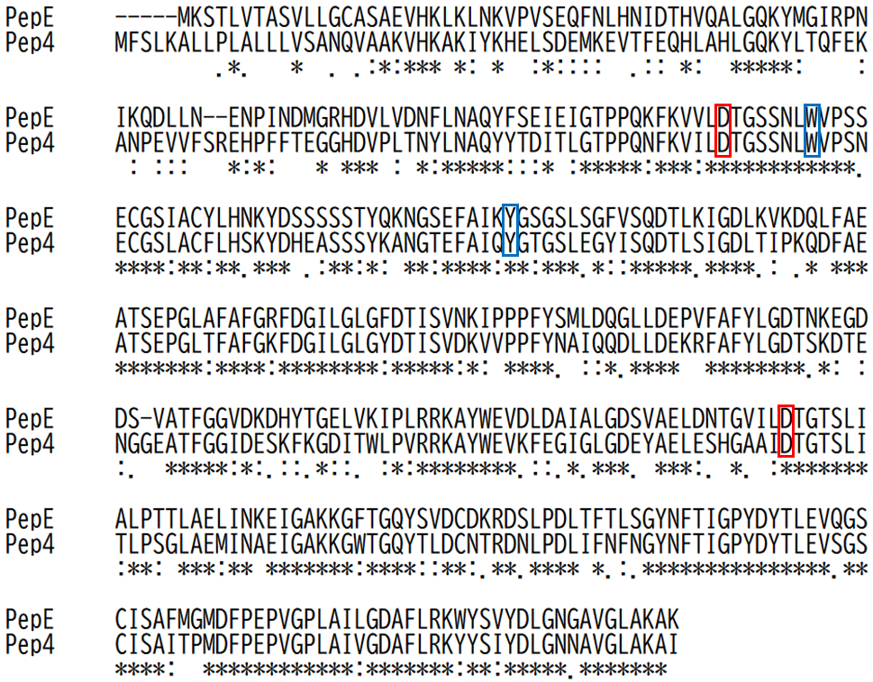
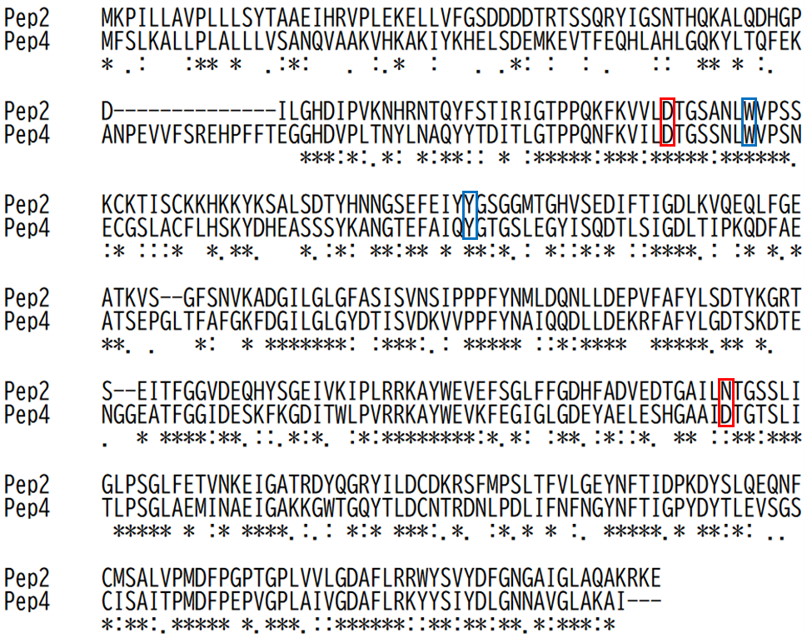
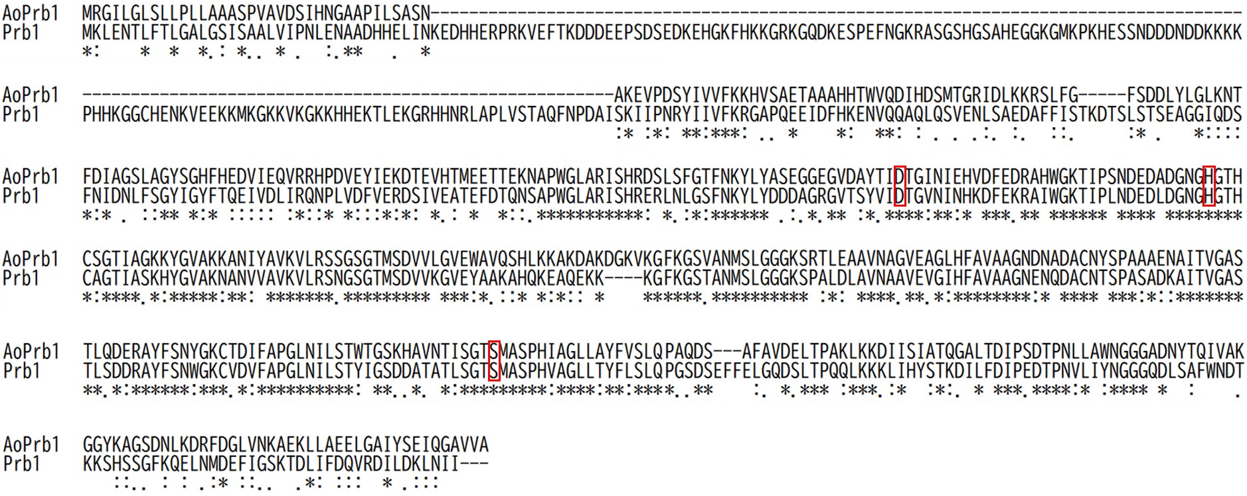
(A)
(B)
(C)
Fig. S1 Amino acid sequence aliment
(A) (B) Amino acid sequence alignment with Pep4 (YPL154C) in S. cerevisiae. The main catalytic residues in Pep4 (D109 and D294) are flamed in red, and residues related to the catalytic site hydrogen bond (W116 and Y152) are flamed in blue. (A) Amino acid sequence alignment of PepE (AO090003000693) and Pep4. The alignment score was 60%. (B) Amino acid sequence alignment of Pep2 (AO090038000229) and Pep4. The alignment score was 44%. (C) Amino acid sequence alignment of AoPrb1 (AO090020000517) and Prb1 (YEL060C). The residues considered to be the main active residues in S. cerevisiae (D325, H357 and S519) are flamed in red. The alignment score was 49%.

Slide 2
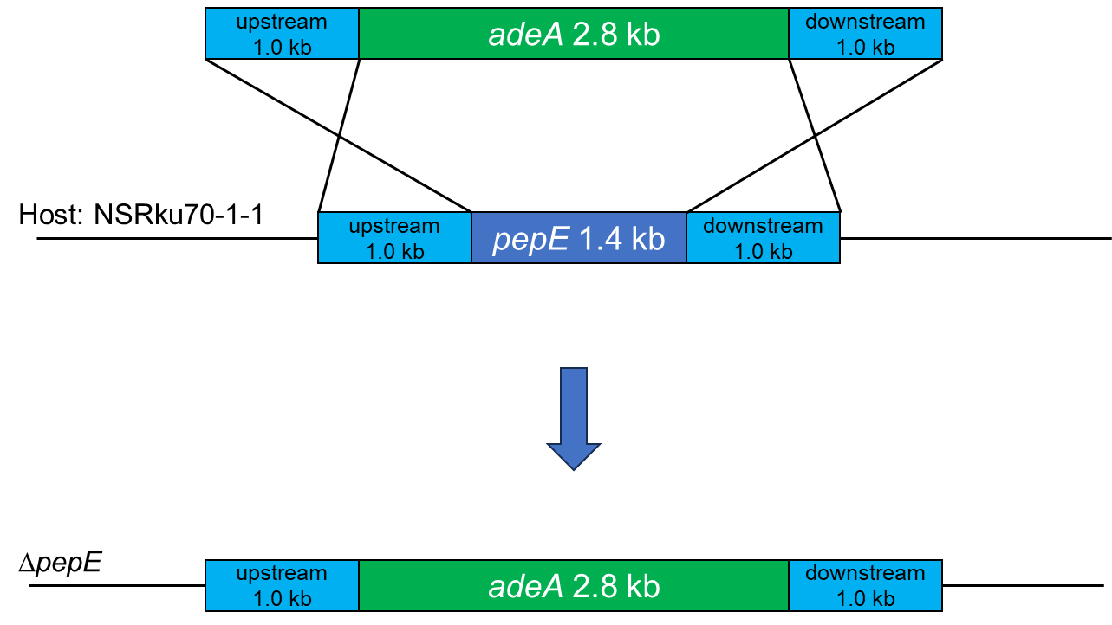
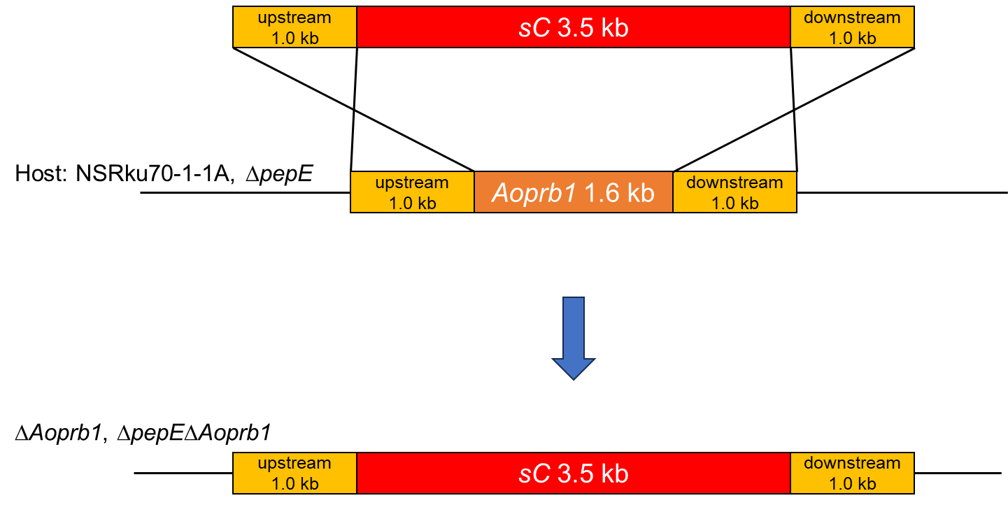
(A)
(B)
Fig. S2 Construction of pepE and Aoprb1 disruptants
(A) pepE gene of the host strain NSRku70-1-1 was disrupted by homologous recombination using the adeA selection marker. DNA fragment amplified pepE-up-Fw and pepE-down-Rv-3 primers using the plasmid pUC19-pepE deletion as a template was used for the transformation.
(B) Aoprb1 gene of the host strains NSRku70-1-1A and ΔpepE were disrupted by homologous recombination using the sC selection marker. DNA fragment amplified AO090020000517-up-Fw and AO090020000517-down-Rv primers using the plasmid pUC19-Aoprb1 deletion as a template was used for the transformation.

Slide 3
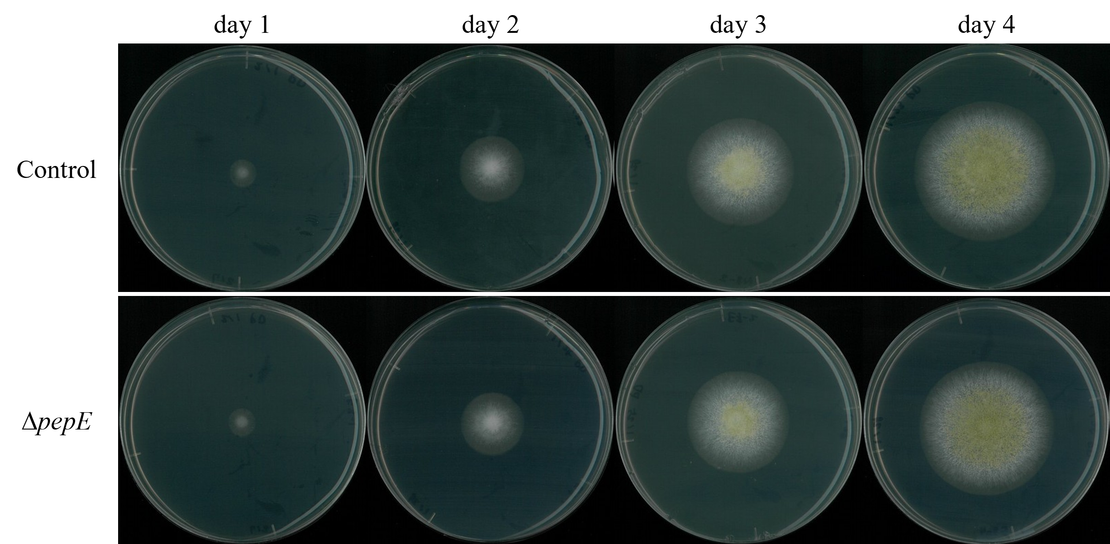
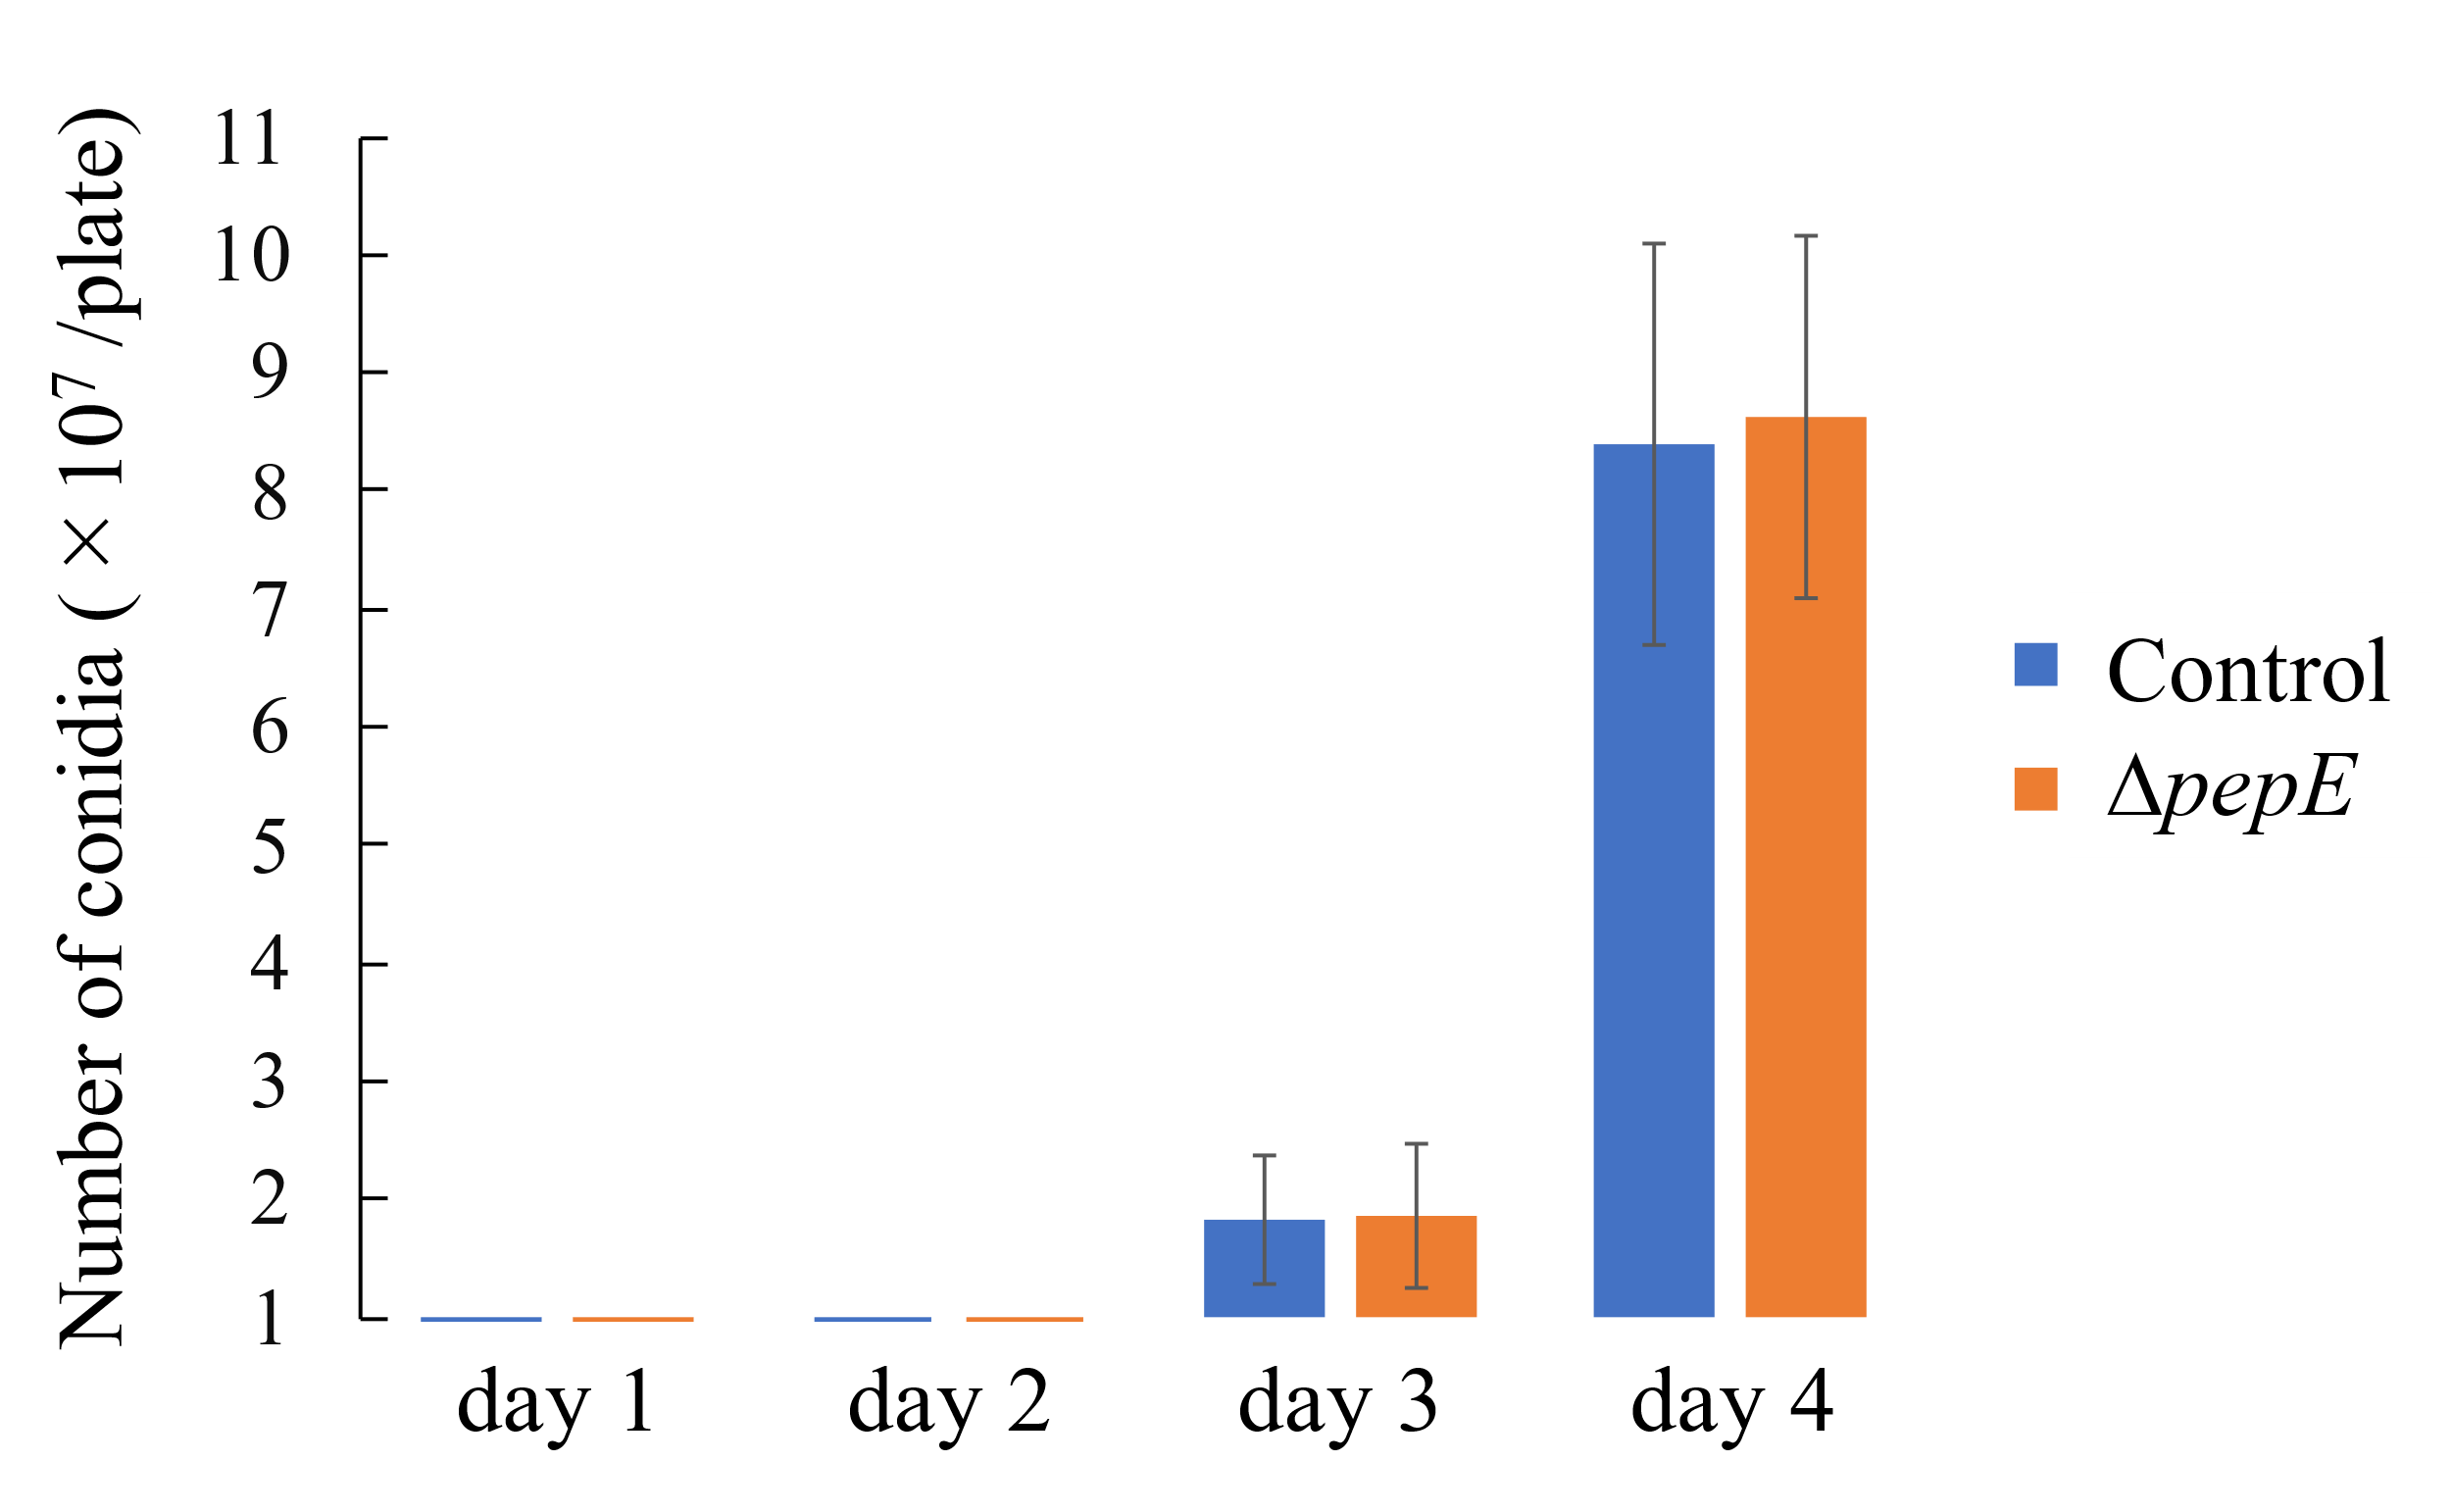
(A)
(B)
Fig. S3 Comparison of the number of conidia formed over time in WT and ΔpepE strains
(A) 1.0×10⁴ conidia of control (NSRku70-1-1AsC) and ΔpepE (ΔpepEsC) strains were inoculated on the center of PD medium and incubated at 30℃ for 1, 2, 3 and 4 days.
(B) The numbers of conidia were counted by collecting the conidia from the plates that had been cultured under the condition in (A), using a hemocytometer.

