Slide 1
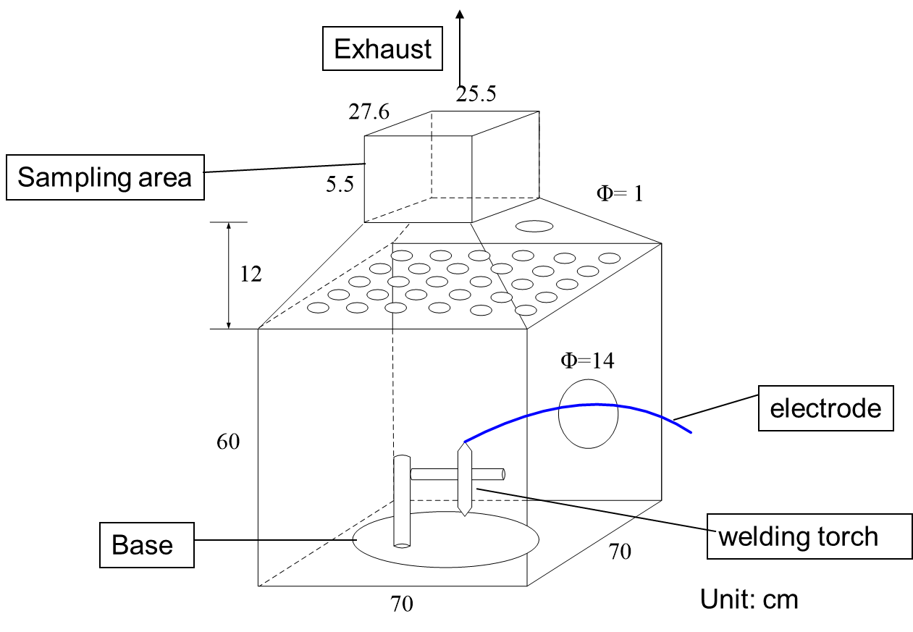
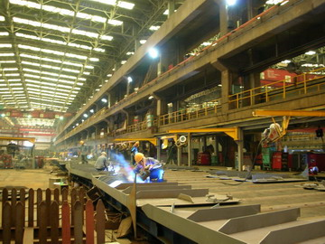
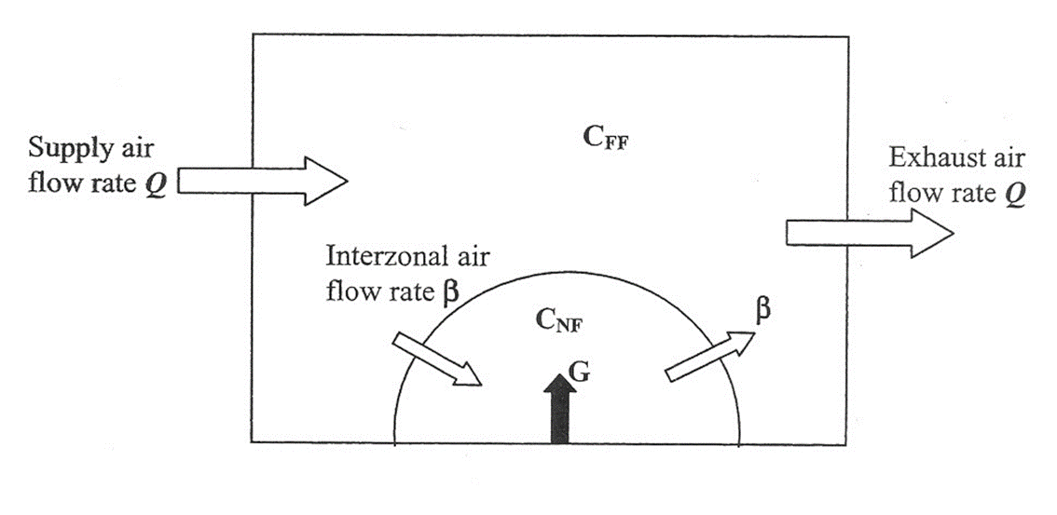
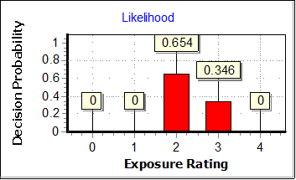
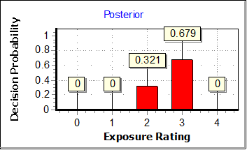
Graphical Abstract
Cp (predicted metal fume concentration)
Cm (measured metal fume concentration)
metal fume emission rate
field sampling
+
Mn, Fe, Cu, Cr, Ni, Pb
Recorded long-term operation condition data
Long-term exposure condition

