Slide 1
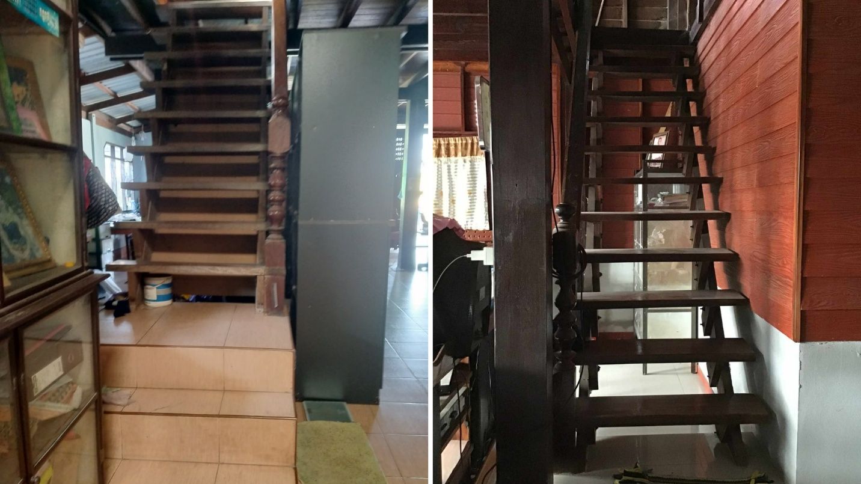
Figure 3 The staircase lacks bilateral handrails and has a steep incline structural features frequently observed in the homes of older adults in community settings.

