Slide 1
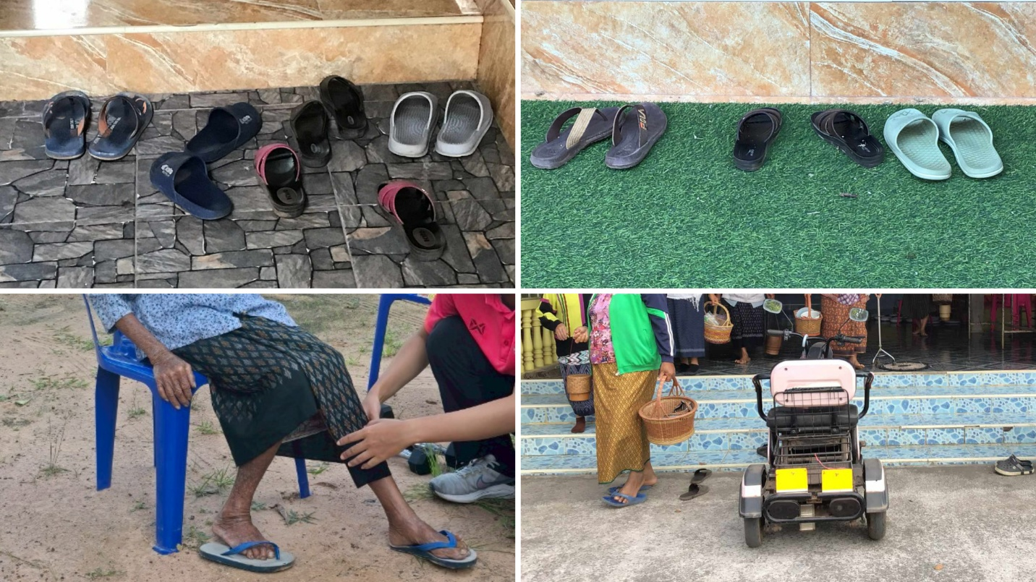
Figure 4 Wearing ill-fitting or inadequately supportive footwear, particularly loose sandals, is common among older adults in rural communities.

