Slide 1



Supplementary Figure 1
A
B
C

Slide 2
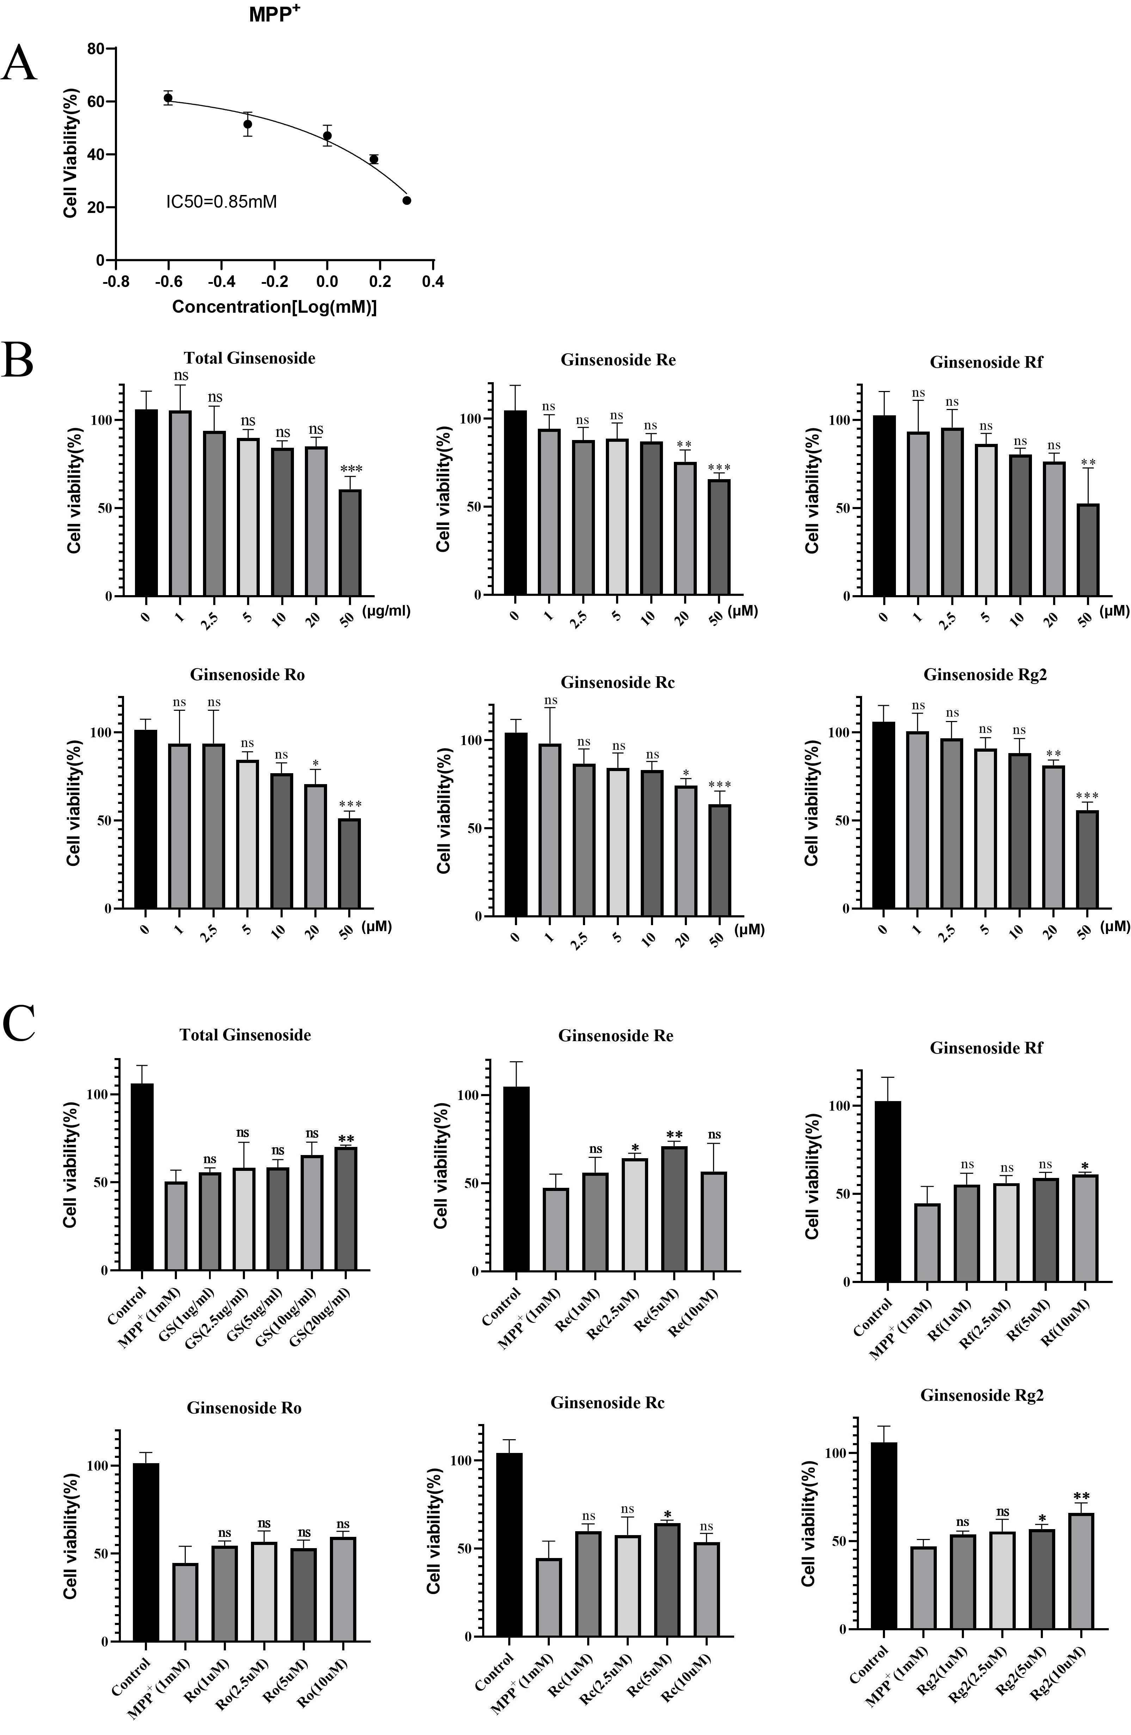
Supplementary Figure 2

Slide 3




Supplementary Figure 3
A
B
C
D

Slide 4
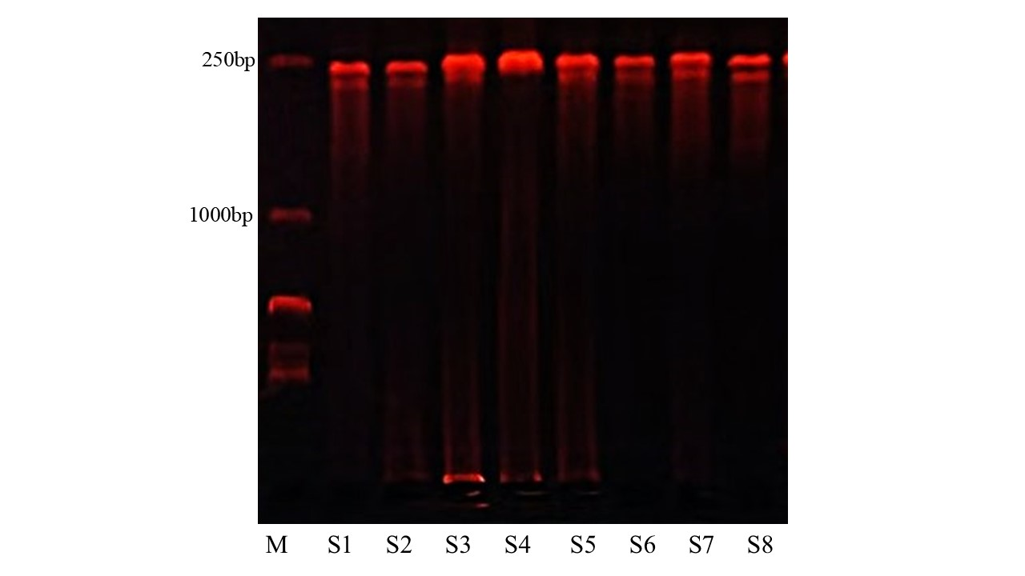
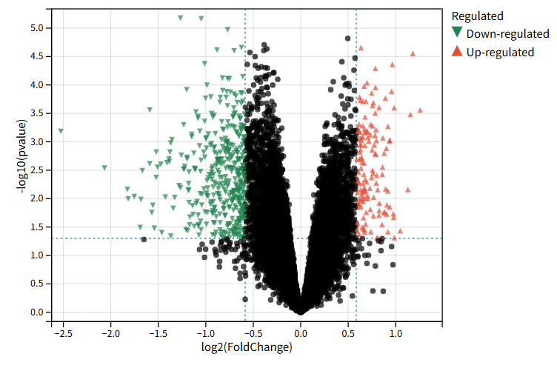
Supplementary Figure 4
A
WT
BDNF cKO
(kDa)
B
TrkB
140
90
BDNF
27
actin
43
C
BDNF

Slide 5
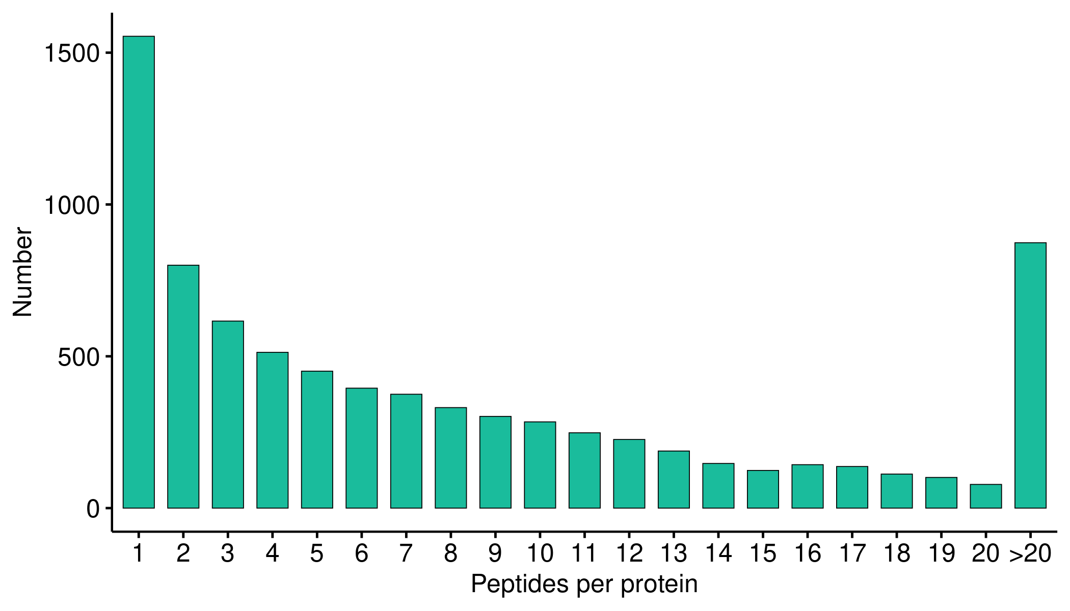
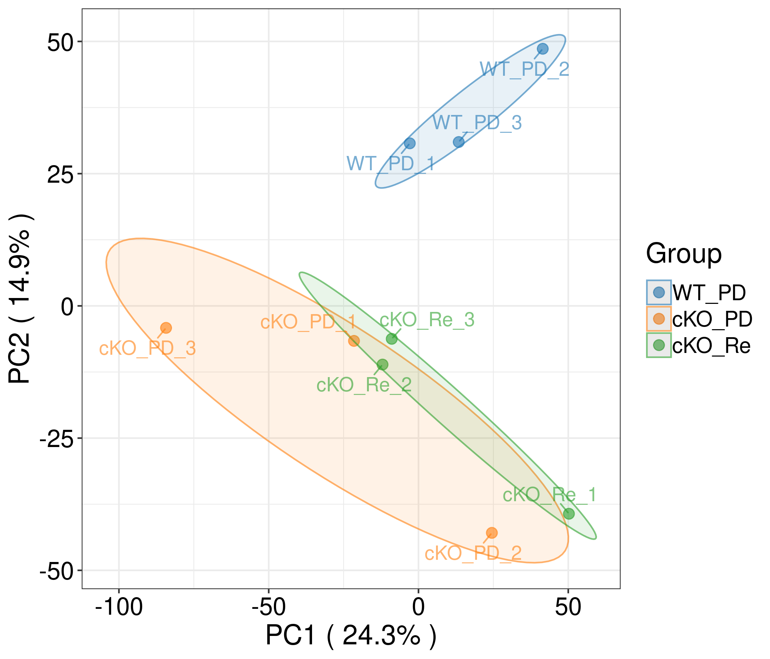
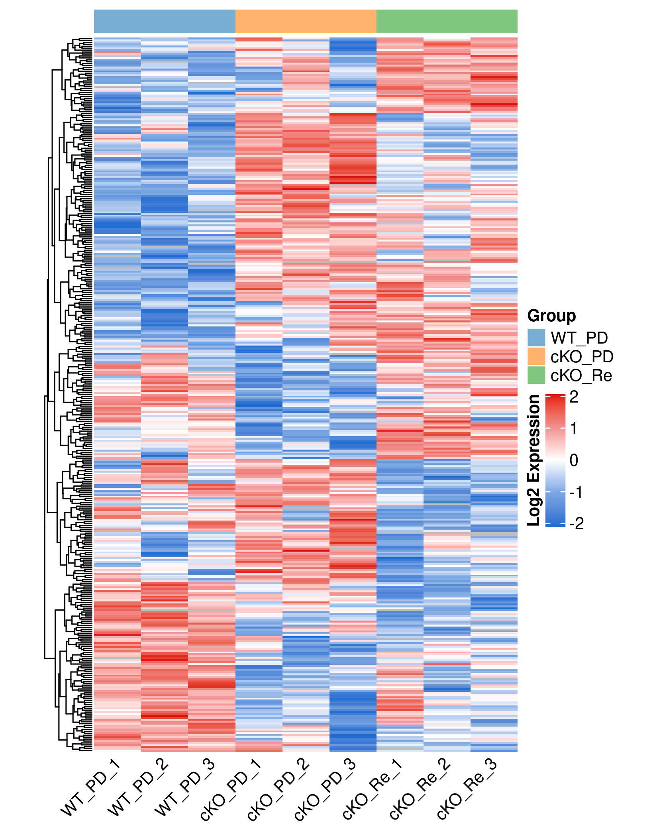
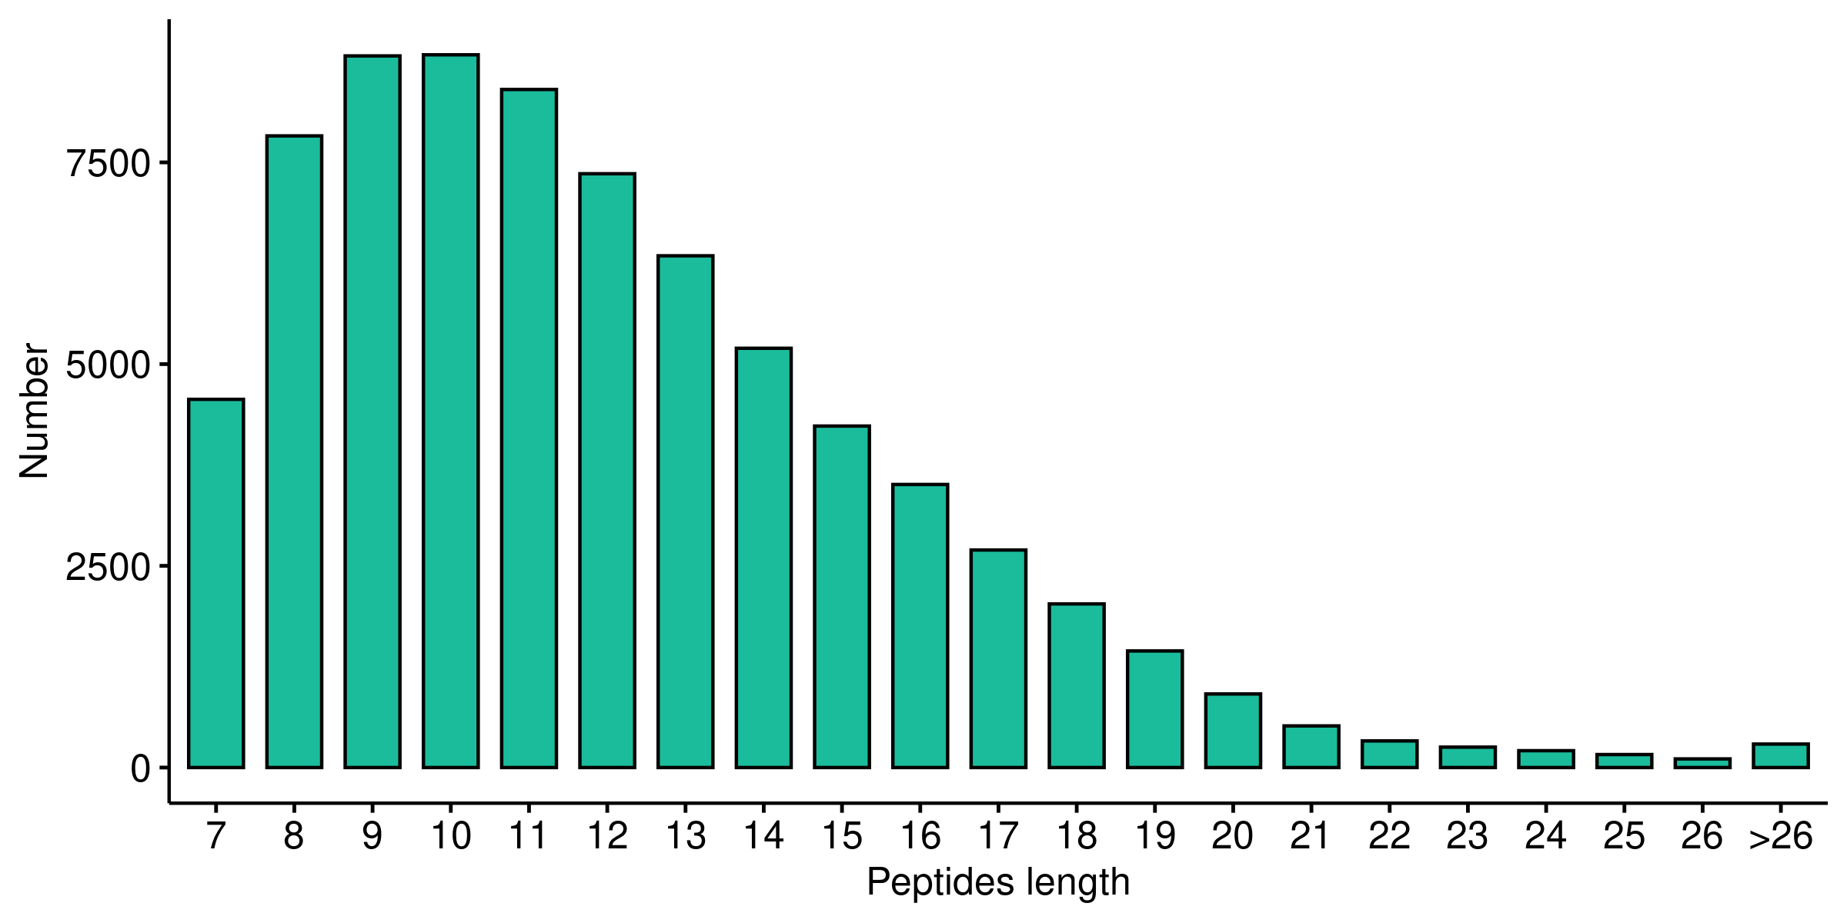
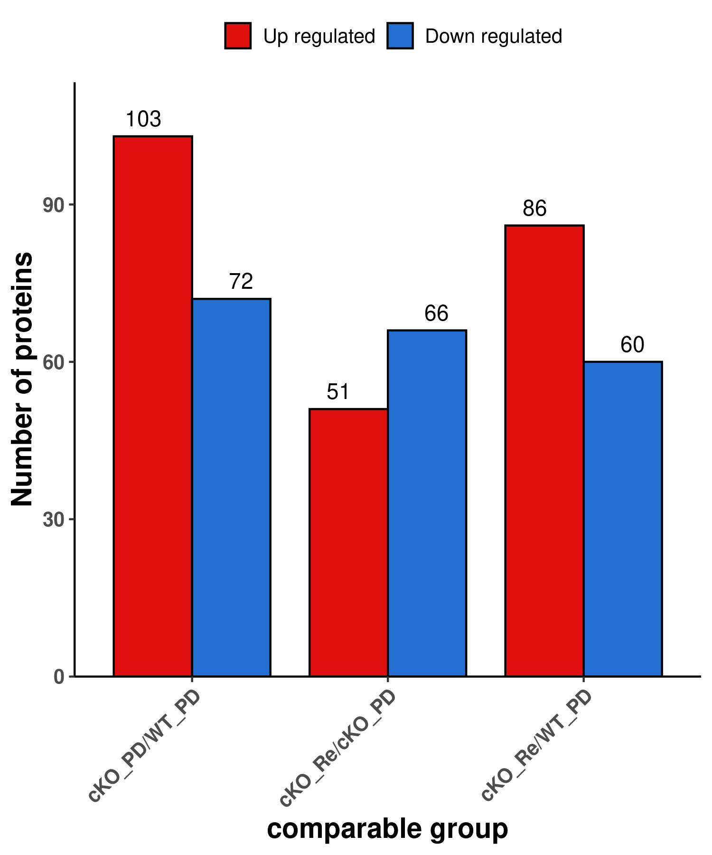
Supplementary Figure 5
A
C
E
B
D
F
G

