Slide 1
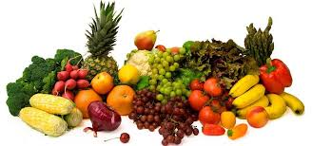

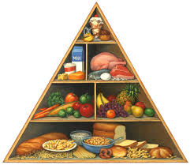



HEALTH CARE PRACTICES FOR WOMEN AND CHILDREN
Personal Hygiene and Sanitation
Basics of nutrition
Nutrition during pregnancy and Lactation
Breastfeeding
Complementary feeding and child care practices
Awareness about Legal Rights

Slide 2

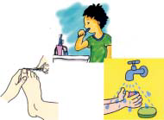
Personal hygiene and sanitation
More than half of all the illnesses and death among children and adolescents are caused by germs
They enter the body through contaminated food water and dirty hands

Slide 3
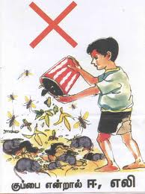
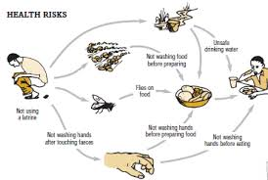
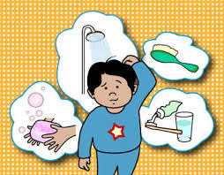
Contd..
Germs can be spread through flies, cockroaches and rats which thrive in refuse such as food scraps and peelings from fruits and vegetables
Keeping the household and nearby areas clean and free from faeces, refuse and waste water can help prevent

Slide 4
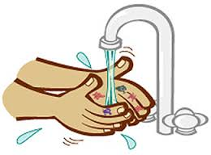



Cont…
Hands should always be washed before preparing, serving and eating food
Should take bath at least once a day and wear clean clothes
Brush your teeth regularly and rinse your mouth with water after each meal

Slide 5


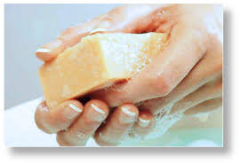


Contd..
Always use sanitary toilets for defecation
Many illnesses, especially diarrhoea can be prevented by good hygienic practices
It is important to wash hands with soap and water after defecation

Slide 6

Contd..
The hair should be kept clean to avoid infestation of head louse
Should cut their nails regularly and keep them clean
A clean cloth or sanitary pads should be used during menstruation (the period of their monthly cycle)
Don’t walk barefoot; always use a foot wear

Slide 7
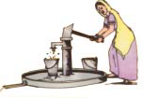



Environmental Sanitation
Latrines and toilets should be cleaned regularly
Household waste water can be disposed safely by making a soak pit or a channel to kitchen garden or to the field
Household garbage should be collected in a garbage bin and disposed into a compost pit or in to community bin if available

Slide 8
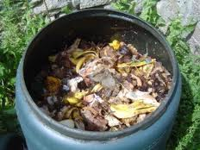
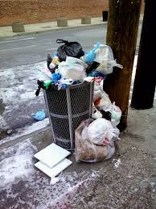

Prevent stagnation of water around houses and hand pumps to prevent breeding of mosquitoes
Chemicals such as pesticides, fertilizers/insecticides and herbicides can be very dangerous if they get into the water supply or food so they should not be used around household or near a water source

Slide 9
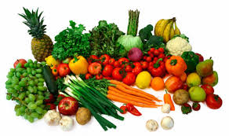
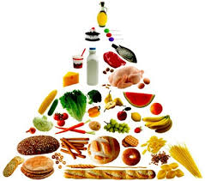

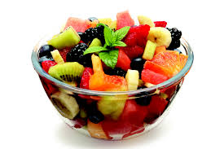
Basics of Nutrition
Nutrition is essential for good health
Food helps in physical growth, mental development and maintenance of the body at all developmental stages of life.
Balanced diets are those which contain different types of food in such quantities and proportions that the daily needs for energy, protein, minerals are met for proper growth, development and maintenance of the body processes.

Slide 10
Sources and Functions of Nutrients
Nutrients | Source | Functions
Carbohydrates | Cereals, millets, roots and tubers,such as potatoes, sweet potatoes, yam, tapioca, colocasia, sugar and jaggery. | Supply energy to the body.
Proteins | Pulses and legumes, milk, cheese, curd, oilseeds and nuts, meat, liver, fish and egg | Builds and repair body tissues, muscles and vital fluids like blood.
Fats | Butter, ghee, vegetable oils and fat, oilseeds, nuts and soya bean. | Help in formation of substances that help in digestion and fight infection

Slide 11

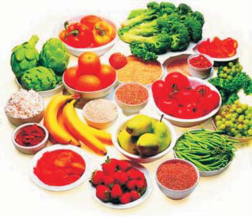
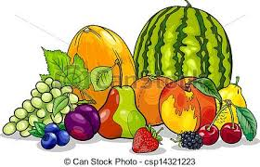
Cont…
Nutrients | Source | Functions
Vitamins and | Fish liver oil, liver, milk, and milk products (curds, butter, ghee), | Serve as a concentrated source of energy and provide essential fatty acids.
Minerals | yellow and red fruits, green leafy and yellow vegetables (carrots, pumpkins) and fortified foods. | Helps keeping the body healthy

Slide 12
Nutrition During Pregnancy
Eat balanced diet and variety of foods, so that all nutritional needs are fulfilled.
Eat small frequent meals four to five times a day.
Increase intake of cereals, pulses, milk and milk products and green leafy vegetables.
No food should be avoided during pregnancy.
Intake of tobacco, alcohol and caffeine should be avoided.
Drink plenty of water.
Consume iodized salt.
Ignore harmful beliefs and food practices during pregnancy.

Slide 13

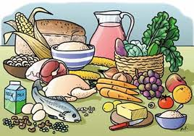

Nutrition during Lactation
A nursing mother should continue to take sufficient amount of nourishing and wholesome food to meet her nutritional requirements to have sufficient milk for her child.
A nursing mother needs more proteins (high quality) for milk production. She should have more of whole grain cereals pulses/dals, milk, curd. Green leafy vegetables and fruits.
Iodized salt should be used.
If a nursing mother does not consume nutritious diet, her own body stores will be used up for production of milk, thus affecting her health.

Slide 14
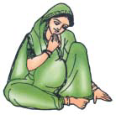
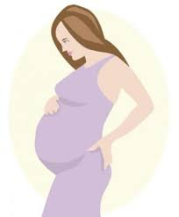
Do’s and Don’ts during Pregnancy
A pregnant women should:
Get registered with a PHC/nursing home
Go for antenatal check-ups
Maintain personal and genital hygiene
Take right kind of fluids and foods (energy giving, body-building and protective)
A pregnant women should not:
Lift/ carry heavy loads
Drink alcohol or smoke cigarettes
Take medicines or herbs without doctors’ prescription
Engage with untrained person for delivery

Slide 15
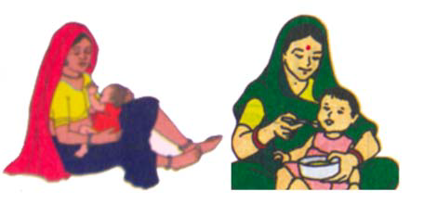

Breastfeeding
National Guidelines on Infant and Young Child Feeding
Optimal feeding includes:
Early Initiation of breastfeeding preferably within first hour.
Exclusive breastfeeding from birth to six months of age.
Continued breastfeeding for two years or beyond with adequate, safe and proper additional foods and liquids to meet nutritional needs.

Slide 16

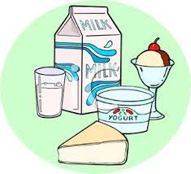
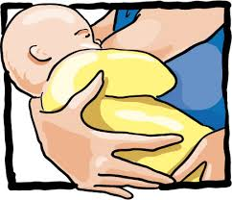
Colostrum and its Importance
Colostrum is the first milk for the child.
Colostrum is a thick yellow coloured secretion and is rich in proteins and vitamins.
This is the source of fats, proteins, sugar, vitamin and minerals for the child.
It gives protection from various infections in the new born.

Slide 17


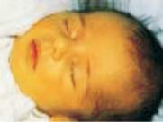
WHO Recommendations for Feeding Young Children
At Birth:
Initiate breastfeeding as early as possible, preferably within first hour.
Do not give pre-lacteals such as water, honey or any milk, other than breast milk.
Do not discard first secretion of breast i.e.colostrum.

Slide 18
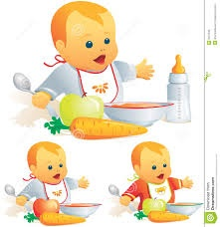

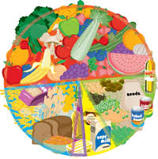
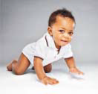
Infants from Birth to 6 Months
‘Exclusive’ breastfeeding until the child is 6 months old. Not to give the child anything other than breast milk, not even water.
Breastfeed as frequently as the child wants during day and night, atleast 8 times in 24 hours.
When a child begins to fuss, sucks fingers or moves lips, it indicate that he/she is hungry.
Ensure that one breast is emptied completely, before shifting to the other.
The child does not require water or any other fluids, as breast milk quenches ‘thirst’ as well as ‘hunger’.

Slide 19

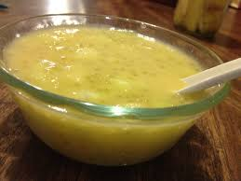
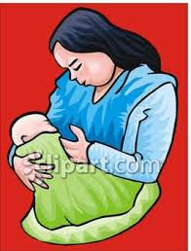

6 Months to 1 Year
Continue breastfeeding as often and as long as the child wants.
At 6 months age, initiate complementary feeding by giving ‘other foods’ in small quantities, in semi solid form.
Start with one type of food, wait for a few days to be sure that the child tolerates the same before introducing another type of food

Slide 20


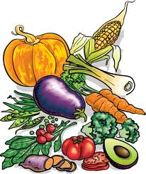


Contd.
Give food that has cereals, pulses, fruits, green leafy vegetables and yellow coloured vegetables, oils & fats, groundnut paste, and animal foods such as meat, fish, liver, egg, milk products such as curd, cheese, etc. wherever culturally acceptable.
Feed from a cup with spoon, both of which are thoroughly cleaned.
Do not give left over foods, milk and milk products.

Slide 21


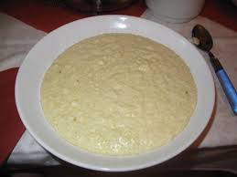
At 6-9 Months
Start by offering 2-3 tablespoons of thick porridge/ mashed food 2-3 times a day.
Gradually increase the quantity to ½ cup (125 ml)
At 8 months help the child to feed him/herself with his/her fingers.
Avoid foods, such as nuts, grapes, raw carrots etc., as they can cause ‘choking’.
Give 1-2 snack foods in between meals, depending on the appetite

Slide 22

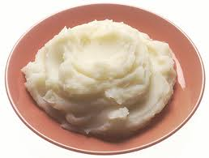
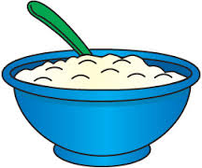
At 9-12 Months
Offer finely chopped or mashed foods that child can pick up about ½ cup, 3-4 times a day.
Give 1-2 snacks in between meals depending on his/her appetite.
Feed him/her from his/her own bowl patiently, talking to him/ her and looking into his/her eyes, lovingly.
Remove distractions, if any, to keep the child interested in meals.
Do not force feed. Do not feed left-overs.
To increase energy density of foods, add 1-2 tsp of ghee/oil to the food supplement. If the preparation is thin, then 2/3 to ¾ cup should be given each time.

Slide 23
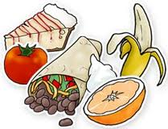



1-2 Years
Breastfeed as often as the child wants, up to the age of 2 years or beyond.
Continue to give 3-4 meals of nutritious foods chopped/ mashed if
necessary, ¾ - 1 cup (250 ml) at each meal. Also give 1-2 snacks per day in between meals.
Give variety of foods.
Actively help the child to eat.. .

Slide 24
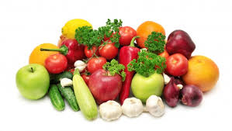
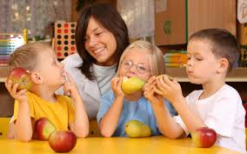

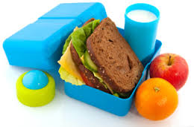
2- 5 Years
Give family food, 3 meals each day. Also give nutritious snacks, twice daily, in between meals.
Give variety of foods, if the child refuses, offer him/her ‘tastes’ of the food several times.
Do not force feed the child. Give realistic portions depending on his age, size and activity.
Increase the quantity of food as child grows older.

Slide 25

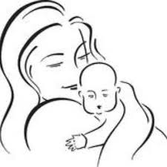
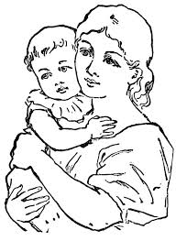

Key Messages to Mother about Care of Young Child at All Times
Brain development is most rapid during first two years of life. So young children need to be stimulated by playing with others, moving around, hearing sounds, having things to see, touch and explore.
Teach the child to communicate by speaking, listening and playing with him/her.
Illness interferes with normal growth and development. To prevent illness, immunize the child, when sick, take to the nearest health care provider for treatment.
Protecting children from physical and emotional distress helps them gain confidence to explore and learn

Slide 26



Awareness about Legal Rights
Our Constitution gives every citizen the fundamental right to conserve her language, script and culture.
Cultural and educational rights
Our Constitution gives every citizen the fundamental right to get admission to any government or government-aided educational institution without discrimination on grounds of religion, race, caste or language.
Our Constitution gives religious and linguistic minorities the fundamental right to establish and administer educational institutions of their choice

Slide 27





Right to Equality
Our Constitution gives every citizen the fundamental right to equality before law and equal protection of laws. This means that
all citizens are equal in law, irrespective of religion, race, caste, sex or place of birth.
Our Constitution gives all citizens the fundamental right to equal opportunity in employment under the government.
Right to life and personal liberty
Our Constitution gives every citizen the fundamental right to protection against arrest and detention. This means that arrest and detention can only be in accordance with the procedure laid down by law.

Slide 28


Fundamental rights to freedom
Our Constitution gives the following fundamental rights to freedom:
Right to freedom of speech and expression
Right to assemble peacefully and without arms
Right to form associations and unions
Right to move freely throughout India
Right to practice any profession or occupation or to carry on any trade and business
Right to Vote
Every citizen of India who is 18 years or more of age can vote at elections.
In case your name is not registered as a voter, or you have shifted to a new place, you can apply to the Electoral Registration Officer to get your name registered.

Slide 29
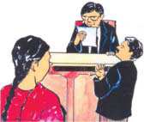


Right to Information
The Right to Information Act gives all citizens the right to access information held by any government, municipal body, panchayat or government-aided body by paying a fee of Rs. 10/- per request and giving an application addressed to the Public Information Officer of the office concerned. No fee is required to be paid by persons who live below the poverty line and furnish certificate for the same.
Right to Education
The Right to Education is understood to establish the right to free, compulsory primary education for all children, an obligation to develop secondary education accessible to all children as well as equitable access to higher education.

Slide 30
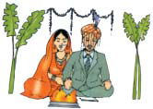



Prohibition of Child Marriage Act
A child marriage is a marriage where either the girl is below 18 years of age or the boy is below 21 years of age.
Any man who is older than 21 years of age and who marries a girl who is less than 18 years old is punishable under law with imprisonment up to two years and/or fine up to Rupees one lakh.

Slide 31


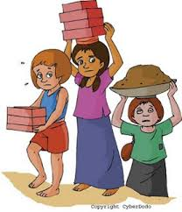

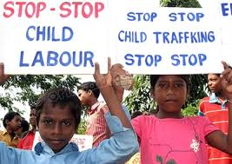
Child Labour Act
Employment of a child below 14 years of age is banned in 13 occupations and 57 processes and any person employing a child in the banned occupations/processes is punishable by law with imprisonment for between three months to a year and/or with fine between Rs. 10,000 to Rs. 20,000.
Children should not be employed in such hazardous occupations which can endanger the physical, mental and social health of the child.

Slide 32





Immoral Traffic (Prevention) Act
Under this law, procuring, inducting, taking, recruiting, transporting, transferring, harboring or receiving a person for prostitution is punishable.

Slide 33




Domestic Violence Act
This law is for protecting and giving relief to women who are victims of domestic violence. Any such woman can file a complaint in the court of a Judicial Magistrate of the First Class (or a Metropolitan Magistrate, in case of metropolises). The law offers protection against—
Threat of harm or actual harm, injury or danger to her health, safety, life, limb, mental or physical well-being, including protection against physical, sexual verbal, emotional or economic abuse, and
Threat of actual harassment, harm, injury or danger for forcing her or her relatives to meet demand for dowry or other property.

Slide 34

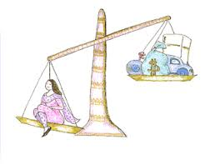
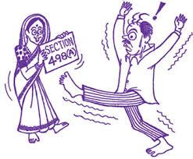


Dowry Prohibition Act
Giving and taking dowry is punishable under law.
Asking for or helping giving/taking dowry is also punishable under law.
Punishment can be up to five years of jail and / or fine up to Rs. 15,000/-.

Slide 35





Preconception and Prenatal Diagnostic Techniques Act (PC-PNDT )
Determining the sex of the unborn child is punishable under law with imprisonment up to three years and / or fine up to Rs. 10,000.
Any member of the family, including the father, the mother and the in-laws, can be punished if they seek to break this law.
Even a doctor/assistant who leaks the sex determination report can be punished.

Slide 36

SARAVANA SELVI C
M.PHIL., RESEARCH SCHOLAR
Prepared for my Research Pupose

