Slide 1
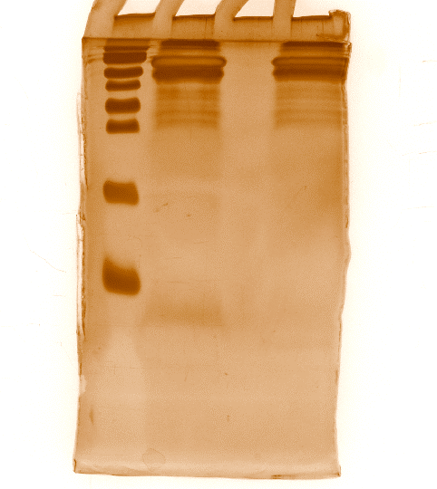
Fig. 1H
EPSCs Medium
EPSCs Medium
Marker
LCDM
Marker
LCDM
15KDa
10KDa
Fig. 3F
50nM Pros
200nM Pros
Blank
EGFP
200nM Pros
p53
50nM Pros
Blank
EGFP
p53
p21
p21
Actin
Actin

