Slide 1
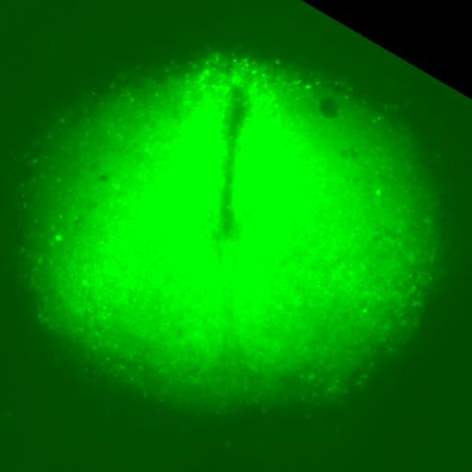
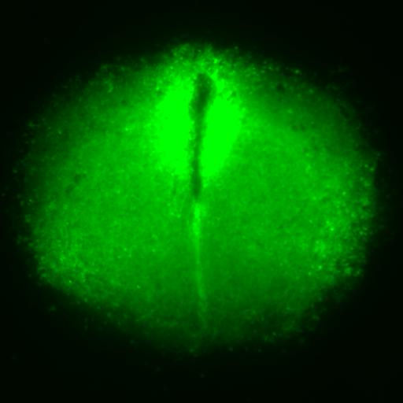
SCN Ca²⁺ Dynamics
DMSO (left), 10uM ARN-3236 (right)

