Slide 1
Domain structure-Promastigote Novel gene

Slide 2
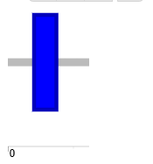
Promastigote_Novel
Supplementary Figure 2
Domain: Transmembrane region

Slide 3
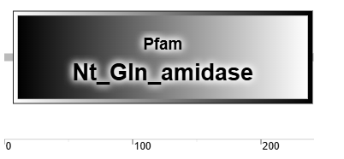
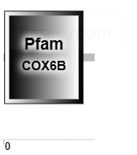
Promastigote_Novel
Supplementary Figure 3
Domain: Structural domain found in the N-terminal glutamine amidohydrolase (Nt ^{Q} -amidase) family of proteins (Nt_Gln_amidase domain)

Slide 4
Promastigote_Novel
Supplementary Figure 4
Domain: Cytochrome c oxidase (COX6B domain)

Slide 5
Promastigote_Novel
Supplementary Figure 6
Domain: Transmembrane region

Slide 6
Domain structure-Promastigote N-terminal extensions

Slide 7
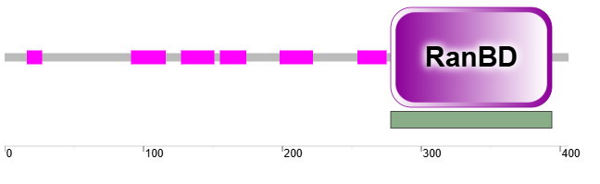
Promastigote_N-termianl
Supplementary Figure 25
Domain: Ran-binding domain (RanBD domain)

Slide 8
Domain structure-Amastigote Novel gene

Slide 9
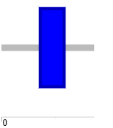
Amastigote_Novel
Supplementary Figure 1
Domain: Transmembrane region

Slide 10
Amastigote_Novel
Supplementary Figure 3
Domain: Transmembrane region

Slide 11
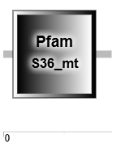
Amastigote_Novel
Supplementary Figure 7
Domain: Ribosomes are the particles that catalyse mRNA-directed protein (S36_mt domain)

Slide 12
Domain structure-Amastigote N-terminal extensions

Slide 13
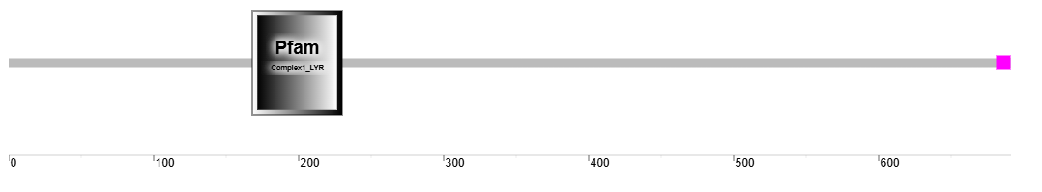
Amastigote_N-termianl
Supplementary Figure 16
Domain: Proteins in this family include an accessory subunit of the higher eukaryotic NADH dehydrogenase complex (Complex1_LYR domain)

Slide 14
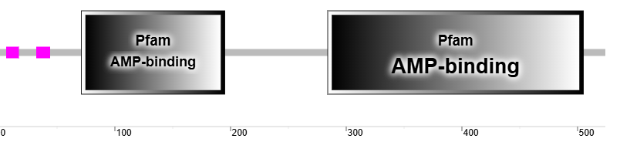
Amastigote_N-termianl
Supplementary Figure 26
Domain: AMP-binding domain

Slide 15
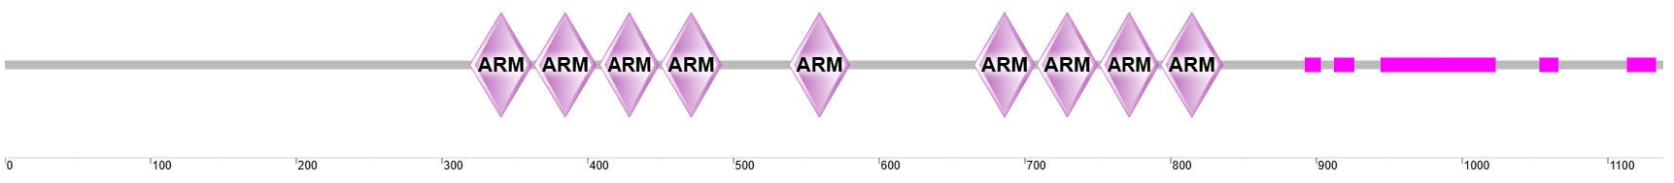
Amastigote_N-termianl
Supplementary Figure 29
Domain: Armadillo/beta-catenin-like repeats

Slide 16
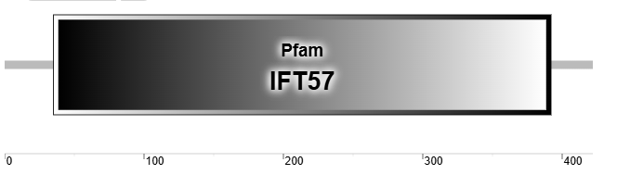
Amastigote_N-termianl
Supplementary Figure 36
Domain: Intra-flagellar transport (IFT57 domain)

