Slide 1

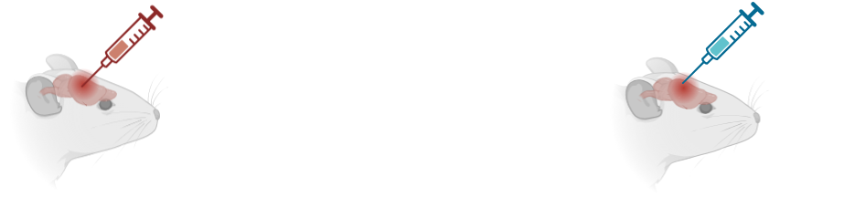


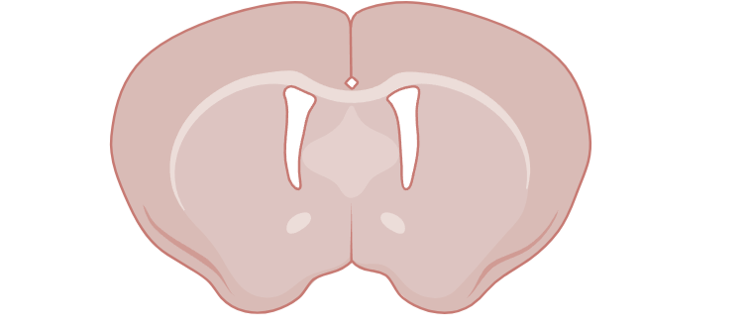
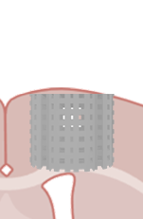
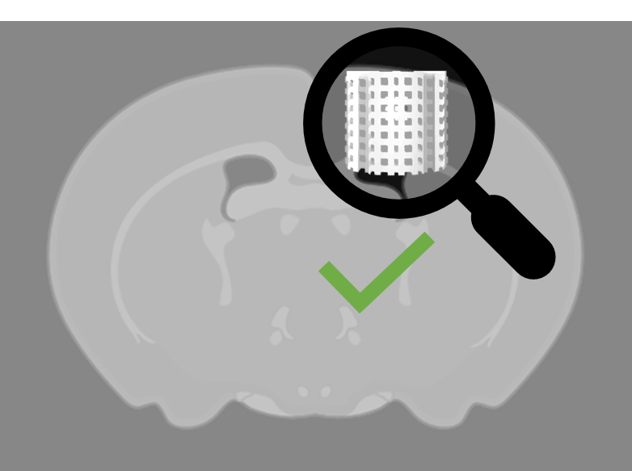
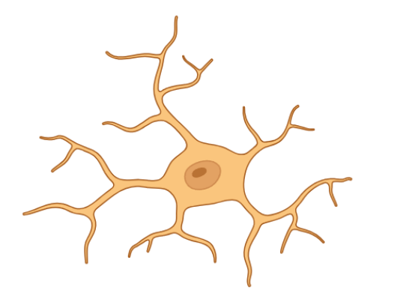
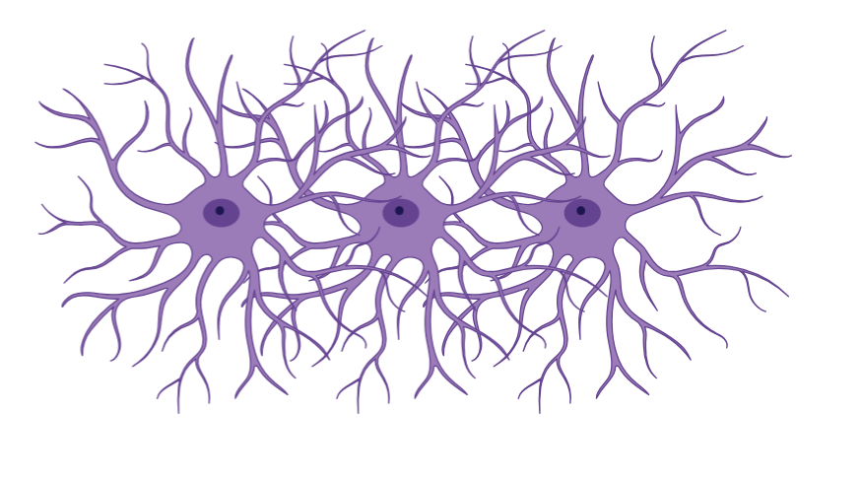




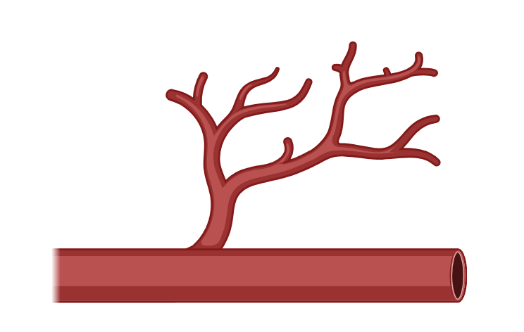
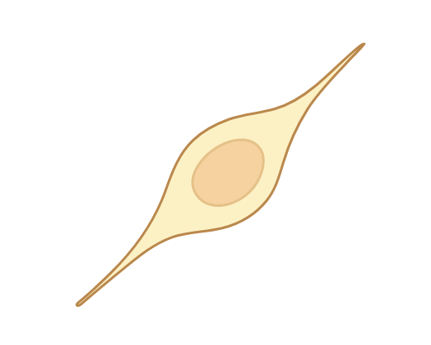
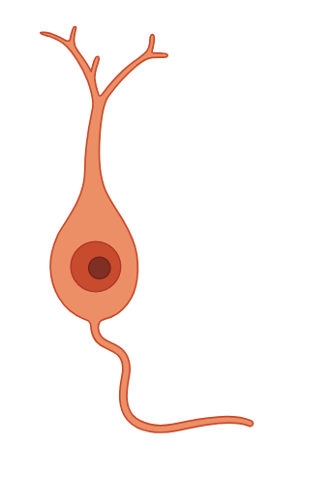
Scaffold
Animals
Preparation
CAD
(Computer-aided design)
& 3D printing
Behavioral training
D⁰
Lesion
Malonate injection
Brain injury control
D⁺⁸
Implantation
P-G scaffold n=8
Sham scaffold n=8
Sham lesion n=1
M⁺³
M⁺⁶
Behavioral tests
MRI
Sacrifice
Histology
Results
Sensorimotor
performances

