Slide 1
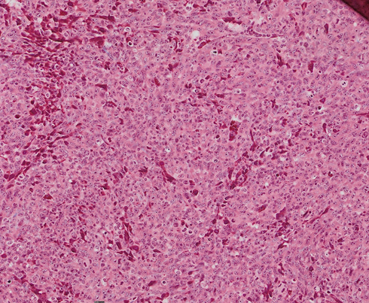
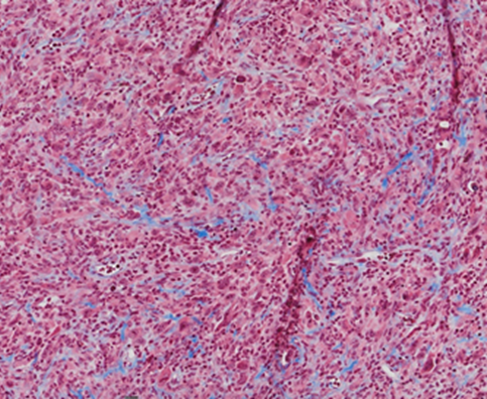
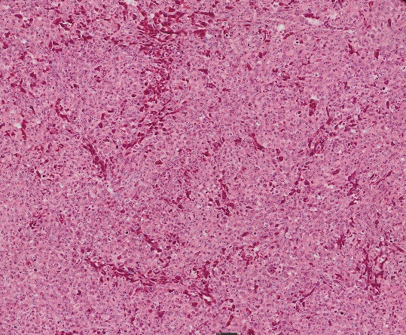
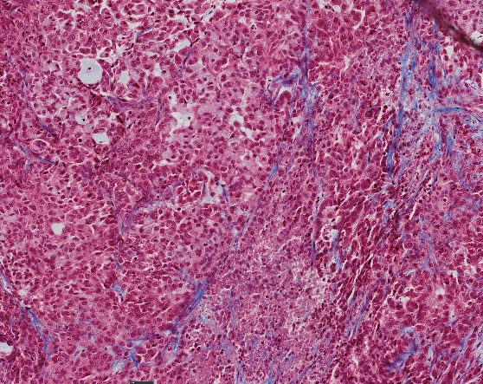
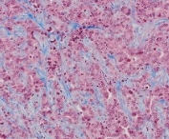
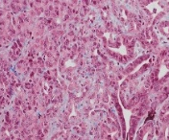
LL/2-Luc2
CT26
4662
Control
1x12Gy
Control
1x12Gy
Control
1x12Gy
Collagen (MT)
Collagen (MT)
Collagen (MT)
100x
100x
100x
100x
100x
100x
100x
100x
100x

