Slide 1
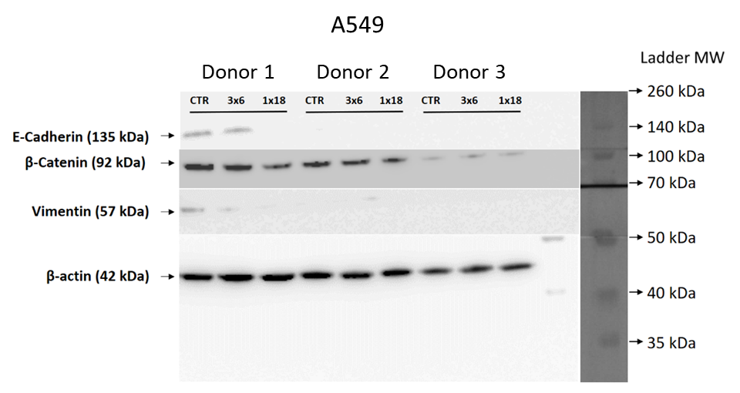
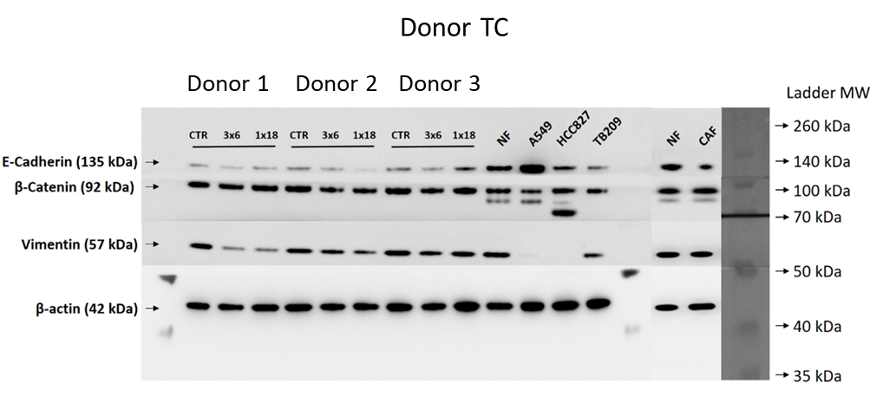
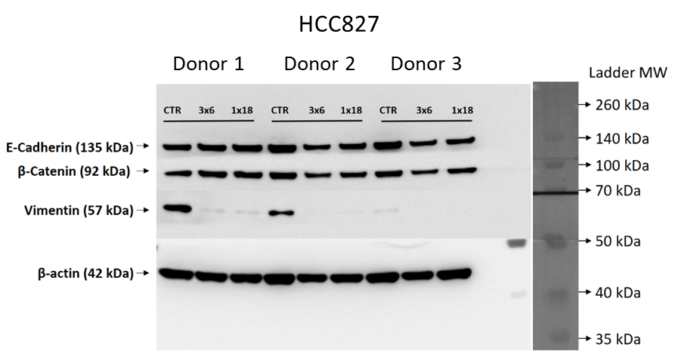
Supplementary Figure 2
Notes:
Supplementary figure 2: Uncropped scans of Western blots found in Figure 3.

