Slide 1
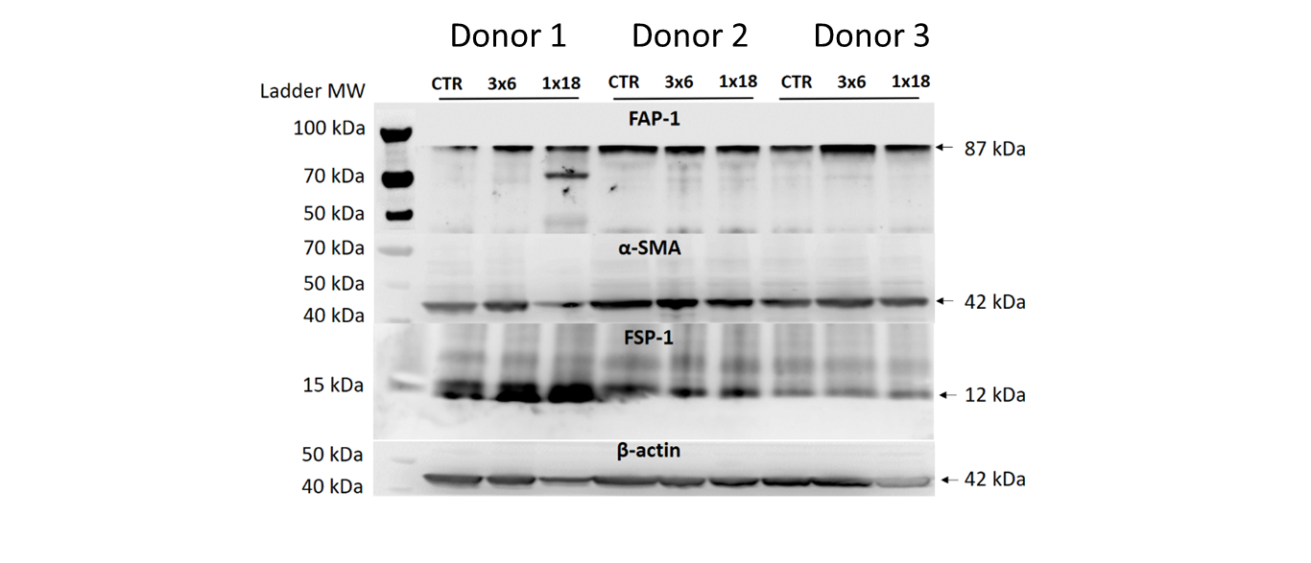
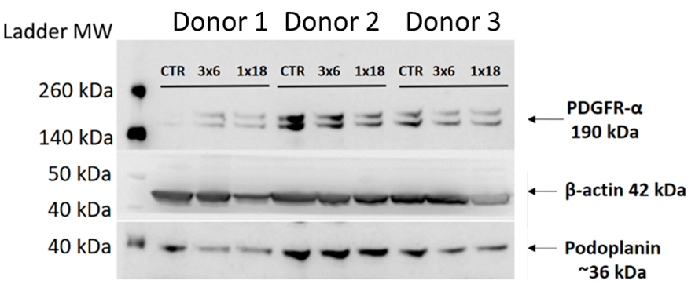
Supplementary Figure 1
Notes:
Supplementary figure 1: Uncropped scans of Western blots found in Figure 2.

