Slide 1
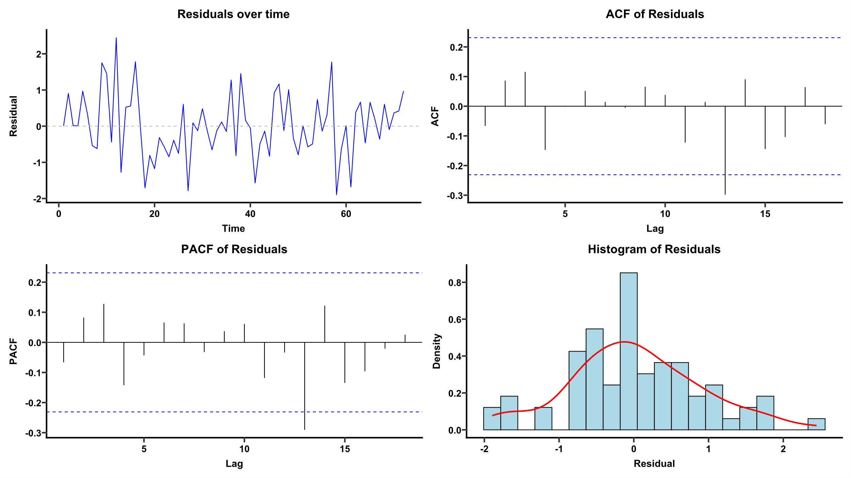
Supplementary Fig. 1
BZRA
Notes:
p-value = 0.8868

Slide 2
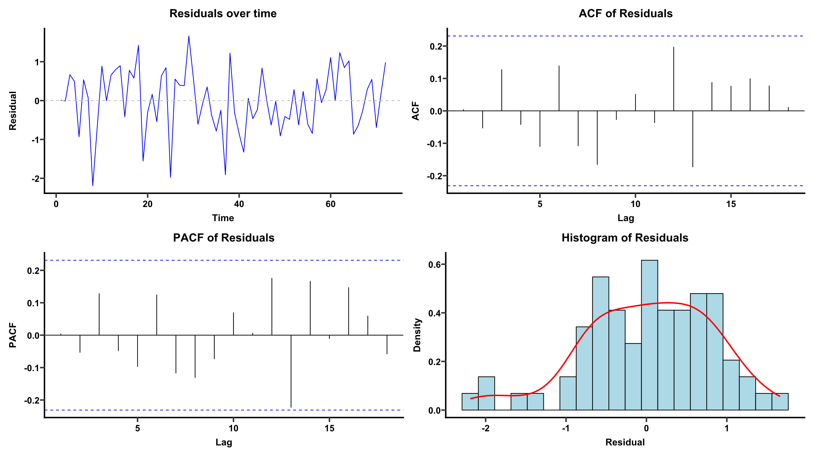
Supplementary Fig. 2
Z-drug
Notes:
p-value = 0.5608

Slide 3
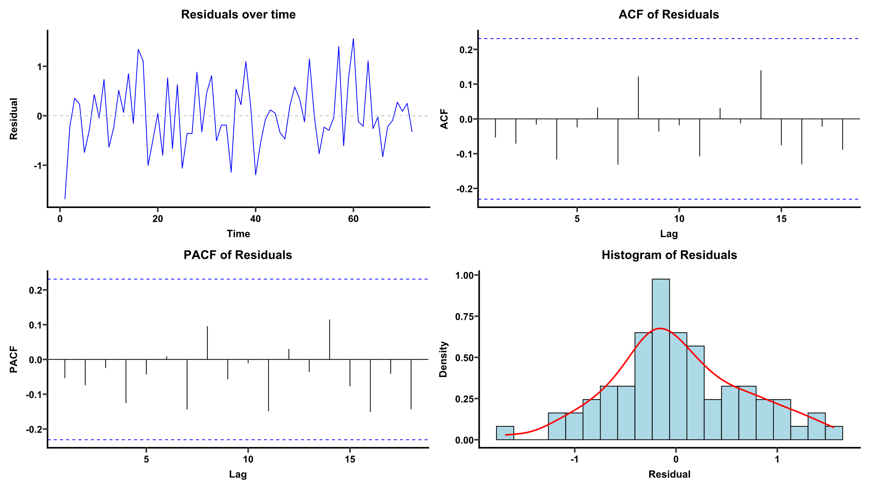
Supplementary Fig. 3
MRA
Notes:
p-value = 0.7043

Slide 4
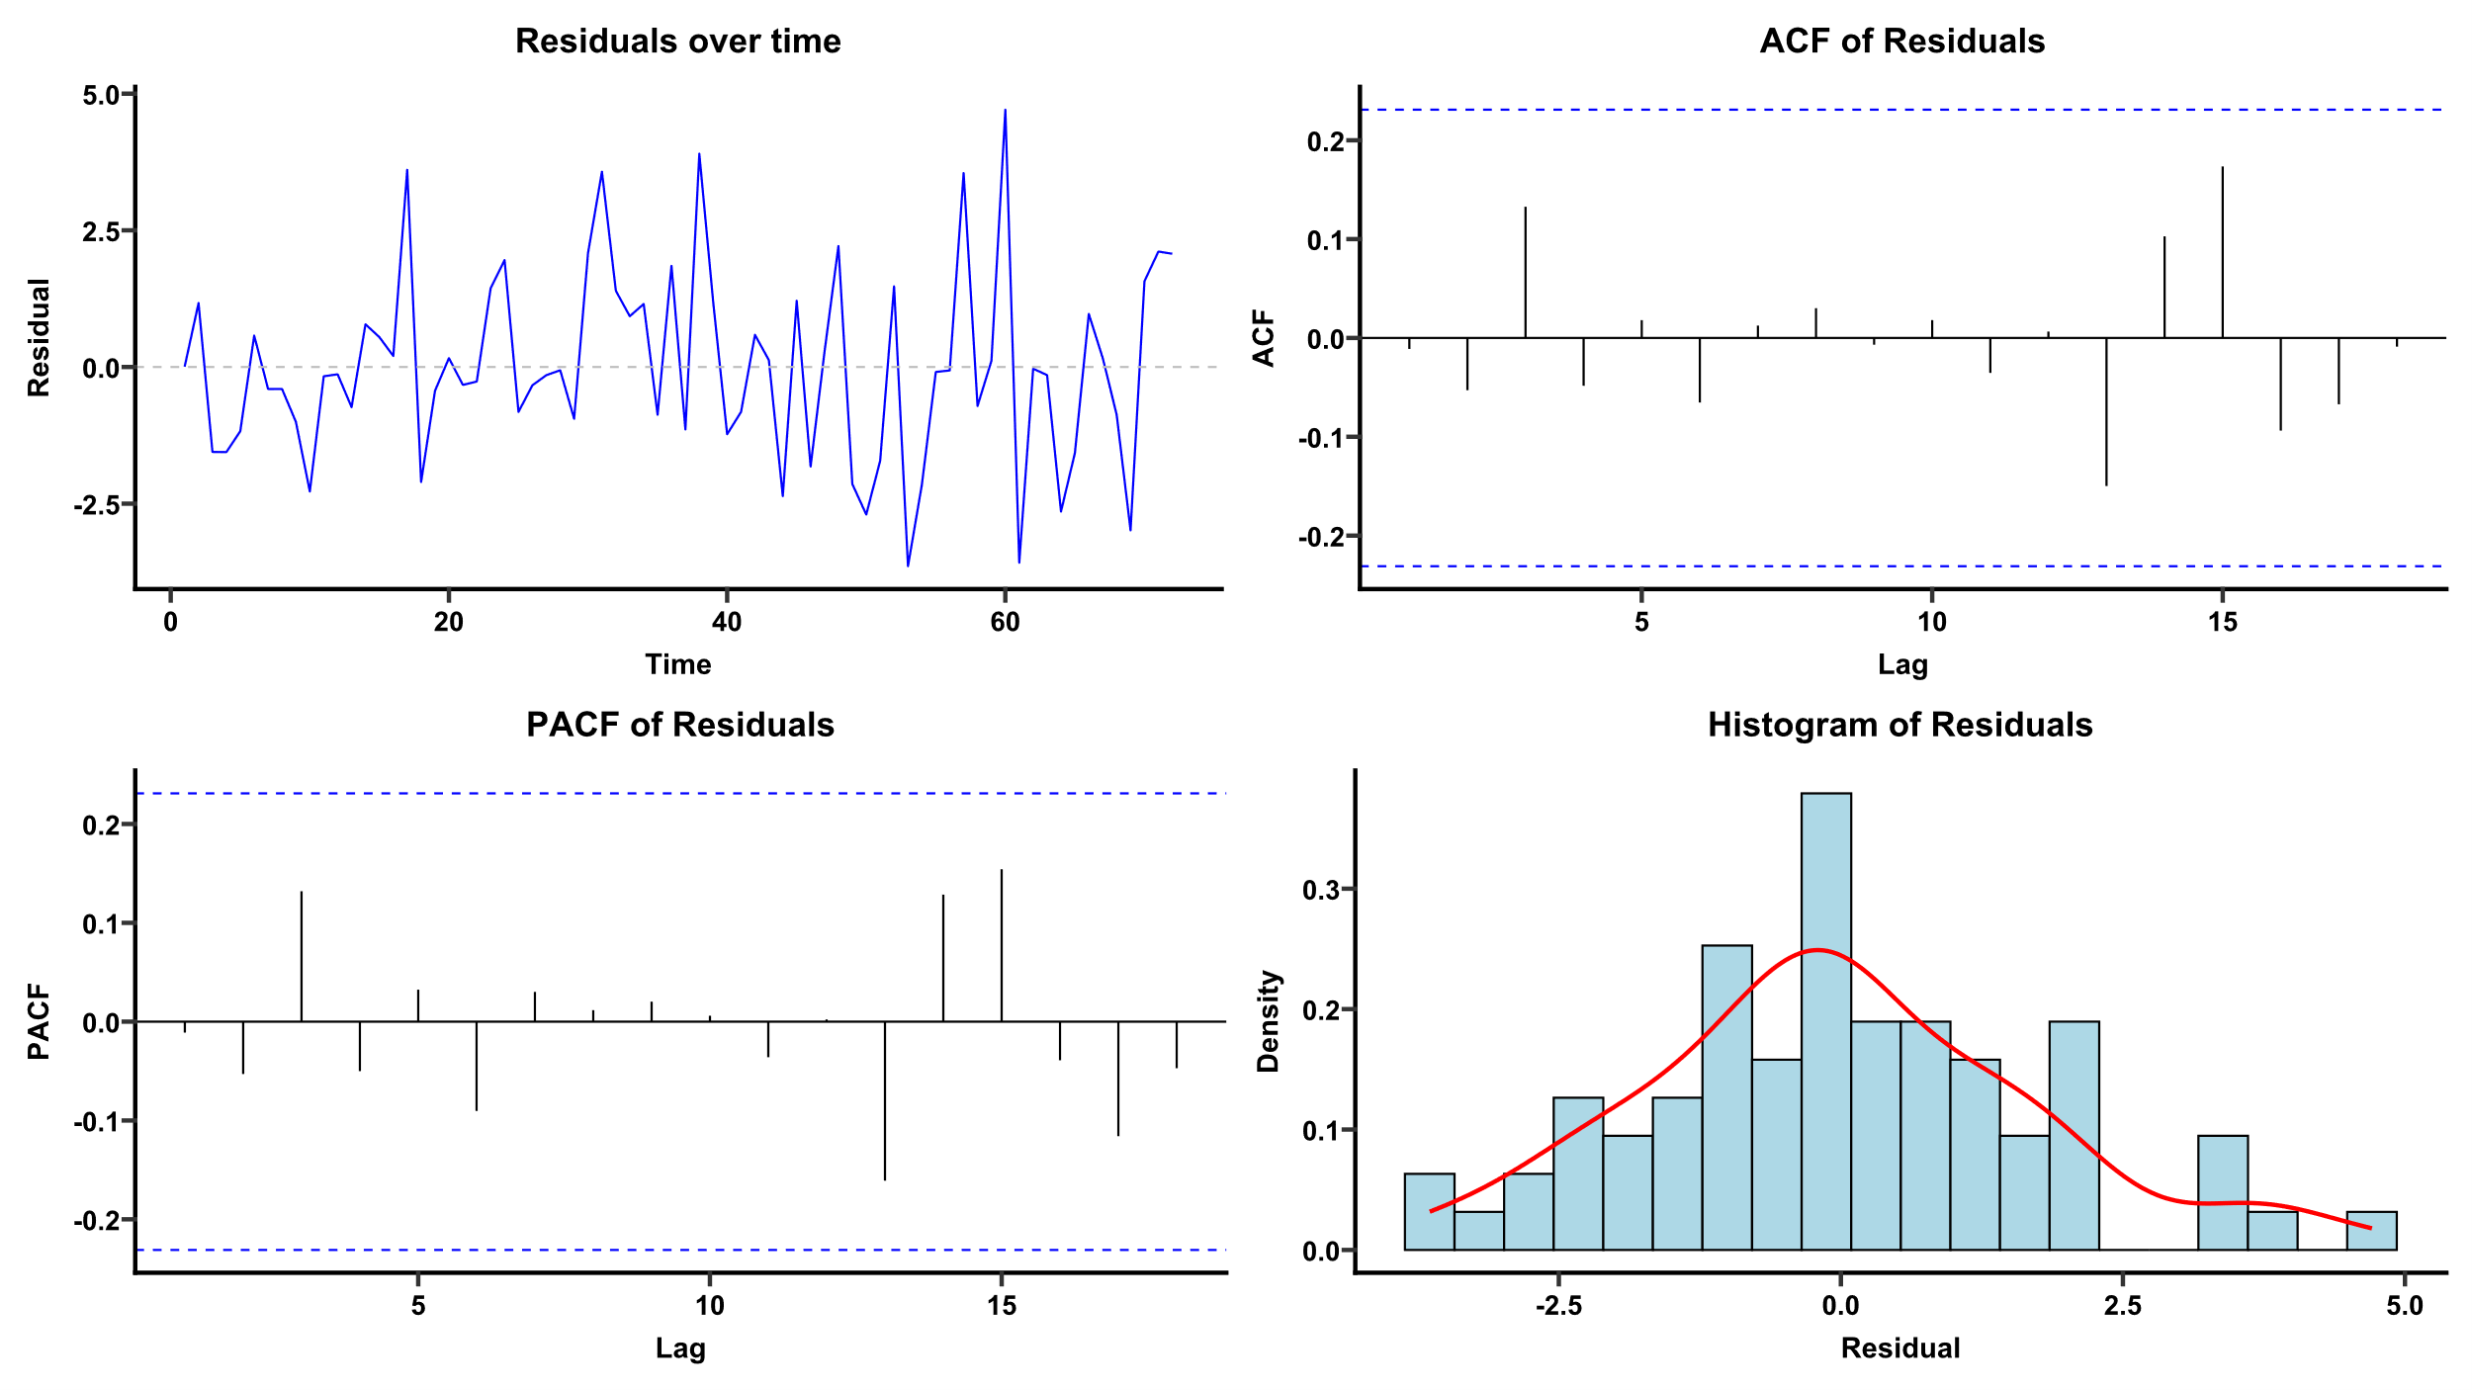
Supplementary Fig. 4
DORA
Notes:
p-value = 0.9867

Slide 5
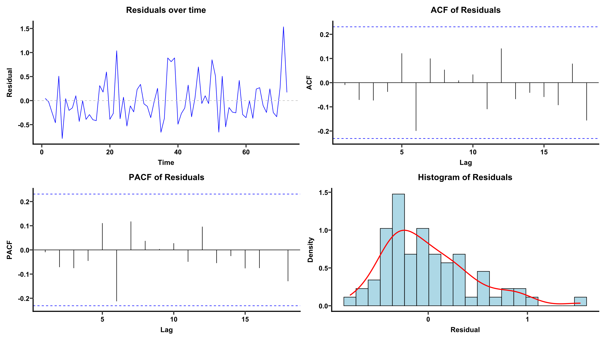
Supplementary Fig. 5
Delirium
Notes:
p-value = 0.6916

Slide 6
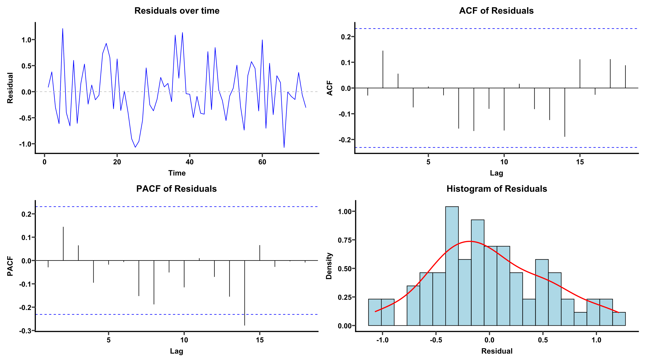
Supplementary Fig. 6
All antipsychotic agents
Notes:
p-value = 0.3774

Slide 7
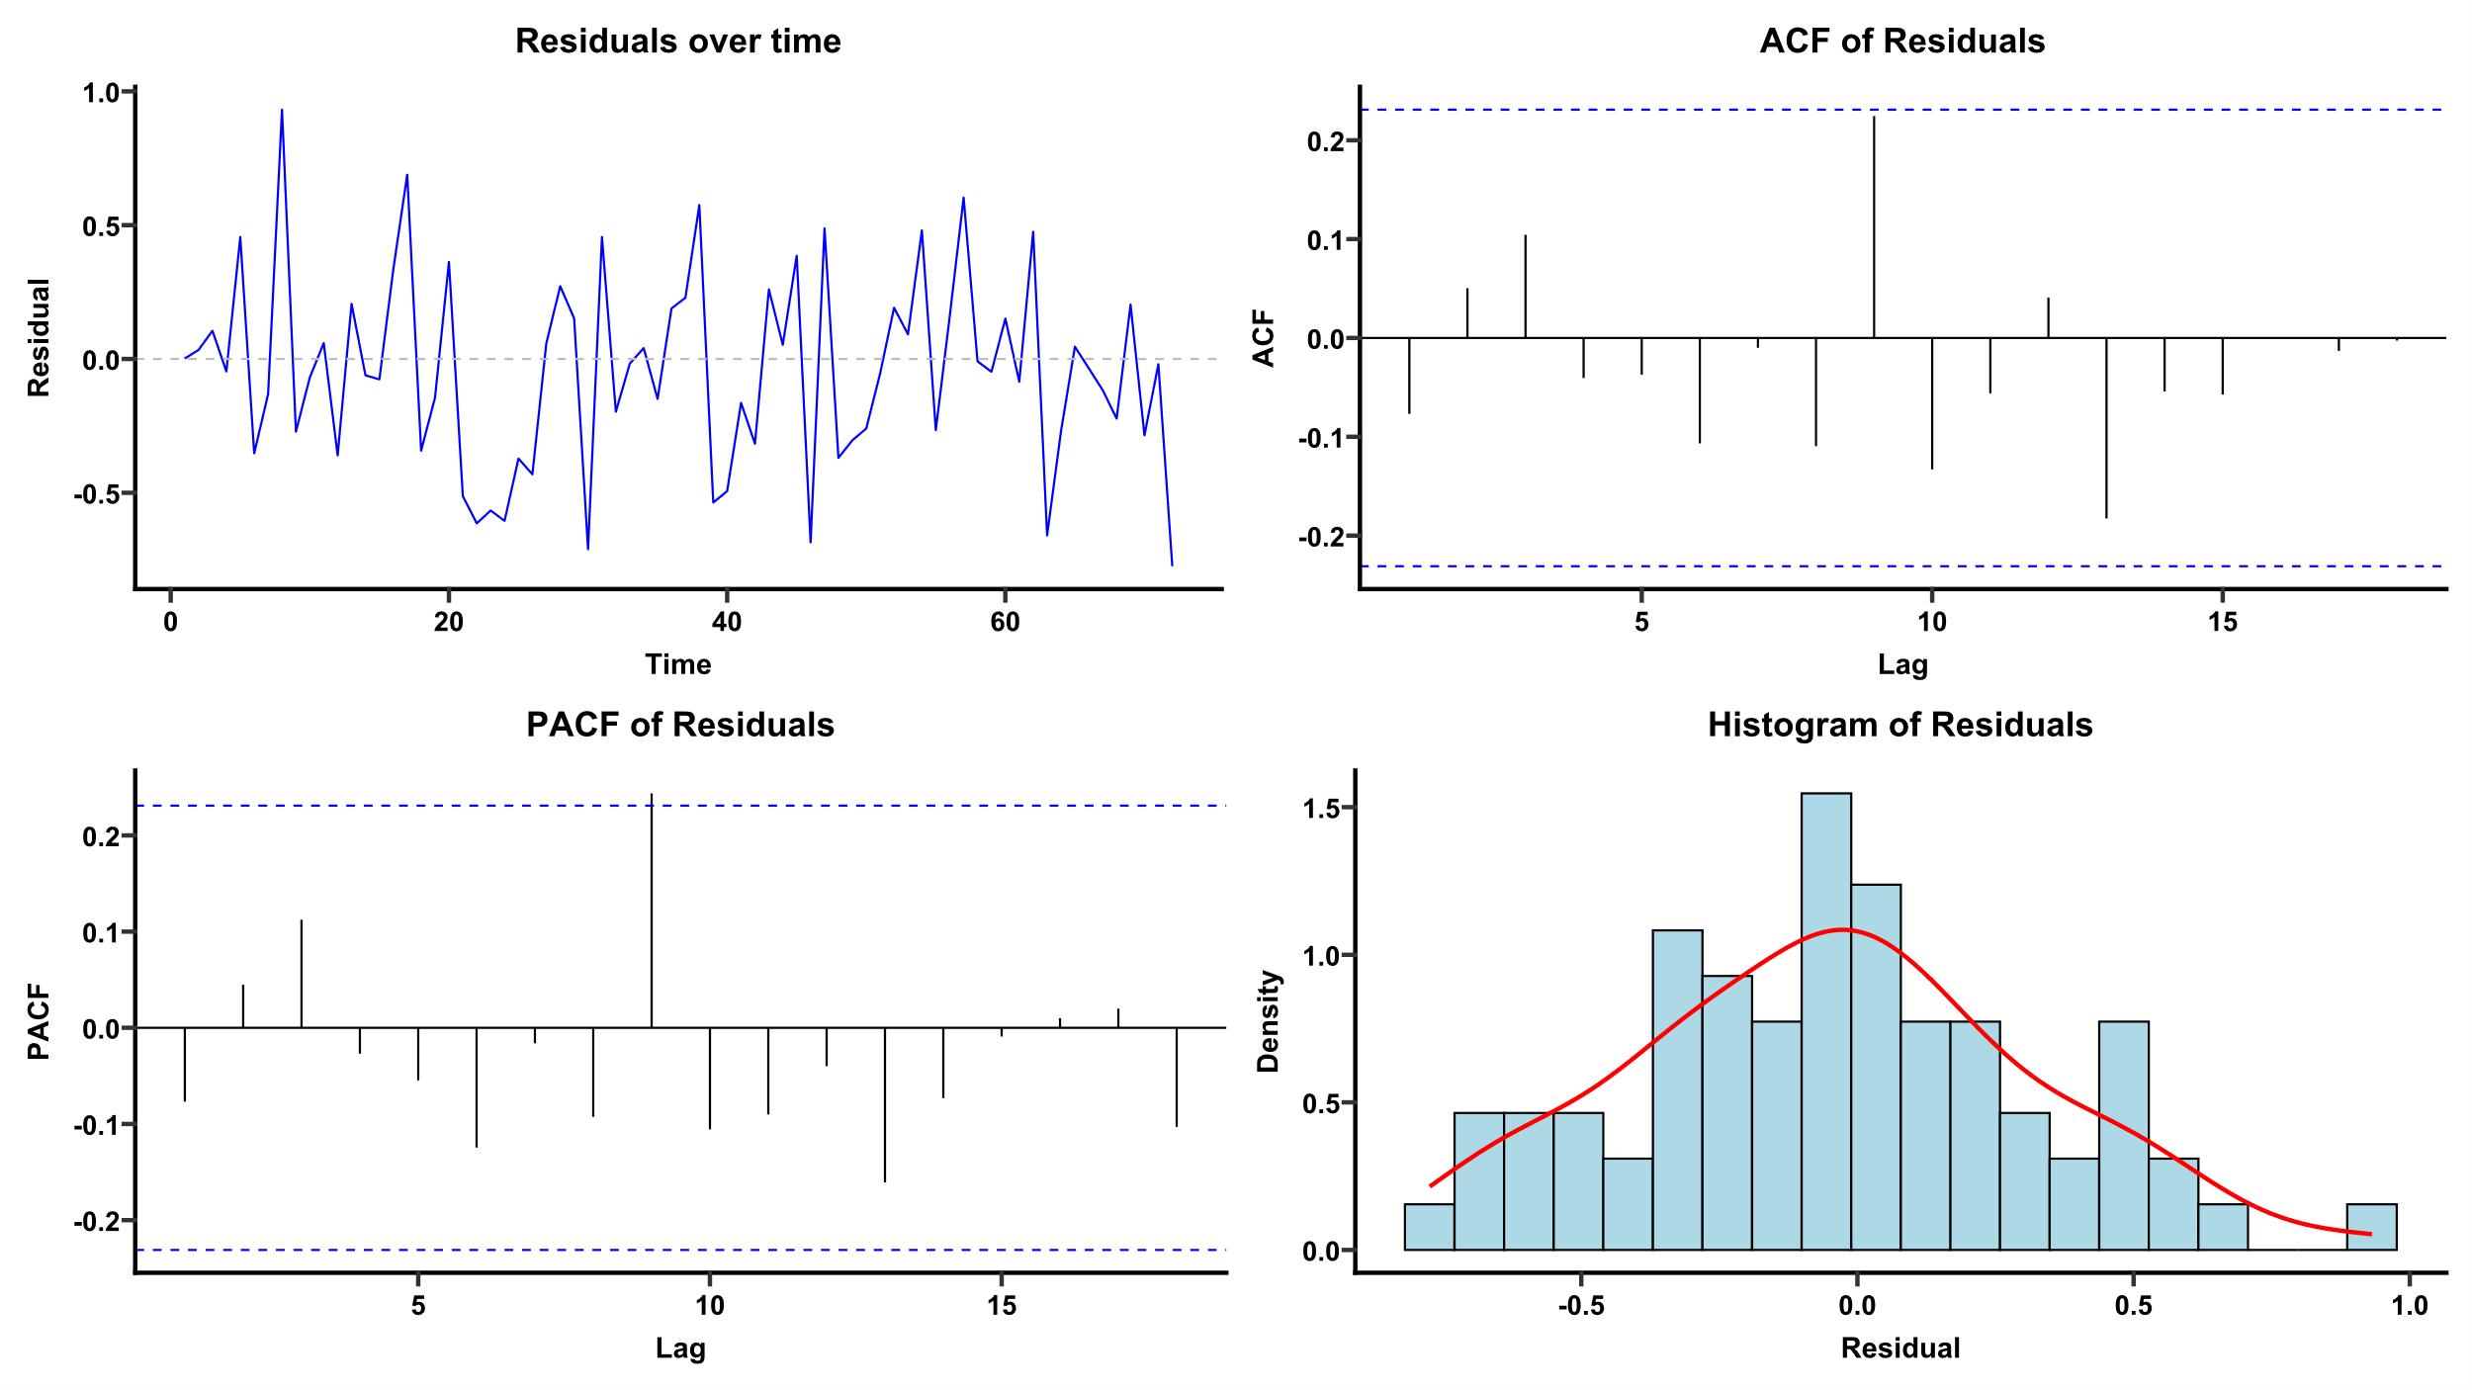
Supplementary Fig. 7
Quetiapine
Notes:
p-value = 0.3077

Slide 8
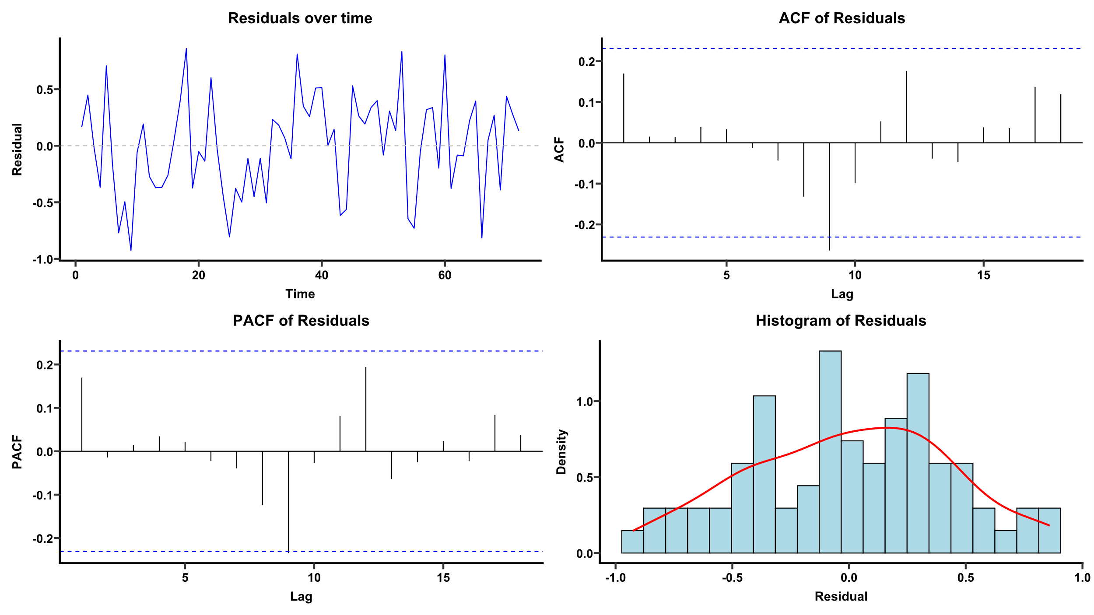
Supplementary Fig. 8
Risperidone
Notes:
p-value = 0.3768

Slide 9
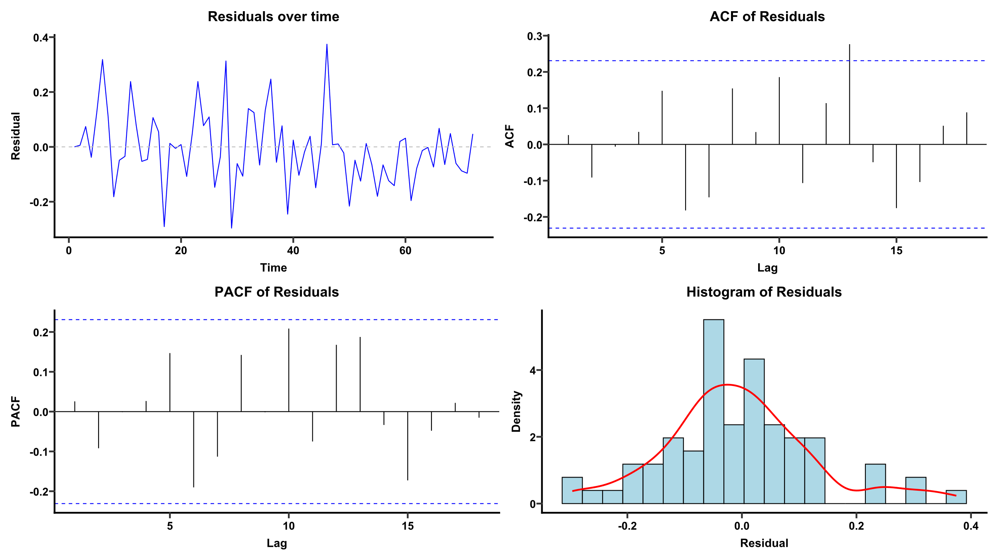
Supplementary Fig. 9
Haloperidol
Notes:
p-value = 0.03488
残差は時系列的にランダムに推移し、PACFに明確な構造は認められず、分布も概ね正規性を示した。一方でACFでは一部ラグで95%信頼区間をわずかに超えるスパイクがみられ、Ljung–Box検定では軽微な残差自己相関が示唆された（p=0.035）。

Slide 10
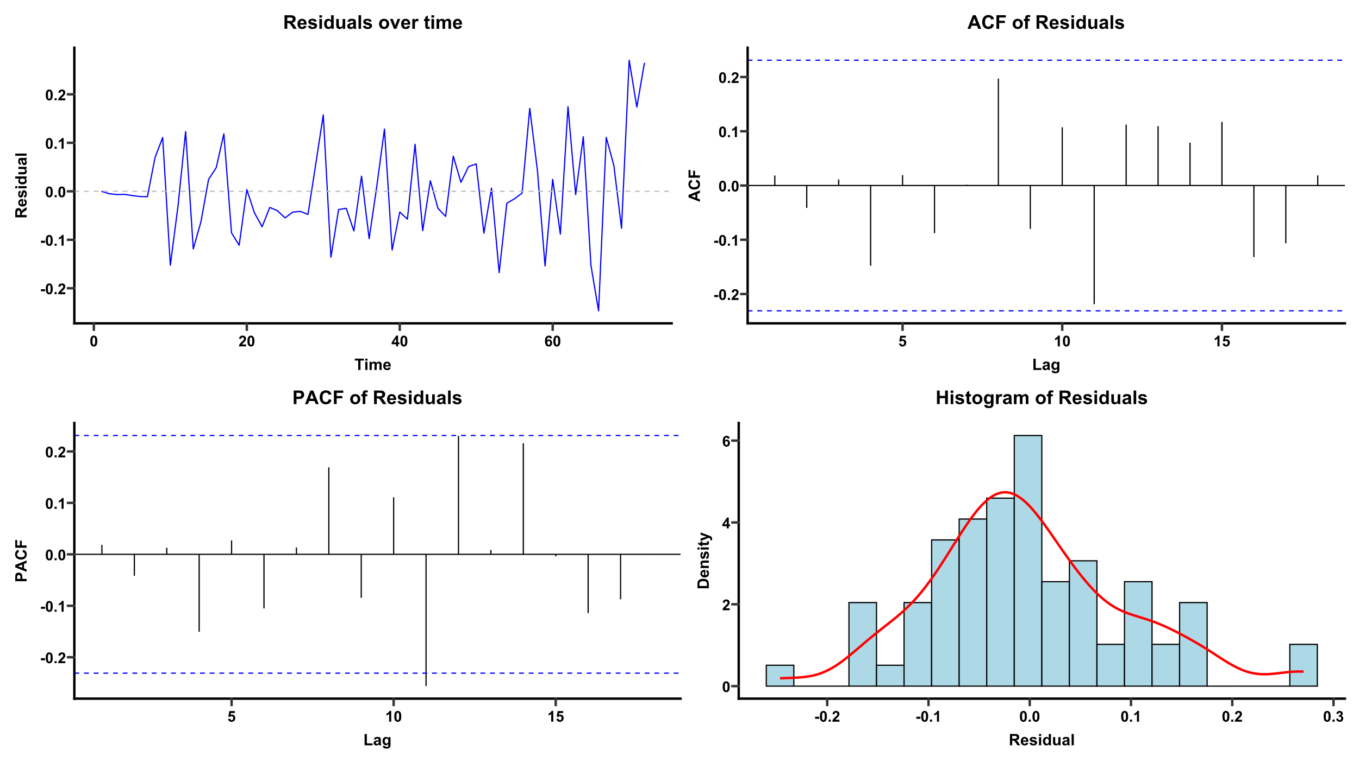
Supplementary Fig. 10
Perospirone
Notes:
p-value = 0.399

