Slide 1
Fig. S1 Antiproliferative activities of SZY-200 against other cell lines with CP-4126, GEM as positive control.
Values are expressed as the mean ± SD from three independent experiments. Abbreviations: GEM, gemcitabine; EA, elaidic acid; LA, lauric acid

Slide 2
Fig. S2 Effects of SZY-200 on cell cycle progression and the apoptosis rate in T24 and 5637 cells and scratch tests. (A) After incubation, the cell cycle of cells was analyzed by flow cytometry. (B) Statistical analysis of the percentage of cells at the G0/G1, S and G2/M phases of cell cycle. (C) Apoptotic analysis was performed by flow cytometry using Annexin V-FITC/PI double staining method. (D) Statistical analysis of the percentages of apoptotic cells. **P＜0.01, ****P＜0.0001 vs control. (E) Apoptosis in cells was observed by fluorescence microscope using Hoechst 33258 staining (Scale bar = 50 µm). (F) Apoptosis-related protein expression in T24 cells was detected by western blotting. (G) Represents the ratio of Bax/Bcl-2 protein expression levels. ***P＜0.001, ****P＜0.0001 vs control

Slide 3
Fig. S3 (A) Representative wound-healing assay pictures for T24 and 5637 cells treated with DMSO or with three drugs (12.5 and 25 nM) are shown (vertical lines indicate wound edges); (400×, original magnification). (B) Histograms represent quantitative analyses of cell migration. Values are expressed as the mean ± S.D. from three independent experiments. ****P＜0.0001 vs DMSO

Slide 4
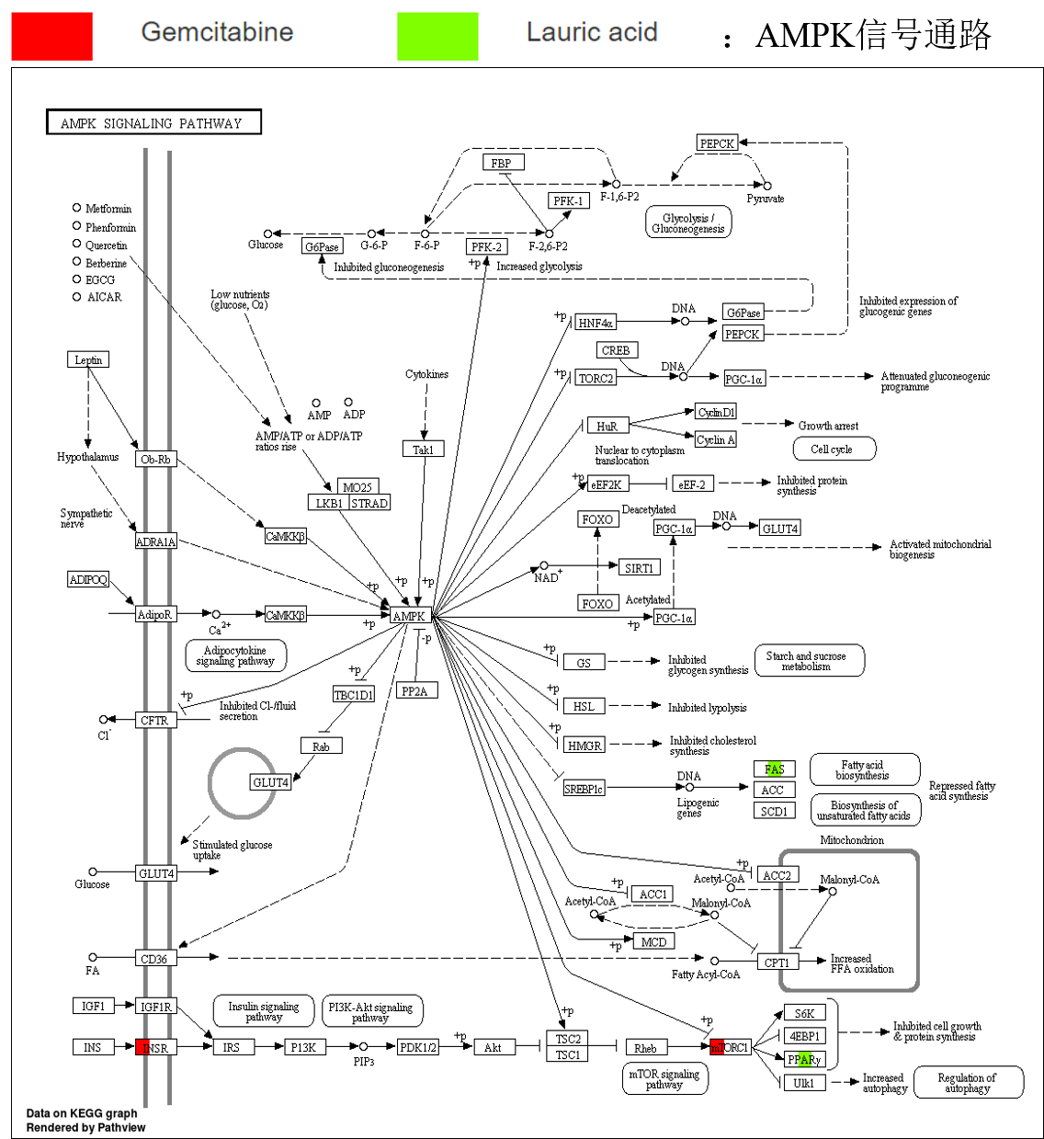
Fig. S4 KEGG biological pathway analyses of potential targets (AMPK signaling pathway)

Slide 5
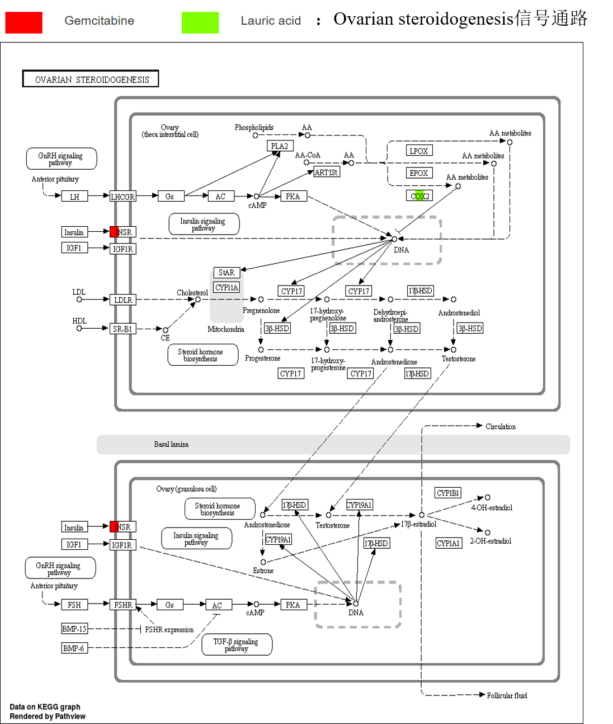
Fig. S5 KEGG biological pathway analyses of potential targets (ovarian steroidogenesis signaling pathway)

