Slide 1
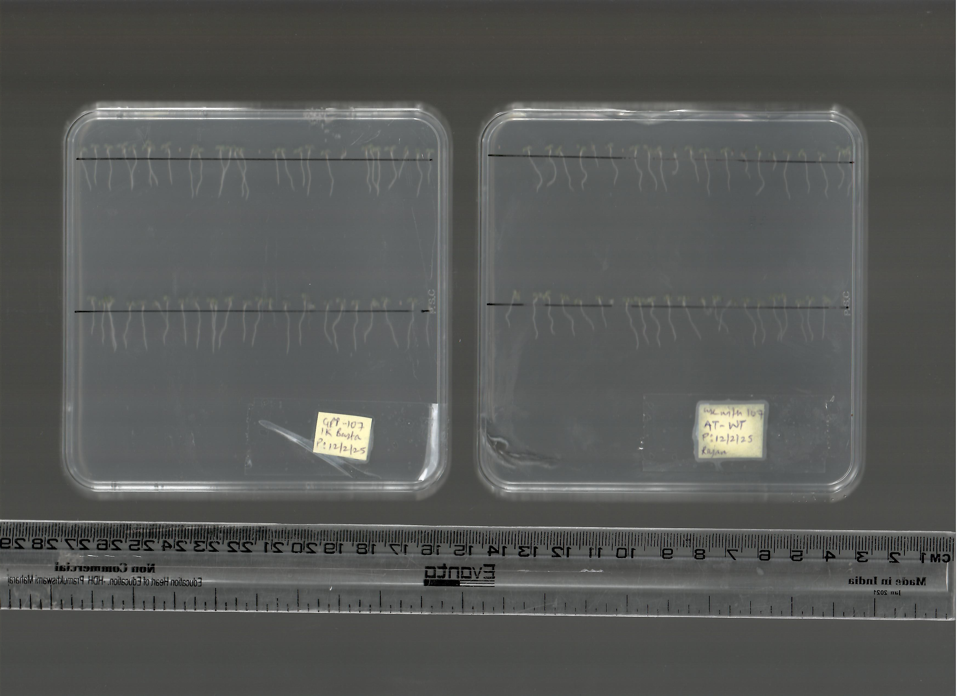
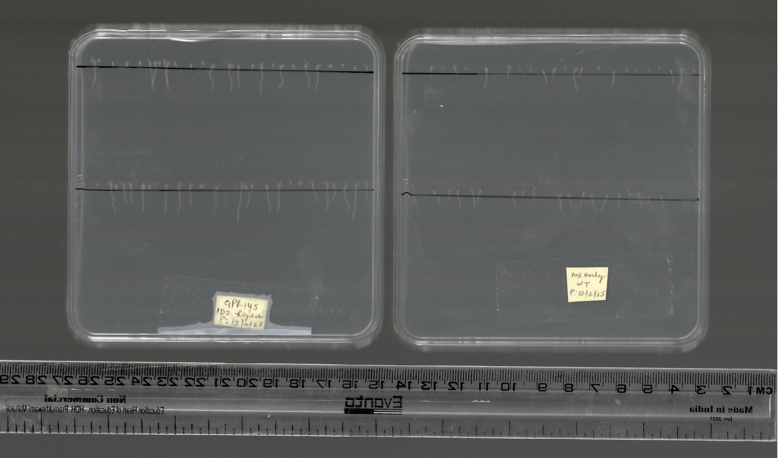
35S::AA14 (K)
WT
C4H::AA14 (D)
WT
Supplementary Figure 1. Comparative morphological characterization of PcAA14 carrying and wild-type plants
a) Representative picture of one week old Wild type, 35S::PcAA14 (K) and C4H::PcAA14 (K). b) Comparison of root length between wild-type and PcAA14-carrying plants at the one-week-old seedling stage. Data represent average ± SD, n ≥ 15, Student’s t test at ***p ≤ 0.01, **p ≤ 0.05, * p ≤ 0.1.

Slide 2
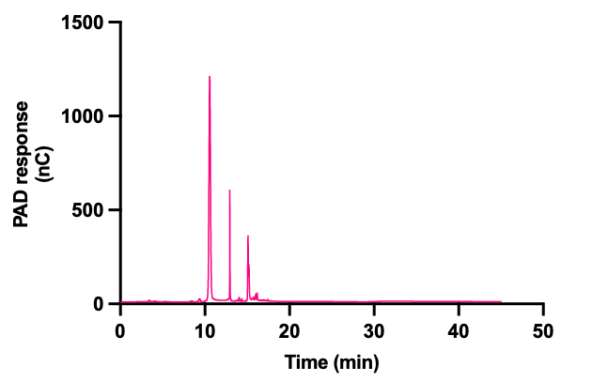
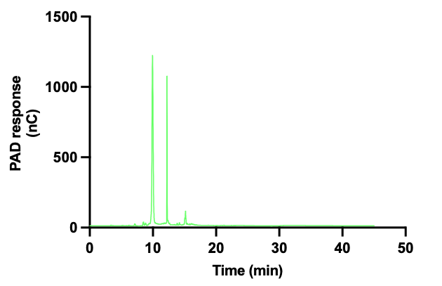
a)
Beechwood
b)
Birchwood
c)
DP | Adduct | m/z
2 | Na⁺ | 305
 | Na⁺+Oxi | 321
 | K⁺ + Oxi | 337
3 | Na⁺ | 437
 | K⁺ | 453
 | K⁺ + Oxi | 469
5 | Na⁺ | 701
 | K⁺ | 717
d)

Slide 3
e)
Supplementary Figure 2. Comparative analysis of wild type and transgenic lines using ion chromatography, MALDI-TOF and FT-IR.
a), b) HPAEC-PAD profile of beechwood xylan and birchwood xylan, respectively, incubated with GH11 xylanase for 24 h. c) and d) Represents MALDI-TOF of WT(wild type), and highest PcAA14 expressing lines 35S::AA14 (K) and C4H::AA14(D), The different xylo-oligomers detected in MALDI spectra are listed in the table in right. e) Overlay of FTIR spectra of Wild type (WT), 35S::AA14 and C4H::AA14. The set represents truncated spectra between 1500 cm⁻¹ and 1800 cm⁻¹. Data represents average ± SD, n = 3, Student’s t test at ***p ≤ 0.01, **p ≤ 0.05, * p ≤ 0.1.

Slide 4
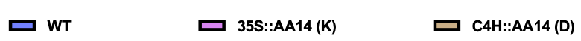
a)
b)
c)
d)
Supplementary Figure 3. RT-qPCR analysis of lignin biosynthetic and transcription-related genes.
a) PAL1, PAL2, PAL3, C4H. b) CAD1, CAD4, CAD5, CCR1. c) 4CL1, 4CL3, 4CL5, F5H. d) MYB46, MYB58, MYB63, C3H. Data represent average ± SD, n = 3, Student’s t test at ***p ≤ 0.01, **p ≤ 0.05, * p ≤ 0.1.

Slide 5
Supplementary Figure 4. Comparative glycome profiling using immunoblot analysis by polysaccharide-specific antibodies.
A Green-white scale indicates signal intensity in the ELISA, with white corresponding to less binding and green showing more binding. Data represent the average of four biological replicates. Student’s t-test at ***p ≤ 0.01, **p ≤ 0.05, * p ≤ 0.1

