Slide 1
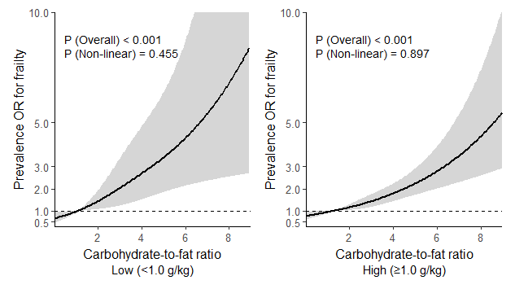
(a)
(b)
Supplemental Figure 1. Restricted cubic spline curves showing the association between the carbohydrate-to-fat energy ratio and the prevalence of comprehensive frailty according to bodyweight-normalized protein intake (<1.0 vs ≥1.0 g/kg/day).

Slide 2
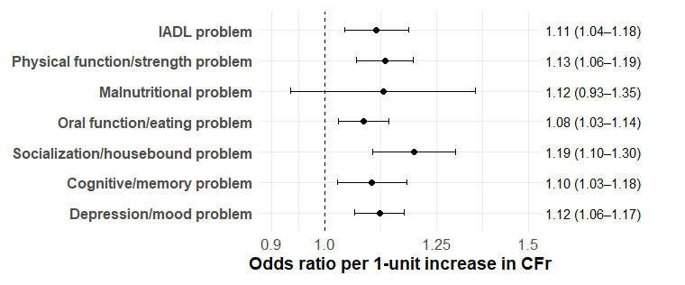
Supplemental Figure 2. Carbohydrate-to-fat ratio and domain-specific impairments assessed by the Kihon Checklist

